Slide 1
Starter: Word Association
WINTER
Notes:
Go round the class and orally ask students: What is the 1st thing that comes to your mind when you think of winter?
OR:
On your mini whiteboard, write down the du’a for when it rains.

Slide 2
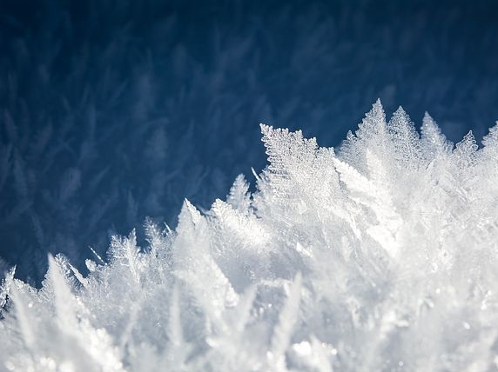

Winter:
The Believer’s Season
Notes:
Start session with Bismillah, Praises of Allah and Salawat
Resource article: https://lifewithallah.com/the-believers-season/
Optional: To create a positive association with this lesson, especially to encourage learners to pray tahajjud and fast, give out hot chocolate/mint tea to the students.
Feel free to adjust this ppt to your learners’ needs.
The ppts sometimes assume prior knowledge and/or knowledge of Arabic.
Read the notes before delivering the lesson.
[A] = Activity. This can be done orally, in writing, on mini whiteboards (MWB), classroom board, through discussion; individually, in pairs, groups etc, and through other methods.
LWA is not responsible for external links.
Please give us feedback on these slides by filling in this short feedback form (you can remain anonymous): https://forms.gle/yP45KNYEbemxT7hS6

Slide 3
Session Objectives
To explain the key features of a believer’s winter
To reflect on the sweetness of the night prayer
To review winter-related duʿas

Slide 4



The Winter Blues
Who likes winter? Why?
Who struggles with winter? Why?
Some people struggle with SAD.
Some may struggle with low levels of SAD.
Exercise
Go outside and get light
Eat well
Vitamin D
Re-orient perspective of winter and make it special >>
Notes:
Seasonal affective disorder (SAD) is a type of depression that you experience during particular seasons or times of year, most commonly in winter.
Some people may not struggle with the disorder but may struggle with low levels for e.g. they may feel a bit down, sad, sluggish, not as interested in their tasks etc.
Some of the ways to overcome this, as doctors advise, is:
Exercise, even if it is just for a little while.
Going outdoors, and exercising outdoors is the perfect combination. E.g. go for a short walk at lunch time OR play some football at break time, instead of staying indoors etc
It’s also useful for many people to take vitamin D.
What really helps is a perspective shift. Yes, there are going to be some struggles, but changing how we think of winter, and focusing on the positives we can get out of it, rather than dwelling on the negatives, will help us inshallah.
Our predecessors described winter as the believer’s best season. Why do you think they said this?

Slide 5
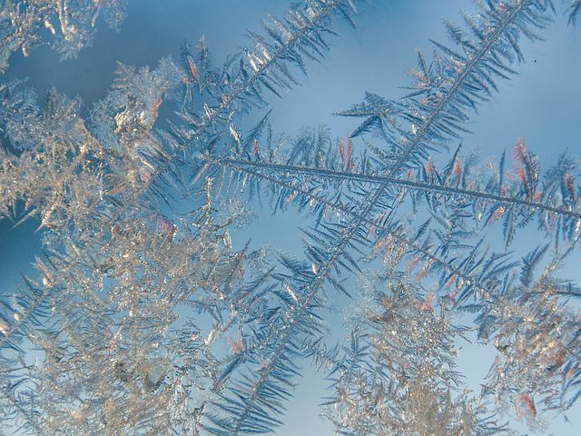
“
“Winter is the best season for the believer. Its nights are long for him to pray in, and its days are short for him to fast in.”
- al-Ḥasan al-Baṣrī (raḥimahullāh)

Slide 6
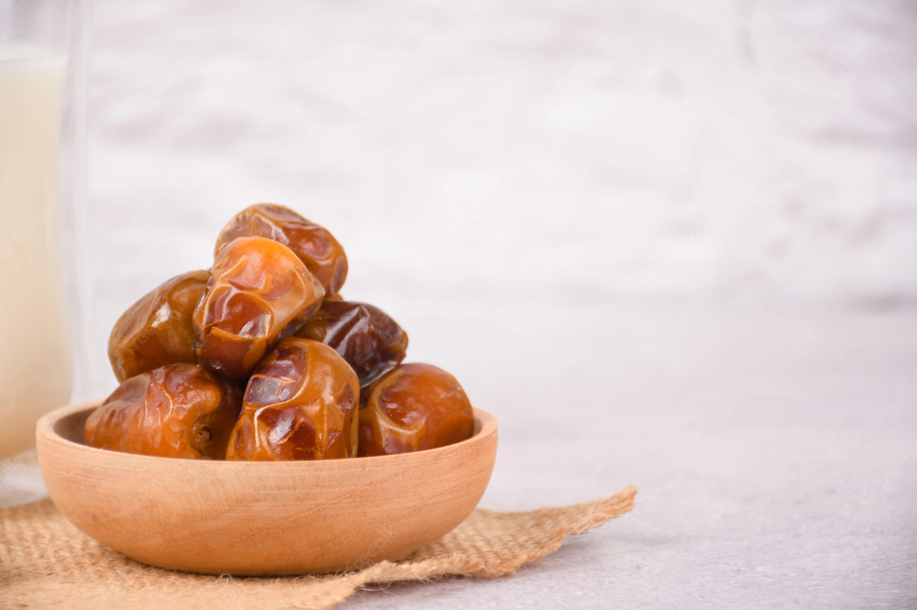
1) Perfect for Fasting
“Fasting in winter is the easy prize.”
(The Messenger of Allahﷺ, Tirmidhī)
Do you have any missed fasts? Perfect time for qada.
[A] What specific days should we try to fast on?
Notes:
Mondays and Thursdays and, the three middle days (13th, 14th and 15th) of the Hijri month (also known as ayyām bīḍ).

Slide 7
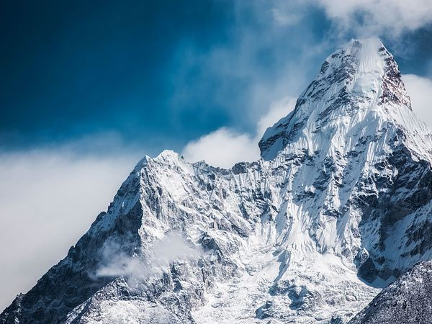
“
When winter would approach, ʿUbayd b. ʿUmayr would say:
“O people of the Qur’ān! The night has become long for your ṣalāh, and the day has become short for your fast, so take full advantage.”

Slide 8
2) Enjoy the Night Prayer
The sweetness of ʿibādah
One of life’s greatest joys is being able to cry out to one’s Maker in the stillness of the night, in Tahajjud, in Sajdah, when one is closest to Him.
“Hold on tight to the night prayer. Indeed it is the habit of the righteous who came before you. It brings you close to your Lord, wipes away your sins and prevents you from sinning.”
(The Messenger of Allah ﷺ , Tirmidhī)

Slide 9

Allah Has A Surprise For You!
[A] Write 32:16-7
تَتَجَافَىٰ جُنُوبُهُمْ عَنِ ٱلْمَضَاجِعِ يَدْعُونَ رَبَّهُمْ خَوْفًا وَطَمَعًا وَمِمَّا رَزَقْنَٰهُمْ يُنفِقُونَ ‎﴿١٦﴾‏ فَلَا تَعْلَمُ نَفْسٌ مَّآ أُخْفِىَ لَهُم مِّن قُرَّةِ أَعْيُنٍ جَزَآءَۢ بِمَا كَانُوا۟ يَعْمَلُونَ ‎﴿١٧﴾‏
“Their sides shun their beds, praying to their Lord in fear and hope; and they spend (in charity) some of what We have given them. Not a single soul is aware of the blissful delight that has been reserved for them in secret, as a reward of what they used to do.” (32: 16-7)
Notes:
From His immense kindness, Allah al-Barr (The Kind), has concealed a magnificent everlasting reward for His slaves who hid away from His creation, pushed their cosy duvets away, and turned to Him in the depths of the night. He (swt) says,
“Their sides shun their beds, praying to their Lord in fear and hope; and they spend (in charity) some of what We have given them. Not a single soul is aware of the blissful delight that has been reserved for them in secret, as a reward of what they used to do.” (32:17)
Al-Ḥasan al-Basrī r said: “The people concealed their deeds, so Allah reserved for them in secret what no eye has seen and what has not crossed the mind of any human being.”
Qur’anic Focus (QF)
This is an attempt to connect learners’ to the Qur’an and form a strong personal bond with it.
At the beginning of the year, instruct learners to bring in their personal mushaf to every class.
Each lesson (wherever possible), physically make them open the Mushaf at least once.
Ask learners to write down the chosen ayah in their books. Ask one student to recite. Ask another student to attempt a translation. Discuss and explain the meaning of the ayah.

Slide 10
Tahajjud Tips
“I really want to wake up for tahajjud, but I find it really tough” – Ahmad, 15.
What advice would you give Ahmad?
Duʿa
Stay away from sins & istighfar
Drink lots of water before sleeping
Tahajjud buddy. Ask a friend/family member to wake you up.
Sleep early!
Qaylulah
Watch Video
Notes:
TAHAJJUD UNLOCKS A PARADISE ON EARTH
https://www.youtube.com/watch?v=O0O5-IjfF4Q

Slide 11

“
“By Allah, if it wasn’t for the night prayer (qiyām al-layl), I would not have loved the world. By Allah, the people of the night (prayer) experience more delight in their night than the people of entertainment experience in their entertainment. Sometimes the hearts experience moments in which they leap out of joy due to the remembrance of Allah, to the extent that I say: ‘If the people of Paradise have anything like this, then how blissful must their lives be!’”
(Abū Sulaymān al-Dārānī)
Notes:
Ask students to write down a specific time, even if it’s 10 mins; and to make a sincere intention and dua to wake up before Fajr to pray tahajjud.

Slide 12


“But I struggle with maintaining the 5 Salahs”
By aiming high – for tahajjud – inshallah you will never miss any of the 5.
Notes:
This is a legitimate question. But inshallah let’s aim high. They say, ‘Aim for the moon. If you miss, you may hit a star.’; which may not be technically true, but the idea is true. By aiming high – for tahajjud – inshallah you will never miss any of the 5.
In sports, it’s usually said that sprinters win their races by focusing on a place PAST the finish line and they aim for that. ‘You want to be running at full tilt through that tape, not strolling through it catching your breath.’

Slide 13
3) A Reminder of the Hell-fire
The Messenger of Allah ﷺ said:
“Hell-fire complained to its Lord, saying: ‘Parts of me have consumed other parts.’ So, He allowed it to breathe out twice: one in the winter and one in the summer. This is the extreme heat that you experience, and the bitter cold that you experience.”
(Bukhārī)
Notes:
We often associate the extreme heat with Hell-fire, but even the cold should remind us of what awaits the wrong-doers.

Slide 14
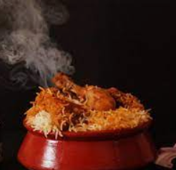


4) Thank Allah and Help Others
Winter is a reminder of how many blessings Allah has bestowed upon us.
[A] List 5 specific blessings we have that others don’t have in this season.
[A] How can we thank Allah for all our blessings?
Notes:
Winter is a reminder of how many blessings Allah has bestowed upon us. There are thousands of homeless people on our streets, shivering through the long nights whilst we remain warm in our homes. Similarly, there are countless more around the world facing even worse difficulties. Let us be grateful to Allah for giving us roofs that shelter us, heating facilities that keep us warm, and clothing which protects us.
One of the best ways to thank Him is to help those less fortunate than us. Don’t hesitate to buy a homeless person a hot meal/drink or donate to a charitable cause, whether it’s local or global.
List 5 specific blessings we have that others don’t have in this season.
For example: Roofs over our heads, coats, jumpers, warm socks, heating, hot food etc

Slide 15
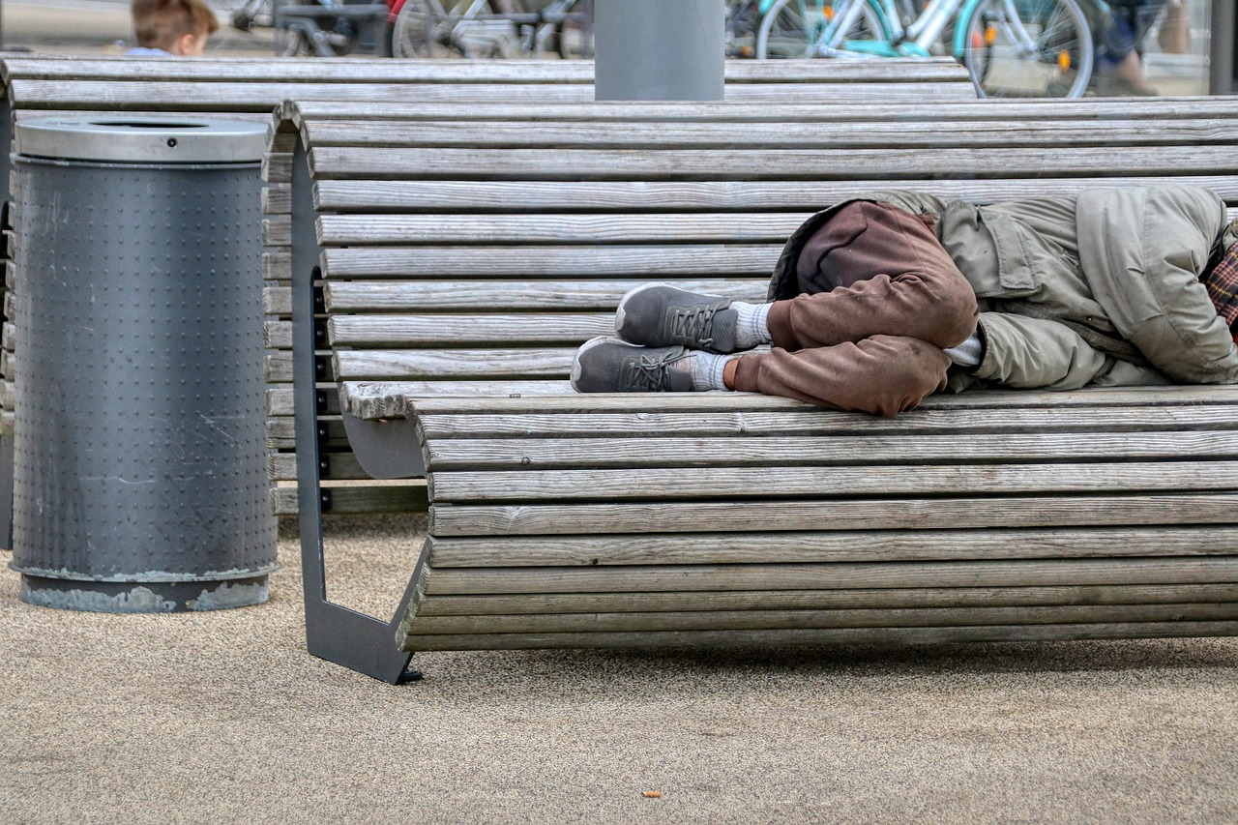
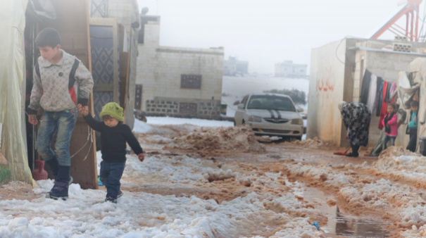
“
Saʿīd al-Kalbī (rahimahullah) used to weep during cold nights. When he was asked about this, he said:
“I thought about the poor amongst the Ummah of Muḥammad ﷺ during this night, and I cried out of compassion for them.”

Slide 16
5) More Opportunities to Have Du‘as Accepted
The Messenger of Allah ﷺ said,
“Two are not rejected: the du‘ā’ made at the time of adhān, and under the rain.”
(Ḥākim)
Notes:
It rains more in the winter, which means even more opportunities to have our du‘ās accepted. The Messenger of Allah ﷺ said, “Two are not rejected: the du‘ā’ made at the time of adhān, and under the rain.” (Ḥākim)
Instead of grumbling about the rain, let us turn to Allah and pour our hearts out to al-Mujīb, who never disappoints.

Slide 17
Duʿas
[A] What is the duʿa for when it rains?
When it rains
اَللّٰهُمَّ صَيِّبًا نَّافِعًا
On hearing thunder
سُبْحَانَ الَّذِيْ يُسَبِّحُ الرَّعْدُ بِحَمْدِهِ وَالْمَلَائِكَةُ مِنْ خِيْفَتِهِ
When it’s very windy
اَللّٰهُمَّ إِنِّيْ أَسْأَلُكَ خَيْرَهَا وَخَيْرَ مَا فِيْهَا وَخَيْرَ مَا أُرْسِلَتْ بِهِ ، وَأَعُوْذُ بِكَ مِنْ شَرِّهَا وَشَرِّ مَا فِيْهَا وَشَرِّ مَا أُرْسِلَتْ بِهِ
Notes:
Translation and references: https://lifewithallah.com/nature/
OR
Dhikr & Dua App: https://lifewithallah.com/app/

Slide 18

Winter: The Believer’s Season
1) Its Days are Perfect for Fasting
2) A Chance to Enjoy the Night Prayer
3) A Reminder of the Hell-fire
4) A Means to Thank Allah and Help Others
5) More Opportunities to have Du‘as Accepted

Slide 19
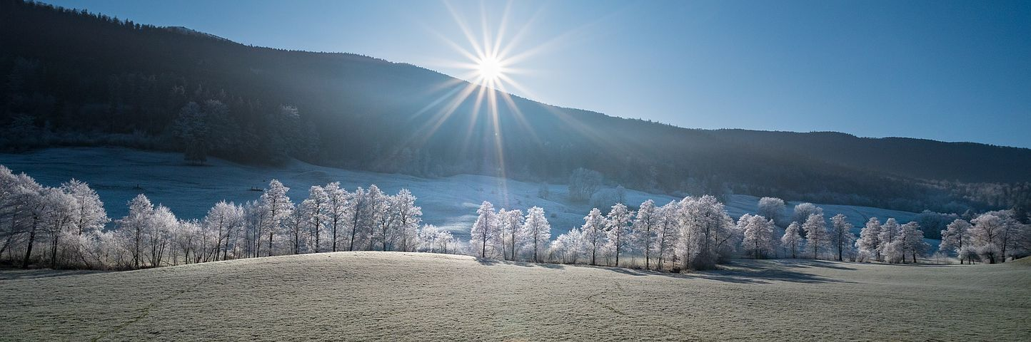
Plenary
Write a set of five questions based on today’s lesson and then use them to interview your partner

