Slide 1
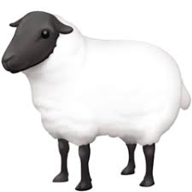
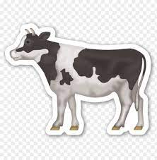
Pictionary: Can You Guess The Word?
+ HASA +
Notes:
MOO (sound a cow makes) + HASA + BAA (sound a sheep makes)
(Muhasabah)

Slide 2

Muhasabah
أعمال القلوب المحاسبة
Notes:
Start session with Bismillah, Praises of Allah and Salawat
Resource article: https://lifewithallah.com/muhasabah/
Feel free to adjust this ppt to your learners’ needs.
The ppts sometimes assume prior knowledge and/or knowledge of Arabic.
Read the notes before delivering the lesson.
To make the lessons interactive, you will find ‘[A]’ = Activity throughout the slides. This can be done orally, in writing, on mini whiteboards (MWB), classroom board, flipchart paper, through discussion; alone, in pairs, groups etc, and through other methods. Vary the activity method to keep the learners engaged.
LWA is not responsible for external links.
Teach with ikhlas, love, passion and genuine care for your students. Build a rapport, be positive and help them to increase their love for Allah and His Messenger ﷺ.
Please give us feedback on these slides by filling in this short feedback form (you can remain anonymous): https://forms.gle/yP45KNYEbemxT7hS6

Slide 3
Session Objectives
To identify how to treat one’s nafs
To design a personal muhasabah plan
To assess the importance of muhasabah

Slide 4

Believers!
[A] Write Q59:18
يَـٰٓأَيُّهَا الَّذِيْنَ اٰمَنُوا اتَّقُوا۟ اللّٰهَ وَلْتَنْظُرْ نَفْسٌ مَّا قَدَّمَتْ لِغَدٍ ، وَاتَّقُوا۟ اللّٰهَ ، إِنَّ اللّٰهَ خَبِيرٌ بِمَا تَعْمَلُونَ
“Believers! Be mindful of Allah and let every soul carefully consider what it has sent forth for tomorrow. And fear Allah: certainly, Allah is All-Aware of what you do” (59:18).
[A] Write down 3 key messages of this ayah.
Iman – taqwa
Accountability. Do you know the Arabic of this?
Focus is ‘tomorrow’.
محاسبة
Notes:
This āyah teaches us that if we are to be worthy of ‘īmān’, we have to adorn ourselves with taqwā, in private and public. Similarly, we have to hold ourselves accountable of what we do in this world, and what consequences our actions will have in the hereafter. This āyah also teaches us that we should live our lives with a focus on the hereafter. This world is a bridge to the hereafter, our real home. Everything we do in this world should be so that tomorrow, when we stand in front of Allah, He is happy with us. We are happy to meet Him, and He is happy to receive us.
We always assess and evaluate our learning, teaching, performance at work, business plans etc…We do it for the dunya because we want to be successful in these different aspects (which is not always blameworthy), but what about the hereafter, and our real purpose in life?
Qur’anic Focus (QF)
This is an attempt to connect learners’ to the Qur’an and form a strong personal bond with it.
At the beginning of the year, instruct learners to bring in their personal mushaf to every class.
Each lesson (wherever possible), physically make them open the Mushaf at least once.
Ask learners to write down the chosen ayah in their books. Ask one student to recite. Ask another student to attempt a translation. Discuss and explain the meaning of the ayah.

Slide 5
What is Muhasabah?
Critical self-assessment
Evaluation
Introspection
Muḥasābah, an action of the heart, is to evaluate one’s actions and behaviour of the nafs (inner self); and then rectifying the mistakes, and continuing the good deeds.
Notes:
Ask learners: How do we rectify the mistakes?
Tawbah and istighfar
If wrongdoing is to creation, apologise/do extra good to them/make dua for them etc

Slide 6
“
“Hold yourselves to account (in the world) before you are held to account (in the hereafter).
Evaluate your actions (today) before you are evaluated (tomorrow), for the Reckoning will be easier upon you tomorrow if you hold yourselves accountable today.”
- ʿUmar b. al-Khaṭṭāb (raḍiy Allāhu ʿanhu)

Slide 7
How To Treat Your Nafs
Tazkiyat al-________?
The nafs is like a treacherous business partner.
We should treat our nafs as though it is another person and remain very strict with it. When it slips and errs, we should tell it off.
When we find it leaning itself to the obedience of Allah, we should push it in that direction.
You control your nafs; don’t let it control you.
Talk to your nafs. Ibn al-Jawzī.
Notes:
It has been said that the nafs is like a treacherous business partner. If you do not hold him accountable, he will run away with your money. Similarly, if we do not hold our nafs accountable, it will run away with our success and land us in the pit of destruction.
We often go easy on our nafs, but this is exactly what it wants! Many of the ʿibādāt trains us to gain mastery over it and teaches us not give in to its every whim. We should not let our nafs fool us by thinking, ‘This is only a minor sin’ or, ‘There is a difference of opinion anyway, so it doesn’t really matter.’
We should treat our nafs as though it is another person and remain very strict with it. When the nafs slips and errs, we should reprimand it; and when we find it leaning itself to the obedience of Allah, we should push it in that direction.
Ibn al-Jawzi (rahimahullah) does this in Sayd al-Khatir. There’s some really amazing conversations he has back and forth with his own nafs. There is also an English translation available. Add it to your reading list inshallah.

Slide 8
“
“I saw a number of the companions of the Prophet ﷺ and I accompanied them. They informed us that those who were the most stringent in taking their inner selves to account in the world, will be the ones with the purest īmān on the Day of Judgement.”
- ʿĀmir b. ʿAbd Qays (raḥimahullāh)

Slide 9

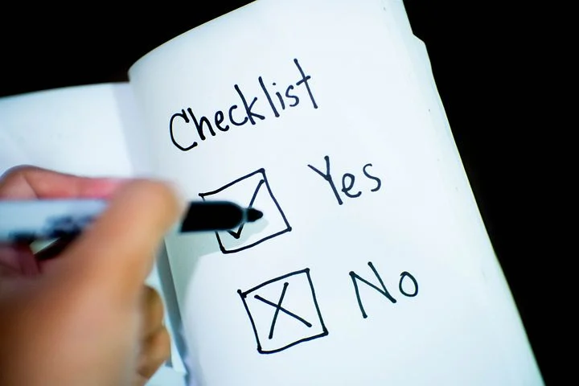

How To Do Muhasabah
Fix a time
Every night/after Fajr/other
Watch Video: 30:48-38:00
Notes:
Put an alert on your phone (if that helps).
(8 mins)
30:48-38:00
Muhasabah (Self Reckoning) | Sh. Yaser Birjas and Sh. Mohammad Elshinawy | Ramadan Repeat
https://www.youtube.com/watch?v=m_mnXPohInY
Possible alternative video:
ISR Season 4 Episode 9: Accountability - Imam Taha Hassane
https://www.youtube.com/watch?v=ouLoNiFy8t8

Slide 10
[A] Check Yourself
Specify the time(s). Write it on the top of your page.
[A] Prepare a Muhasabah checklist for yourself.
What are some of the questions we can ask ourselves?
Rate your own deeds

Slide 11
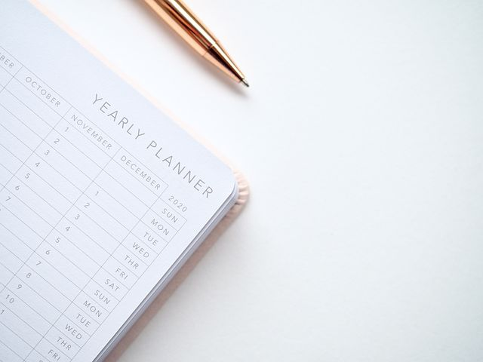
The Order of Accountability
1. Farḍ deeds
2. Forbidden acts
3. Heedlessness
4. Intentions
Notes:
Ibn al-Qayyim (raḥimahullāh) explains that we can evaluate ourselves in the following way:
Obligatory (farḍ) deeds. Firstly, we should reflect on whether we fulfilled those deeds which are obligatory upon us, and then expiate for them. E.g if ṣalāh was missed, then immediately perform qaḍā or if it was rushed and deficient then make amends by praying additional voluntary (nafl) prayers.
2. Forbidden acts. Then, we should reflect on our sins. We should sincerely repent by regretting what we did and resolve to not repeat such a sin. Where possible, we should also make amends e.g. if we insulted someone, then we should apologise to them and make duʿā’ for them.
3. Heedlessness/moments of distraction. The next step is to evaluate moments where we are not doing ḥarām, but are indulging in activities which are not conducive to our purpose in life (worshipping Allah). In an era of distraction, we are bombarded with various forms of entertainment and notifications leading us to wasting precious time. We should make amends for this by increasing our remembrance of Allah (dhikr, ṣalāh, Qur’ān etc.).
4. Intentions. This is vital, as we may perform an amazing deed, but ruin it due to riyā’ (showing off) and not do it for the sake of Allah. Or we may have done something ordinary in the day, but this could become a great act of worship if we intended to do it for the sake of Allah. For e.g. we may have a mind-numbing job, but we could intend every day before we leave the house that we are doing it to earn a ḥalāl living, provide for our families, give charity through it etc. Or we may feel like cooking for our families is a chore, but this could become an act of worship if we intend with it to feed nutritious ḥalāl food to our loved ones, so they can become strong believers and serve the dīn of Allah.

Slide 12
Other Self-Reflection Questions
Did I do it sincerely for the sake of Allah alone?
What were my deficiencies in the act of worship I did (e.g. Did I miss out on khushūʿ in ṣalāh? Did I ruin my fast by backbiting?)
Did I perform a good deed which was of lesser importance, and justified it to myself by thinking that I was ‘still doing something good’?
Did I use my intention to transform an ordinary deed into an act of worship?
How much of my ‘screen time’ is spent on what spiritually and mentally nourishes me?
Which ones are you going to add to your list?

Slide 13

Lack of Muhasabah
[A] What does lack of muhasabah lead to?
وَلَا تَكُونُوا كَالَّذِينَ نَسُوا۟ ٱللَّهَ فَأَنسَىٰهُمْ أَنفُسَهُمْ أُو۟لَٰٓئِكَ هُمُ الْفَٰسِقُونَ
“And do not be like those who forgot Allah, so He made them forget themselves. It is they who are defiantly disobedient” (59:19).
If we are heedless of Allah, and we fail to remember Him and uphold His rights, Allah will cause us to forget that which is actually beneficial for our souls. So who loses out?
Notes:
If we are heedless of Allah, and we fail to remember Him and uphold His rights, Allah will cause us to forget that which is actually beneficial for our souls. In effect, it is we who lose out, when we move far away from our Creator, and surrender to the whims and desires of our souls.

Slide 14
Muhasabah For All
Story
  يا ابن الخطاب، كنت وضيعا فرفعك الله، وضالا فهداك الله، وضعيفا فأعزك الله، وجعلك خليفة فأتي رجل يستعين بك على دفع الظلم فظلمته ؟!! ما تقول لربك غدا إذا أتيته ؟
Why do you think muhasabah is more important for tullab al- ʿ ilm and people active in daʿwah?
Notes:
وجاء رجل يشكو إلى عمر وهو مشغول فقال له : (أتتركون الخليفة حين يكون فارغا حتى إذا شغل بأمر المسلمين أتيتموه) ؟ وضربه بالدرة، فانصرف الرجل حزينا، فتذكر عمر أنه ظلمه، فدعا به وأعطاه الدرة، وقال له : «اضربني كما ضربتك» فأبى الرجل وقال : تركت حقي لله ولك ، فقال عمر : «إما أن تتركه لله فقط، وإما أن تأخذ حقك» فقال الرجل : تركته لله ، فانصرف عمر إلى منزله فصلى ركعتين ثم جلس يقول لنفسه : «يا ابن الخطاب، كنت وضيعا فرفعك الله، وضالا فهداك الله، وضعيفا فأعزك الله، وجعلك خليفة فأتي رجل يستعين بك على دفع الظلم فظلمته ؟!! ما تقول لربك غدا إذا أتيته ؟ وظل يحاسب نفسه حتى أشفق الناس عليه» ⁽مناقب أمير المؤمنين عمر بن الخطاب) لابن الجوزي⁾ .
A man came to complain to ʿUmar (ra) whilst he was busy, so he said to him. “Do you leave the Caliph when he is free; and when he becomes occupied with the matters of the Muslims, you come to him?!” And he hit him with a whip. The man returned upset. After some time ʿUmar realized that he had wronged him, so he called for him and gave him the whip and said to him, “Hit me as I hit you.” The man refused and said, “I have given up my right for Allah and for you.” ʿUmar said, “Either you give it up just for Allah, or you take your right.” The man said, “I have given it up for Allah”. ʿUmar went back home and prayed two rakʿahs. He then sat saying to himself, “Son of Khaṭṭāb! You were insignificant and Allah raised you. You were misguided and Allah guided you. You were weak and Allah honoured you; and He made you a Caliph! A man came to ask your help to remove injustice, and you oppressed Him! What will you say to your Lord when you go to Him tomorrow?”
عَنْ أَنَسِ بْنِ مَالِكٍ، قَالَ سَمِعْتُ عُمَرَ بْنَ الْخَطَّابِ، وَخَرَجْتُ، مَعَهُ حَتَّى دَخَلَ حَائِطًا فَسَمِعْتُهُ وَهُوَ، يَقُولُ وَبَيْنِي وَبَيْنَهُ جِدَارٌ - وَهُوَ فِي جَوْفِ الْحَائِطِ - عُمَرُ بْنُ الْخَطَّابِ أَمِيرُ الْمُؤْمِنِينَ بَخٍ بَخٍ وَاللَّهِ لَتَتَّقِيَنَّ اللَّهَ أَوْ لَيُعَذِّبَنَّكَ ‏.‏
https://sunnah.com/urn/518170
عن أنس بن مالك – رضي الله عنه – قال : سمعت عمر بن الخطاب – رضي الله عنه – يوما وخرجت معه حتى دخل حائطا فسمعته يقول – وبيني وبينه جدار «عمر !! أمير المؤمنين !! بخ بخ، والله بُنَيَّ الخطاب لتتقين الله أو ليعذبنك» ⁽الزهد للإمام أحمد⁾ .
When you’re trying to do s.th good, you are more vulnerable to Shaytan’s attacks, as he wants you to either stop or ruin your deeds (e.g. through riya or hasad).

Slide 15
Duʿa
How many times do we pray this duʿa throughout the day ?
اَللّٰهُمَّ عَالِمَ الْغَيْبِ وَالشَّهَادَةِ ، فَاطِرَ السَّمٰوَاتِ وَالْأَرْضِ رَبَّ كُلِّ شَيْءٍ وَمَلِيْكَهُ ، أَشْهَدُ أَنْ لَّا إِلٰهَ إِلَّا أَنْتَ ، أَعُوْذُ بِكَ مِنْ شَرِّ نَفْسِيْ ، وَمِنْ شَرِّ الشَّيْطَانِ وَشِرْكِهِ ، <وَأَنْ أَقْتَرِفَ عَلَىٰ نَفْسِيْ سُوْءًا ، أَوْ أَجُرَّهُ إِلَىٰ مُسْلِمٍ>
Notes:
3x
Morning, evening & before sleep
O Allah, Knower of the unseen and the seen, Creator of the heavens and the earth, the Lord and Sovereign of everything; I bear witness that there is no god but You. I seek Your protection from the evil of my own self, from the evil of Shaytān and from the evil of polytheism to which he calls, [and from inflicting evil on myself, or bringing it upon a Muslim*].
*Addition in Tirmidhī 3529
Abū Bakr al-Ṣiddīq (raḍiy Allāhu ʿanhu) said: “O Messenger of Allah, instruct me what to say in morning and in the evening.” He said: “Say [the above].” (Tirmidhī 3392)
عَنْ أَبِي رَاشِدٍ الْحُبْرَانِيِّ، قَالَ أَتَيْتُ عَبْدَ اللَّهِ بْنَ عَمْرِو بْنِ الْعَاصِي فَقُلْتُ لَهُ حَدِّثْنَا مِمَّا، سَمِعْتَ مِنْ، رَسُولِ اللَّهِ صلى الله عليه وسلم ‏.‏ فَأَلْقَى إِلَىَّ صَحِيفَةً فَقَالَ هَذَا مَا كَتَبَ لِي رَسُولُ اللَّهِ صلى الله عليه وسلم قَالَ فَنَظَرْتُ فِيهَا فَإِذَا فِيهَا إِنَّ أَبَا بَكْرٍ الصِّدِّيقَ رضى الله عنه قَالَ يَا رَسُولَ اللَّهِ عَلِّمْنِي مَا أَقُولُ إِذَا أَصْبَحْتُ وَإِذَا أَمْسَيْتُ ‏.‏ فَقَالَ ‏ "‏ يَا أَبَا بَكْرٍ قُلِ اللَّهُمَّ فَاطِرَ السَّمَوَاتِ وَالأَرْضِ عَالِمَ الْغَيْبِ وَالشَّهَادَةِ لاَ إِلَهَ إِلاَّ أَنْتَ رَبَّ كُلِّ شَيْءٍ وَمَلِيكَهُ أَعُوذُ بِكَ مِنْ شَرِّ نَفْسِي وَمِنْ شَرِّ الشَّيْطَانِ وَشَرَكِهِ وَأَنْ أَقْتَرِفَ عَلَى نَفْسِي سُوءًا أَوْ أَجُرَّهُ إِلَى مُسْلِمٍ ‏"‏
For the full explanation of this duʿa, see Morning & Evening Dua 6 (Dhikr & Dua App)
Our first request is that Allah saves us from the evil of our own nafs (self). We seek refuge in Allah from our ‘self’ (nafs), even though our nafs is a part of us. So how can it be our enemy? Ibn al-Qayyim said, “Beware of your nafs (self), for you have not been faced with a tribulation except due to it. Do not make peace with it, for by Allah you do not honour it if you do not degrade it. You do not give it respect if you do not humiliate it. You do not give it strength if you do not break it. You do not give it rest if you do not tire it. You do not give it safety if you do not frighten it, and you do not give it happiness if you do not make it sad.”
The statement of Ibn al-Qayyim can be understood when one considers that the life of the soul does not end at death. Rather it journeys on to the Hereafter. If you resist the temptations of your nafs (self) in this world, tomorrow you will enjoy eternal bliss, success and peace in the hereafter inshā’Allah.

Slide 16


Journal & Reflect
Notes:
5 or more minutes.
In this series of lessons (on the actions and diseases of the heart), ask learners/participants to keep a reflective journal. Tell them that you will not be checking it, and it is personal to them. Ask them: reflect on what we have discussed today, and jot down some key reflections. How does it link to your life? How would you like to incorporate *today’s action of the heart* / eliminate *today’s disease of the heart* in your life? How are you going to attain Allah’s closeness through it? Write down at least 1 tangible thing you are going to do/not do.
Each week, ask them to review last week’s and if they did/stopped doing what they wrote down in the previous week.
At the end of the term/end of sessions, ask them to do a complete review, to remind themselves.
(Tafakkur and reflection are key aspects of journeying to Allah. It is not enough to tell students do XYZ, but to give them some quiet space and time to think and reflect.)

Slide 17

Plenary
What is muhasabah?
What does lack of muhasabah lead to?
How should we treat our nafs?
What are some of the self-critical questions we should always ask ourselves?
Why is muhasabah more important for tullab al-ilm and people active in daʿwah?
Why is muhasabah closely linked to tawbah?

