Slide 1
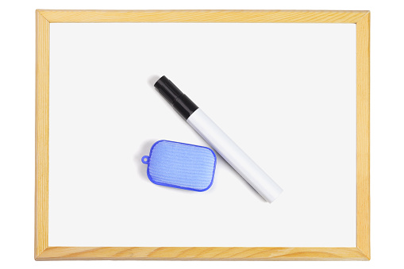
Starter
Define khushu.
List 3 ways in which we can attain khushu.

Slide 2

Session 2
Year 9
Praying Salah with Ihsan
Aiming for the best

Slide 3
LOs
To define uluw al-himmah
To explain the essence of salah
To identify the spiritual components of wudu and qiblah

Slide 4

Isn’t it enough that I pray
5x a day?
عُلُوُّ الهِمَّة
Salah without the presence of the heart is actually not accepted
You won’t attain the purpose of salah
[A] Read 56:7-11, and write down the 3 categories of people identified by Allah.
Sabiqun
Right
Left
Notes:
https://lifewithallah.com/featured/importance-of-khushu-2/
Qur’anic Focus (QF)
This is an attempt to connect learners’ to the Qur’an and form a strong personal bond with it.
At the beginning of the year, instruct learners to bring in their personal mushaf to every class.
Each lesson (wherever possible), physically make them open the Mushaf at least once.
Ask learners to write down the chosen ayah in their books. Ask one student to recite. Ask another student to attempt a translation. Discuss and explain the meaning of the ayah.

Slide 5
Ihsan: 3 meanings
What does ‘ihsan’ mean?
Do you remember how the Prophet g responded when Jibril (as) asked him ‘What is ihsan?’
“That you worship Allah as though you are seeing Him; for if you cannot see Him, He truly sees you” (Muslim).
إحْسَان
ihsan
Notes:
Ihsan
1) perfection/excellence (itqan)
2) Good treatment and kindness. See 2:83
3) “That you worship Allah as though you are seeing Him; for if you cannot see Him, He truly sees you” (Muslim).

Slide 6
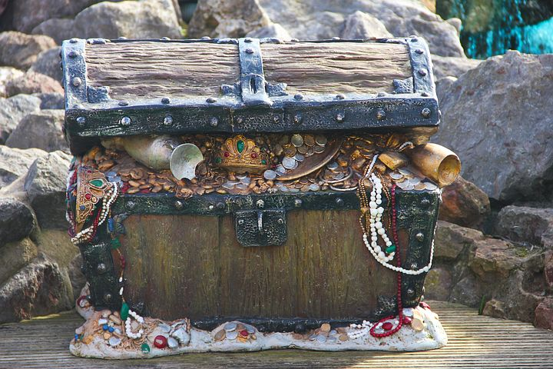
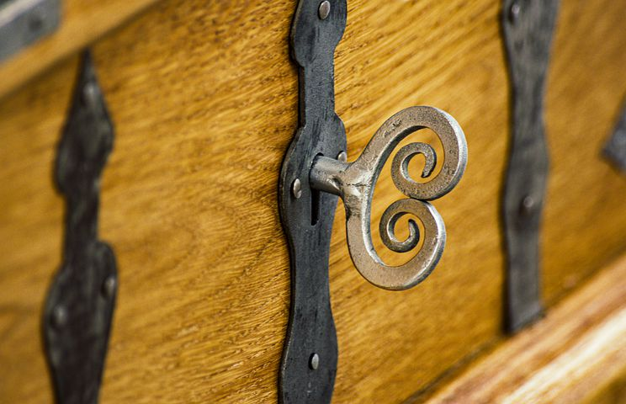
The key to the treasure
Notes:
Ṣalāh is akin to a heavily guarded treasure chest that can be opened only with a specific key. That key is to turn towards Allah and turn away from everything other than Him.
Go to Allah with full presence and concentration. Incline to Him completely. Focus on Him Alone. If you turn to Him, He will turn to you. If you turn away from Him, He will turn away from you.

Slide 7
How to attain ihsan
Desires
Doubts
Cup demonstration
Steer your mind to think about Allah: His majesty, His beauty, His kindness, His love and His Generosity.
Notes:
We can attain ihsan by removing the world from our hearts and purifying our hearts from desires and doubts.
Ask learners: What are desires?
Desire for wealth, sexual gratification, power, praise etc Desires lead to sin & to rejecting truth. Worship of own desires/slave of nafs/hawa
Doubts distort beliefs and weaken your iman. You can’t sacrifice time, comforts, life etc if you don’t have strong iman. Shaytan’s powerful weapon.
Think of a cup which is full.
[Bring a cup to class and pour in some water/juice/tea etc to demonstrate. Give class beverage to sip on through the class for a positive attachment].
Ask learners: Can I add to this cup?
To add to it, you must first throw out some of its contents. Likewise, the treasures of ṣalāh cannot enter a heart that is filled with concerns for the dunyā, is steeped in desires, and is riddled with doubts. These must first be removed.

Slide 8
Video
Humility (Khushu) In Salah | Speechless | Moutasem Al-Hameedi
https://www.youtube.com/watch?v=EtkVAiDaYVE

Slide 9
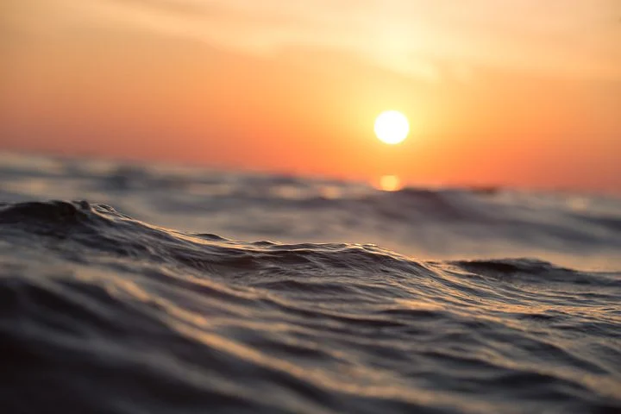

Wudu
[A] What can you keep in mind when you do wudu?
ʿUthmān b. ʿAffān 
Notes:
Once, ʿUthmān b. ʿAffān  performed wuḍū’ and then smiled. He then asked, “Do you know what made me smile?” He went on to say, “The Prophet g performed wuḍū’ like I just did, and then smiled. He then asked, ‘Do you know what made me smile?’… We replied, ‘Allah and His Messenger g know best.’ He g said, ‘Indeed when the servant performs wuḍū’, and perfects it; and then enters his prayer, and perfects it – he comes out from his prayer as he came out from his mother’s stomach without any sins’” (Aḥmad).

Slide 10
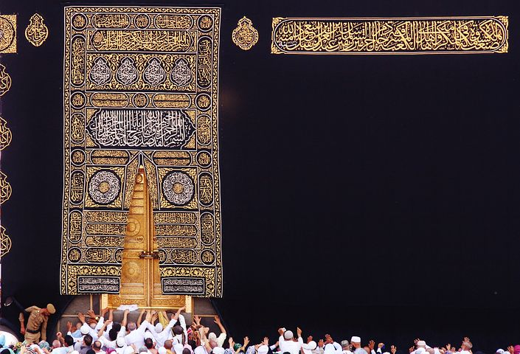
Qiblah
Notes:
During ṣalāh it is not permissible to turn your face away from the qiblah. Similarly, as His sincere slave, it is not befitting to turn your heart away from your Lord to matters other than Him

Slide 11
The Adhkar Bank
Adhkar after Salah
اَللّٰهُمَّ أَعِنِّيْ عَلَىٰ ذِكْرِكَ وَشُكْرِكَ وَحُسْنِ عِبَادَتِكَ.
O Allah, help me in remembering You, in being grateful to You, and in worshipping You in an excellent manner.
Notes:
(Bukhārī 844)
Mu’ādh b. Jabal (raḍiy Allāhu ‘anhu) reported that the Messenger of Allah ﷺ took him by the hand and he said, “O Mu’ādh, I swear by Allah that I love you. I swear by Allah that I love you. O Mu’ādh, I advise you not to forget supplicating after every prayer by saying: [the above].” (Abū Dāwūd 1522)

Slide 12
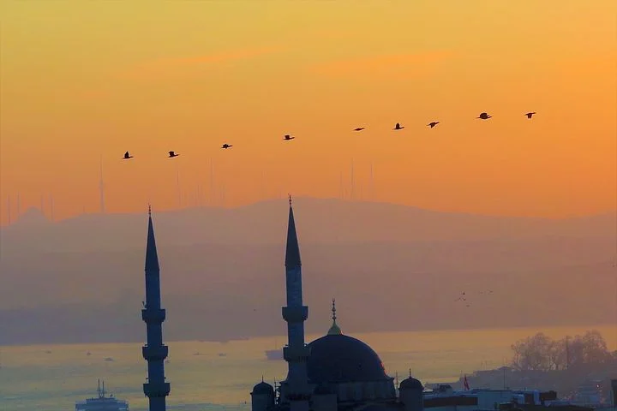
Plenary
Why is the mindset of ‘is it not enough that I pray 5x a day’ problematic?
What is ihsan?
What must we remove from our hearts in order to attain ihsan?
Finish off this sentence: Just as you turn your body towards the ______, _________________________________________

Slide 13
Practising What We’re Learning
2 rak’ah with the highest level of khushu you can, with the help of Allah b
Notes:
Pray Salah al-Duha/upcoming fard prayer/2 rak’ah nafl etc with a full focus on Allah, and try to practice something we have learnt today.

