Slide 1

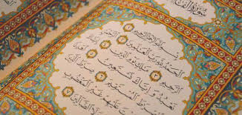
Starter
What does Allah say when you say:
Notes:
What does Allah say when the servant says: “…………”? For students who also learn Arabic: write it both in Arabic and English.
"‏ قَالَ اللَّهُ تَعَالَى: قَسَمْتُ الصَّلاَةَ بَيْنِي وَبَيْنَ عَبْدِي نِصْفَيْنِ وَلِعَبْدِي مَا سَأَلَ فَإِذَا قَالَ الْعَبْدُ الْحَمْدُ لِلَّهِ رَبِّ الْعَالَمِينَ‏ ‏.‏ قَالَ اللَّهُ تَعَالَى حَمِدَنِي عَبْدِي
وَإِذَا قَالَ: ‏‏الرَّحْمَنِ الرَّحِيمِ‏‏ ‏.‏ قَالَ اللَّهُ تَعَالَى أَثْنَى عَلَىَّ عَبْدِي ‏.‏
وَإِذَا قَالَ: مَالِكِ يَوْمِ الدِّينِ‏‏ ‏.‏ قَالَ مَجَّدَنِي عَبْدِي - وَقَالَ مَرَّةً فَوَّضَ إِلَىَّ عَبْدِي –
فَإِذَا قَالَ‏: إِيَّاكَ نَعْبُدُ وَإِيَّاكَ نَسْتَعِينُ‏‏ ‏.‏ قَالَ هَذَا بَيْنِي وَبَيْنَ عَبْدِي وَلِعَبْدِي مَا سَأَلَ ‏.‏
فَإِذَا قَالَ:‏‏ اهْدِنَا الصِّرَاطَ الْمُسْتَقِيمَ * صِرَاطَ الَّذِينَ أَنْعَمْتَ عَلَيْهِمْ غَيْرِ الْمَغْضُوبِ عَلَيْهِمْ وَلاَ الضَّالِّينَ‏‏ ‏.‏ قَالَ هَذَا لِعَبْدِي وَلِعَبْدِي مَا سَأَلَ ‏"‏
The Messenger of Allah g said, “Allah, the Most High, said, ‘I have divided the prayer (i.e. the Fātiḥah) between Myself and My slave equally and My slave shall have what he asked for.’ Therefore, when the slave says, ‘All praises and thanks are due to Allah, the Lord of the worlds,’ Allah says, ‘My slave has praised Me.’ When he says, ‘The All-Merciful, the Very Merciful,’ Allah says, ‘My slave has extolled Me.’ When he says, ‘Master of the Day of Judgement,’ Allah says, ‘My slave has glorified Me.’ (In another narration, he says, ‘My slave has entrusted his affairs to Me.’). When he says, ‘You Alone we worship and You Alone we ask for help,’ Allah says, ‘This is between Me and My slave and My slave shall have what he asked for.’ When he says, ‘Guide us to the Straight Path, the Path of those whom You have favoured, not of those who incur [Your] anger, nor of those who have gone astray,’ Allah says, ‘This is for My slave and My slave shall have what he asked for’” (Muslim).

Slide 2

Lesson 4
Year 10
Surah al-Fatihah
The Mother of the Book

Slide 3
LOs
To review and memorise the Surah al-Fatihah conversation hadith
To explain the meaning of Surah al-Fatihah
To identify the significance of Surah al-Fatihah

Slide 4
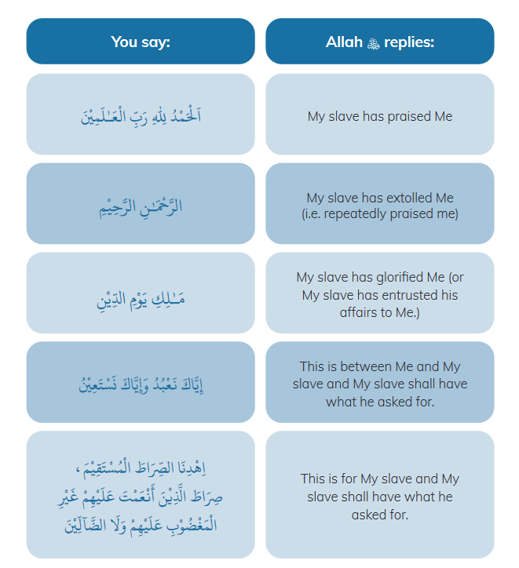

Slide 5

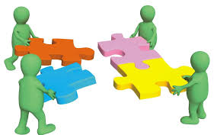
Group Activity
Notes:
Listen to a recitation of Surah al-Fatihah e.g. https://quranicaudio.com/quran/109
Teacher divides group into 7 groups and each group is assigned an ayah. Give each group handouts from relevant books/direct them to Qur’an.com (English tafsirs available: Ma’riful Quran/Tafsir Ibn Kathir) and ask them to explore the meaning and significance of their particular ayah which can help them to connect with it in salah. They will then present key findings to the rest of the class.
Alternatively, print the relevant pages from ‘Taste the Sweetness of Salah’ (Surah al-Fatihah in Ch.4) and give to each group as a resource
https://lifewithallah.com/publication/the-salah-series/
As a class, listen to the recitation together. Go through the entire surah. Let each group share their findings and the teacher can jot down key points on the board under each ayah, so the rest of the class can take notes; and the teacher can correct where needed or intersperse key information. Keep track of time.

Slide 6
بِسْمِ اللهِ الرَّحْمَـٰنِ الرَّحِيْمِ
Iqra bismi – 1st revelation
Start with Allah’s name for every action = becomes worship
Bi= seeking help; seeking blessing
Al-Rahman: exclusive for Allah (hence no plural)
Rahmah: mercy, compassion, kindness, tenderness, love
Notes:
Iqra bismi – 1st revelation
Start with Allah’s name for every action = becomes worship
Bi= seeking help; seeking blessing
Al-Rahman: exclusive for Allah (hence no plural)
Al-Rahim:
Rahmah: mercy, compassion, kindness, tenderness, love

Slide 7

اَلْحَمْدُ لِلّٰهِ رَبِّ الْعَـٰلَمِينَ
1st ayah: we learn the most important thing we can ever learn. Knowledge of Allah.
Al- lil-istighraq. All.
Allah is most deserving of praise
Hamd:
Praise
Gratitude
Negates shirk
Rabb: Nurtures, Takes care, Creates, Provides, Gives life and death.
Notes:
Al-
Allah is most deserving of praise
Hamd:
Praise
Gratitude
Negates shirk
Rabb: Nurtures, Takes care, Creates, Provides,

Slide 8
الرَّحْمَـٰنِ الرَّحِيْمِ
What kind of Rabb is He?
The difference between the 2.
Allah sustains us, not because He needs us; rather, He sustains us out of His mercy.
Every blessing we have stems from His mercy. We were created through His mercy; the Messengers and the Books were sent down to guide us towards the truth through His Mercy and Paradise was created through His Mercy.
It is because of His mercy that we are invited to stand before Him, and become more aware of and closer to Him.
Notes:
The difference between the 2.

Slide 9
مَـٰلِكِ يَوْمِ الدِّيْنِ
Previous ayah could make you complacent
Belief in hereafter
The Prophet g said, “Allah will hold the whole earth, and roll up the heavens in His Right Hand. Then He will say, ‘I am the King! Where are the kings of the earth?’” (Bukhārī).
Ayah which makes you tremble & humble yourself
Visualise yourself standing in front of Allah!
Notes:
.

Slide 10
4
إِيَّاكَ نَعْبُدُ وَإِيَّاكَ نَسْتَعِيْنُ
Every human has a void.
Worship: utmost humility and submission + utmost love
Seek help: tawakkul. Acknowledging our need for Him.
Most beneficial du‘a
Repetition of iyyaka

Slide 11
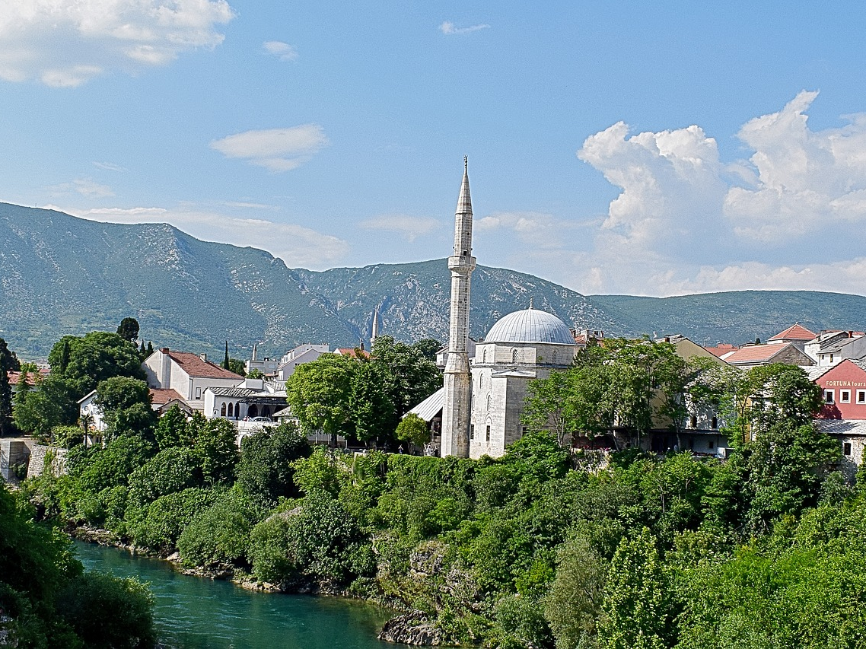
اِهْدِنَا الصِّرَٰطَ الْمُسْتَقِيْمَ
Notes:
The straight path is the way of Allah b, the path of truth, the path of His beloved Messenger g and the path to paradise. Allah b has defined the straight path for us to ensure we are led to Him. On this path we single Allah b out for worship, and remain obedient to Him and His Messenger. It is the path of truth (ḥaqq) which is embodied in the Sunnah of the Messenger of Allah g and the way of his Companions .
There is only one path of truth and that is the path of Allah b. Allah b says, “This is My path which is straight, so follow it. Do not follow other ways, for they cause you to deviate from His way. This is what He has instructed you to do, so that you will have taqwā (piety)” (6:153).

Slide 12
صِرَٰطَ الَّذِينَ أَنْعَمْتَ عَلَيْهِمْ
غَيْرِ الْمَغْضُوْبِ عَلَيْهِمْ وَلَا الضَّآلِّيْنَ
The blessed people
Good company
An antidote to loneliness.
Those who incurred anger
Had the knowledge but did not act upon it
Jews
The misguided
Lacked the knowledge and hence veered
off the Straight Path.
Christians
علم
عمل

Slide 13

My Adhkar Bank
Adhkar of Standing Up From Ruku‘
اَللّٰهُمَّ رَبَّنَا لَكَ الْحَمْدُ مِلْءَ السَّمَاوَاتِ وَمِلْءَ الْأَرْضِ وَمِلْءَ مَا بَيْنَهُمَا وَمِلْءَ مَا شِئْتَ مِنْ شَيْءٍ بَعْدُ.
O Allah, Our Lord, for You Alone is all praise; praise which fills the heavens, which fills the earth, which fills whatever is in between them, and which fills whatever You wish after that (Muslim).
رَبَّنَا لَكَ الْحَمْدُ مِلْءَ السَّمَاوَاتِ وَالأَرْضِ وَمِلْءَ مَا شِئْتَ مِنْ شَىْءٍ بعْدُ ، أَهْلَ الثَّنَاءِ وَالْمَجْدِ ، أَحَقُّ مَا قَالَ الْعَبْدُ - وَكُلُّنَا لَكَ عَبْدٌ - اَللّٰهُمَّ لَا مَانِعَ لِمَا أَعْطَيْتَ ، وَلَا مُعْطِيَ لِمَا مَنَعْتَ ، وَلَا يَنْفَعُ ذَا الْجَدِّ مِنْكَ الْجَدُّ.
Our Lord, for You Alone is all praise; praise which fills the heavens and the earth, and which fills whatever You wish after that. You are most worthy of praise and glory. The greatest truth the slave can utter is – and we are all Your slaves- O Allah, there is none who can withhold what You give, and none can give what You withhold; and the wealth of the wealthy does not avail him from You (Muslim).

Slide 14
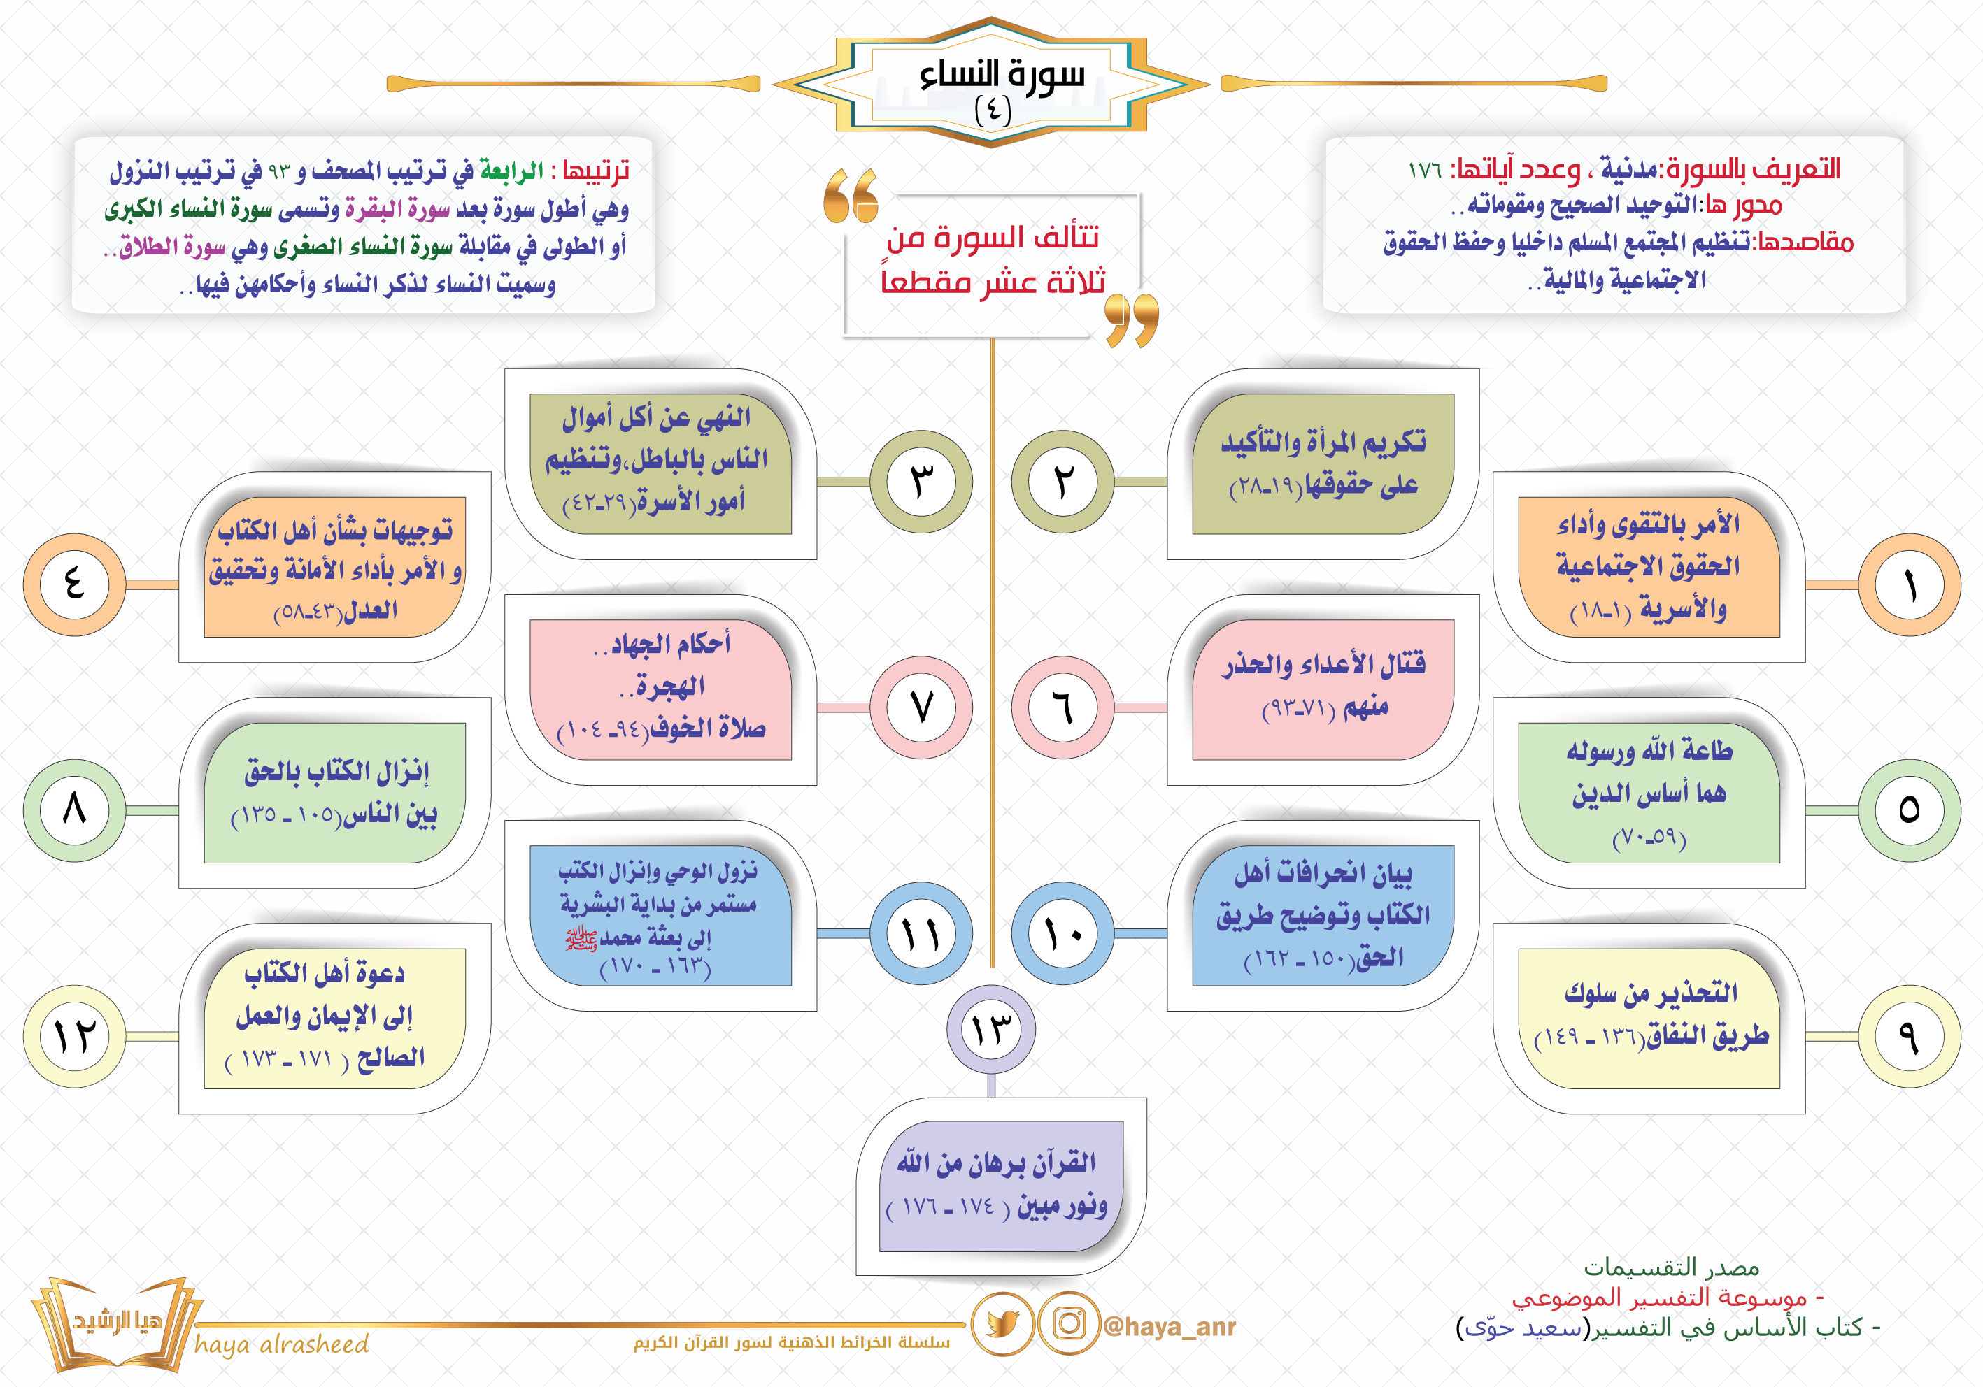
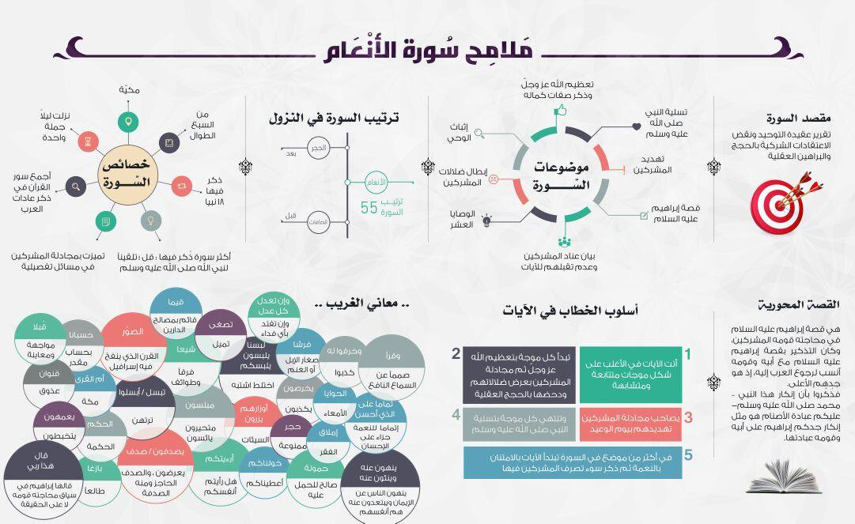
Infographic
Design an infographic summarising Surah al-Fatihah
Notes:
This task can be started in class and completed as homework.

Slide 15
Practising What We’re Learning
Let us pray_______with the highest level of khushu we can, with the help of Allah b
Notes:
Pray Salah al-Duha/upcoming fard prayer/2 rak’ah nafl etc with a full focus on Allah, and try to practice something we have learnt today.

