Slide 1
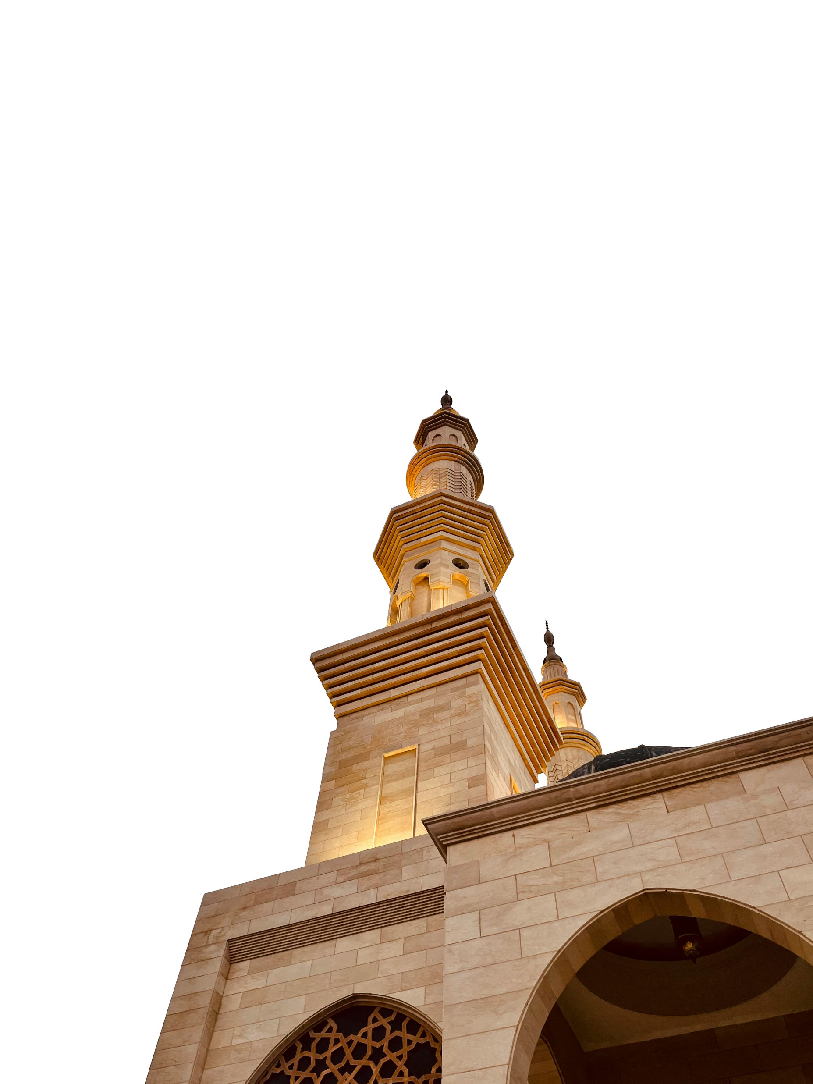


Ramadan
LEVEL 9
Part I: Gift of Ramadan & Fasting

Slide 2
Starter
# What does Ramadan mean to you?

Slide 3
Learning Objectives
To appreciate the gift of Ramadan
To identify the purpose of fasting
To list various ways of accumulating as much reward as possible

Slide 4
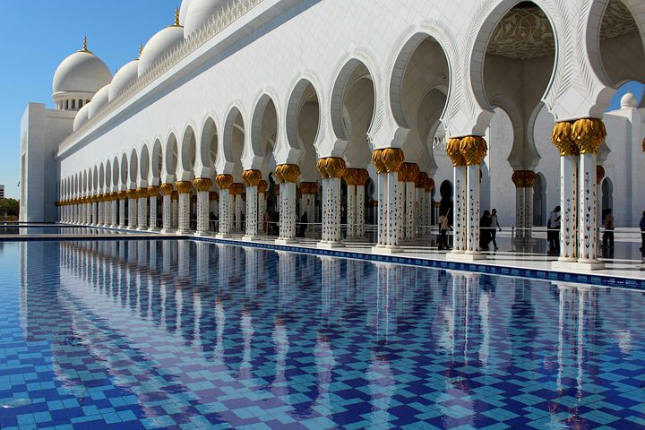
[A]
[A] Why is Ramadan an exquisite gift? What is so special about Ramadan?

Slide 5
The Gift of Ramadan
Doors of Jannah…
Doors of Jahannam…
Shayatin…
Notes:
The Messenger of Allah ﷺ said: “The month of Ramadān has come to you, a blessed month in which Allah - Exalted and Majestic is He - has obligated (its) fasting upon you. In it the gates of Paradise are opened, the gates of Hell-fire are closed, and the rebellious devils are chained. In it, Allah has a night which is better than a thousand months. Whoever is deprived of its good is truly deprived!” (Nasā’ī 2106)

Slide 6
The Gift of Ramadan
Month of…
Qur’an
Du’a
Forgiveness
Mercy
Good deeds
Fasting
Generosity
Freedom from Hell-fire

Slide 7
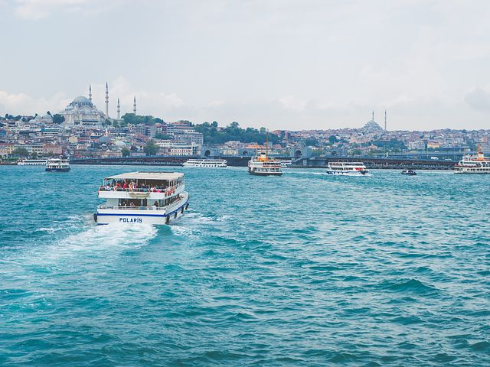
3 Opportunities
وَمَنْ صَامَ رَمَضَانَ إِيمَانًا وَاحْتِسَابًا غُفِرَ لَهُ مَا تَقَدَّمَ مِنْ ذَنْبِهِ ‏‏‏.‏
‏ مَنْ قَامَ رَمَضَانَ إِيمَانًا وَاحْتِسَابًا غُفِرَ لَهُ مَا تَقَدَّمَ مِنْ ذَنْبِهِ.
مَنْ قَامَ لَيْلَةَ الْقَدْرِ إِيمَانًا وَاحْتِسَابًا غُفِرَ لَهُ مَا تَقَدَّمَ مِنْ ذَنْبِهِ،
Notes:
The Messenger of Allah ﷺ said: “Whoever observes the fasts of Ramadān with īmān and hoping for reward, all his previous sins will be forgiven.” (Bukhārī 2014)
The Messenger of Allah ﷺ said: “Whoever stands in prayer at night (qiyām) in the month of Ramaḍān with firm belief and hoping for reward, all his previous sins will be forgiven.” (Bukhārī 2014)
The Messenger of Allah ﷺ said: “Whoever stands in prayer at night (qiyām) in the Night of Decree (laylat al-qadr) with īmān and hoping for reward, all his previous sins will be forgiven.” (Bukhārī 2014)
Be from those who are pleased with Ramaḍān and are eager to strive in it. Show Allah how happy you are with His special month through your intention, worship and desire for reward. Be not from those who become miserable with Ramadhan’s arrival and feel ‘forced’ to fast its days.

Slide 8

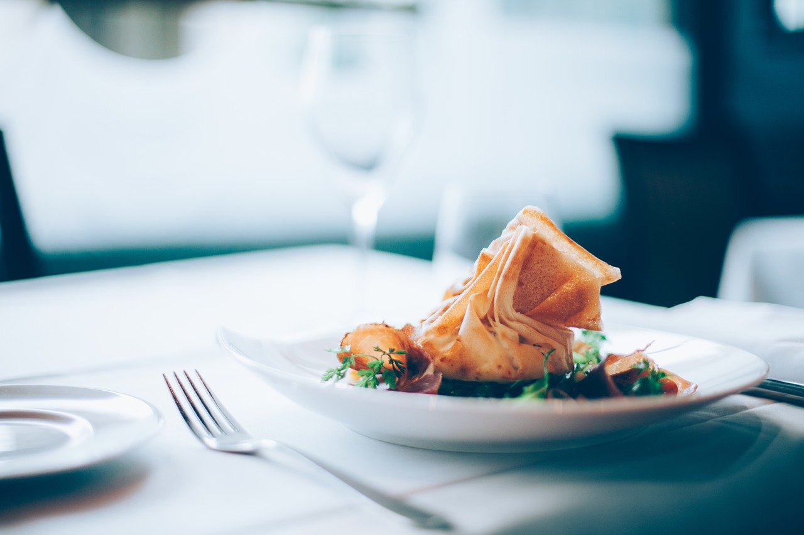
Why Do We Fast?
[A] Why do we fast?
Write (Q2:183)
يَا أَيُّهَا الَّذِينَ آمَنُوا كُتِبَ عَلَيْكُمُ الصِّيَامُ كَمَا كُتِبَ عَلَى الَّذِينَ مِنْ قَبْلِكُمْ لَعَلَّكُمْ تَتَّقُونَ ﴿١٨٣﴾
[A] What do we desire?
Desire of…
Stomach. Sleep. Soaps. Movies. The opposite gender.
Notes:
قال الله تعالى: ﴿يا أيُّها الَّذِينَ آمَنُوا كُتِبَ عَلَيْكُمُ الصِّيامُ كَما كُتِبَ عَلى الَّذِينَ مِن قَبْلِكُمْ لَعَلَّكُمْ تَتَّقُونَ﴾ [البقرة ١٨٣]
“…Fasting is prescribed for you, as it was prescribed for those before you, so that you may attain taqwā (piety and mindfulness of Allah).” (2:183)
Taqwā is to protect yourself from the punishment of Allah by avoiding His prohibitions and implementing His commands.
When we fast, we temporarily make harām on ourselves what is usually halāl (eating, drinking etc). This teaches us to say ‘NO!’ to our nafs and inner desires, & helps us to train ourselves to restrain from all harām throughout the year.
Qur’anic Focus (QF)
This is an attempt to connect learners’ to the Qur’an and form a strong personal bond with it.
At the beginning of the year, instruct learners to bring in their personal mushaf to every class.
Each lesson (wherever possible), physically make them open the Mushaf at least once.
Ask learners to write down the chosen ayah in their books. Ask one student to recite. Ask another student to attempt a translation. Discuss and explain the meaning of the ayah.

Slide 9
Fasting and Taqwa
Who can explain how fasting helps you to gain taqwa? Do you remember the example of the burger?
When we fast, we temporarily make harām on ourselves what is usually halāl (for e.g?).
This teaches us to say ‘NO!’ to our nafs and inner desires & helps us to train ourselves to stay away from all harām throughout the year.
Fasting = a means of training ourselves to obey Allah.

Slide 10
Why Do We Fast?
To obey Allah’s orders
To attain taqwa
To be protected from Hell-fire
To be forgiven for one’s past sins
To enter Paradise
To have your du‘as accepted
To receive intercession on the Day of Judgement
Surprise reward from Allah

Slide 11
Fasting From Haram…
Fasting is not just to restrain from food and drink.
[A] How can you control your anger/tongue/if someone provokes you etc?
Backbiting
Social media
Notes:
عَنْ أَبِي هُرَيْرَةَ، قَالَ: قَالَ رَسُولُ اللَّهِ ـ صلى الله عليه وسلم ـ ‏ "‏ رُبَّ صَائِمٍ لَيْسَ لَهُ مِنْ صِيَامِهِ إِلاَّ الْجُوعُ. وَرُبَّ قَائِمٍ لَيْسَ لَهُ مِنْ قِيَامِهِ إِلاَّ السَّهَرُ
The Messenger of Allah ﷺ said: “There are many who fast, who gain nothing of their fast except hunger; and there are many who stand for the night prayer, who gain nothing of their prayer except sleeplessness.” (Ibn Mājah 1690)

Slide 12
Role Play (in pairs)
Your non-Muslim colleague asks you at work:
“Why do you have to fast? Isn’t it a bit harsh?”
How do you respond?

Slide 13
Du‘a & Dhikr
[A] When are the optimum times for du’a in Ramadan?
Whilst you’re fasting
Before you open your fast
In the last 3rd of night, in sujud
Dhikr
General: ALL THE TIME, ANYTIME
Specific: (1) After Salah (2) Morning & Evening (3) Before Sleeping (4) Bathroom, Eating, Entering house, clothes etc
“I can’t make du’a for more than 5 minutes…I get really stuck on what to say.”

Slide 14
[A]
Ramadan Schedule
Notes:
Ask learners to come up with a personal Ramadan timetable (different schedule for school day and weekends). Be as specific as possible. Share ideas as a class and give individual suggestions etc

Slide 15
Plenary
How does fasting help you attain taqwa?
What are the virtues of fasting?
What is the reward of siyam/qiyam/qiyam of Laylat al-Qadr?
What are the two conditions of the above reward?

Slide 16
Ramadan
LEVEL 9
Part I: Qur’an & Laylat al-Qadr

Slide 17
LOs
To discuss how we can strengthen our bond with the Qur’an in this month
To explore how we can gain closeness to Allah through Salah & the Night Prayer
To explain the significance of Laylat al-Qadr

Slide 18
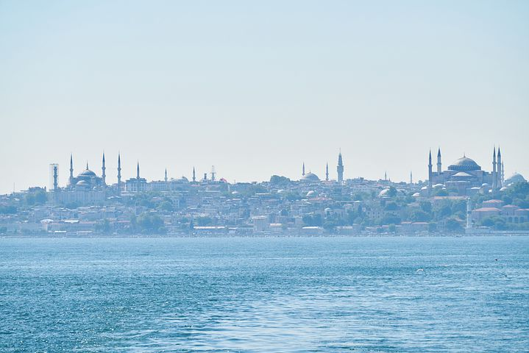
Starter
What do you struggle with in Ramadan?
[A] How can we overcome these struggles?

Slide 19
Review
What is the purpose of fasting?
How does fasting help you attain taqwa?
What is the du‘a after opening the fast?
List 3 virtues of fasting
Why is it important to eliminate/control your social media intake in Ramadan?

Slide 20
Qur’an
[A] Write Q2:185
شَهْرُ رَمَضَانَ الَّذِي أُنْزِلَ فِيهِ الْقُرْآنُ هُدًى لِلنَّاسِ وَبَيِّنَاتٍ مِنَ الْهُدَىٰ وَالْفُرْقَانِ
“Ramaḍān is the month in which the Qur’ān was revealed – a guidance for mankind, and clear proofs of the guidance, and the criterion
(between right and wrong)…” (2:185)
Picture the scene: Jibril and the Prophet ﷺ
Notes:
عَنِ ابْنِ عَبَّاسٍ ـ رضى الله عنهما ـ قَالَ كَانَ رَسُولُ اللَّهِ صلى الله عليه وسلم أَجْوَدَ النَّاسِ، وَكَانَ أَجْوَدَ مَا يَكُونُ فِي رَمَضَانَ حِينَ يَلْقَاهُ جِبْرِيلُ، وَكَانَ جِبْرِيلُ يَلْقَاهُ فِي كُلِّ لَيْلَةٍ مِنْ رَمَضَانَ، فَيُدَارِسُهُ الْقُرْآنَ، فَلَرَسُولُ اللَّهِ صلى الله عليه وسلم حِينَ يَلْقَاهُ جِبْرِيلُ أَجْوَدُ بِالْخَيْرِ مِنَ الرِّيحِ الْمُرْسَلَةِ‏.‏
ʿAbdullāh b. ʿAbbās r said: “The Messenger of Allah g was the most generous of all people; and he was the most generous during the month of Ramaḍān when Jibrīl would meet him. Jibrīl would meet him every night in Ramaḍān to study the Qur’ān with him g. When Jibrīl would meet him, the Messenger of Allah would be more generous than strong winds (which cause rain and prosperity).” (Bukhārī 3220)

Slide 21
Qiyam
Do you remember the reward?
The sweetness of Qiyam
How can we taste the sweetness?

Slide 22
The Month of Qur’an
Recitation
Meaning
Explanation
Reflection
Action
How are you going to make the Qur’an the focus of your Ramadan?
Go back and adjust your schedule

Slide 23
[A] How to gain reward…
Parents
-
-
Siblings
-
-
Classmates/colleagues/neighbours/relatives etc
-
-

Slide 24
The last 10 days
“
“When the last ten days of Ramadān arrived, the Prophet ﷺ would tighten his waist belt (stay away from his wives/strive hard), spend the night in worship, and awaken his family.” (Bukhārī)
Notes:
عَنْ عَائِشَةَ ـ رضى الله عنها ـ قَالَتْ كَانَ النَّبِيُّ صلى الله عليه وسلم إِذَا دَخَلَ الْعَشْرُ شَدَّ مِئْزَرَهُ، وَأَحْيَا لَيْلَهُ، وَأَيْقَظَ أَهْلَهُ‏.‏
The Messenger of Allah ﷺ said: “When the last ten days of Ramadān arrived, the Prophet ﷺ would tighten his waist belt (stay away from his wives/strive hard), spend the night in worship, and awaken his family.” (Bukhārī 2024)

Slide 25
Laylat al-Qadr
Write the surah from your memory.
How much of it can you translate?
إِنَّا أَنْزَلْنَاهُ فِي لَيْلَةِ الْقَدْرِ ﴿١﴾ وَمَا أَدْرَاكَ مَا لَيْلَةُ الْقَدْرِ ﴿٢﴾
لَيْلَةُ الْقَدْرِ خَيْرٌ مِنْ أَلْفِ شَهْرٍ ﴿٣﴾ تَنَزَّلُ الْمَلَائِكَةُ وَالرُّوحُ فِيهَا بِإِذْنِ رَبِّهِمْ مِنْ كُلِّ أَمْرٍ ﴿٤﴾ سَلَامٌ هِيَ حَتَّىٰ مَطْلَعِ الْفَجْرِ ﴿٥﴾
What does ‘better than a 1,000 months’ mean?
Notes:
Ask a student to recite Surah al-Qadr

Slide 26
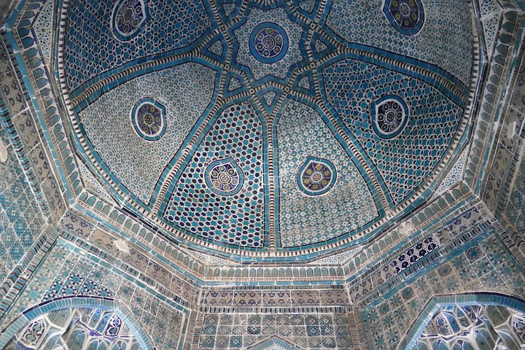
Du‘a of Laylat al-Qadr
اَللّٰهُمَّ إِنَّكَ عَفُوٌّ كَرِيْمٌ
تُحِبُّ الْعَفْوَ فَاعْفُ عَنِّيْ.
Notes:
O Allah, You are the Ever-Pardoning, the Generous; You love to pardon so pardon me.

Slide 27

Plenary
How can we strengthen our bond with the Qur’an in Ramadan?
How can we begin to *enjoy* the night prayer?
What did the Prophet ﷺ used to do in the last 10 nights?
What is the du‘a of Laylat al-Qadr?
What does it mean by ‘better than a 1,000 nights’?

