Slide 1



Preparing For Ramadan
LEVEL 8
PART 1
Notes:
Start session with Bismillah, Praises of Allah and Salawat
Resource articles and books: https://lifewithallah.com/ramadan/
Feel free to adjust this ppt to your learners’ needs.
The ppts sometimes assume prior knowledge and/or knowledge of Arabic.
Read the notes before delivering the lesson.
[A] = Activity. This can be done orally, in writing, on mini whiteboards (MWB), classroom board, through discussion; individually, in pairs, groups etc, and through other methods.
LWA is not responsible for external links.
Please give us feedback on these slides by filling in this short feedback form (you can remain anonymous): https://forms.gle/yP45KNYEbemxT7hS6

Slide 2
Learning Objectives
To explain the purpose of fasting
To list the dos and don’ts of Ramadan
To prepare a list of specific actions for Ramadan

Slide 3
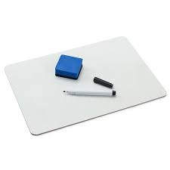
Starter
Complete the following sentence:
Ramadan is a month where…..

Slide 4
[A]
In pairs, discuss:
Why do we fast?
Notes:
Ask learners to discuss in pairs/groups/breakout rooms etc

Slide 5

Why do we fast?
[A] 2:183
يَا أَيُّهَا الَّذِينَ آمَنُوا كُتِبَ عَلَيْكُمُ الصِّيَامُ كَمَا كُتِبَ عَلَى الَّذِينَ مِنْ قَبْلِكُمْ لَعَلَّكُمْ تَتَّقُونَ ﴿١٨٣﴾
Taqwa: protect yourself from Allah’s punishment and anger BY (1) following His commands (2) staying away from His Prohibitions
Notes:
Ask learners to write down Ayah from Mushaf
Ask if anyone knows the translation
Ask if anyone can explain what taqwa is and how fasting is linked to taqwa?
O believers! Fasting is prescribed for you—as it was for those before you—so perhaps you will become mindful ˹of Allah˺/attain taqwa/become God-fearing/conscious of God etc
“…Fasting is prescribed for you, as it was prescribed for those before you, so that you may attain taqwā.” (2:183)
Taqwā (God-consciousness) is to protect yourself from the punishment of Allah by avoiding His prohibitions and implementing His commands.
Qur’anic Focus (QF)
This is an attempt to connect learners’ to the Qur’an and form a strong personal bond with it.
At the beginning of the year, instruct learners to bring in their personal mushaf to every class.
Each lesson (wherever possible), physically make them open the Mushaf at least once.
Ask learners to write down the chosen ayah in their books. Ask one student to recite. Ask another student to attempt a translation. Discuss and explain the meaning of the ayah.

Slide 6
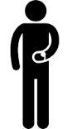
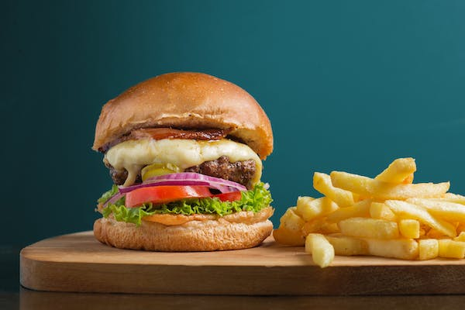
Fasting → Taqwa
Feed me!!
When we fast, we temporarily make harām on ourselves what is usually halāl (for e.g?).
This teaches us to say ‘NO!’ to our nafs and inner desires & helps us to train ourselves to stay away from all harām throughout the year.
Notes:
When we fast, we temporarily make harām on ourselves what is usually halāl (eating, drinking etc). This teaches us to say ‘NO!’ to our nafs and inner desires, & helps us to train ourselves to restrain from all harām throughout the year.
Taqwa: protect yourself from Allah’s punishment and anger BY (1) following His commands (2) staying away from His Prohibitions
Normally: it is HALAL to eat a burger
In Ramadan: 4 am – 8pm …by 3 pm your stomach is growling
Stomach: FEED ME
You: I’m going to give preference to ALLAH over my stomach (desire)
Fasting: training your nafs.
Training yourself to stay away from haram

Slide 7
The Reward of Fasting
“
“Every action of the son of Ādam is multiplied: a good deed receiving a tenfold to seven hundredfold reward. Allah (‘azz wa jall) has said: ‘Except for fasting. It is for Me and I will (personally) reward it; he abandons his desires and food for My sake.’ The fasting person will have two moments of joy: one when he opens his fast, and the other when he will meet his Lord. The unpleasant smell coming out of his mouth is more fragrant to Allah than musk.” (Muslim)
Notes:
Ask a learner to read hadith
Explain Hadith (and choose a learner by name to give specific examples)
Reward is SURPRISE!! From Allah! the Most Generous, The Most Rich, The Owner of the heavens and the earth….

Slide 8
[A]
In groups, discuss and jot down on A3 paper:
Actions of Ramadan:
b) to avoid
a) to do
Notes:
Ask learners to discuss in pairs/groups/breakout rooms etc
Collect feedback from some groups

Slide 9
Actions of Ramadan
To Do
To Avoid
Fasting
Qur’an
Qiyam
Dhikr
Du‘a
Charity
Reading/listening to beneficial lectures
Silat al-Rahim
Backbiting
Arguing (esp. with siblings!)
Foul language
Social media
Wasting time
Looking at haram
Overeating
Eating unhealthy food
“I’m starving!”
Notes:
Collect feedback from some groups

Slide 10

Protect Your Fast
What should you say if someone insults you or argues with you in Ramadan?
The Messenger of Allah ﷺ said: “Whoever does not give up lying and false conduct, Allah has no need in him giving up his food and his drink.” (Bukhārī)
Notes:
“I’m fasting”
َدَّثَنَا آدَمُ بْنُ أَبِي إِيَاسٍ، حَدَّثَنَا ابْنُ أَبِي ذِئْبٍ، حَدَّثَنَا سَعِيدٌ الْمَقْبُرِيُّ، عَنْ أَبِيهِ، عَنْ أَبِي هُرَيْرَةَ ـ رضى الله عنه ـ قَالَ قَالَ رَسُولُ اللَّهِ صلى الله عليه وسلم ‏ "‏ مَنْ لَمْ يَدَعْ قَوْلَ الزُّورِ وَالْعَمَلَ بِهِ فَلَيْسَ لِلَّهِ حَاجَةٌ فِي أَنْ يَدَعَ طَعَامَهُ وَشَرَابَهُ ‏"‏‏.‏

Slide 11
Du’a After Opening a Fast
ذَهَبَ الظَّمَأُ ، وَابْتَلَّتِ الْعُرُوْقُ ، وَثَبَتَ الْأَجْرُ إِنْ شَاءَ اللهُ.
Who remembers what this du ‘a means?
Notes:
The thirst has gone, the veins have been moistened, and the reward has been secured, if Allah wills. (Abū Dāwūd)

Slide 12
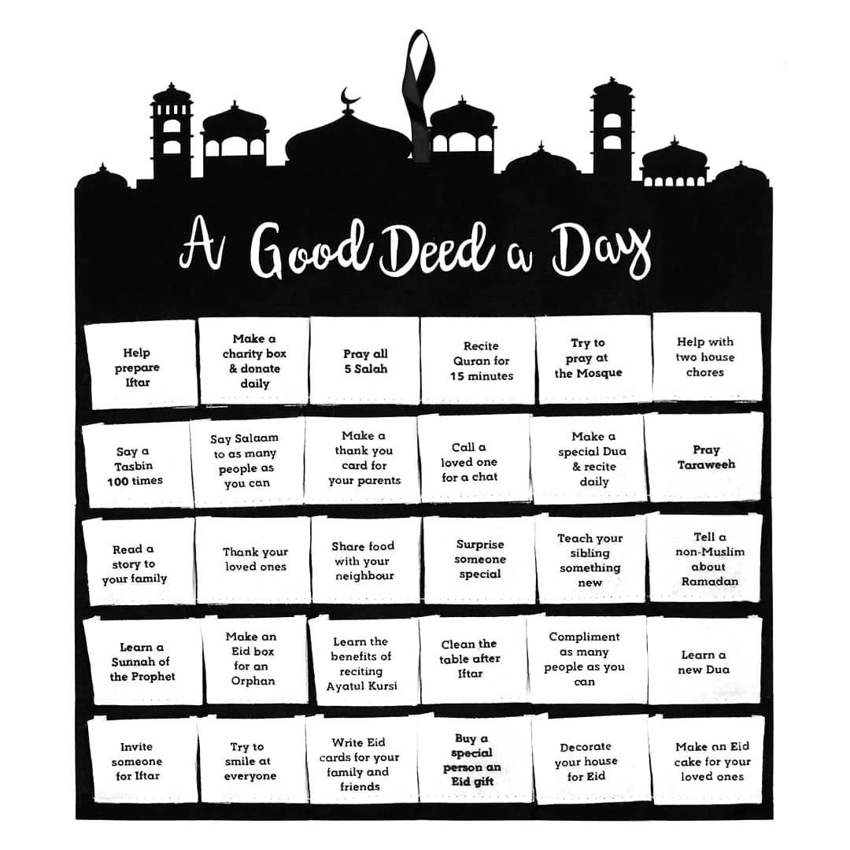

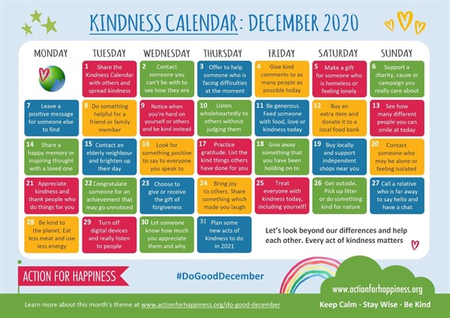
Good deed Calendar
Let’s inspire each other and prepare a calendar for this Ramadan.
Notes:
Encourage them to be as specific as possible….share some ideas on the board as a class.

Slide 13
Plenary
Why do we fast?
What is the reward of fasting?
How should we protect our fasts?
What is the du‘a after we open our fasts?

Slide 14
Homework
“What does Ramadan mean to me?”
Poetry/Short Essay/Poster Contest

Slide 15
Ramadan: the Month of Qur’an & Laylat al-Qadr
LEVEL 8
PART 2
Notes:
Start session with Bismillah, Praises of Allah and Salawat
Resource articles and books: https://lifewithallah.com/ramadan/
Feel free to adjust this ppt to your learners’ needs.
The ppts sometimes assume prior knowledge and/or knowledge of Arabic.
Read the notes before delivering the lesson.
[A] = Activity. This can be done orally, in writing, on mini whiteboards (MWB), classroom board, through discussion; individually, in pairs, groups etc, and through other methods.
LWA is not responsible for external links.
Please give us feedback on these slides by filling in this short feedback form (you can remain anonymous): https://forms.gle/yP45KNYEbemxT7hS6

Slide 16
Starter
Why do we fast?
What is the link between taqwa and fasting?
What is really cool about the reward of fasting?
What is the du’a after we open the fast?

Slide 17
LOs
To identify how we can strengthen our bond with the Qur’an in Ramadan
To explain how we can improve in our night prayer
To explore the significance of Laylat al-Qadr

Slide 18
Fasting
“Whoever observes the fasts of Ramadān with īmān and hoping for reward, all his previous sins will be forgiven.”
(Bukhārī)

Slide 19
Ramadan & the Qur’an
[A] Q2:185
شَهْرُ رَمَضَانَ الَّذِي أُنْزِلَ فِيهِ الْقُرْآنُ هُدًى لِلنَّاسِ وَبَيِّنَاتٍ مِنَ الْهُدَىٰ وَالْفُرْقَانِ
“Ramaḍān is the month in which the Qur’ān was revealed – a guidance for mankind, and clear proofs of the guidance, and the criterion (between right and wrong)…”
(2:185)
Notes:
Ask learners to write the beginning of the ayah from the Mushaf
And then explain what it means and how Ramadan is the month of Qur’an

Slide 20
The Month of Qur’an
How Can I Make Ramadan the Month of Qur’an?

Slide 21
Tips
Recite a minimum fixed portion every day…and more inshallah ☺
Read/Listen to a tafsir lecture, for e.g. ….
Ask yourself: what is Allah telling ME?
Listen to Qur’an
Revise what you have memorised so you are not reciting the last 10 surahs only in Tarawih

Slide 22
Qiyam al-Layl
“Whoever prays at night (qiyām) in the month of Ramadān with firm belief and hoping for reward, all his previous sins will be forgiven.” (Bukhārī)
[A] How should your perform
tarawih/tahajjud?
“I find Tarawih so tiring ☹ What can I do?”
Do you have any advice ?
Notes:
Slowly
Tadabbur
Tajwid
Enjoy your recitation
We’re so lucky that we can talk DIRECTLY to Allah (swt)
Loudly/Audibly so you can enjoy (but not too loud as to disturb others)
If in masjid, read a summary of the juz in the day…link them/direct them to a suitable easy-to-understand and concise resource
Advice will differ based on audience/levels of maturity and spirituality

Slide 23

Laylatul-Qadr
“Whoever prays at night (qiyām) during the Night of Qadr with firm belief and hoping for reward, all his previous sins will be forgiven.” (Bukhārī)
- What makes this night SUPER SPECIAL?
Notes:
Better than a 1000 months.
Catch this night and it will be as though you have worshipped Allah for 1,000+ months = 83+ years!
Lots and lots of Angels come down
A night of blessings, mercy and special gifts from Allah swt.

Slide 24

Du‘a of Laylat al-Qadr
اَللّٰهُمَّ إِنَّكَ عَفُوٌّ كَرِيْمٌ
تُحِبُّ الْعَفْوَ فَاعْفُ عَنِّيْ.
Notes:
O Allah, You are the Ever-Pardoning, the Generous; You love to pardon so pardon me.

Slide 25
Month of Du’a
[A] How should we make du’a?
Praise
Salawat
Istighfar
Du’a for yourself + ummah

Slide 26
Special Times for Du’a in Ramadan
During your ENTIRE fast
Before Iftar
In the last 3rd of Night, in Sujud

Slide 27
Plenary
What is the reward of fasting Ramadan/qiyam/qiyam of Laylat al-Qadr?
How can we make Ramadan the month of the Qur’an?
What are the special times for du’a in Ramadan?
How should we make du’a?
Why is Laylat al-Qadr extremely special?
What du’a should we read in Laylat al-Qadr?

