Slide 1

PALESTINE
GUIDED BY THE QUR’AN
Palestine: A Quranic Lens
Notes:
Start the presentation with bismillah, praising Allah and salawat.
Ask the audience to renew their intention and dedicate their time for Allah's sake.

Slide 2
It is essential that educators read the speaker notes and research the topic BEFORE delivering the session.
Ask all participants to have a Mushaf/use an app/Quran.com etc.
If you are conducting this presentation to students who have a background in Arabic/Tafsir, you can make the session more interactive and meaningful by:
  Removing the English translations of the Qur’anic verses.
  Dividing the class into groups/pairs, giving them an ayah each and asking them to identify the key lessons which can be learned from these āyāt. If it is given as homework, they can be directed to relevant tafsir sources which will make the subsequent discussions more meaningful and richer.
If you are presenting via a projector, you can access the speaker notes if you extend the screen and click on present.
You can also print the slides with the notes. Go on print, then underneath slides, click the option of Notes Pages (Print slides with notes).
Resources required:
  Mushaf/Phone
  Speaker
  Projector
Educators’
notes
To make optimal use of this presentation, we recommend using the PowerPoint version which includes audio of the Qur’anic verses and visual elements.
Notes:
Additional Information for Educators:
For a list of what brings/prevents victory:
https://lifewithallah.com/articles/seasons-of-worship/ramadan/ramadan-a-month-of-victory/
If you have any suggestions or improvements, please email: info@lifewithallah.com
LWA is not responsible for external links, and does not necessarily endorse all the content of external links and videos.

Slide 3
01
02
“WHY IS ALLAH ALLOWING ALL THIS PAIN & SUFFERING?”
WHAT LESSONS CAN WE LEARN FROM THE PALESTINIANS?
Questions
answered
03
04
WHAT DOES ALLAH WANT FROM US?
WHAT BRINGS VICTORY? WHAT PREVENTS VICTORY?
Notes:
These are some of the questions which we will be exploring today bi'idhnillah.

Slide 4
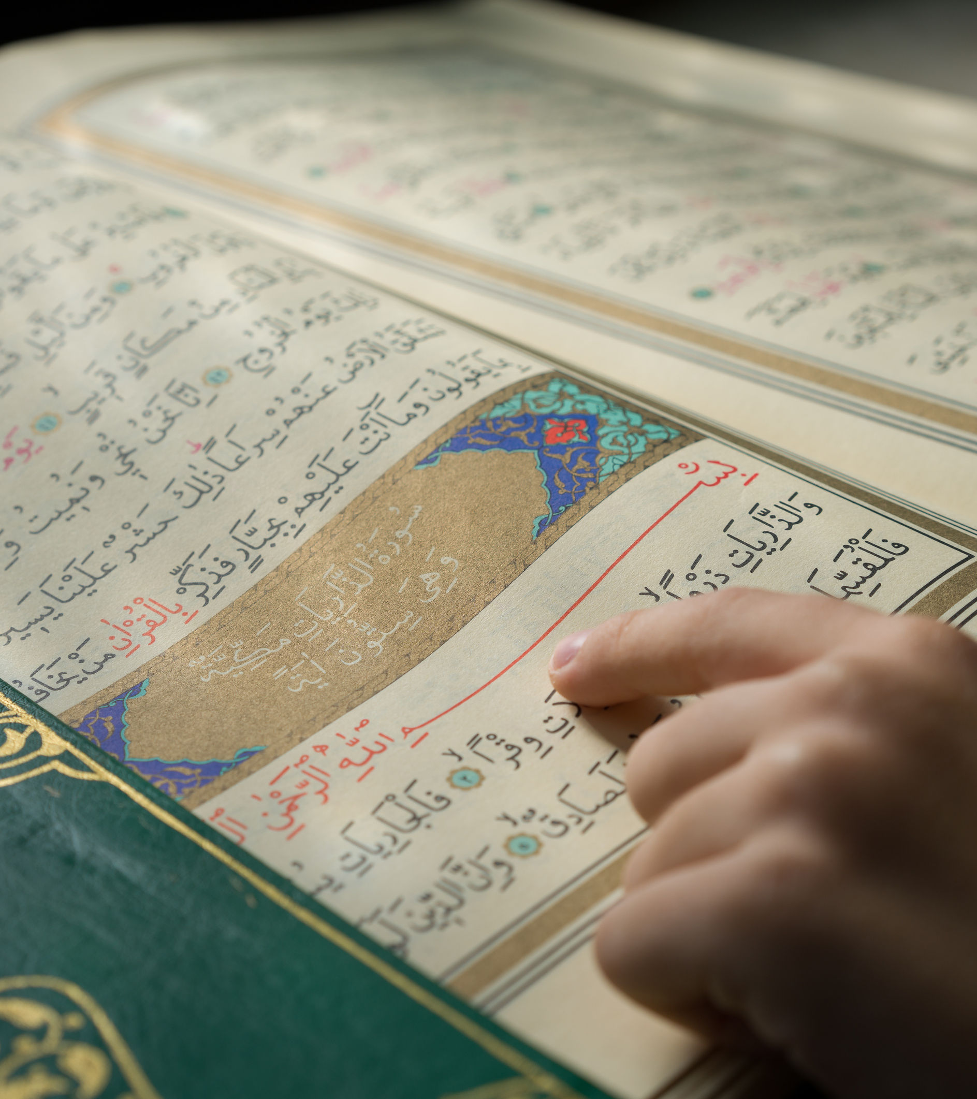
Quranic
lens
The Qur’an always has the answers. The Qur’an is constant, perfect and timeless.
The purpose of the Qur’an is guidance. Just as it guided and strengthened the Prophet ﷺ and the Companions through difficult times, we too should make it our guide and anchor.
Let us develop a Qur’anic lens.
Notes:
The Qur’an always has the answers. The Qur’an is constant, perfect and timeless.
We need to develop a Qur’anic lens: view everything around us from the perspective of revelation.
The purpose of the Qur’an is guidance. Just as it guided and strengthened the Prophet ﷺ and the Companions (ra) through difficult times, we too should make it our guide and anchor.

Slide 5
Part I: “Why is Allah
this to happen to the Palestinians?”
allowing

Slide 6
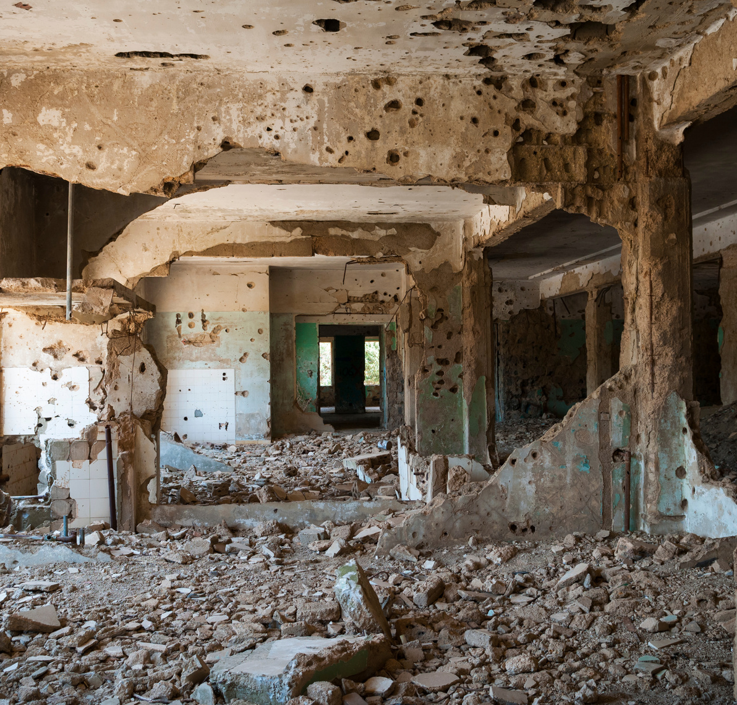
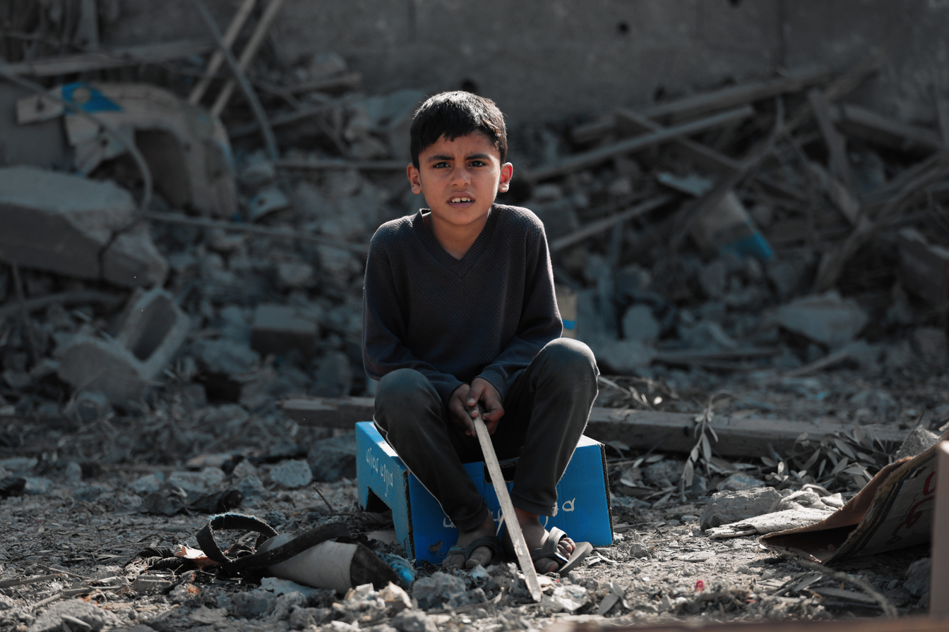

How would you
respond?
In groups/pairs discuss:
“Why is Allah allowing this to happen to the Palestinians?”
Notes:
Classroom/Teaching Ideas:
If teaching a class, you could place this quote on the board/slide: The Prophet ﷺ said, “There will always remain a group of my Ummah clearly upon the truth, defeating and subjugating their enemy. Those who oppose them will not harm them—except for some calamities that shall (occasionally) befall them—until the command of Allah comes while they are in that condition.”
The companions asked, “And where will they be, O Messenger of Allah?”
He ﷺ replied, “𝐈𝐧 𝐁𝐚𝐲𝐭 𝐚𝐥-𝐌𝐚𝐪𝐝𝐢𝐬 (𝐉𝐞𝐫𝐮𝐬𝐚𝐥𝐞𝐦) 𝐚𝐧𝐝 𝐭𝐡𝐞 𝐬𝐮𝐫𝐫𝐨𝐮𝐧𝐝𝐢𝐧𝐠𝐬 𝐨𝐟 𝐁𝐚𝐲𝐭 𝐚𝐥-𝐌𝐚𝐪𝐝𝐢𝐬.” [Musnad Ahmad (22320)]
Then ask the question: 'If the people of Bayt al-Maqdis are considered to be those on the truth who will always be helped by Allah in the world, then why is Allah allowing this to happen to the Palestinians?'

Slide 7


“WHY IS ALLAH ALLOWING THIS TO HAPPEN TO THE PALESTINIANS?”
There is no
without tests
أَمْ حَسِبْتُمْ أَن تَدْخُلُوا الْجَنَّةَ وَلَمَّا يَأْتِكُم مَّثَلُ الَّذِينَ خَلَوْا مِن قَبْلِكُم ۖ مَّسَّتْهُمُ الْبَأْسَاءُ وَالضَّرَّاءُ وَزُلْزِلُوا حَتَّىٰ يَقُولَ الرَّسُولُ وَالَّذِينَ آمَنُوا مَعَهُ مَتَىٰ نَصْرُ اللَّهِ ۗ أَلَا إِنَّ نَصْرَ اللَّهِ قَرِيبٌ ‎﴿٢١٤﴾
Jannah
Do you think you will be admitted into Paradise without being tested like those before you? They were afflicted with suffering and adversity and were so (violently) shaken that (even) the Messenger and the believers with him cried out, “When will Allah’s help come?” Indeed, Allah’s help is near. (2:214)
  This life is not Jannah. Everybody will be tested.
  Allah tests those whom He loves more.
  In order for victory to come, the tests before it will be very severe.
WE ARE NOT HERE FOR THIS LIFE.
OUR FOCUS IS THE AKHIRAH.
Notes:
Some people may have this question because they have a very limited understanding of the meaning of life. Why did Allah create us? What is my role here? What is your role here? Difficulties like these wake us up and shake us up: they remind of us the bigger picture.
This world is dar al-balaa - the place of tests and trials. The next life is dar al-jazaa - the place where we will either get rewarded or punished. This life is not Jannah. In this life you will be tested. And everybody’s test will be different. Those who are closer to Allah, Allah will test them even more.
Allah says: Do you think you will be admitted into Paradise without being tested like those before you? They were afflicted with suffering and adversity and were so (violently) shaken that (even) the Messenger and the believers with him cried out, “When will Allah’s help come?” Indeed, Allah’s help is near. (2:214)
Jannah is not cheap. Jannah has to be earned. Jannah requires sabr. Jannah requires sacrifice. In this ayah we see that believers before us were tested so severely that even the Messengers would cry out ‘When will Allah’s help arrive?’ - This is the path of the Prophets and all great people: the path of difficulties, perseverance and courage for the sake of Allah.
We also learn from this ayah that they were shaken - this indicates that in order for victory to come, the tests before it will be very severe.
Classroom/Teaching Ideas:
Ask the students to reflect on these questions: What has shaken your faith in life? How did you respond

Slide 8


“WHY IS ALLAH ALLOWING THIS TO HAPPEN TO THE PALESTINIANS?”
This Life
The Akhirah
(Everlasting Life)
Notes:
This life is nothing in comparison to the akhirah.

Slide 9

“WHY IS ALLAH ALLOWING THIS TO HAPPEN TO THE PALESTINIANS?”
Unfailing
life
patterns
قَدْ خَلَتْ مِن قَبْلِكُمْ سُنَنٌ فَسِيرُوا فِي الْأَرْضِ فَانظُرُوا كَيْفَ كَانَ عَاقِبَةُ الْمُكَذِّبِينَ ‎﴿١٣٧﴾‏
  This conflict is not new. There will always be a struggle between the truth and falsehood.
  Allah will give respite to the disbelievers, but their eventual outcome and punishment will be severe.
Similar situations came to pass before you, so travel throughout the land and see what was the fate of those who denied the truth. (3:137)
Notes:
The Sunan of Allah = The universal established laws of Allah that govern the universe and are applicable to all times and places.
It is essential that we learn about these sunan so that we understand what Allah requires from us, and how He wants us to perceive events unfolding around us.
If we understand these sunan, we won’t lose our faith. We will view the state of the Ummah from the lens that Allah requires us to do so. And we will learn how to live our lives and respond in the best way possible.
Amongst these sunan are that: there will always be a struggle between the truth and falsehood. This conflict is not new. Allah will always raise those who confront and resist evil. Sometimes the evil ones will gain ascendancy, other times the people of good will triumph — but at the end, the outcome will always be for the righteous.
Another sunnah is that Allah does not grip the evildoers immediately. He gives them respite, but their eventual outcome and punishment will be severe.

Slide 10

“WHY IS ALLAH ALLOWING THIS TO HAPPEN TO THE PALESTINIANS?”
Exposes the hypocrites
&
the believers
إِن يَمْسَسْكُمْ قَرْحٌ فَقَدْ مَسَّ ٱلْقَوْمَ قَرْحٌ مِّثْلُهُۥ وَتِلْكَ ٱلْأَيَّامُ نُدَاوِلُهَا بَيْنَ ٱلنَّاسِ وَلِيَعْلَمَ ٱللَّهُ ٱلَّذِينَ ءَامَنُوا۟ وَيَتَّخِذَ مِنكُمْ شُهَدَآءَ وَٱللَّهُ لَا يُحِبُّ ٱلظَّـٰلِمِينَ ‎﴿١٤٠﴾‏ وَلِيُمَحِّصَ ٱللَّهُ ٱلَّذِينَ ءَامَنُوا۟ وَيَمْحَقَ ٱلْكَـٰفِرِينَ ﴿١٤١﴾‏
purifies
If you have suffered injuries, they suffered similarly. We alternate these days (of victory and defeat) among people so that Allah may reveal the (true) believers, choose martyrs from among you—and Allah does not like the wrongdoers— and so that Allah may purify those who believe and destroy the disbelievers. (3:140-141)
  Tests are like a sieve: they make apparent who the true believer is and who the hypocrite is.
  Trials and difficulties purify the believers from their sins.
Notes:
ASK: From this ayah, what are the 4 reasons for why sometimes believers suffer losses in a battle?
1) Reveal who the true believers really are
2) Gift the believers with martyrdom
3) Purify the believers
4) Destroy the disbelievers
Often we see a difficulty but we don’t see the wisdom behind it. These ayat were revealed after a very painful time for the Muslims - the Battle of Uhud. Allah ﷻ tells us about the wisdoms behind these tests. Tests are like a sieve: they make apparent who the true believer is and who the hypocrite is. These tests purify the ranks of the believers from the hypocrites. In another verse, Allah mentions: “So what you suffered on the day the two armies met was by the will of Allah, so that He might distinguish the believers, and expose the hypocrites…” (3:166-7)
وَمَا أَصَابَكُمْ يَوْمَ الْتَقَى الْجَمْعَانِ فَبِإِذْنِ اللَّهِ وَلِيَعْلَمَ الْمُؤْمِنِينَ ‎﴿١٦٦﴾‏ وَلِيَعْلَمَ الَّذِينَ نَافَقُوا
In this war, the true colours of people have been revealed: how willing people are to speak the truth & where people’s allegiances lie.
Similarly Allah says “so that Allah may purify those who believe”. In other words, trials and difficulties purify the believers from their sins. Thus these difficulties are actually blessings in disguise. So many people have returned back to Allah because of this great difficulty.

Slide 11
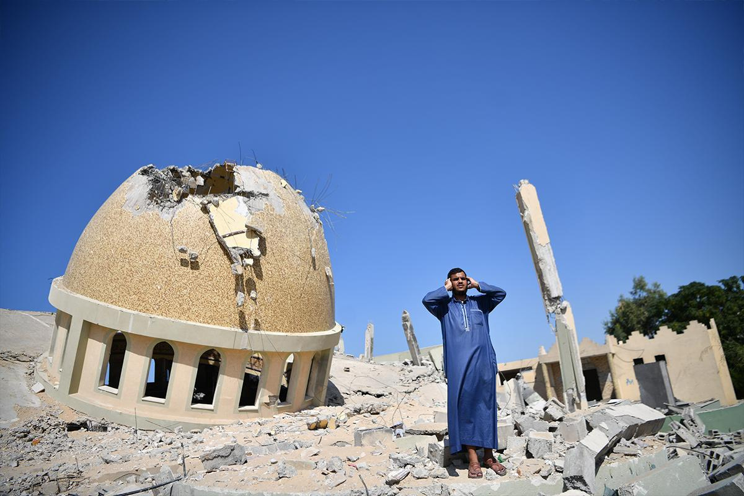
“WHY IS ALLAH ALLOWING THIS TO HAPPEN TO THE PALESTINIANS?”
They are
not
alone
إِذْ يُوحِى رَبُّكَ إِلَى ٱلْمَلَـٰٓئِكَةِ أَنِّى مَعَكُمْ فَثَبِّتُوا۟ ٱلَّذِينَ ءَامَنُوا۟ سَأُلْقِى فِى قُلُوبِ ٱلَّذِينَ كَفَرُوا۟ ٱلرُّعْبَ
When your Lord revealed to the angels, “I am with you. So make the believers stand firm. I shall put terror into the hearts of the disbelievers...” (8:12)
  Allah has not abandoned them.
  He is with them. He sends His angels who reassure the believers.
  The tranquility of the believers vs. the fear felt by the disbelievers.
Notes:
Allah has not abandoned them. We are hearing of so many incidents of how Allah is helping the believers and granting them strength.
One way in which Allah helps us is through His angels, who strengthen the hearts of the believers and reassure them.
How is their iman so strong and firm despite the horrific atrocities carried out against them?
A small thing happens to us, and we feel like the world has turned upside down. And our iman is shaken.
Contrast this with how firm they are in their iman. Allah is sending down His angels to keep them firm.

Slide 12
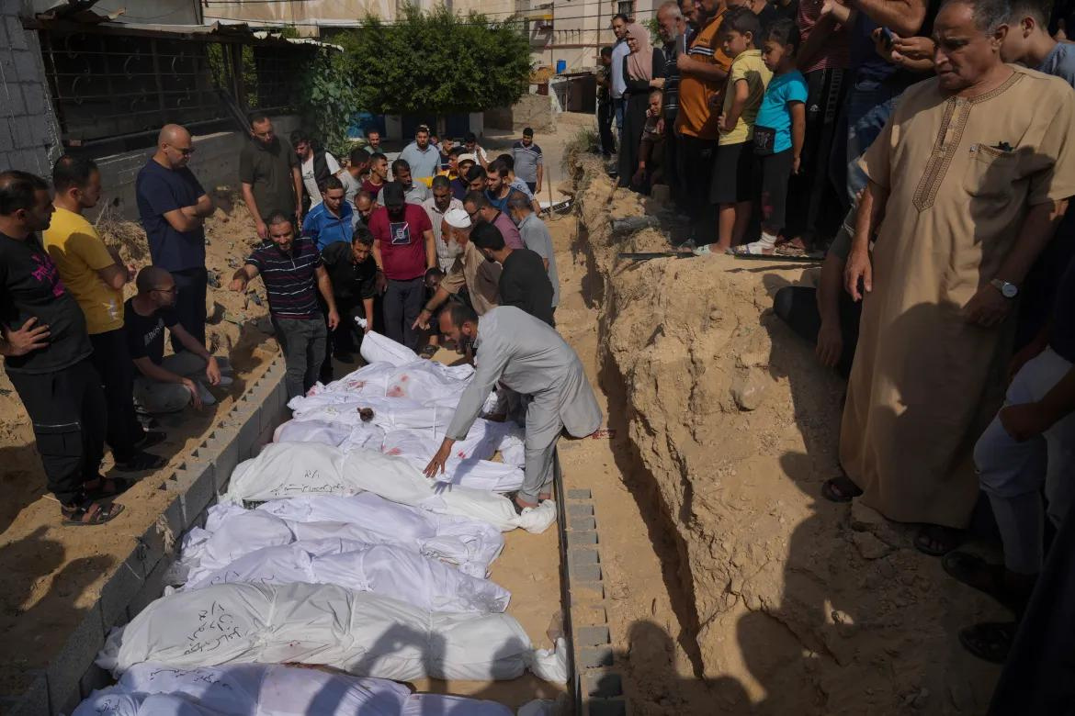
“WHY IS ALLAH ALLOWING THIS TO HAPPEN TO THE PALESTINIANS?”
وَلَا تَحْسَبَنَّ الَّذِينَ قُتِلُوا فِي سَبِيلِ اللَّهِ أَمْوَاتًا ۚ بَلْ أَحْيَاءٌ عِندَ رَبِّهِمْ يُرْزَقُونَ ‎﴿١٦٩﴾‏ فَرِحِينَ بِمَا آتَاهُمُ اللَّهُ مِن فَضْلِهِ وَيَسْتَبْشِرُونَ بِالَّذِينَ لَمْ يَلْحَقُوا بِهِم مِّنْ خَلْفِهِمْ أَلَّا خَوْفٌ عَلَيْهِمْ وَلَا هُمْ يَحْزَنُونَ ‎﴿١٧٠﴾‏ يَسْتَبْشِرُونَ بِنِعْمَةٍ مِّنَ اللَّهِ وَفَضْلٍ وَأَنَّ اللَّهَ لَا يُضِيعُ أَجْرَ الْمُؤْمِنِينَ ‎﴿١٧١﴾
Allah’s
reward
unlimited
Never think of those martyred in the cause of Allah as dead. In fact, they are alive with their Lord, well provided for — rejoicing in Allah’s bounties and being delighted for those yet to join them. There will be no fear for them, nor will they grieve. They are joyful for receiving Allah’s grace and bounty, and that Allah will not let the reward of the believers go to waste. (3:169-171)
The Messenger of Allah (ﷺ) said: “The martyr does not feel the pain of being killed except as one of you feels the pinch of an insect bite.” (Tirmidhī)
Notes:
We saw in the previous ayah that Allah said “We alternate these days (of victory and defeat) among people so that Allah may reveal the (true) believers, choose martyrs from among you.”
Shahadah is a gift - it is the best death. Don’t pity these people. They have passed their test -inshaAllah- and are roaming in the insides of green birds in Paradise, eating from the fruits of Jannah. These people have been chosen by Allah.
In this ayah, Allah tells us that the martyrs are alive by their Lord - ʿinda Rabbihim - they are by Allah. They are near Him. They have a very lofty status. They are from the Muqarrabun, those drawn close to Him: enjoying the blessings and delights of Paradise.
The martyr is not just alive, but his blood also gives life to and revives the dead Ummah.

Slide 13
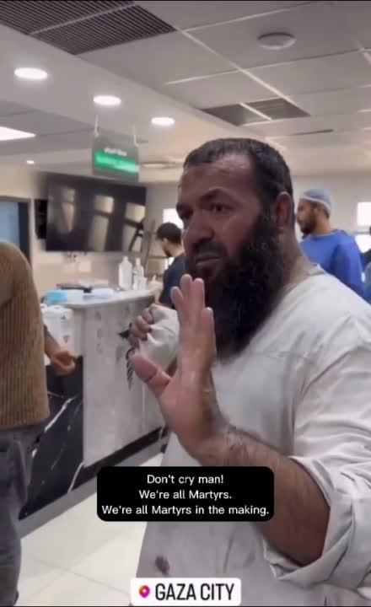

CLICK HERE TO WATCH ONLINE

Slide 14
“WHY IS ALLAH ALLOWING THIS TO HAPPEN TO THE PALESTINIANS?”
Ultimately...

Slide 15
“WHY IS ALLAH ALLOWING THIS TO HAPPEN TO THE PALESTINIANS?”
وَٱلْعَـٰقِبَةُ لِلْمُتَّقِينَ
The future belongs to those who are
.
(7:128)
God-fearing
Notes:
Musa (as) told his people to seek help with Allah and to be patient.
In Surah al-Baqarah, Allah tells us to seek help with two things: What are they?
Sabr and Salah. In these difficult days, we need to take recourse to both of these.
May think sabr is a form of passive resignation. Of giving up and just accepting what is being inflicted upon you. It’s not.
Sabr is hard work, sacrifice and perseverance. It is never giving up despite the odds.
Sabr is giving up those sins which are very difficult to give up. Sabr is praying tahajjud in the darkness and cold of the night.
Sabr is to be patient on the decree of Allah; to not ask 'Why O Allah?'
Musa (as) then reminded them that the earth belongs to Allah, and He will cause it to be inherited by whomsoever He wishes.
And ultimately, the final outcome and the future belongs to those who have taqwa. So never fear, never lose hope — and live a life of taqwa.
[Taqwā is to protect yourself from the punishment of Allah by avoiding His prohibitions and implementing His commands.]

Slide 16

“WHY IS ALLAH ALLOWING THIS TO HAPPEN TO THE PALESTINIANS?”
فَٱلَّذِينَ كَفَرُوا۟ قُطِّعَتْ لَهُمْ ثِيَابٌ مِّن نَّارٍ يُصَبُّ مِن فَوْقِ رُءُوسِهِمُ ٱلْحَمِيمُ ‎﴿١٩﴾‏ يُصْهَرُ بِهِۦ مَا فِى بُطُونِهِمْ وَٱلْجُلُودُ ‎﴿٢٠﴾‏ وَلَهُم مَّقَـٰمِعُ مِنْ حَدِيدٍ ‎﴿٢١﴾‏ كُلَّمَآ أَرَادُوٓا۟ أَن يَخْرُجُوا۟ مِنْهَا مِنْ غَمٍّ أُعِيدُوا۟ فِيهَا وَذُوقُوا۟ عَذَابَ ٱلْحَرِيقِ ‎﴿٢٢﴾
…As for the disbelievers, garments of Fire will be tailored for them and boiling water will be poured over their heads, whereby everything in their bellies, as well as the skins, . And awaiting them are hooked rods of iron. Whenever they try to escape from Hell—out of anguish—they will be forced back into it, (and will be told), ‘Taste the torment of burning!’
(22:19-22)
will be melted
“We are not equal. Our dead go to Paradise, and your dead go to Hell.” - ʿUmar (ra)
Notes:
This is the outcome for the disbelievers. Sometimes, we may feel hopeless and feel like the oppressors are getting away with their crimes.
However, Allah never forgets.
He will show them humiliation, punishment and torment, if not in this world, then most definitely in the Hereafter where they will roast in the Hellfire eternally - with no one to save them; no weapons, no superpowers, no money.

Slide 17
Part II: What lessons can we learnfrom the Palestinians?
learn

Slide 18
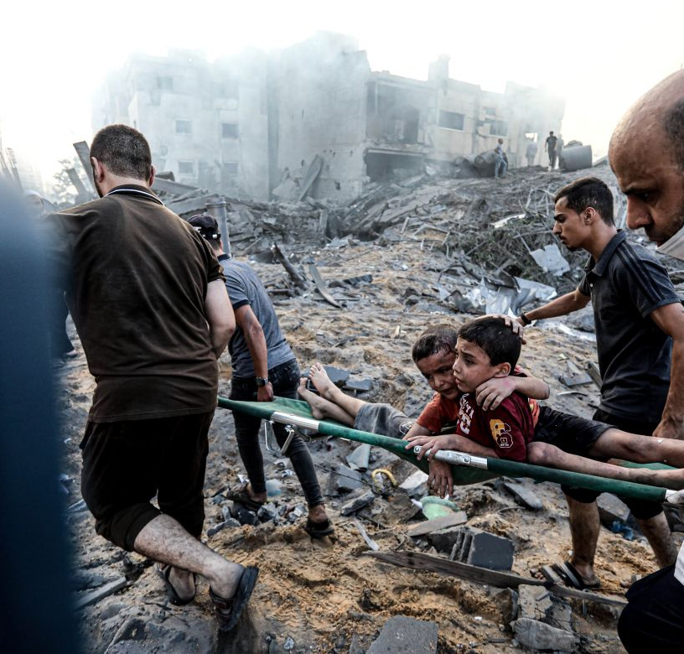
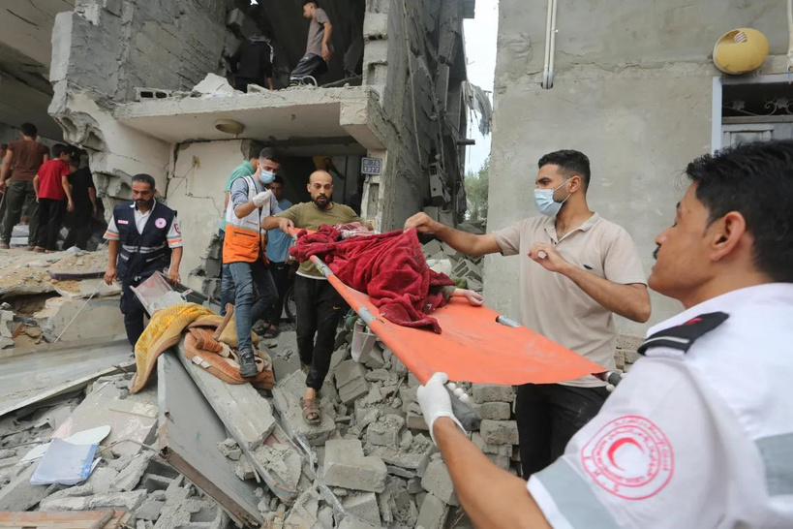
How would you
respond?
In groups/pairs discuss:
What are the Palestinians teaching us?
Notes:
Ask the audience to discuss this question and then feedback with the rest of the group.

Slide 19
WHAT LESSONS CAN WE LEARN FROM THE PALESTINIANS?
Palestinians are teaching us the true meaning of , patience, and perseverance.
iman

Slide 20
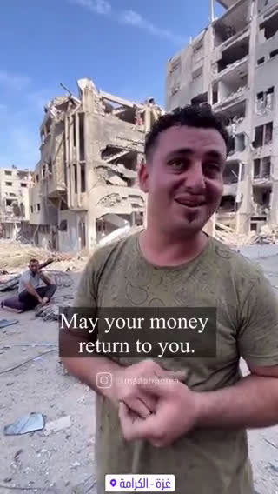
CLICK HERE TO WATCH ONLINE

Slide 21
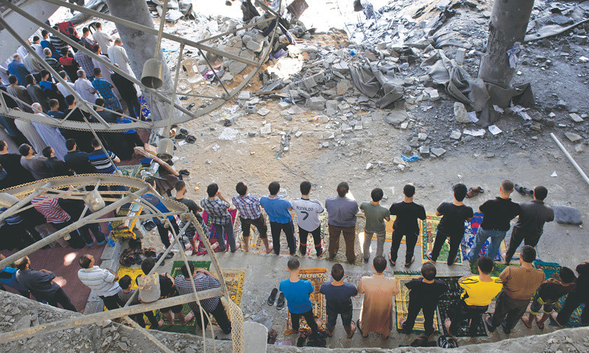
WHAT LESSONS CAN WE LEARN FROM THE PALESTINIANS?
Patience
& steadfastness
الْحَمْدُ لِلَّهِ رَبِّ الْعَالَمِينَ ﴿٢﴾
All praises and thanks are for Allah, the Lord of all the worlds. (1:2)
  True sabr: being patient at the first strike of calamity.
  Seeking strength through dhikr.
Notes:
Palestinians are teaching the whole world the meaning of patience, courage and steadfastness.
Patience - The Prophet ﷺ said: “Verily, patience is at the first stroke of a calamity” — the immediate response of Palestinians is one of immense patience, courage and repeatedly saying ‘Alhamdulillah’, despite the grave situations they are facing.
How many times do we say Alhamdulillah in a day? But do we really internalise its meaning?
The Palestininans are helping us to revive our iman. Their iman should inspire us and remind us to go to back to Allah, to live on this earth as His true servants and to fulfill our purpose in life.

Slide 22
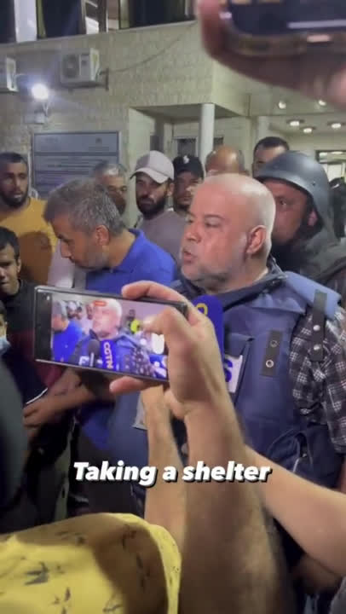
CLICK HERE TO WATCH ONLINE

Slide 23
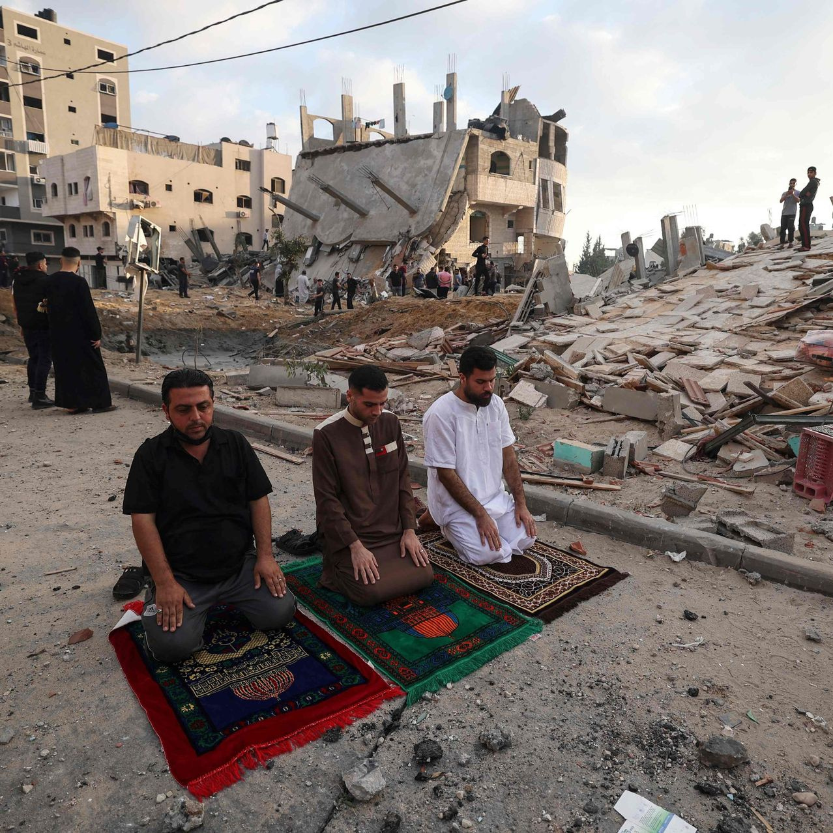
WHAT LESSONS CAN WE LEARN FROM THE PALESTINIANS?
Contentment
‏وَلَنَبْلُوَنَّكُم بِشَىْءٍ مِّنَ ٱلْخَوْفِ وَٱلْجُوعِ وَنَقْصٍ مِّنَ ٱلْأَمْوَٰلِ وَٱلْأَنفُسِ وَٱلثَّمَرَٰتِ وَبَشِّرِ ٱلصَّـٰبِرِينَ ‎﴿١٥٥﴾‏ٱلَّذِينَ إِذَآ أَصَـٰبَتْهُم مُّصِيبَةٌ قَالُوٓا۟ إِنَّا لِلَّهِ وَإِنَّآ إِلَيْهِ رَٰجِعُونَ ‎﴿١٥٦﴾
with Allah’s decree
We will certainly test you with something of fear and famine and loss of property, life, and crops. Give good news to those who patiently endure— who, when faced with a disaster, say, “Indeed we belong to Allah, and to Him we will return.”
(2:155-156)
  Iman in al-Qadr - Allah has already decreed everything that will happen.
  Allah’s plan is perfect.
Notes:
This video illustrates contentment with Allah’s decree. Whilst some of us sit here in our comfortable homes and cry ‘Why?’, here we see complete surrender and submission to Allah’s will.
They are teaching us what it means to have Iman in al-Qadr. And to firmly believe that Allah’s plan is perfect.

Slide 24
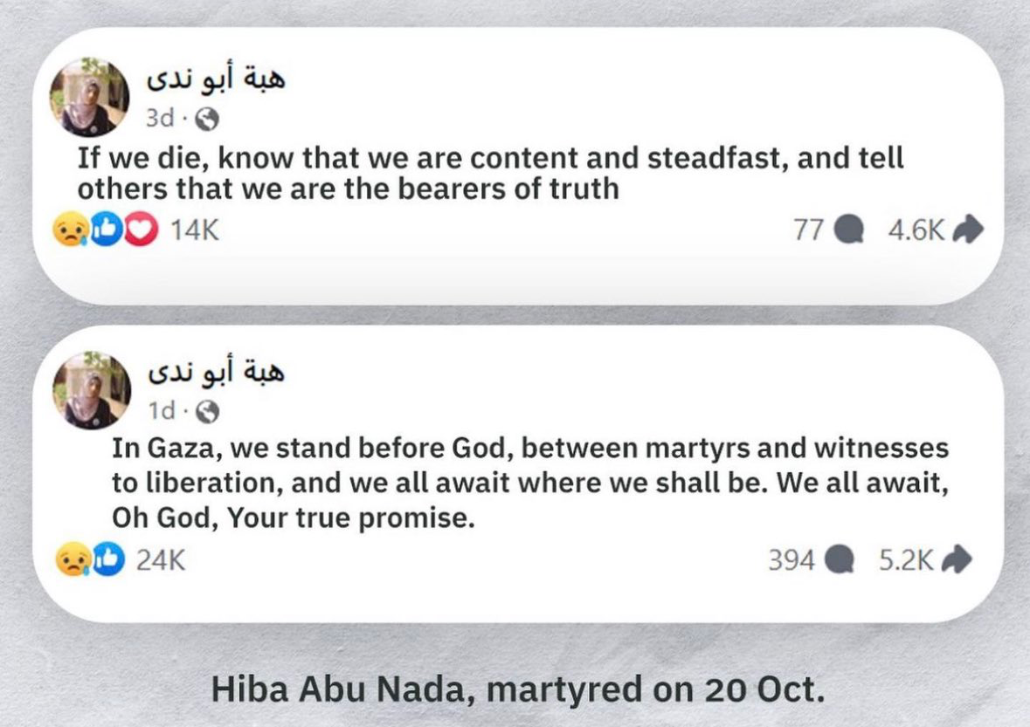


Slide 25

WHAT LESSONS CAN WE LEARN FROM THE PALESTINIANS?
The true colours of those who cry ‘freedom/liberalism/feminism/human rights’ are being exposed.
The iman of so many in the Ummah has been revived.
الحكيم
The crisis has brought about unity amongst the believers.
The All-Wise
Many people have been inspired to serve the dīn of Allah.
Many non-Muslims are inspired by the courage and resilience of the Palestinians and want to know about the source of their faith.
Notes:
Allah is al-Hakim and His wisdom is perfect.
There are so many wisdoms that we can't even perceive. These are just some of the many wisdoms behind what is happening right now.
Allah ﷻ has the totality of wisdom and knowledge; we have its particulars. In other words: Allah has the entire picture. We just have a pixel.

Slide 26
Part III: What does
want from us?
Allah

Slide 27
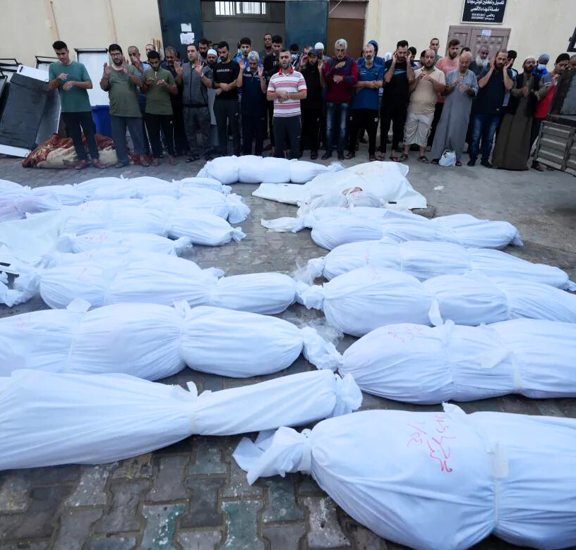
How does Allah want us to
respond?
In groups/pairs, identify 5 essential actions from these two verses:
8:45-46
Notes:
Ask learners to open up their mushaf and write the 5 essential action points down on their mini whiteboards/books.
Alternatively, participants can discuss this in pairs/groups.
Classroom extended task:
Discuss this statement in pairs:
'Allah wants us to be the rescuers, not the bystanders!'

Slide 28
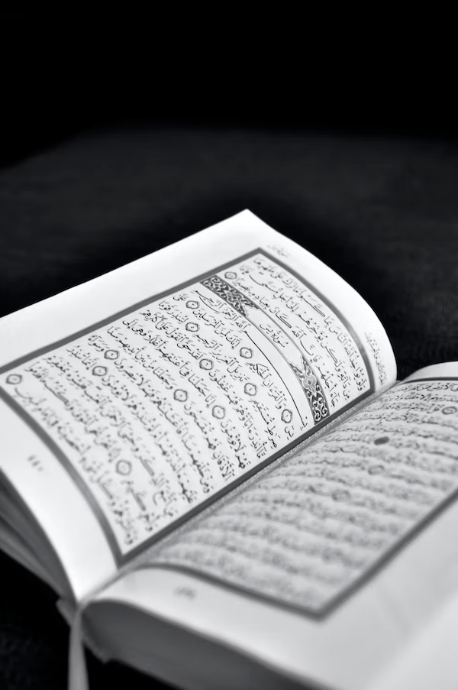
WHAT DOES ALLAH WANT FROM US?
يَـٰٓأَيُّهَا ٱلَّذِينَ ءَامَنُوٓا۟ إِذَا لَقِيتُمْ فِئَةًۭ فَٱثْبُتُوا۟ وَٱذْكُرُوا۟ ٱللَّهَ كَثِيرًۭا لَّعَلَّكُمْ تُفْلِحُونَ ‎﴿٤٥﴾
وَأَطِيعُوا۟ ٱللَّهَ وَرَسُولَهُۥ وَلَا تَنَـٰزَعُوا۟ فَتَفْشَلُوا۟ وَتَذْهَبَ رِيحُكُمْ ۖ وَٱصْبِرُوٓا۟ ۚ إِنَّ ٱللَّهَ مَعَ ٱلصَّـٰبِرِينَ ﴿٤٦﴾‏
action
5
points
Believers! When you encounter a group (in battle), stand firm and remember Allah abundantly, so you may triumph. Obey Allah and His Messenger and do not quarrel with one another, lest you lose heart and your moral courage. And persevere, for surely Allah is with those who persevere. (8:45-46)
  Stand firm
  Remember Allah
  Follow the Qur’an & Sunnah - moral compass
  Don’t dispute - be united
  Sabr
Notes:
1. We need to stand up and be strong.
2. Then Allah says: Remember Allah a lot. Dhikr is the key to success. We have to attach our hearts to Allah, and make lots and lots of dhikr and duʿa.
3. The next part is obedience to Allah and His Messenger. This is the number ONE ingredient to attaining victory.
4. Then Allah reminds us to stay united and not be fragmented. An Ummah that is united cannot be defeated.
5. And finally be patient, persevere & keep going. Stay firm.

Slide 29
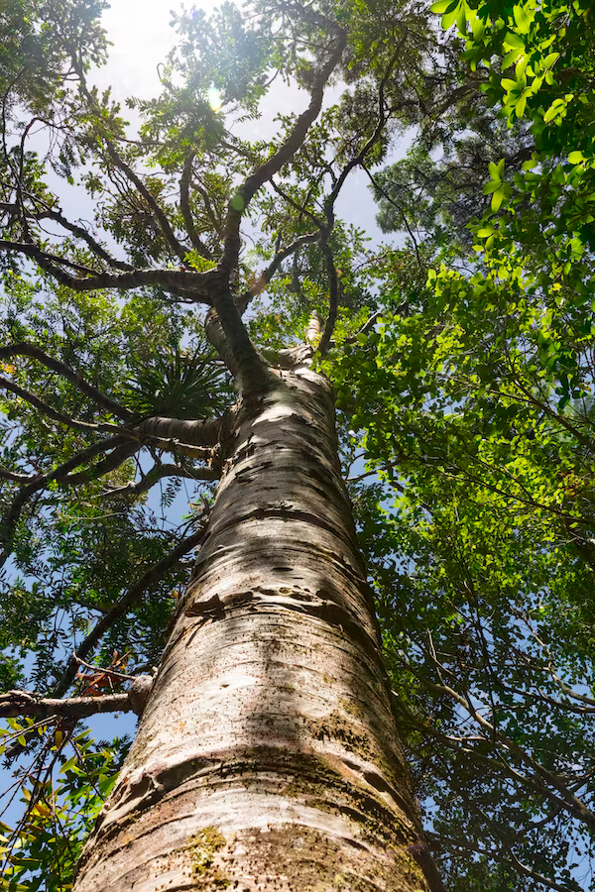
WHAT DOES ALLAH WANT FROM US?
وَعَدَ ٱللَّهُ ٱلَّذِينَ ءَامَنُوا۟ مِنكُمْ وَعَمِلُوا۟ ٱلصَّـٰلِحَـٰتِ لَيَسْتَخْلِفَنَّهُمْ فِى ٱلْأَرْضِ كَمَا ٱسْتَخْلَفَ ٱلَّذِينَ مِن قَبْلِهِمْ وَلَيُمَكِّنَنَّ لَهُمْ دِينَهُمُ ٱلَّذِى ٱرْتَضَىٰ لَهُمْ وَلَيُبَدِّلَنَّهُم مِّن بَعْدِ خَوْفِهِمْ أَمْنًا يَعْبُدُونَنِى لَا يُشْرِكُونَ بِى شَيْـًٔا
Iman
&
good deeds
Allah has promised those of you who believe and do good deeds that He will certainly make them successors in the land, as He did with those before them; and will surely establish for them their religion which He has chosen for them; and will indeed change their fear into security— (provided that) they worship Me, associating nothing with Me… (24:55)
  Strengthening iman and becoming true believers: a lifelong mission.
  Work everyday on becoming closer to Him.
اَللّٰهُ أَكْبَرُ
Notes:
The number one key to attaining victory is strong iman and good deeds. In this ayah, Allah promises victory to those who have iman and amal salih (good deeds).
We have to strengthen our iman in Allah. We have to fear none but Him, love Him more than anyone or anything and put our reliance solely on Him. We have to have full hope and yaqin in Him.
We learn from this ayah that in order to gain authority in the land, the believers have to embody true ʿubudiyyah: worship Allah Alone, and to not commit shirk.
Throughout the day there is a phrase which we repeat. This phrase is Allahu Akbar.
ASK: How often do we say this phrase in a day? What does Allahu Akbar mean?
Allahu Akbar means Allah is Greater… He is greater than everything.
But the truth is do we internalise this statement? Do we really feel that Allah is greater than everything and everyone? Is He number one in our lives? Is He our first priority?
When we say Allahu Akbar, it is a reminder: Allah is greater than me, greater than my desires, greater than my loved ones, greater than my hobbies, greater than the most powerful armies and empires, greater than everything.

Slide 30

WHAT DOES ALLAH WANT FROM US?
Stop
sinning
إِنَّ ٱللَّهَ لَا يُغَيِّرُ مَا بِقَوْمٍ حَتَّىٰ يُغَيِّرُوا۟ مَا بِأَنفُسِهِمْ
  Just as collective obedience leads to victory, collective disobedience leads to Allah removing the peace and prosperity of a nation.
  Sincere tawbah and istighfar.
...Indeed, Allah will not change the condition of a people until they change what is in themselves… (13:11)
Notes:
This is included under the previous ayah as obedience to Allah includes not sinning.
However this point is essential as it is the number one blocker to the victory. Allah says, “Indeed, Allah will not change the condition of a people until they change what is in themselves…” (13:11).
Just as collective obedience leads to victory, collective disobedience leads to Allah removing the peace and prosperity of a nation.
In these times, we must make an extra effort to review our lives, to stop sinning. To engage in sincere repentance and make abundant istighfar.
We must especially be very careful of social media and not publicising our sins. As these are the ones that will not be forgiven by Allah.
If we make sincere tawbah, stop sinning and turn back to Allah, Allah will give this Ummah victory.

Slide 31
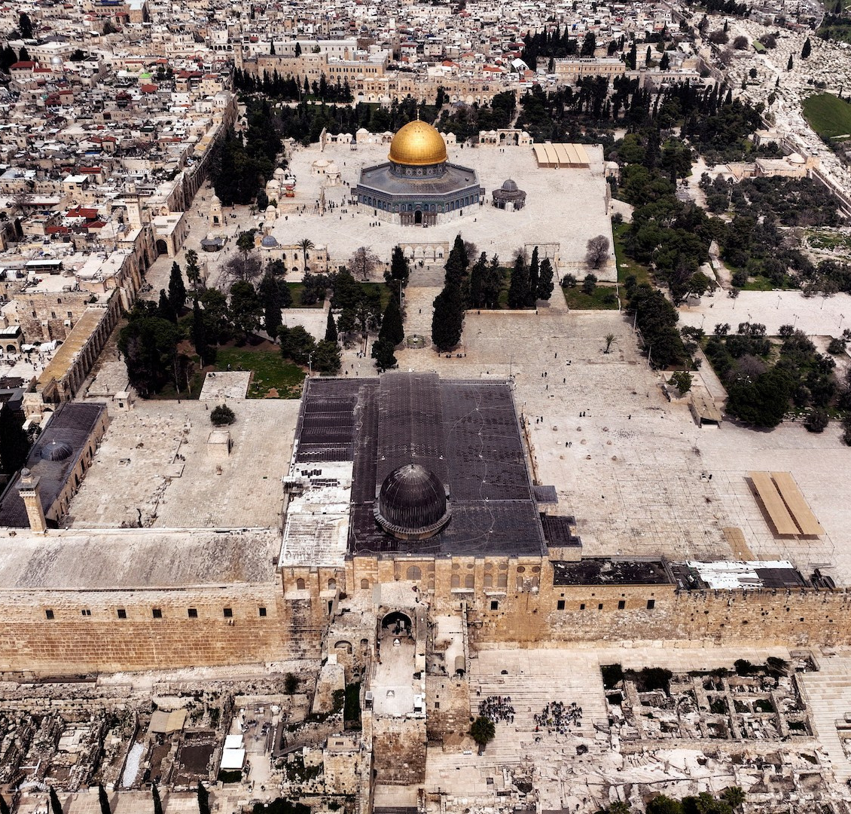
WHAT DOES ALLAH WANT FROM US?
Never
lose
hope
وَلَا تَهِنُوا وَلَا تَحْزَنُوا وَأَنتُمُ الْأَعْلَوْنَ إِن كُنتُم مُّؤْمِنِينَ ‎﴿١٣٩﴾
Do not lose heart, and do not grieve, for you will have the upper hand, if you are (true) believers. (3:139)
IMAN
ACTION
HOPE
حَسْبُنَا اللّٰهُ وَنِعْمَ الْوَكِيْلُ
Notes:
When we see constant pictures and videos of the atrocities it easy to feel despair and to feel depressed.
Don’t let Shaytan and your nafs convince you to feel despair and hopelessness.
Allah says, “Do not lose heart, and do not grieve, for you will have the upper hand, if you are (true) believers.” (3:139).
If the Palestinians are not feeling hopeless despite 70 + years of brutality, how can we lose hope? We owe them better. Let us strengthen our iman and be of benefit to them and our ummah.
We are people of Hasbunallahu wa niʿmal Wakīl. This phrase is not merely a dhikr of the tongue. We have to believe it in and it has to emanate from our heart.
ASK: Who said this phrase?
1) The great Prophet Ibrahim (as) when he was thrown into the fire — and what happened to him? The fire became cool for him.
2) The Prophet ﷺ and the Companions (radiy Allāhu ʿanhum) had just returned from the Battle of Uḥud. It had been a testing battle in which the initial happiness of victory quickly turned to sadness. 70 companions lost their lives, many more were injured, and rumours spread that the Prophet ﷺ had been killed.
Amidst this pain and exhaustion, the Companions (rA) were asked by the Messenger of Allah ﷺ to join him in battle again the next day. They were warned, “Your enemies have mobilized their forces against you, so fear them!” (3:173).
But the believers were not fazed. On the contrary, Allah says, it “increased them in īmān, and they replied,
حَسْبُنَا اللّٰهُ وَنِعْمَ ٱلْوَكِيْلُ
Allah is sufficient for us and He is the best Protector (Wakīl) (3:173).”
Just as we saw previously, the condition of having the upper hand is contingent on our level of iman.
Extended classroom activity:
Discuss: How do I know If I am a true believer? Is it enough to just say 'I believe'? Explain.

Slide 32
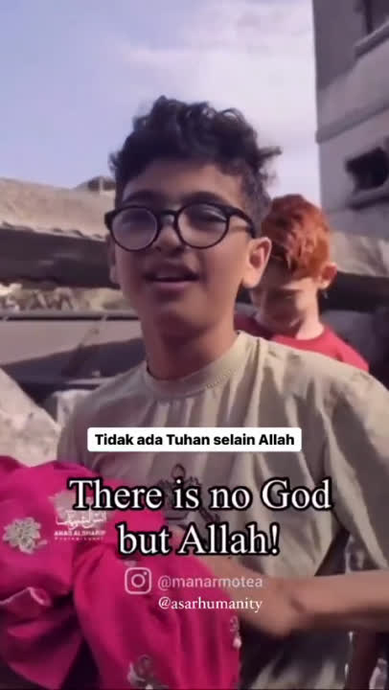
CLICK HERE TO WATCH ONLINE

Slide 33

WHAT DOES ALLAH WANT FROM US?
Be brave
&
strong
أَتَخْشَوْنَهُمْ فَٱللَّهُ أَحَقُّ أَن تَخْشَوْهُ إِن كُنتُم مُّؤْمِنِينَ ‎﴿١٣﴾‏
  Don’t be scared.
  Don’t be psychologically defeated.
  Be confident in your identity.
...Do you fear them? Allah is more deserving of your fear, if you are (true) believers. (9:13)
لَا حَوْلَ وَلَا قُوَّةَ إِلَّا بِالله
Notes:
We have to be strong and brave. Let us only fear Allah, the Lord of the heavens and the earth. We are people of La hawla wa laa quwwata illaa billah. Nothing can go from one state to another, except by the will and permission of Allah. Allah is in control: if He decrees for something to happen, and the whole decides otherwise — it WILL happen. And if He decrees for something to not happen, and the whole world tries to make it happen — it will NOT happen. There is no power that can defeat Allah. He is al-Qahhar, The All-Dominant, The Supreme.
Let us emancipate ourselves from the shackles of colonialism and imperialism. Let us rid ourselves from the materialism, liberalism and hedonism that we are constantly bombarded with. Let us become mentally and physically strong.
Let us find ʿizzah (honour) in our din, in the Qur’an, in the Sunnah.
We have the best way of life.
We have Rasulullaah ﷺ.
We have Allah!

Slide 34
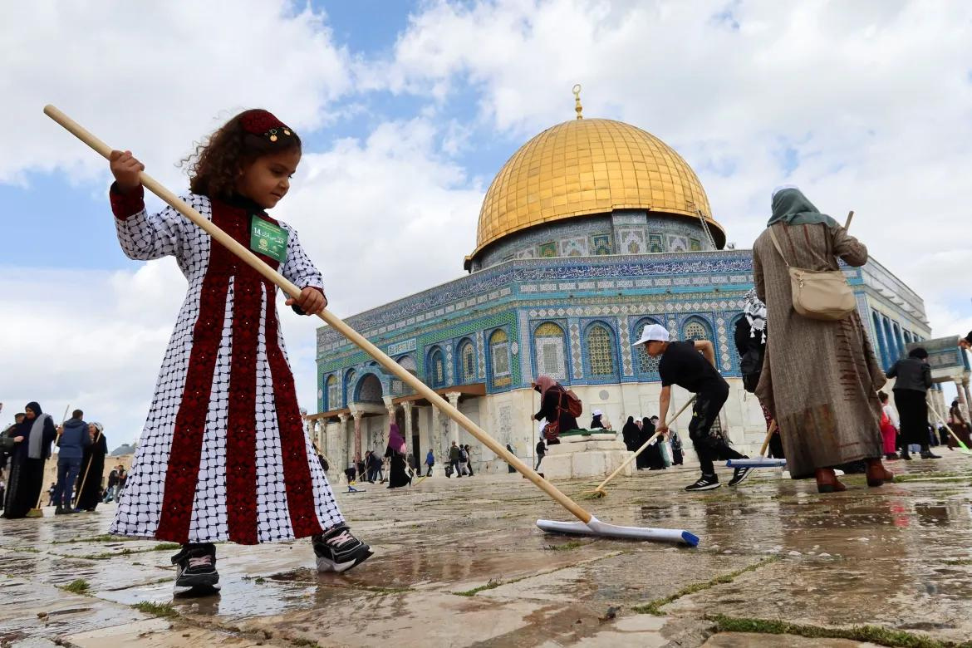
WHAT DOES ALLAH WANT FROM US?
Help
Allah’s deen
يَا أَيُّهَا الَّذِينَ آمَنُوا إِن تَنصُرُوا اللَّهَ يَنصُرْكُمْ وَيُثَبِّتْ أَقْدَامَكُمْ ‎﴿٧﴾‏
Believers! If you help the dīn of Allah, He will help you and make you stand firm. (47:7)
  A command from Allah to the believers to support the cause of Allah by establishing His deen, doing daʿwah, and striving in His Path.
  To cultivate good in people and in society; and to end evil, injustice and corruption.
Notes:
Why is Allah not helping the people of Palestine, some people ask.
We learn here that If you help the din of Allah, Allah ﷻ will help you. Don’t sit and slavishly follow the way of the disbelievers and expect the help of Allah to arrive.
Ask yourself: What have I done to strengthen and serve the din of Allah? What is my project for the Ummah? How am I going to become a strong believer? How am I going to ensure that my family are strong believers? How am I going to spread the word of Allah on His earth?

Slide 35
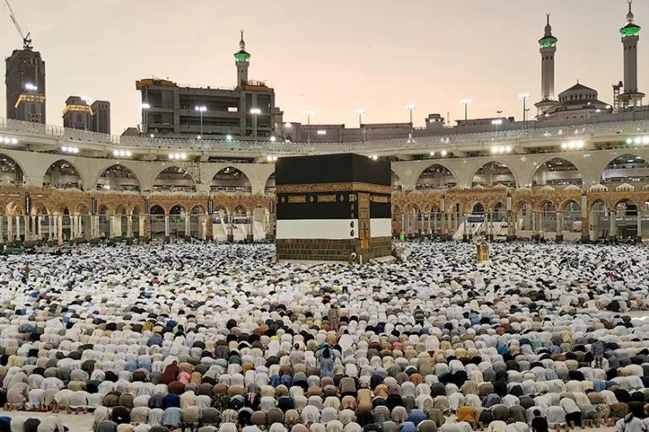
WHAT DOES ALLAH WANT FROM US?
Feel the Ummah’s
pain
إِنَّمَا ٱلْمُؤْمِنُونَ إِخْوَةٌ
All believers are but brothers… (49:10)
  The Ummah is like one body.
  We should feel the pain of our brothers and sisters, wherever they may be in the world.
  We are tied and united by لا إله إلا الله.
Notes:
The Ummah is like one body. We should feel the pain of our brothers and sisters, wherever they may be in the world. This feeling should not cripple us, but rather it should motivate us to help them in every way possible.
We are one Ummah: tied and united by لا إله إلا الله.
We can’t be selfish and continue living our lavish lives. We can’t turn a blind eye to the plight of the Ummah. We have to educate ourselves and our children about the history and the current situation of what is happening to our believing brothers and sisters across the world. The Prophet ﷺ told us that the person who is not concerned with the matters and the affairs of the believers is not from us. Our hearts should feel their pain.
Rasulullah ﷺ was very sensitive to the feelings and pain felt by others. Once a group of bedouins came to him and they were barefooted, almost naked. They were very poor and they could not even afford to cover themselves properly. Their clothes were tattered. When the Prophet ﷺ saw them, his blessed face changed colour. He was deeply upset. So after salah, the Prophet ﷺ gave a sermon and encouraged the Sahabah to give charity and help these poor bedouins. So the Sahabah brought to the masjid whatever they could, each one according to their capacity, until there were two heaps of clothes and food. The narrator Jarir b. ʿAbdillah says that I saw the face of the Prophet ﷺ glistening and glowing like gold! His blessed face was beaming, happy that these poor bedouins would have something to eat and wear. Allahu Akbar!
He ﷺ was deeply saddened by the poverty of a group of people. Imagine how he would feel if he saw today, as we abandon our brothers and sisters who are being brutally massacred in their thousands. Imagine how he would feel at our apathetic state and our ghaflah (heedlessness), living our own materialistic comfortable lives.

Slide 36
WHAT DOES ALLAH WANT FROM US?
اَللّٰهُمَّ إِنَّا نَجْعَلُكَ فِيْ نُحُوْرِهِمْ وَنَعُوْذُ بِكَ مِنْ شُرُوْرِهِمْ
O Allah, we make You our shield against them,
and we seek from their evil.
Your protection
Notes:
O Allah, we make You our shield against them, and we seek Your protection from their evil
When the Messenger of Allah ﷺ feared that a group of people (would harm the Muslims), he would say: [the above]. (Abū Dāwūd 1537)

Slide 37
Reflection &
action
01
02
Recommended Surahs
Which ONE sin am I going to give up today for the sake of Allah?
Which ONE Surah am I going to read the explanation of and reflect on?
Aal ʿImrān
al-Anfāl
al-Tawbah
al-Ahzāb
Muhammad
03
al-Fath
al-Burūj
What ONE thing am I going to start doing to strengthen the dīn of Allah?
al-Nasr
Āyāt about the Prophets
Āyāt about Jannah and Jahannam
Notes:
We have discussed many different things today, but it is essential that we leave with a sincere intention and a firm resolve to do something. Let us reflect on these 3 questions, and make a note of what we are going to do inshaAllah.
In the 1st slide, we mentioned how we need to develop a Qur’anic worldview and see everything around us through a Qur’anic-lens. This requires us to engage with the Qur’an. To recite it regularly, to learn its explanation, to reflect on what Allah is saying to us. And this should propel us to action and to form our character by it, just as our beloved Prophet Muhammad ﷺ did.
These are some Surahs which are pertinent to understanding what is happening right now. Choose a Surah, read or listen to the tafsir. Reflect on what Allah is saying and let it shape you and your life.

Slide 38
Further resources
English:
In The Shade of The Qur’an (PDF available online)
Maarif-ul-Quran (Available on Quran.com)
https://quranreflect.com/
The Noble Life of The Prophet by Dr Ali M. Sallabi
Arabic:
https://tafsir.app/
ﷺ

Slide 39

Any questions?
اَللّٰهُمَّ اقْسِمْ لَنَا مِنْ خَشْيَتِكَ مَا يَحُوْلُ بَيْنَنَا وَبَيْنَ مَعَاصِيْكَ ، وَمِنْ طَاعَتِكَ مَا تُبَلِّغُنَا بِهِ جَنَّتَكَ ، وَمِنَ الْيَقِيْنِ مَا تُهَوِّنُ عَلَيْنَا مُصِيْبَاتِ الدُّنْيَا ، وَمَتِّعْنَا بِأَسْمَاعِنَا ، وَأَبْصَارِنَا ، وَقُوَّتِنَا مَا أَحْيَيْتَنَا ، وَاجْعَلْهُ الْوَارِثَ مِنَّا ، وَاجْعَلْ ثَأْرَنَا عَلَىٰ مَنْ ظَلَمَنَا ، وَانْصُرْنَا عَلَىٰ مَنْ عَادَانَا ، وَلَا تَجْعَلْ مُصِيْبَتَنَا فِيْ دِيْنِنَا ، وَلَا تَجْعَلِ الدُّنْيَا أَكْبَرَ هَمِّنَا ، وَلَا مَبْلَغَ عِلْمِنَا ، وَلَا تُسَلِّطْ عَلَيْنَا مَنْ لَّا يَرْحَمُنَا
Notes:
ʿAbdullāh ibn ʿUmar (raḍiy Allāhu ‘anhu) said: “Rarely would the Messenger of Allah ﷺ rise from a gathering without supplicating for his companions with [the above].” (Tirmidhī 3502)
O Allah, apportion for us enough fear and awe of You to prevent us from sinning against You, and enough obedience to You to make us reach Your Paradise, and enough certainty to make the difficulties of this world easy for us. Let us enjoy our hearing and sight and strength as long as You allow us to live, and make it an inheritance for us. Let our vengeance be upon those who have wronged us, and help us against those who harbour enmity towards us. Let not our afflictions be in our religion, and make not the world our biggest concern, or the full extent of our knowledge, and do not give power over us to anyone who will not have mercy on us.

