Slide 1
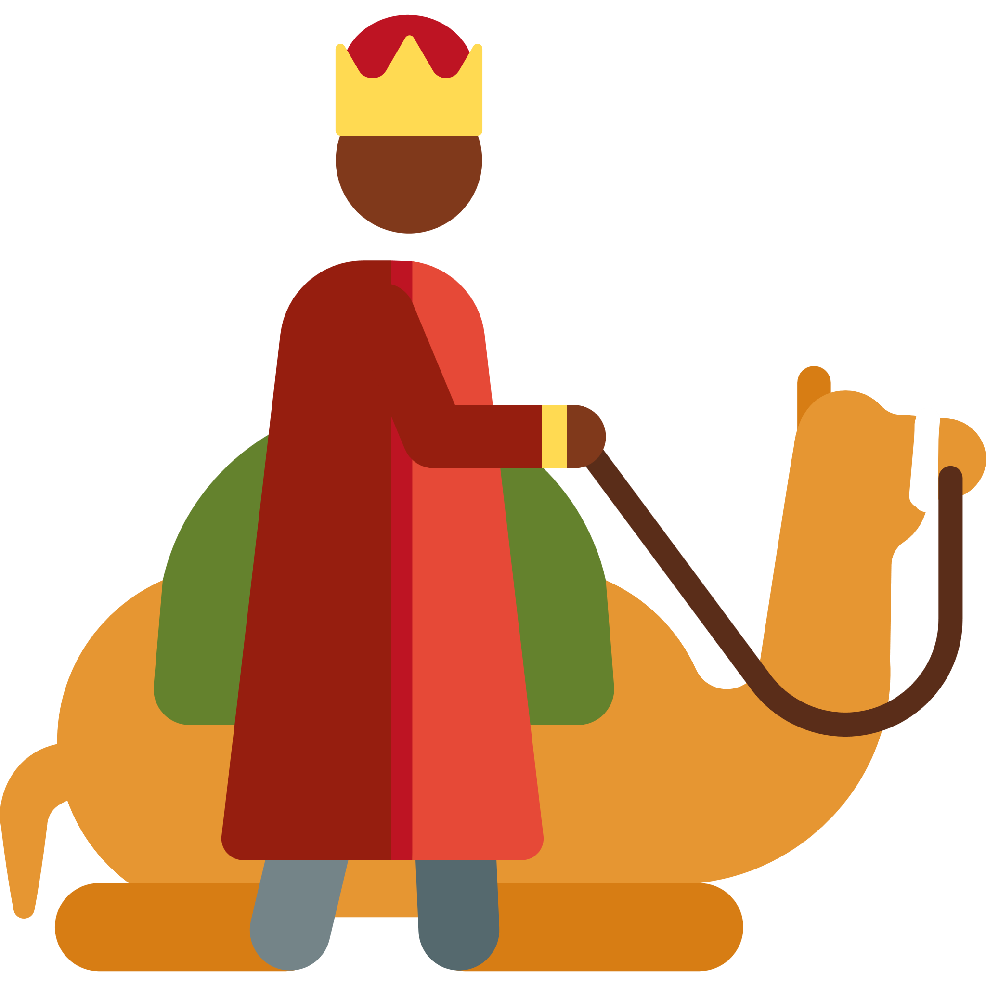
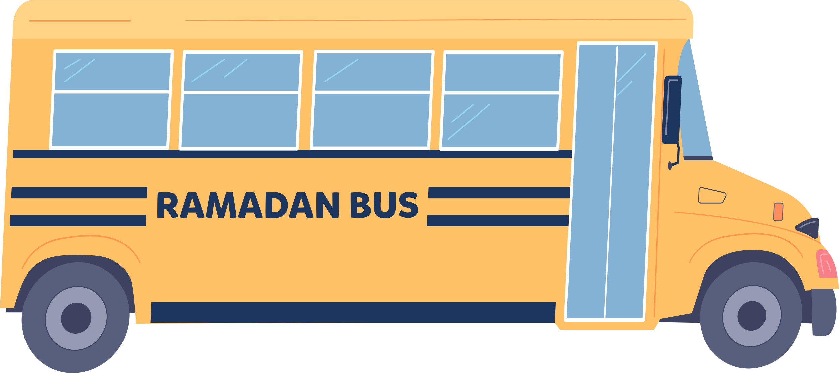
My Journey Through Ramadan
LEVEL 3
Notes:
Target Class - Year 3. Can be adapted for other years too inshaAllah.
http://www.youtube.com/watch?v=0heyG-Px48I
Have these nasheeds switched on as children enter the classroom

Slide 2
Learning
Map
Stop 4:
Suhur
L2
Stop 5:
During the Day
How do
we fast?
Stop 6:
Iftar
Why do
we fast?
Stop 7:
The Night
Prayer
A Special Night
Stop 9:
It’s Eid!
Stop 3:
Why do
we Fast?
L1
Stop 2:
What is
Sawm?
L3
L4
Stop 8:
Laylat al-Qadr
Stop 1:
Ramadan is here
Eid
al-Fitr
Bismillah. Let’s begin!

Slide 3
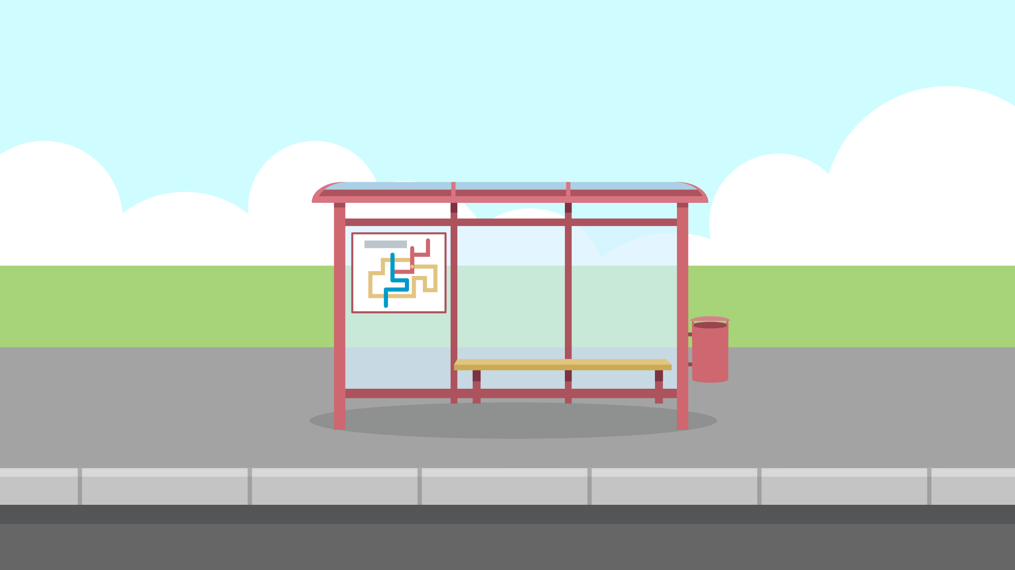
Lesson 1: Why do we fast?
Lesson 1
Stop 1
Stop 2
Stop 3
Lesson 2
Stop 4
Stop 5
Stop 6
Stop 7
Lesson 3
Stop 8
Lesson 4
Stop 9

Slide 4
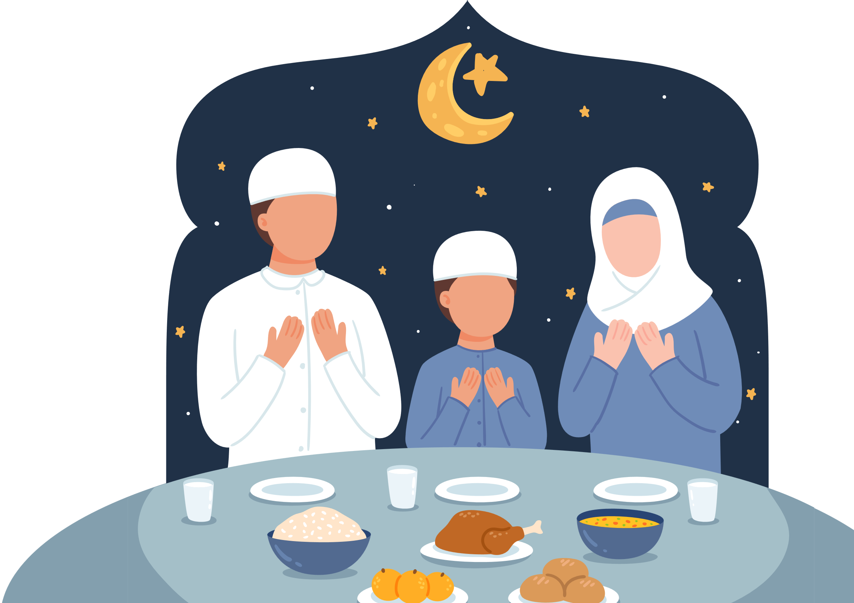
Lesson Objectives
By the end of this lesson, I will:
Remember and write the Arabic word for fasting
Describe why we fast in Ramadan
List some benefits of fasting
Notes:
http://www.youtube.com/watch?v=0heyG-Px48I
Have these nasheeds switched on as children enter the classroom

Slide 5
Warm-up Starter
Choose 3 words that you think of when you hear ‘Ramadan’:
Qur’an
Masjid
Food
Fasting
Prayer
Family
Eid
Exciting
Moon
Taqwa
Tarawih
Dates
Suhur
Iftar
Notes:
Select high, middle and low ability pupil to share answers. Ask students to justify their choice.
This is a baseline task to assess what pupils already know. Write down any new vocabulary on the board. New vocabulary will be the key words to emphasise during the lesson.

Slide 6
Stop 1: Ramadan is here!
Let’s fill in the gaps together.
Ramadan is the _________ month of the Islamic calendar.
The first verse of the _________ was revealed in Ramadan.
During the month of Ramadan, we fast from _________ until dusk everyday.
At the end of Ramadan, we celebrate _________.
Lesson 1
Stop 1
Stop 2
Stop 3
Lesson 2
Stop 4
Stop 5
Stop 6
Stop 7
Lesson 3
Stop 8
Lesson 4
Stop 9
Word Bank
Eid al-Fitr
Qur’an
Dawn
Ninth
Notes:
(Ramadan a Special Month Moon starter, Month of the Qur’an, Intention

Slide 7
What is the Arabic word for Fasting?

Slide 8
Stop 2: What is Sawm?
Sawm means fasting. It means to not eat or drink from dusk till dawn, for the sake of Allah.
Fasting the month of Ramadan is one of the 5 pillars of Islam.
[A] Can you write this word in your best handwriting?
Lesson 1
Stop 1
Stop 2
Stop 3
Lesson 2
Stop 4
Stop 5
Stop 6
Stop 7
Lesson 3
Stop 8
Lesson 4
Stop 9
صَوْم
Notes:
Why we fast, How we fast, benefits

Slide 9
Task: A view from my window
Don’t forget to draw
the Ramadan moon!
Draw and colour a picture to show what the sky looks like at dawn from your window at home.
This Ramadan, I will begin my fast at _____ am.
Draw and colour a picture to show what the sky looks like at dusk from your window at home.
This Ramadan, I will end my fast at _____ pm.
Notes:
Possible H/W ACTIVITY

Slide 10
Challenge
Did you know?
Can you calculate how long the fasting day will be for you?
The length of the fasting day is different in different parts of the world!
Notes:
Activity on next slide can help with the challenge task

Slide 11
Stop 3: Why do we fast?
Keyword: Taqwa
[A] Think Pair Share: Why do we fast?
يَا أَيُّهَا الَّذِيْنَ آمَنُوْا كُتِبَ عَلَيْكُمُ الصِّيامُ كَمَا كُتِبَ عَلَى الَّذِيْنَ مِنْ قَبْلِكُمْ لَعَلَّكُمْ تَتَّقُونَ
Lesson 1
Stop 1
Stop 2
Stop 3
Lesson 2
Stop 4
Stop 5
Stop 6
Stop 7
Lesson 3
Stop 8
Lesson 4
Stop 9
تقوى
We fast so that we can attain taqwa.
This might sound like a hard word but it means…
To do everything Allah has asked us to, and to stay away from all bad things.
Notes:
Read together

Slide 12
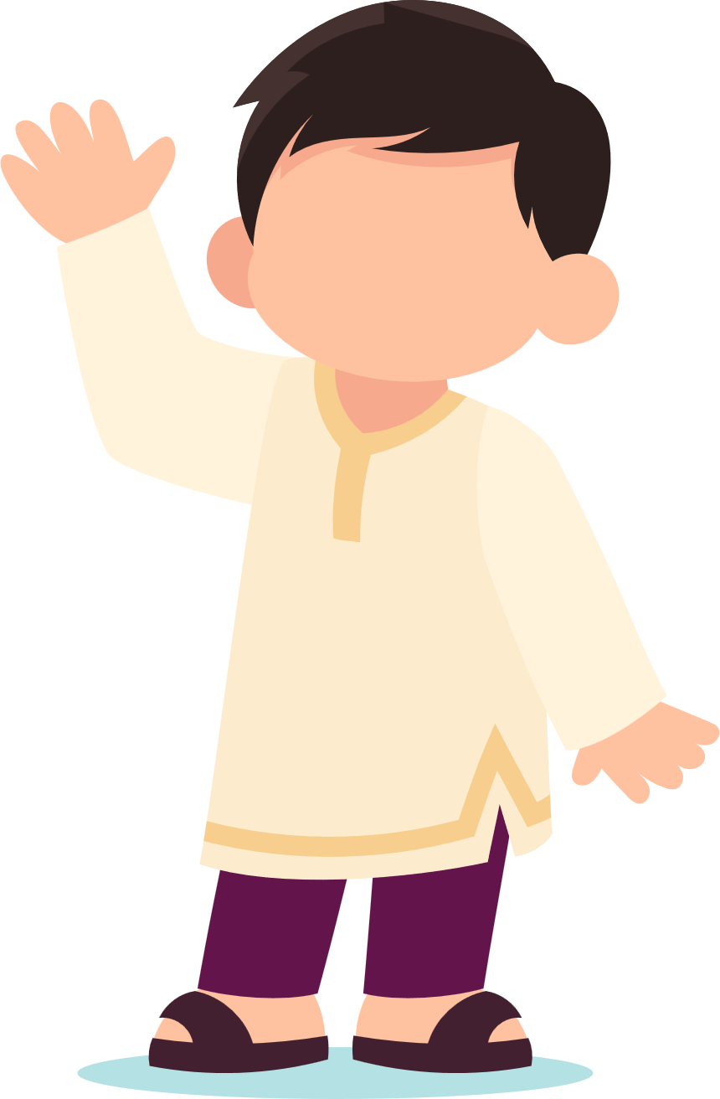
Why do we fast?
Sorry tummy, I do like to keep you happy,
but I love to keep Allah happy even more than you.
This makes Zayd strong.
Now he can say NO to Shaytan when he whispers to him telling him to do bad things.
Please
feed
me!
Notes:
Give an example of Shaytan whispering to [pick a child’s name in class] to hit your little brother because he keep taking your toys. Shaytan will say ‘hit him!’ but now that you’re a strong believer, you will say ‘Nope shaytan, even though I want to hit him, I am not going to, because I love to keep Allah happy even more than myself and you!’

Slide 13
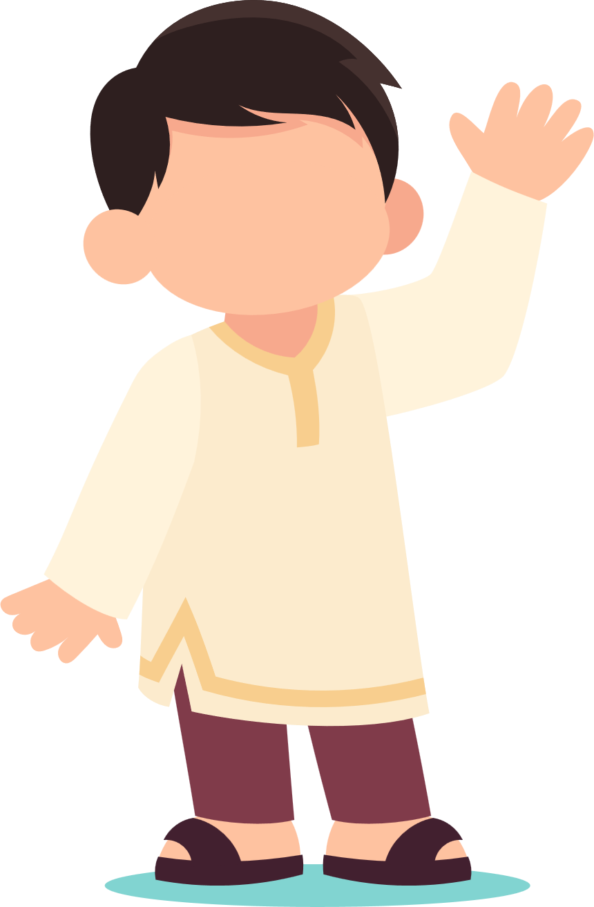
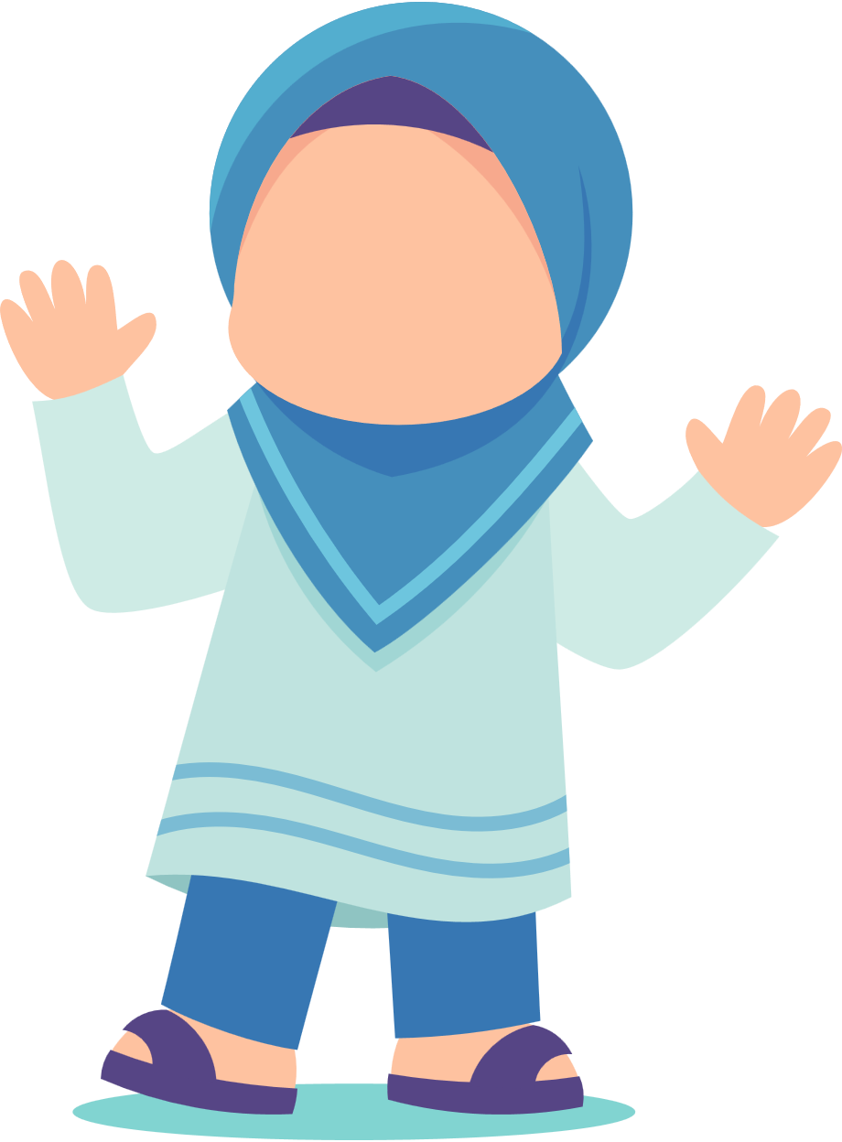
When we fast in Ramadan, we should also fast with our eyes, our tongues, and even our hands.
Eyes?? How can we fast with our eyes? Eyes don’t eat!
[A] How can we fast with our:
Eyes
Tongues
Hands
Ears
Notes:
Eyes: watch something we’re not supposed to for e.g. on YouTube
Tongues: Try to not to say any rude of bad words/lying/saying bad things about others
Hands: hitting siblings
Ears: listening to music

Slide 14
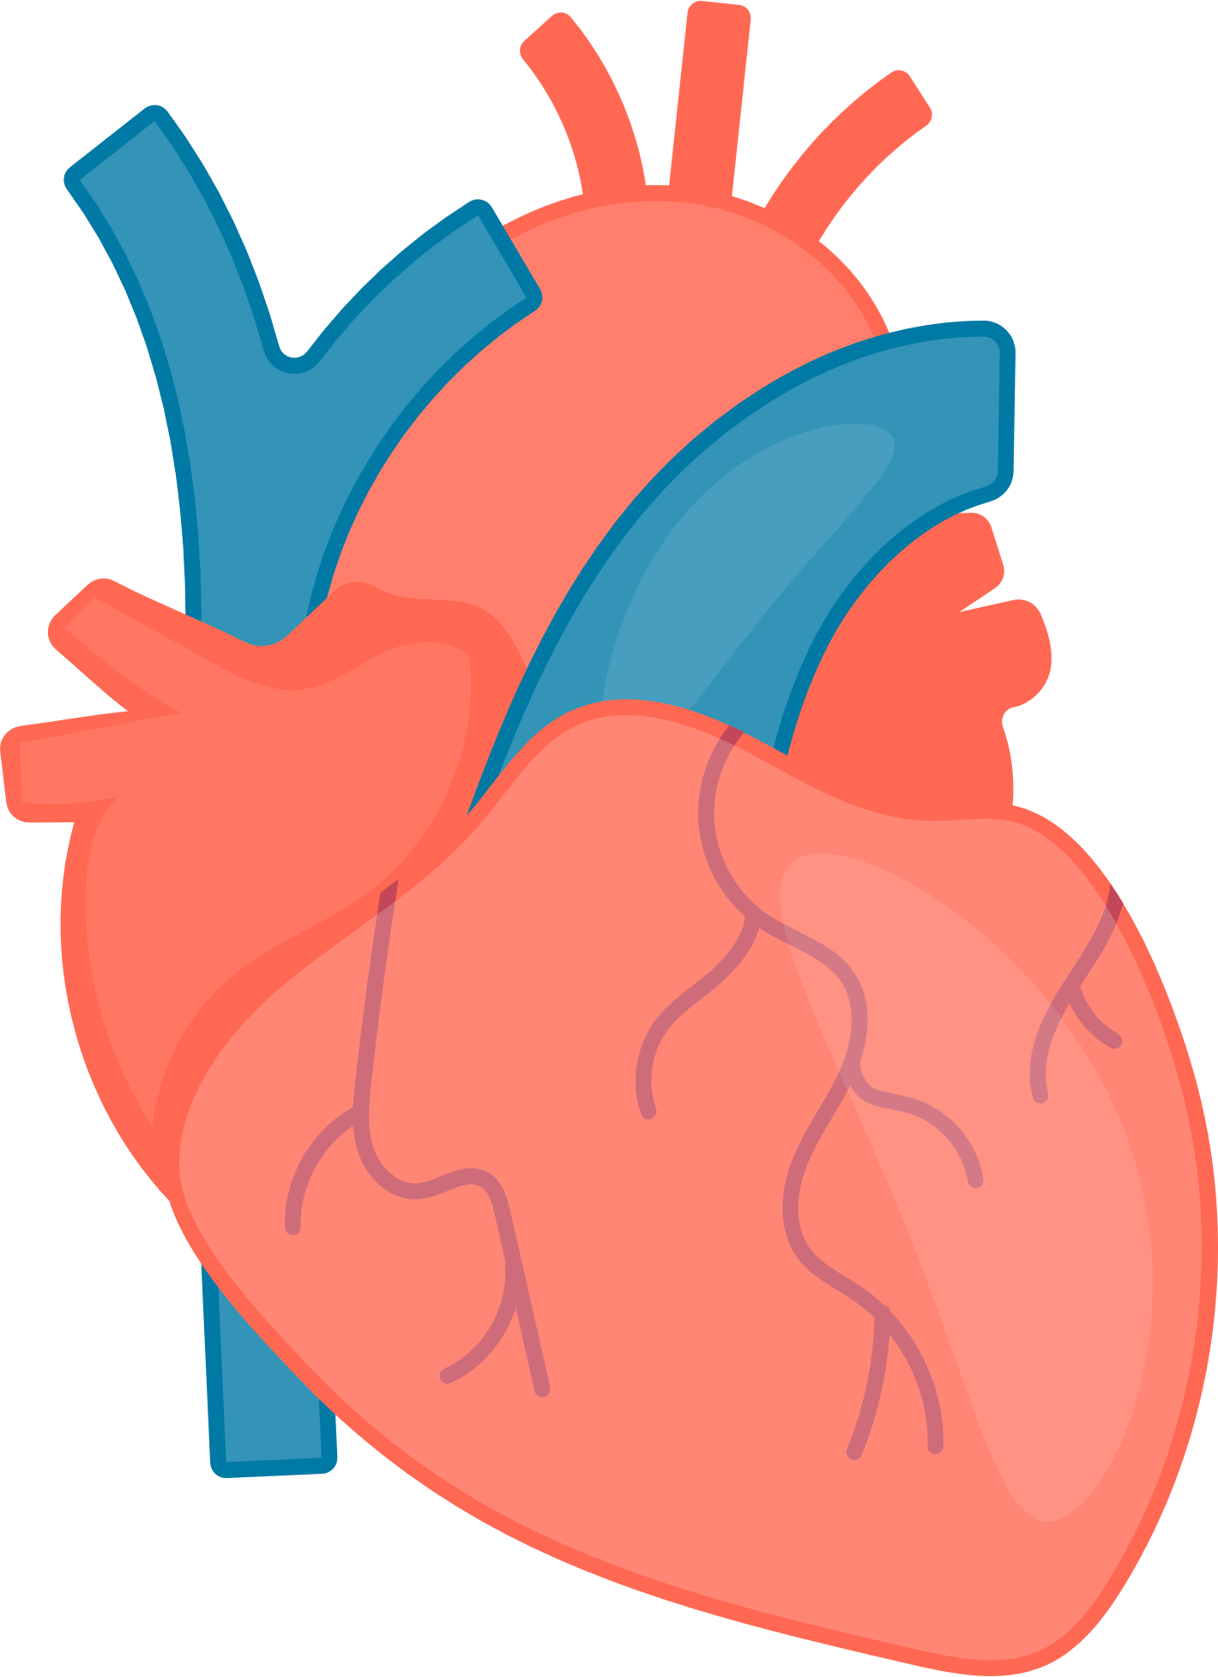
[A] Group Work
Fasting is also very good for your health.
Can you think of ways in which it might be good for your health?
It protects you from many illnesses
It is good for your heart
It is good for the digestion system
It makes your brain function better
It makes you feel less sad

Slide 15
Summary: Why do we fast?
Because Allah has asked us to
Fasting helps us to say NO to shaytan when he whispers and tells us to do bad things
To become a strong believer
We will get amazing rewards for it in Jannah inshaAllah!
Woohooo, I can’t wait for the SURPRISE reward Allah will give me in Jannah, InshaAllah!

Slide 16
Plenary
Ready to give fasting a try?
Today we have learnt about why we fast.
You may not have to fast yet, but why not give it a try?
Remember that fasting is an act of worship, and we can earn the love of Allah by trying our best to fast in Ramadan.
BOUNCE!
If the teacher throws the bean-bag to you, shout out one benefit of fasting!

Slide 17
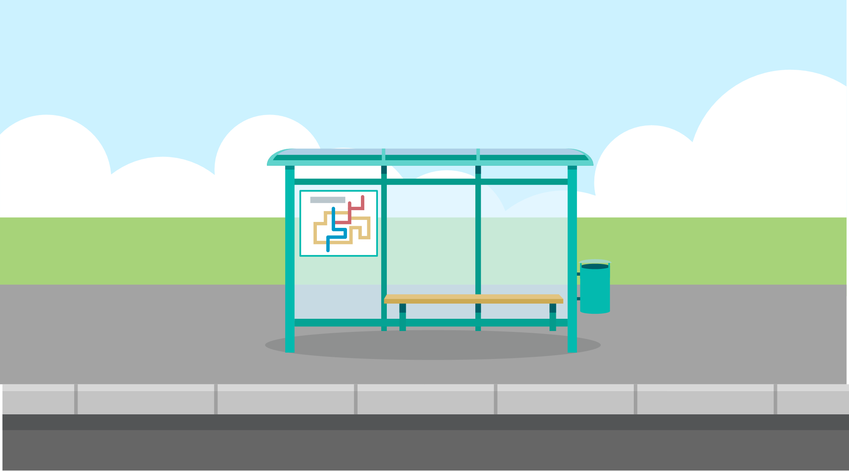
Lesson 2: How should we fast?
Lesson 1
Stop 1
Stop 2
Stop 3
Lesson 2
Stop 4
Stop 5
Stop 6
Stop 7
Lesson 3
Stop 8
Lesson 4
Stop 9
Notes:
http://www.youtube.com/watch?v=0heyG-Px48I
Have these nasheeds switched on as children enter the classroom

Slide 18
Lesson Objectives
By the end of this lesson, I will:
Outline and plan how to start my fast
Describe how to end my fast
Identify the actions I should fill the days and nights of Ramadan with

Slide 19
Starter
How many miswaks can you find hidden in this picture?

Slide 20
Stop 4: Suhur
The Messenger of Allah g said:
“Eat suhur, for indeed there is blessing in it” (Bukhārī).
Lesson 1
Stop 1
Stop 2
Stop 3
Lesson 2
Stop 4
Stop 5
Stop 6
Stop 7
Lesson 3
Stop 8
Lesson 4
Stop 9
Suhur is the Arabic word for the pre-dawn meal before starting the fast.
It is important to always be mindful of what and how you are eating - even if it’s very very early in morning!
Did You Know?
You can keep your breath fresh whilst fasting by using a miswak just like the Prophet Muhammad g!
Notes:
Homework to memorise this dua

Slide 21
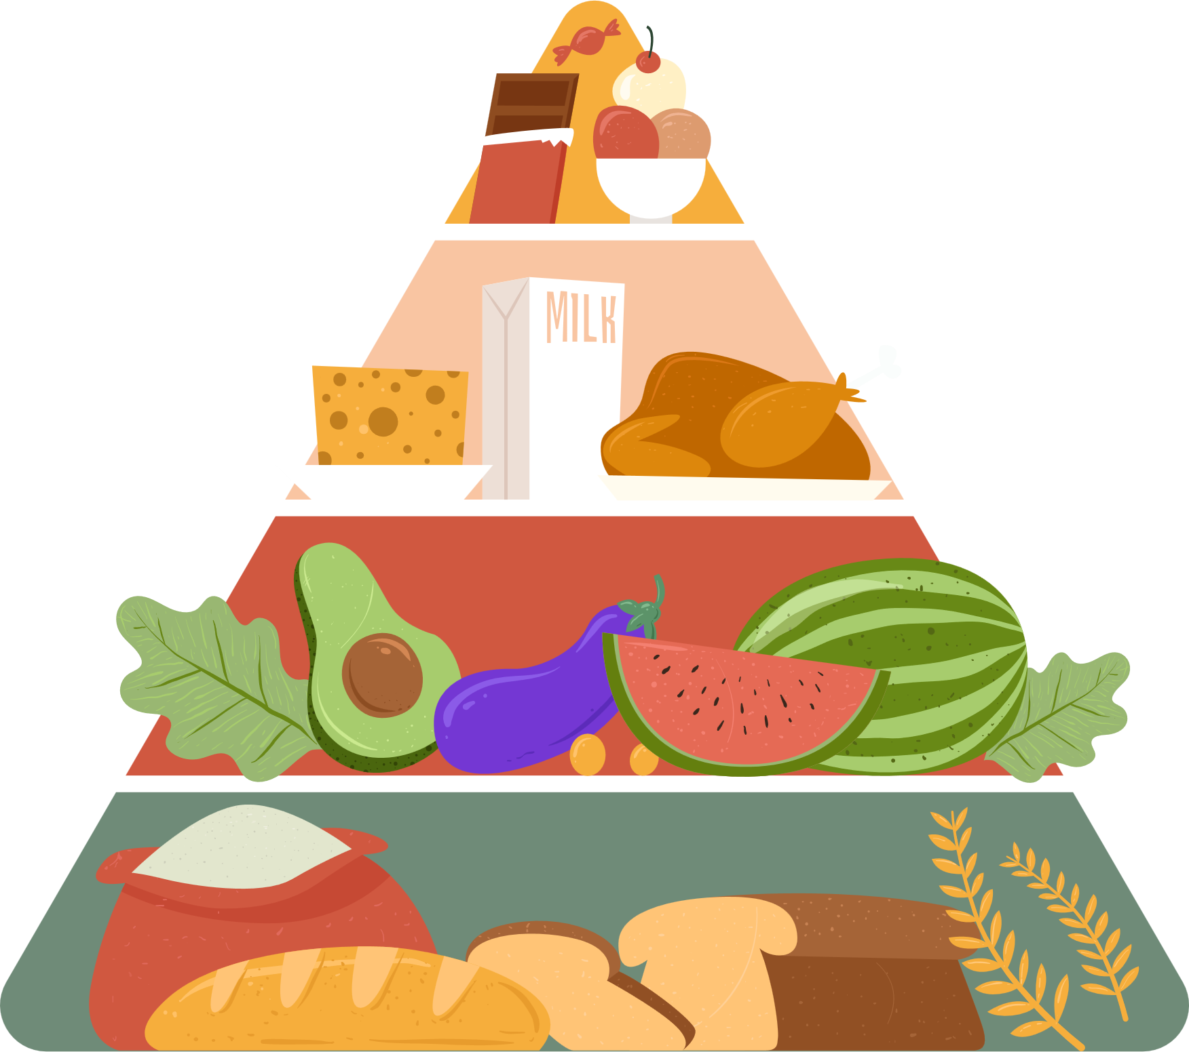
[A] Plan a healthy Suhur for your family
Gastronomy
The science of cooking and eating good food
Today, you are a gastronomer.
Design your own ideal Suhur meals using the science of healthy eating.
5%
products high on sugar and salt
20%
meat, chicken,
eggs, dairy products
Challenge
Can you try to include any Sunnah foods in your meal plan?
35%
fruits, vegetables
40%
Bread, pastas and cereals

Slide 22
Stop 5: During the Day
Fill your days with
the best of actions!
[A] How should we spend our Ramadan?
To Do
To NOT Do
Lesson 1
Stop 1
Stop 2
Stop 3
Lesson 2
Stop 4
Stop 5
Stop 6
Stop 7
Lesson 3
Stop 8
Lesson 4
Stop 9
Notes:
Mind map together as a class on the board.

Slide 23
Did You Know?
If someone makes you feel angry you should try to keep calm and say…
“I am fasting.”
إنِّيْ صائِمٌ
I am fasting!
Notes:
Mind map together as a class on the board.

Slide 24
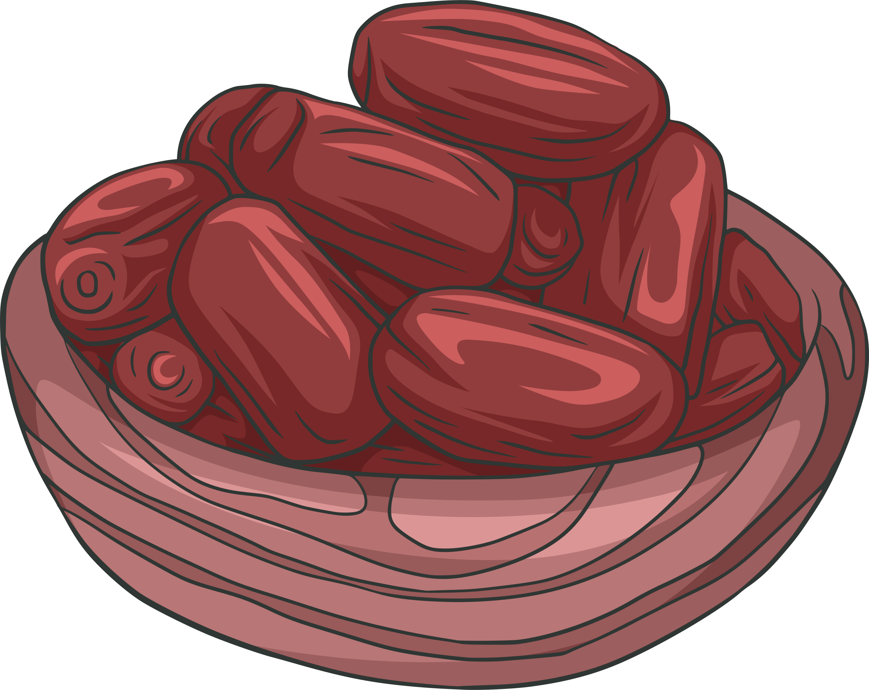
Stop 6: Iftar
Did You Know?
Iftar is the meal at the time of sunset, where we open our fast.
Our beloved Prophet g used to open his fast with dates.
Lesson 1
Stop 1
Stop 2
Stop 3
Lesson 2
Stop 4
Stop 5
Stop 6
Stop 7
Lesson 3
Stop 8
Lesson 4
Stop 9
Yayyy!! Best part of the day!
Challenge
What would happen to your body if you eat too quickly after a full day of fasting?
Notes:
Homework - to learn the duas for iftar

Slide 25
Du‘a After Opening A Fast
ذَهَبَ الظَّمَأُ ، وَابْتَلَّتِ الْعُرُوْقُ ، وَثَبَتَ الْأَجْرُ إِنْ شَاءَ اللهُ
Let’s repeat it together 5 times!
Notes:
The thirst has gone, the veins have been moistened, and the reward has been secured, if Allah wills.

Slide 26
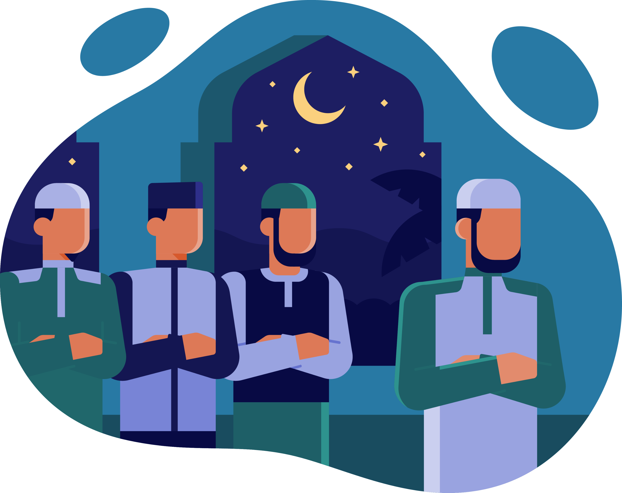
Stop 7: The Night Prayer
Keyword: Tarawih ^{تراويح}
Extra prayers which we perform at night in the month of Ramadan
The nights of Ramadan are the best time to stand in extra prayer and read extra Qur’an (now that you have all of your physical energy back!).
What is the name of this prayer?
Who has attended these in the masjid?
Lesson 1
Stop 1
Stop 2
Stop 3
Lesson 2
Stop 4
Stop 5
Stop 6
Stop 7
Lesson 3
Stop 8
Lesson 4
Stop 9
Notes:
Tarawih/Qiyam al-Layl
After sunset, we can eat and drink (as well as sleep!)
But don’t spend too long doing this - otherwise you will miss out on earning some great reward!

Slide 27
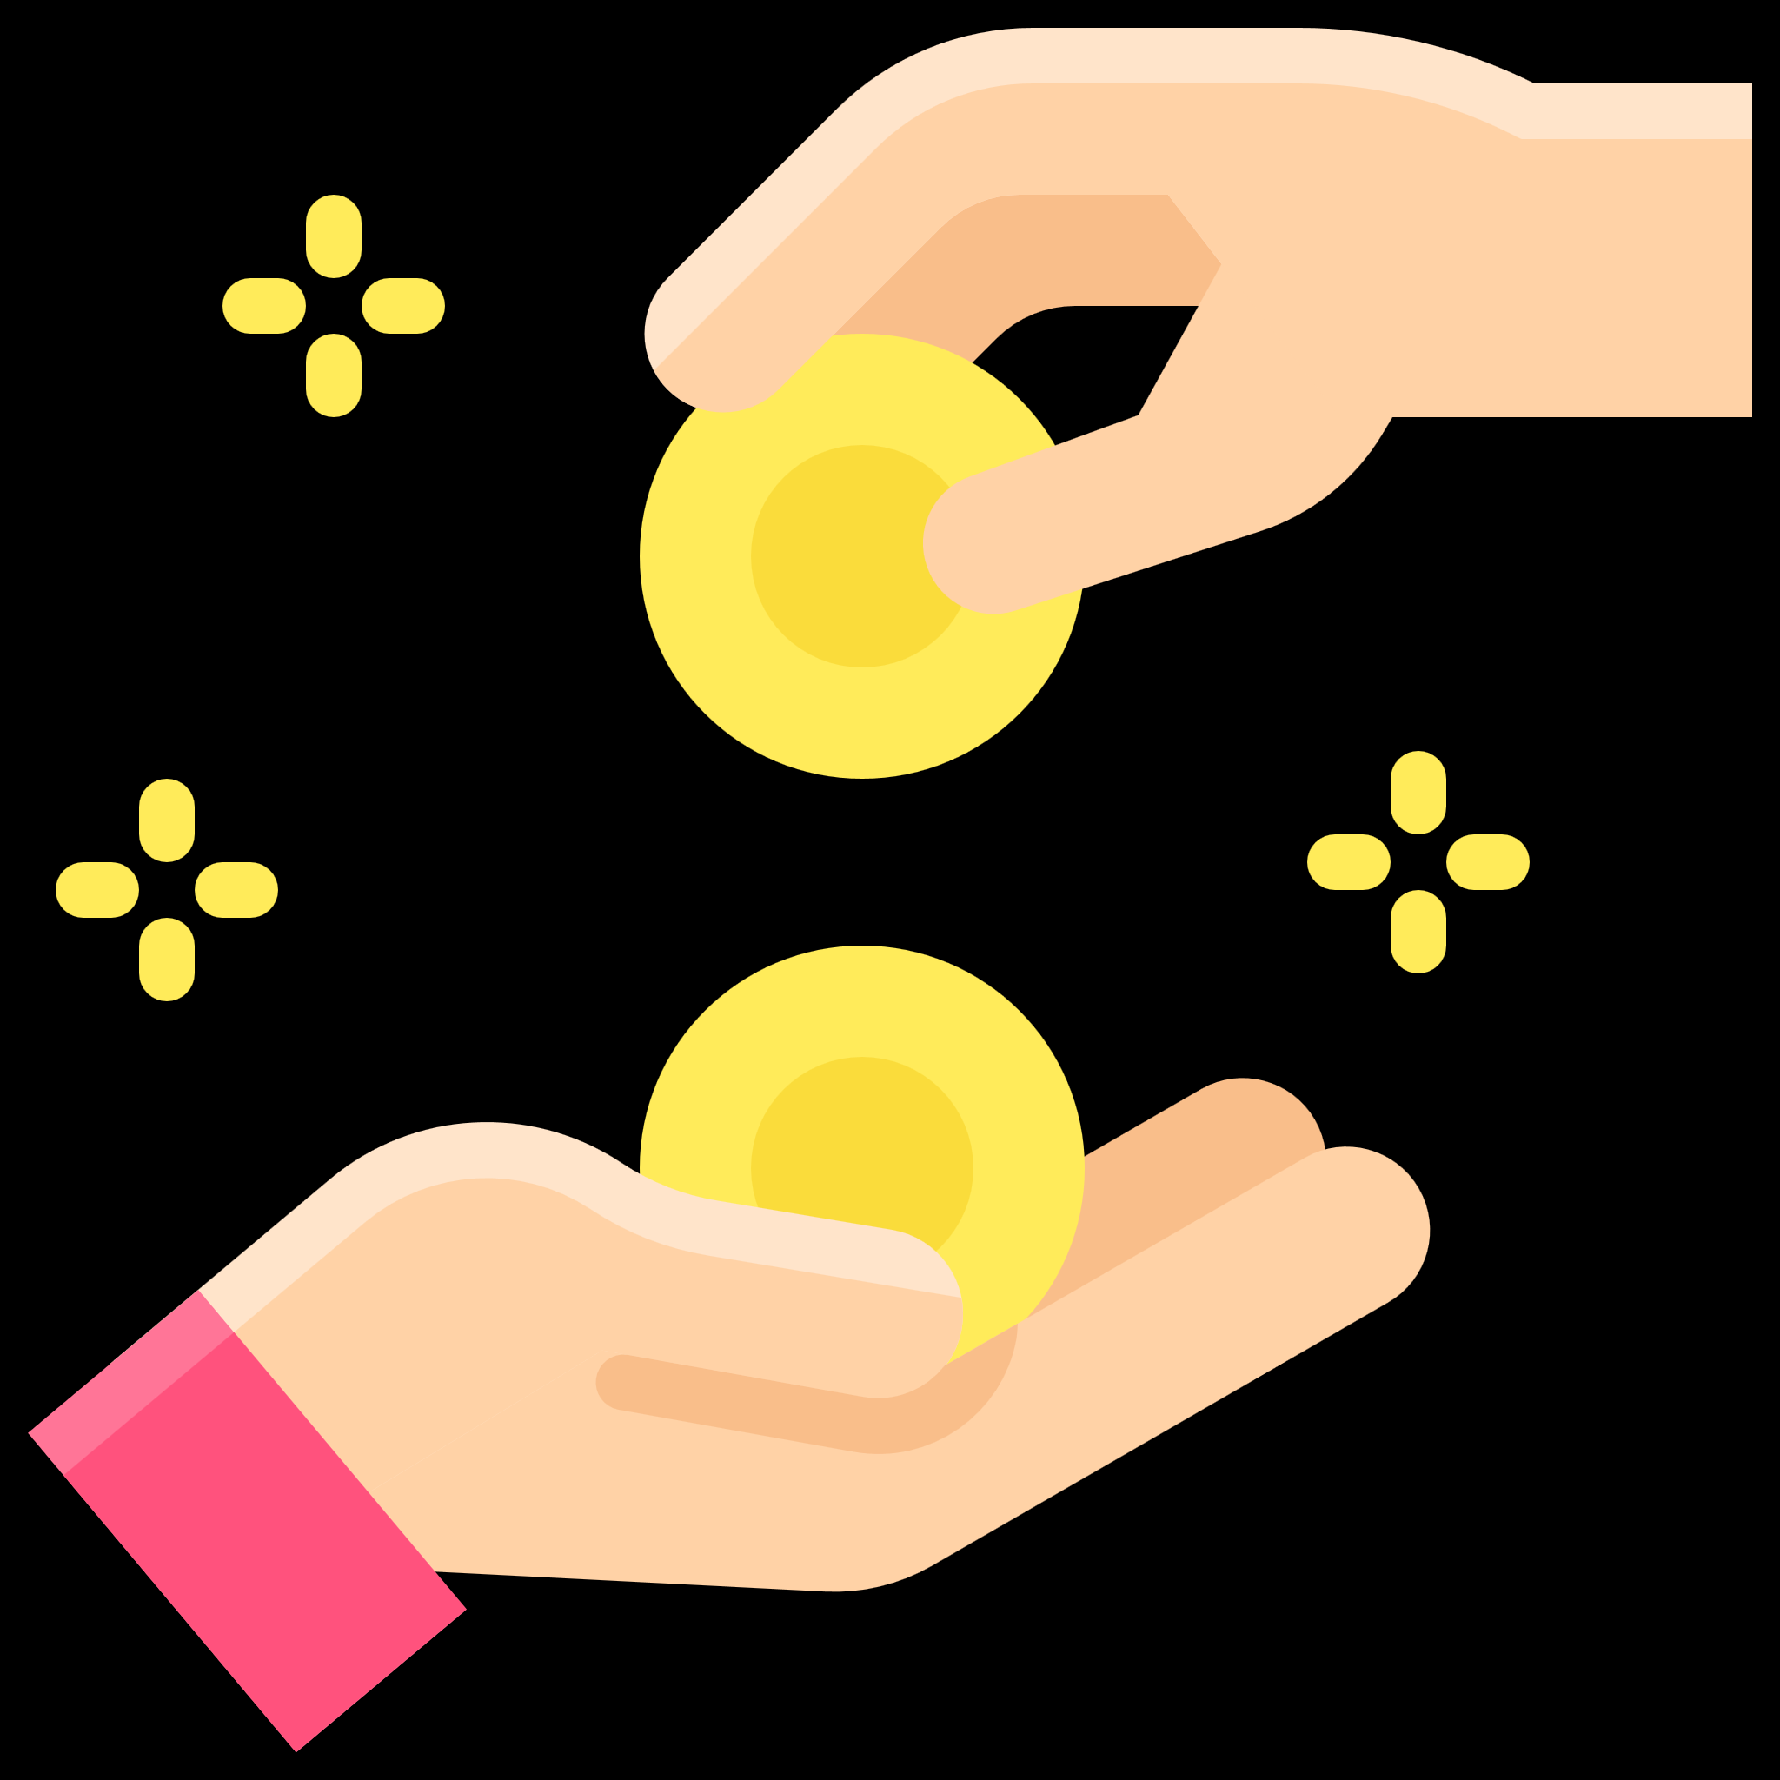
Plenary
Did you know?
Which 1 new good habit do you think you can develop by the end of Ramadan?
Research shows that it takes about 30 days to develop a new habit - and Ramadan is one month long!
Reciting
Quran
Good Hygiene
Charity
Eating Healthy
No fighting with siblings
No shouting

Slide 28
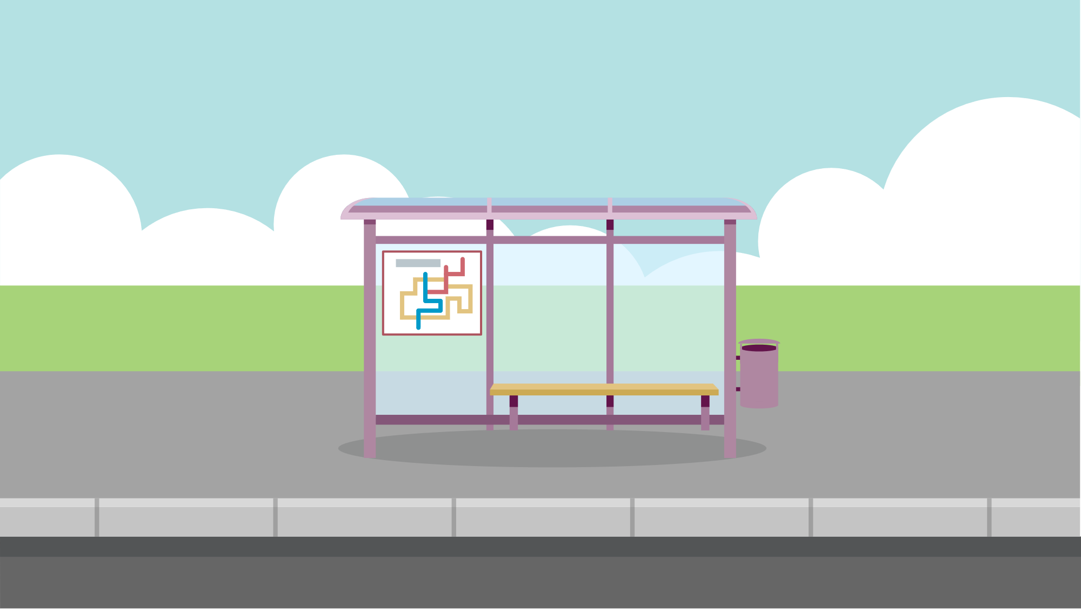
Lesson 3: A Special Night
Lesson 1
Stop 1
Stop 2
Stop 3
Lesson 2
Stop 4
Stop 5
Stop 6
Stop 7
Lesson 3
Stop 8
Lesson 4
Stop 9

Slide 29
Lesson Objectives
By the end of this lesson, I will:
Remember the story of the 1st revelation
Describe why Laylat al-Qadr is so special
Recap what I have learnt in the previous lessons
Notes:
http://www.youtube.com/watch?v=0heyG-Px48I
Have these nasheeds switched on as children enter the classroom

Slide 30
Story Time
The 1st
Revelation
Notes:
Sit all the children in a circle. Narrate the story of the 1st revelation as a story…make it exciting, use different pitches, pause for dramatic effect etc.
See Simple Seerah by Asim Khan and simplify it for children at this level.
You could also get ideas from the extract below and adapt it.
Everyone loved him. He never lied, and he was always so kind and helpful to everyone.
His name was Muhammad.
Sometimes, however, he wanted quiet and peace. Time to think.
After a long, difficult journey walking by foot for more than two hours and climbing the very steep mountain, he would arrive at the Cave of Hira. He wanted to retreat away from the hustle and bustle of the busy city of Makkah, and instead spend his time thinking and worshipping Allah. The houses of Makkah appeared tiny below with only the dim lights of the city visible to him. One night, he sat in the cave with his eyes resting shut for a moment until something pulled him into focus.
His eyes snapped open as he sensed the presence of someone else. As he turned around, a figure appeared in the corner of his eye so suddenly and silently that he thought it had come out of thin air. Before he could say a single word, the figure ordered him "Read".
He was startled. He had not heard or seen anyone approaching behind him or in front of him. It was angel Jibreel in the form of a man.
"I am unable to read!" he replied.
Without warning, the angel embraced him, squeezing him so tightly that he thought he would pass out. Just as he began to feel lightheaded, he was released, only to once again hear the command: "Read!"
Muhammad stood there stunned and confused. He could only muster up enough energy to repeat his first reply, "I am not of those who can read."
Then, the angel overwhelmed him again with a tight embrace, holding it until he could not take any more. He gasped for air and was then released.
"Read!" came the impossible command once more. When The Prophet gave the same reply again, the angel gave him one final powerful squeeze, before releasing him.
This time the angel said:
[recite Arabic]
"Read, O Prophet in the Name of your Lord Who created humans from a clinging substance. Read! And your Lord is the Most Generous, Who taught by the pen-taught man what he never knew.”
The words shook the Prophet Muhammad to his core. His heart pounded so loudly he could hear it. He didn't know how to make sense of what was happening. His mind and heart raced so quickly, he didn't even notice when and how the figure left the cave. One thing, however, was very clear. Those words had pierced through his heart. He could still hear them ringing in his ears. They were, in fact, the words of Allah that He had chosen to reveal to him on that night.
They were the first words of the Qur’an.
They were the words which would transform him from an ordinary man into an extraordinary Prophet.
From this point onwards, he was no longer just Muhammad. He was now the beloved Prophet and Messenger of Allah, Muhammad, Sallallahu ‘alayhi wa sallam.

Slide 31
Stop 8: The Night Prayer
This night was so special that Allah called it Laylat al-Qadr, the Night of Glory.
This special night was in the month of Ramadan. This is why Ramadan is known as:
Lesson 1
Stop 1
Stop 2
Stop 3
Lesson 2
Stop 4
Stop 5
Stop 6
Stop 7
Lesson 3
Stop 8
Lesson 4
Stop 9
The Month of the Qur’an
Notes:
Reward learner(s) who is willing to recite it

Slide 32
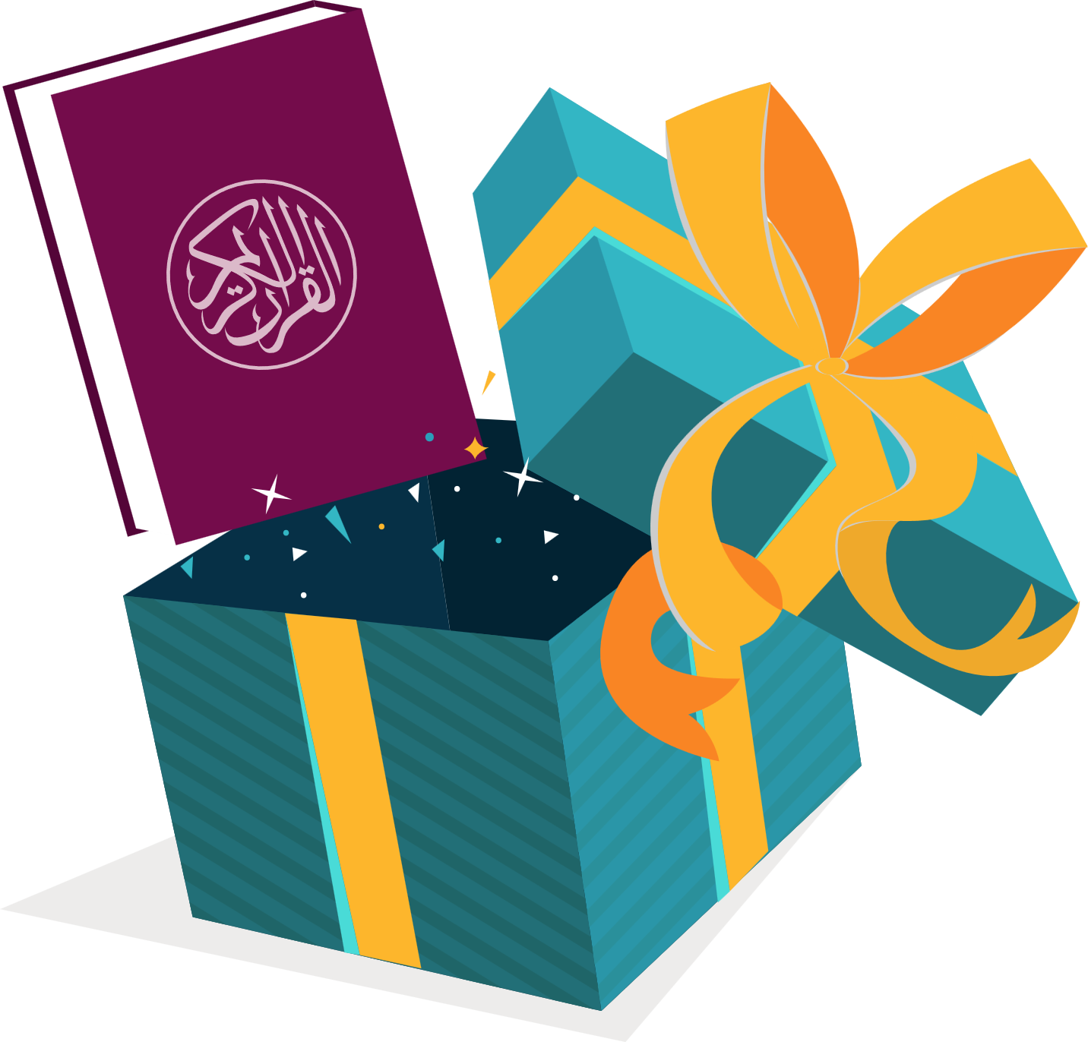
The Best Present
[Think Pair Share] Why is the Qur’an so special?
It tells us how to live.
It has so many amazing stories.
It is Allah’s special message to us.
Who knows Surah al-Qadr by heart?
Notes:
Reward learner(s) who is willing to recite it

Slide 33
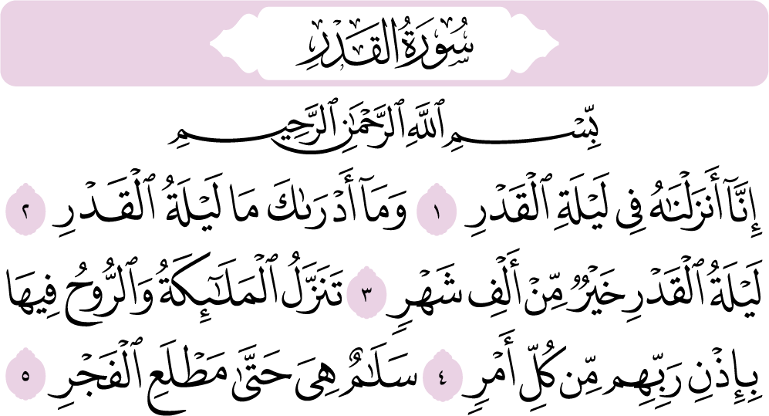
Let’s Recite Together
Notes:
Can also listen to this: https://download.quranicaudio.com/quran/ahmed_ibn_3ali_al-3ajamy/097.mp3

Slide 34
Understand and Memorise

Slide 36
1000!
Did You Know?
1000 months = more than 83 years
Laylat al-Qadr is BETTER than a 1000 months.
How long can you pray Qur’an for before you get tired, or start fidgeting?
By praying and worshipping Allah for one night, Allah will give us the reward for worshipping for more than a 1000 months!
That is awesome! Forget buy 1 get 1 free in Asda. This is the best deal I will ever get.

Slide 37
Full of Angels
Do you know how many angels come down on this special night?
Loads and loads…the earth is FULL of angels.
Challenge
Guess who else comes down on this night.
The special visitor who came to visit Prophet Muhammad g and told him to ‘RECITE!.
Do you know his name?

Slide 38
Du‘a for this night
اَللّٰهُمَّ إِنَّكَ عَفُوٌّ كَرِيمٌ تُحِبُّ الْعَفْوَ فَاعْفُ عَنِّيْ
If you can’t remember this du‘a you can say,
Allah I am so sorry, please forgive me.
How many days do you think you could forgive Zayd for?
Allah is so Kind and Loving that He forgives us AGAIN and AGAIN and AGAIN.
Notes:
Once the wife of our beloved Prophet Muhammad ﷺ, ʿĀ’ishah (raḍiy Allāhu ʿanhā) asked him: “If I know which night is the Night of Qadr, what do you think I should say during it?” He ﷺ replied,
اَللّٰهُمَّ إِنَّكَ عَفُوٌّ كَرِيمٌ تُحِبُّ الْعَفْوَ فَاعْفُ عَنِّيْ
O Allah, You are the Ever-Pardoning, the Generous; You love to pardon so pardon me (Tirmidhī).
Ask students:
On Monday, Zayd took your football home without asking you. The next day, he said sorry to you. So you forgave him. But then he did it again on Tuesday. And Wednesday. And Thursday. How many days do you think you could forgive him for?
Once the wife of our beloved Prophet Muhammad ﷺ, ʿĀ’ishah (raḍiy Allāhu ʿanhā) asked him: “If I know which night is the Night of Qadr, what do you think I should say during it?” He ﷺ replied,
اَللّٰهُمَّ إِنَّكَ عَفُوٌّ كَرِيمٌ تُحِبُّ الْعَفْوَ فَاعْفُ عَنِّيْ
O Allah, You are the Ever-Pardoning, the Generous; You love to pardon so pardon me (Tirmidhī).
Ask students:
On Monday, Zayd took your football home without asking you. The next day, he said sorry to you. So you forgave him. But then he did it again on Tuesday. And Wednesday. And Thursday. How many days do you think you could forgive him for?

Slide 39
Quiz
What is the name of the night in which the Qur’an was revealed?
This night is better than a ______ months.
What is the du’a we say in this night?
What is the name of the wife of the Prophet Muhammad g who asked him about the special dua for this night?

Slide 40
Quiz
What is the name of the angel who brought down the Qur’an to our beloved Prophet Muhammad g?
What is the name of the extra prayer we do every night in Ramadan?
Why do we fast?

Slide 41
Quiz
Ramadan is the _____th month in the calendar.
What TWO things can we do in Laylat al-Qadr?
What is the du’a for when we open our fast?

Slide 42
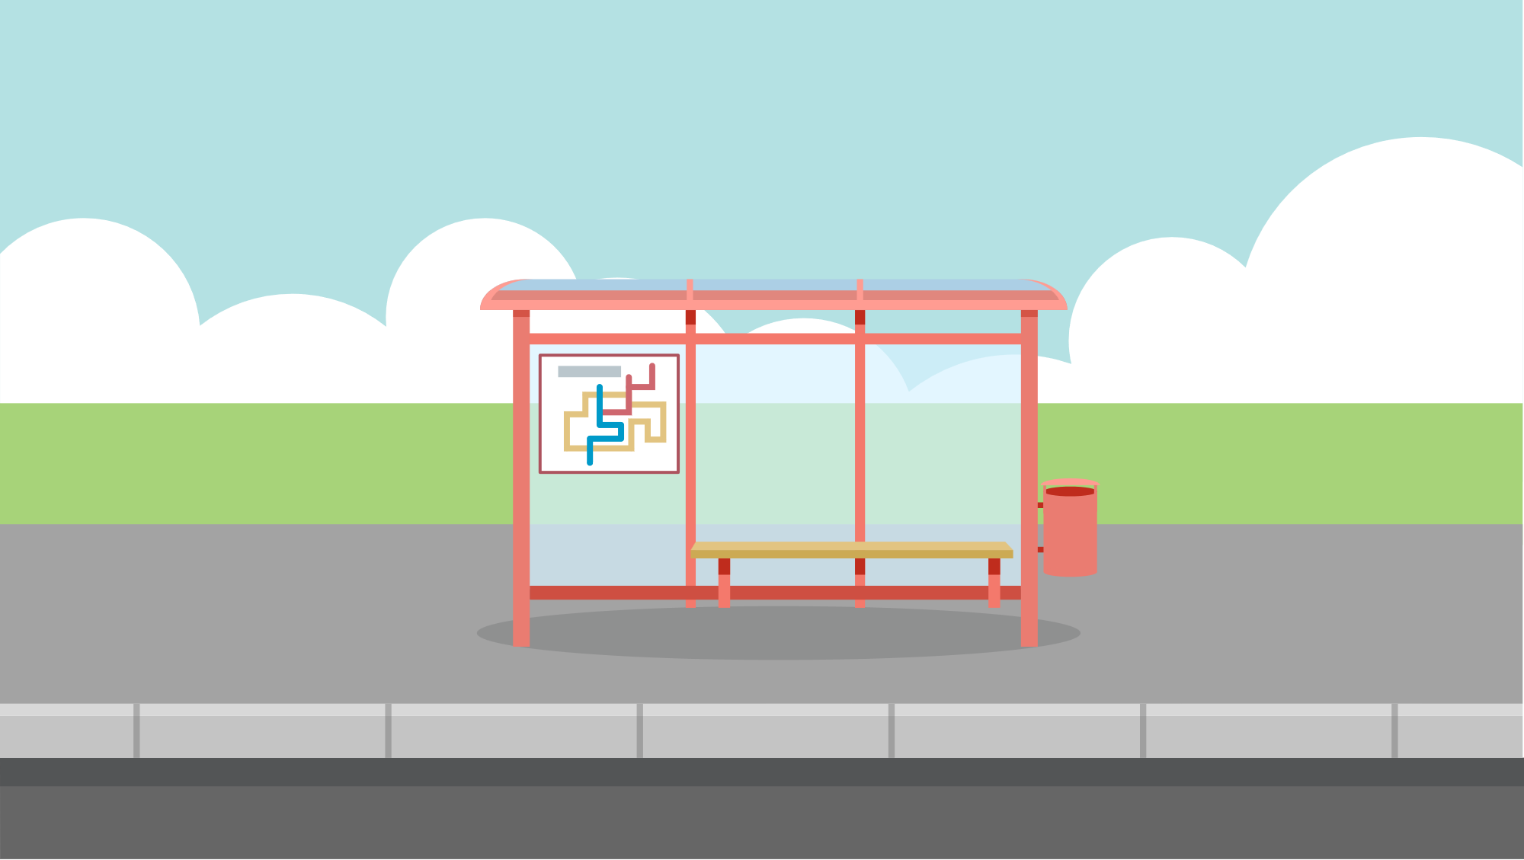
Lesson 4: It’s Eiiid!
Lesson 1
Stop 1
Stop 2
Stop 3
Lesson 2
Stop 4
Stop 5
Stop 6
Stop 7
Lesson 3
Stop 8
Lesson 4
Stop 9
Notes:
http://www.youtube.com/watch?v=0heyG-Px48I
Have these nasheeds switched on as children enter the classroom

Slide 43
Warm-up Starter
Define these key words:
صَوْم
تقوى
Sawm
Suhur
Iftar
Taqwa
Tarawih
Notes:
Use mini whiteboards or choose students to define the key words orally.

Slide 44
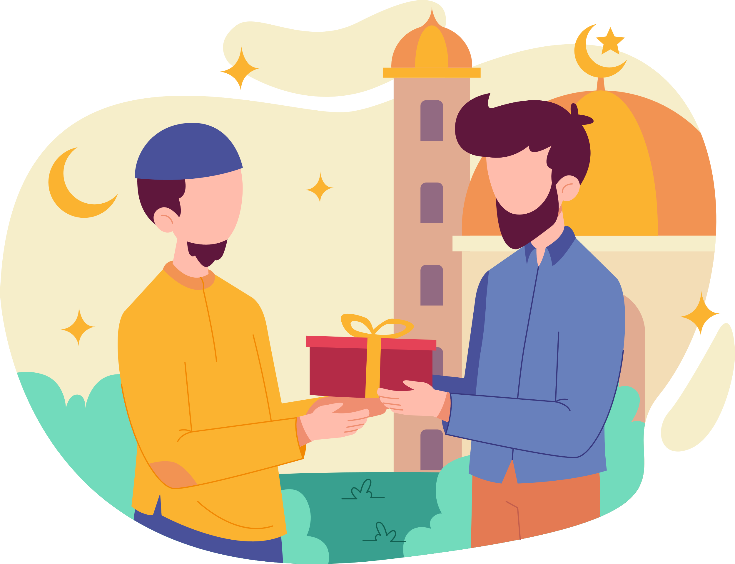
Lesson Objectives
By the end of this lesson, I will:
Design an Eid card
Think about others who may not have as much as me

Slide 45
Stop 9: It’s Eid
When Ramadan finishes, Allah gives us a celebration called Eidul-Fitr. We celebrate Eid with our family, friends and community.
We thank Allah for giving us the beautiful month of Ramadan.
Allah is so Loving and so Kind!
Lesson 1
Stop 1
Stop 2
Stop 3
Lesson 2
Stop 4
Stop 5
Stop 6
Stop 7
Lesson 3
Stop 8
Lesson 4
Stop 9
Notes:
Giving gifts reward
Gifts Key word def.match AFL

Slide 46
Eid
What do you love about Eid?
But who might be all alone this Eid?
Yayy! I love Eid!
Who might be feeling sad?
What should we do?
Notes:
Giving gifts reward
Gifts Key word def.match AFL

Slide 47
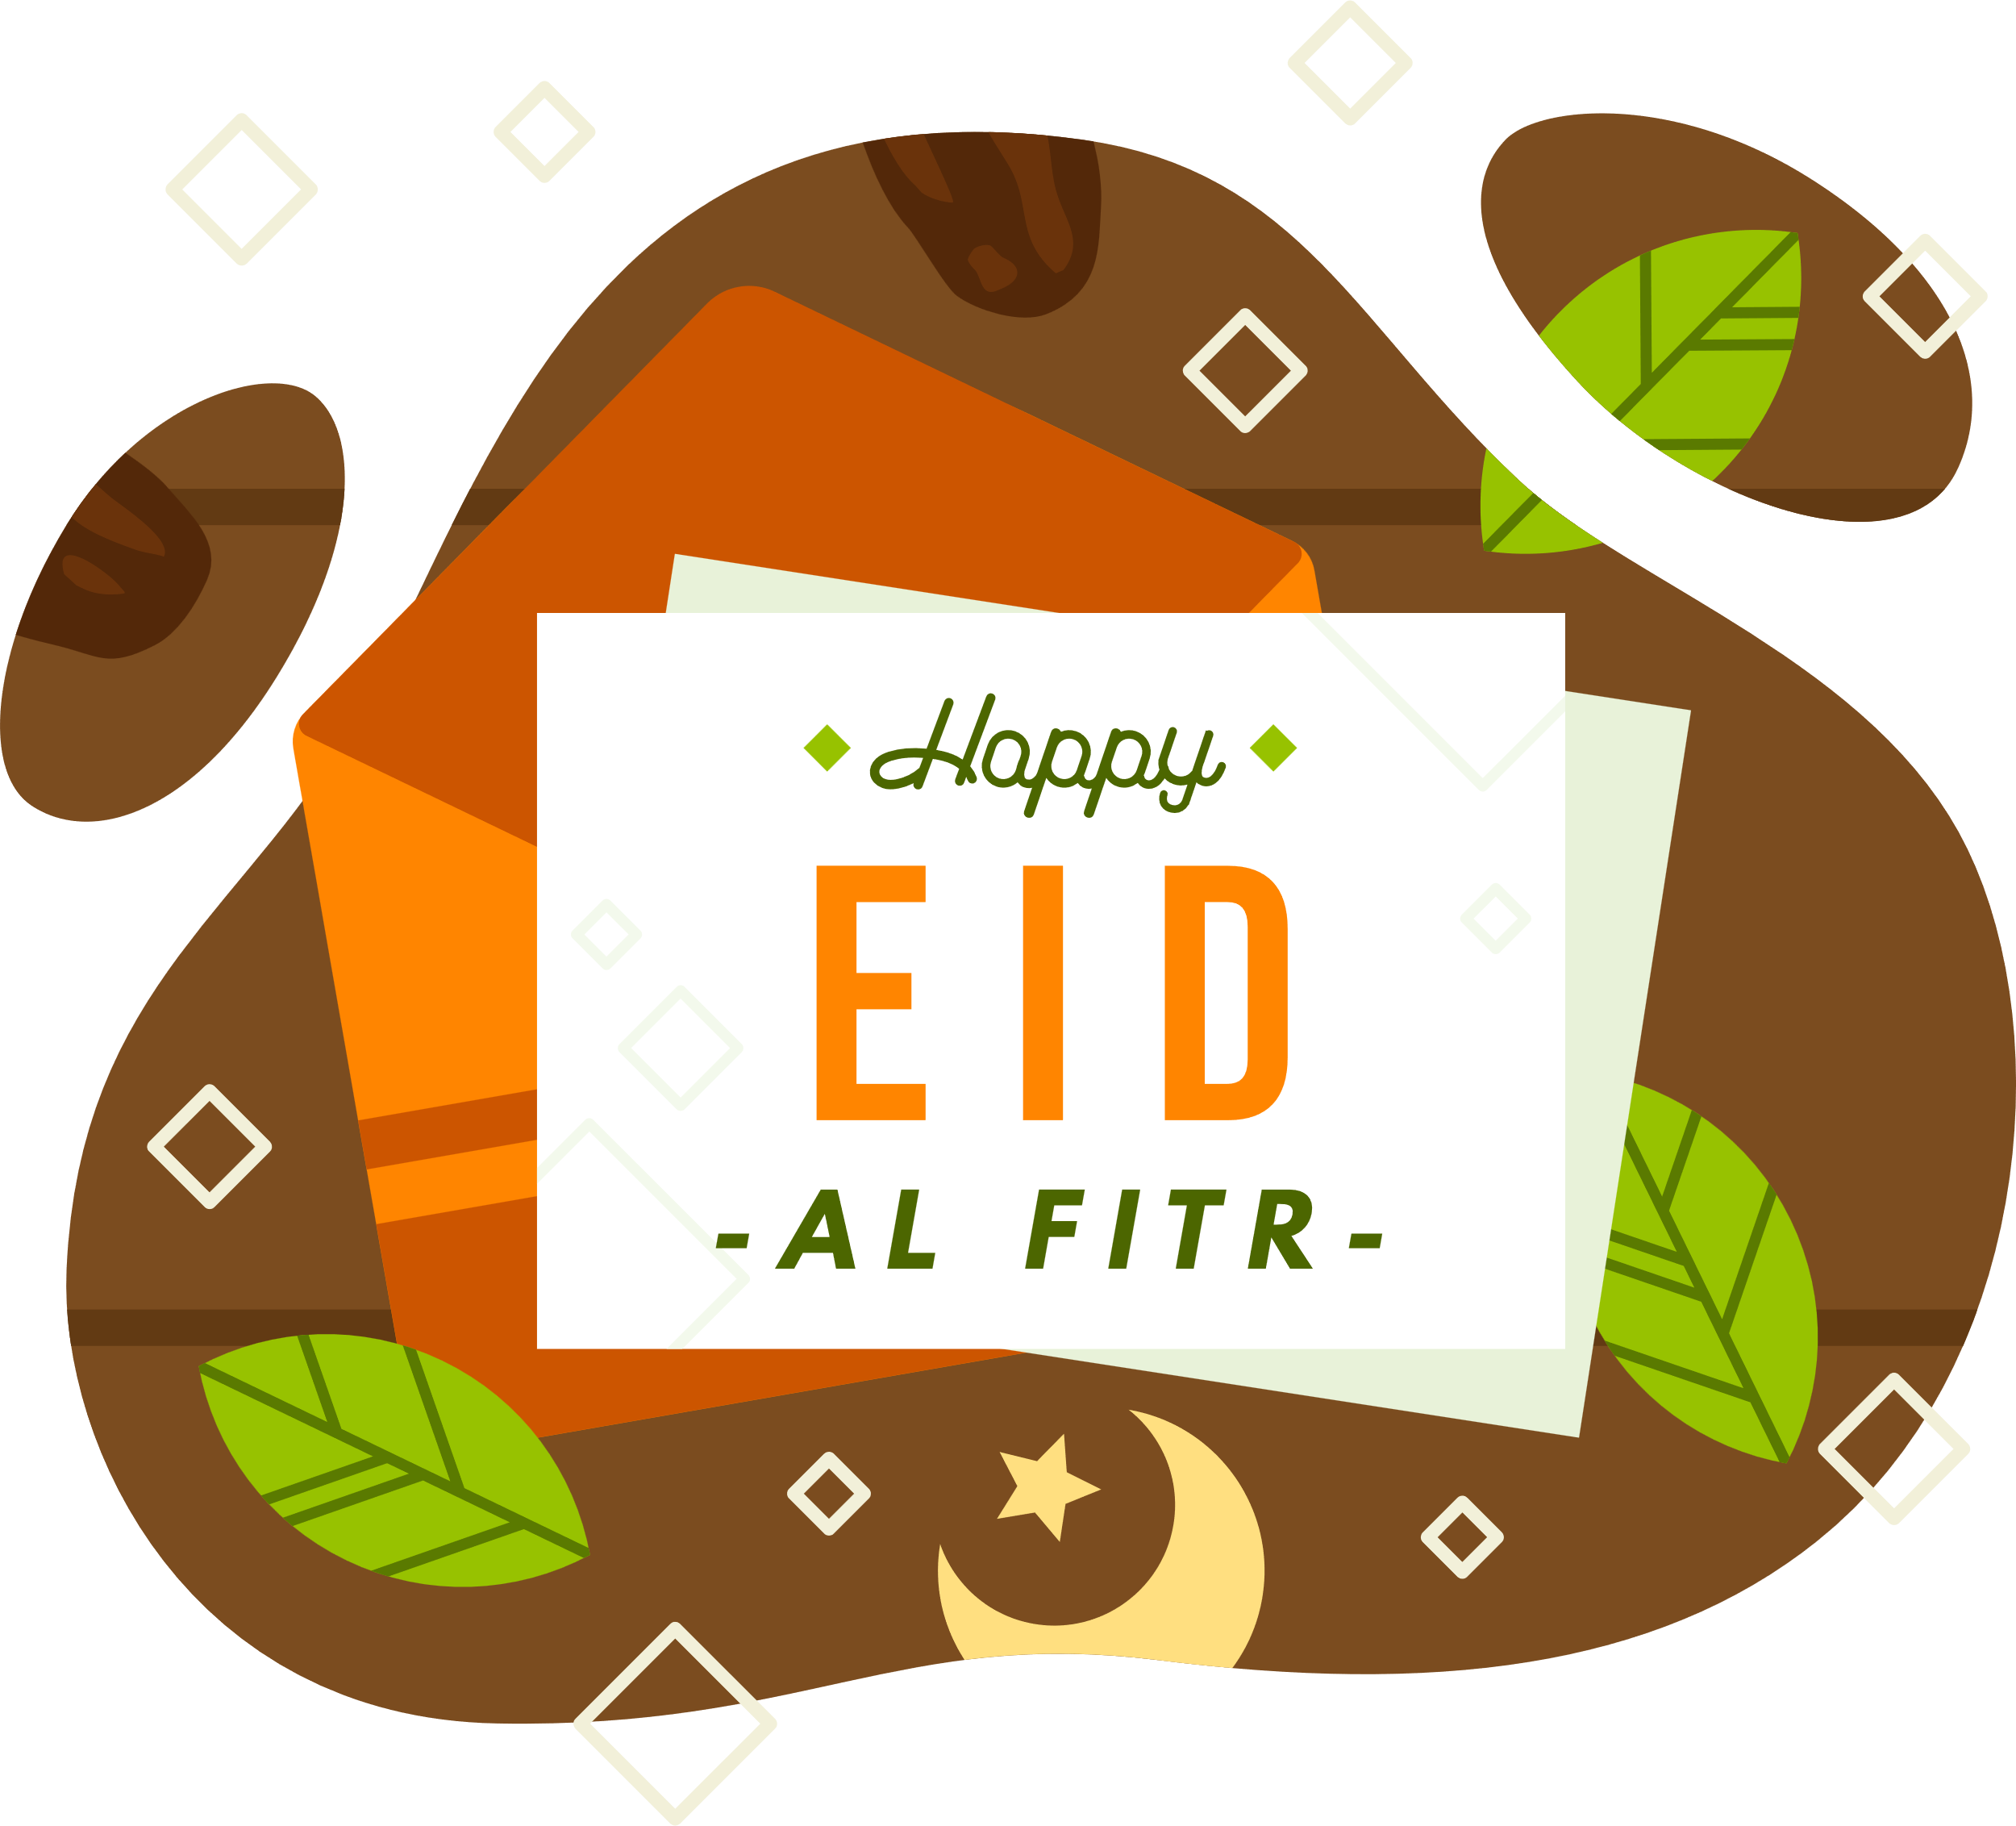
Eid Card
[A] Make an Eid Card for either
A distant relative
A neighbour
Someone celebrating Eid without their family.
Notes:
Giving gifts reward
Gifts Key word def.match AFL
Play the nasheeds in the background as children design their Eid cards

Slide 49
Learning
Map
Stop 4:
Suhur
L2
Stop 5:
During the Day
How do
we fast?
Stop 6:
Iftar
Why do
we fast?
Stop 7:
The Night
Prayer
A Special Night
Stop 9:
It’s Eid!
Stop 3:
Why do
we Fast?
L1
Stop 2:
What is
Sawm?
L3
L4
Stop 8:
Laylat al-Qadr
Stop 1:
Ramadan is here
Eid
al-Fitr
Alhamdulillah!

