Slide 1
RESOURCES NEEDED FOR THIS PRESENTATION
Sticky Notes
Pens
4 x A3 Sheets of paper (preferably card)

Slide 2
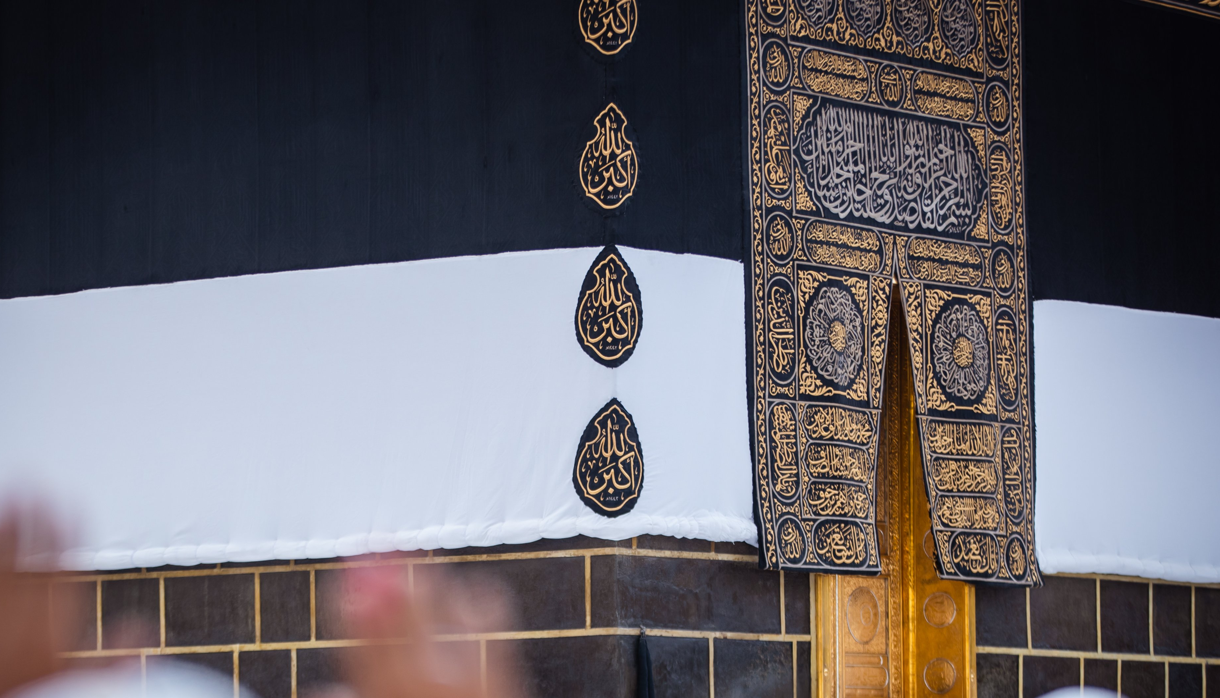
STARTER
Z
What is the first word that comes to your mind when you think of Ḥajj?
Notes:
Display the question as the participants enter the room. You may also want to play the labbayk in the background or a ḥajj nashīd: https://www.youtube.com/watch?v=EgbY3qMIMeg
The facilitator can either create a Sli.do poll or use Post-it notes

Slide 3
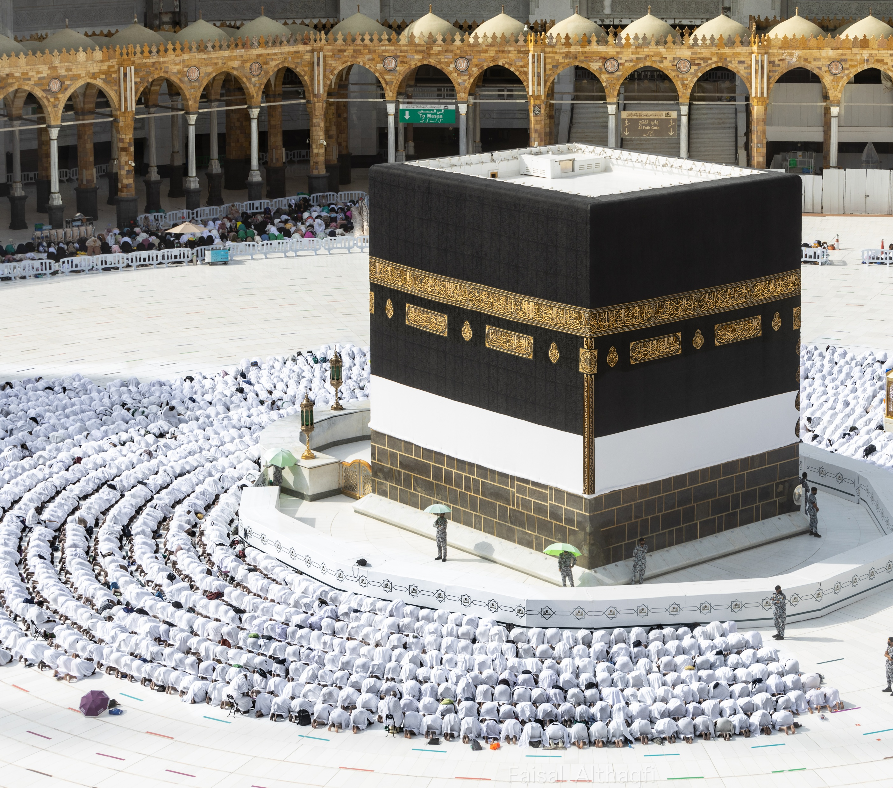
Hajj: A JOURNEY OF A LIFETIME
Z
SESSION 1
Notes:
Bismillah, hamd, salawāt and seeking Allah’s help.

Slide 4
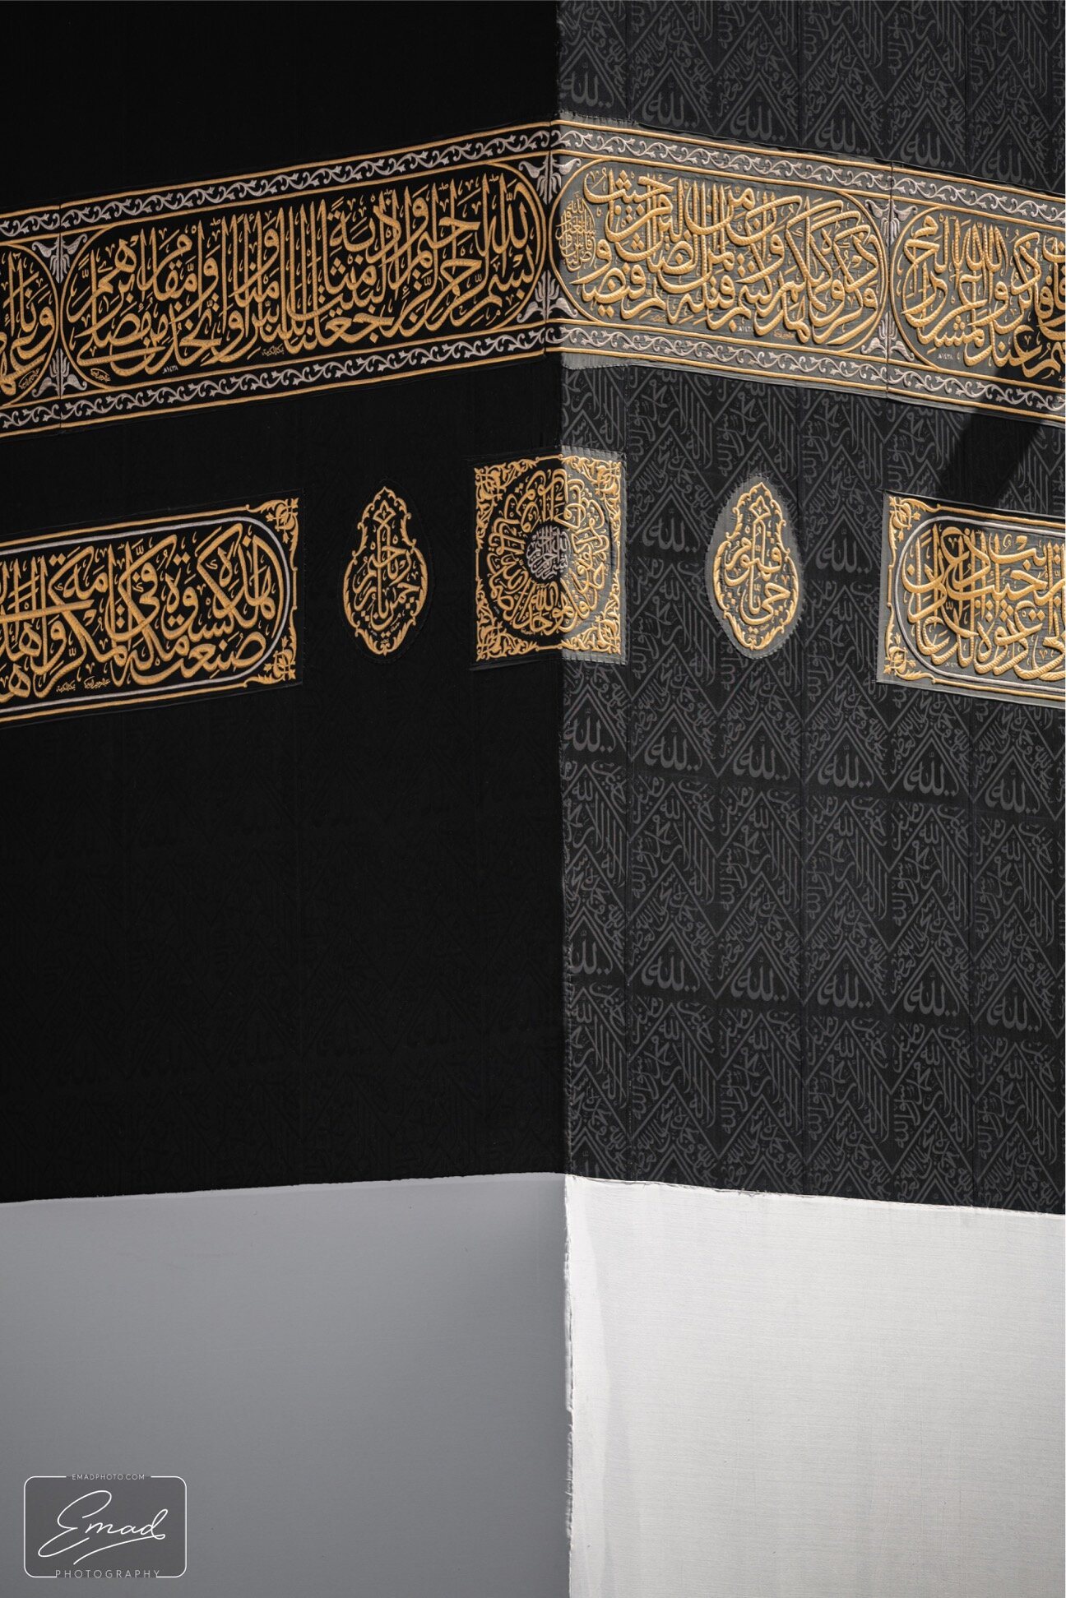
LEARNING OBJECTIVES
Explore the goals and virtues of ḥajj
Identify ways to spiritually prepare for ḥajj
Outline the key steps for physical preparation for ḥajj

Slide 5
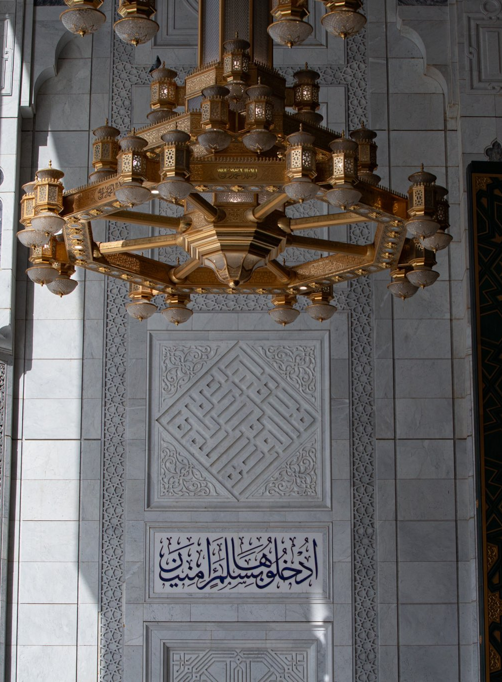
DISCLAIMER
This is not a fiqh class.
It is an interactive workshop to discover the secrets of ḥajj.
Notes:
The sessions will cover the method of the most common type of Hajj: tamattu’
The facilitator is encouraged to do their own research on the various types of ḥajj.

Slide 6
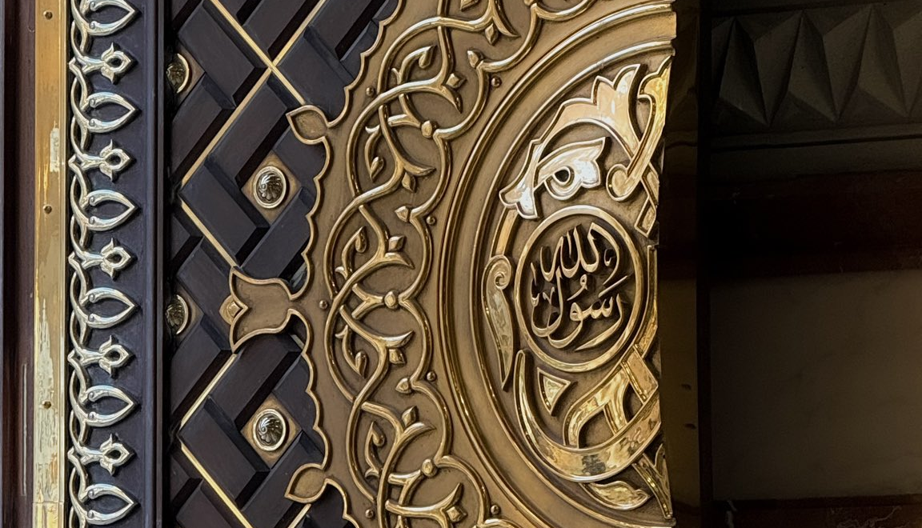
Z
What do you want to get out of this workshop?
SESSION 1
Notes:
Ask all attendees to share what they want to get out of ḥajj.
Ask whether they have attended any other ḥajj events/programmes so you can see the level of knowledge in the classroom and then adapt the sessions as needed.
The facilitator can either create a Sli.do poll or use Post-it notes

Slide 7
RESOURCES
A6 Book: Duʿā’ book
Duʿā’ Prompts
Ṭawāf Tasbīḥ
My Hajj Companion
Notes:
This slide contains all of the resources we encourage facilitators to either provide or participants to purchase.
Facilitators may also want to provide handouts for the slides to allow participants to make notes more easily.

Slide 8
JUST ONE MINUTE
Close Your Eyes for 1 minute
Ask Allah al-Fattāh, The Supreme Opener, to open your heart so you can absorb the true secrets and inner realities of ḥajj. Ask Him to clear the fog from your mind so that you can discern truth from falsehood. Ask al-Jabbār to heal your heart, purify it from all evil and attach it to Him/anchor it firmly to His love and remembrance.
Start your duʿāʾ now.
Notes:
This slide is to set the scene and to enable participants to get into the right frame of mind.
Encourage all participants to leave all of their worries and thoughts behind and to fully engage with the sessions.

Slide 9
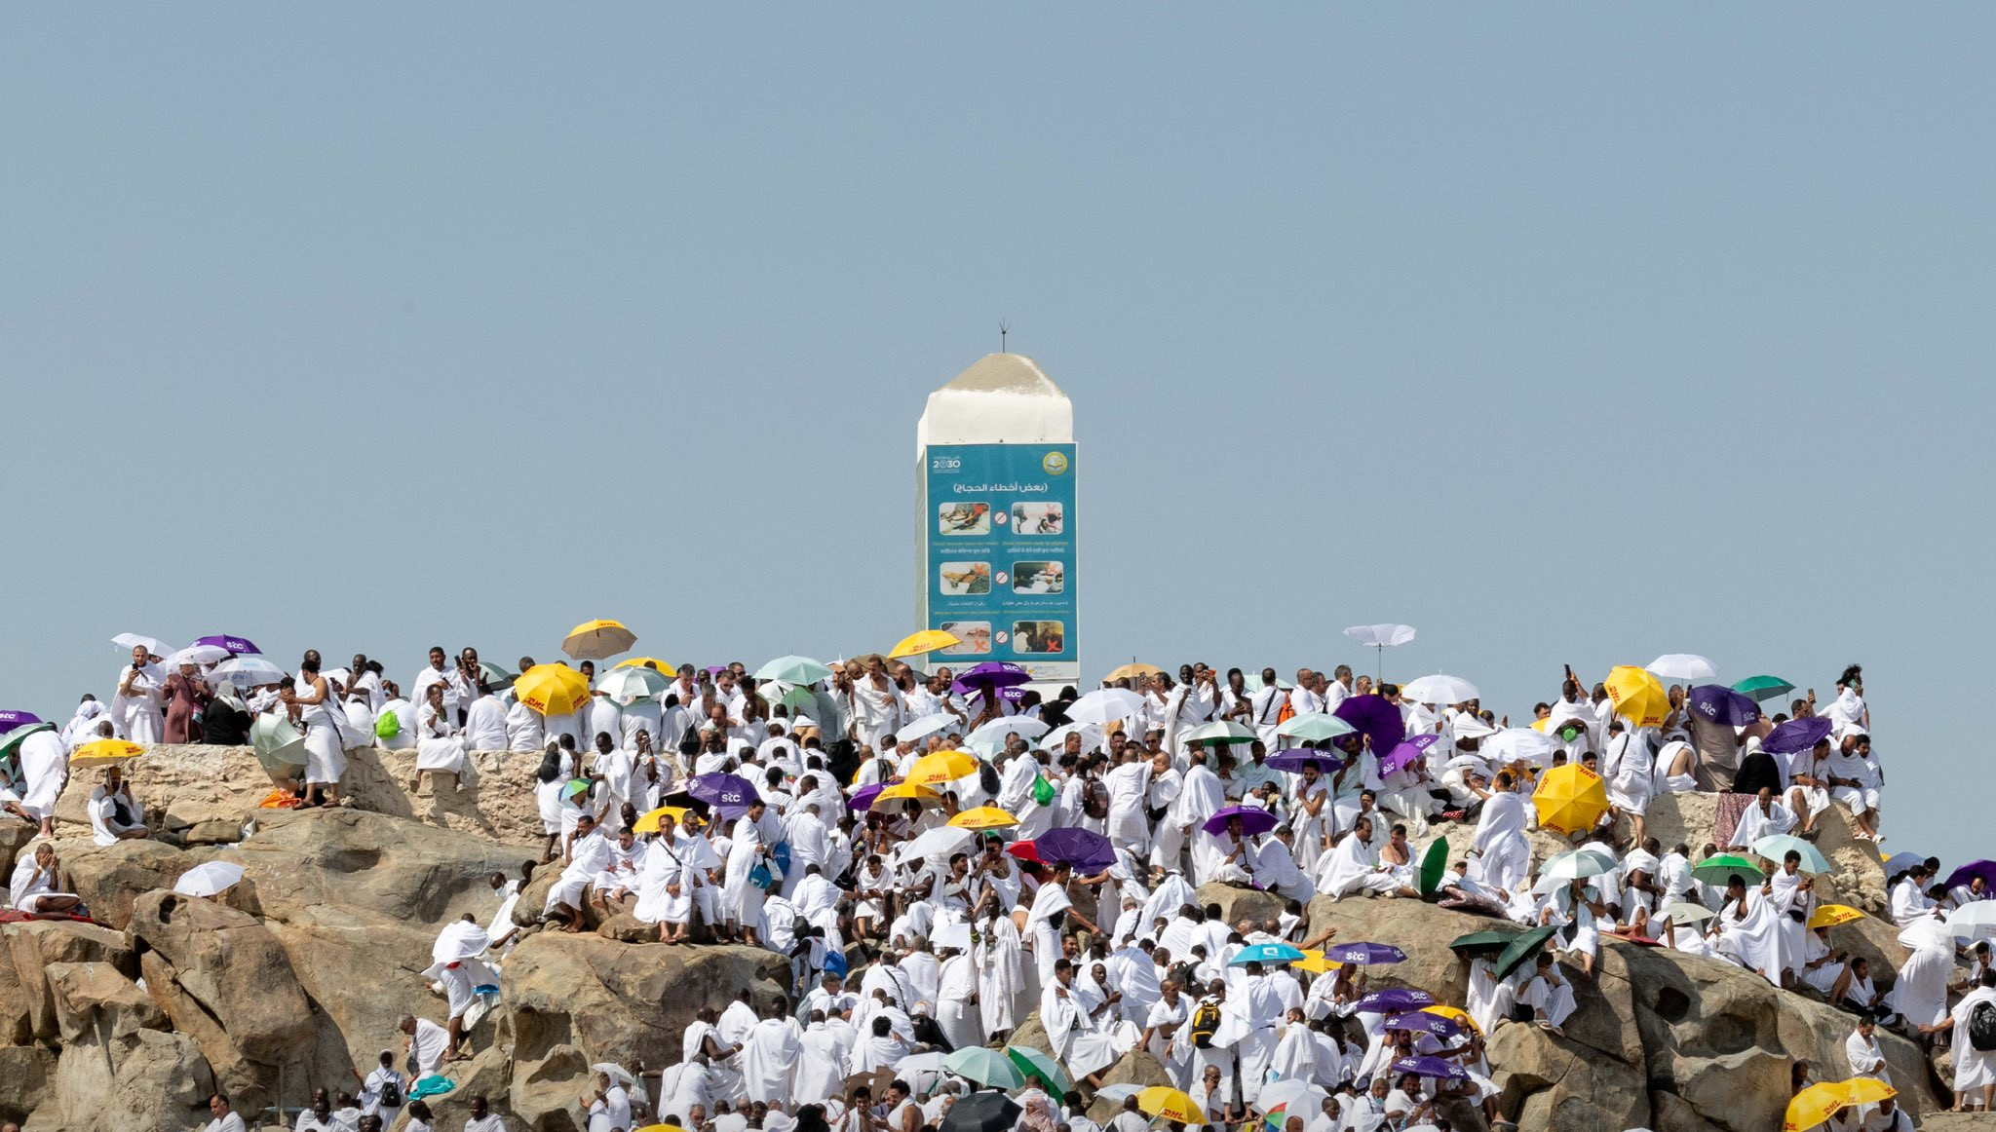
WHAT IS HAJJ?
SESSION 1

Slide 10
/
WHAT IS HAJJ?
وَأَذِّن فِي النَّاسِ بِالْحَجِّ يَأْتُوكَ رِجَالًا وَعَلَىٰ كُلِّ ضَامِرٍ يَأْتِينَ مِن كُلِّ فَجٍّ عَمِيقٍ
“Call ˹all˺ people to the pilgrimage. They will come to you on foot and on every lean camel from every distant path” (22:27).
Ḥajj - Qaṣd (aim is Allah)
Once in a lifetime opportunity
Investment
Notes:
Thousands of years ago, Allah ﷻ asked Ibrāhīm (as) to announce the call for ḥajj to all people. Ibrāhīm (as) asked, “O Lord, how can my voice reach all the people?” Allah replied, “’Make an announcement, and it is upon Me to convey.” So Ibrāhīm climbed Mount Abū Qubays and announced: “O people, your Lord has ordered you to perform ḥajj of this House, so that He can reward you with Paradise and protect you from Hell-fire; so perform ḥajj.”
Allah made his voice reach everyone on earth: humankind and jinn alike. They answered his call from the most distant villages to the crowded cities.
You were among them. You heard. You responded. You have been granted the honour of living this once-in-a-lifetime moment with Him. Now, you are here, carrying the covenant of renewing your commitment to Him.
“Labbayk Allāhumma labbayk: Here I am, O Allah, here I am.”
You are Allah’s GUESTS! The Messenger of Allah ﷺ said, “The warrior in the path of Allah, the pilgrim, and the person performing ʿumrah are the guests of Allah. He invited them so they responded to Him; they asked Him, so He gave them” (Nasā’ī)
الغازي في سبيل الله، والحاج والمعتمر وفد الله، دعاهم فأجابوه، وسألوه فأعطاهم
The pilgrims are the ‘delegation’ of Allah. A delegation refers to distinguished guests who travel to meet a king or ruler for a specific purpose. It is well known that human rulers receive such guests with honour, celebration, and generous hospitality. Can you even begin to imagine the honour and generosity shown by the Lord of all creation?
Hajj is a journey of transformation. It’s a journey to Allah.

Slide 11
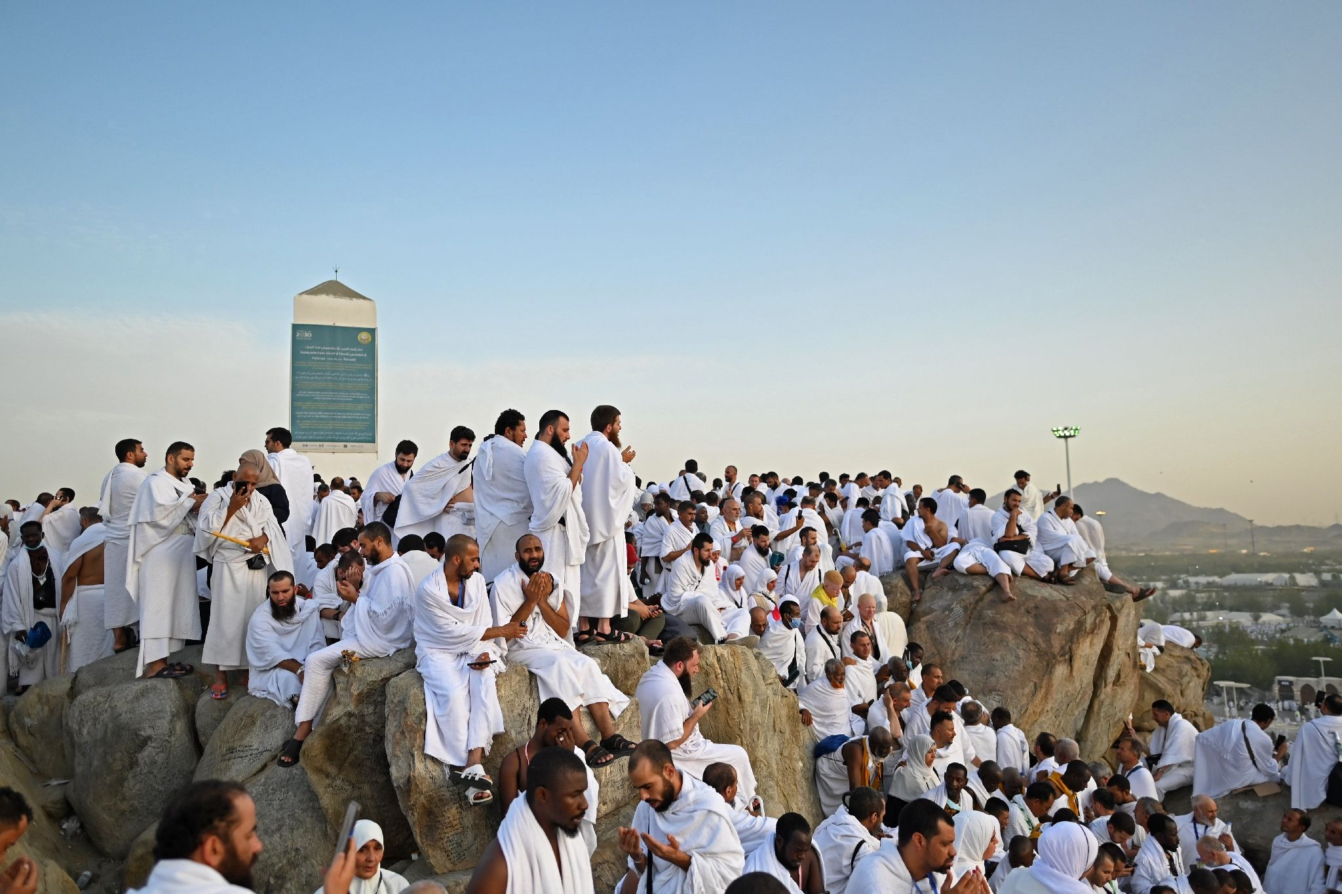
JOURNEY OF THE HEART
WHAT IS HAJJ?
Present Heart
Understand Wisdom & Secrets
Quality > Quantity
Enjoy Your Ḥajj!
Notes:
Presence of the Heart
Acts of worship in Islam consist of:
An outer form — what the body does
And an inner reality — what the heart feels
The secret to a transformational ḥajj is the presence of your heart. Throughout ḥajj, whilst you are physically engaged in acts of worship (ṭawāf, saʿī, duʿāʾetc), fill your heart with humility, love, hope, and awe.
Understand the Wisdom and Secrets
In order to perform ḥajj with the presence of your heart, it is essential to understand the wisdom and secrets of the acts of ḥajj. We may sometimes perform our worship in a state of heedlessness: mechanical acts of routine without soul or intention. This can lead us to become bored of worship and see it as a chore, rather than recognising it as one of the greatest gifts we have been bestowed. As a result, we miss out on the real objectives that were intended, and thus our hearts and lives are not transformed by them.
Focus on Quality over Quantity
In a world that measures success by numbers, Islam reminds us to focus on quality. Allah ﷻ says:
‏ ٱلَّذِى خَلَقَ ٱلْمَوْتَ وَٱلْحَيَوٰةَ لِيَبْلُوَكُمْ أَيُّكُمْ أَحْسَنُ عَمَلًا وَهُوَ ٱلْعَزِيزُ ٱلْغَفُورُ ‎
“He is the One who created death and life in order to test which of you is best in deeds…” (67:2).
Notice how the āyah mentions “best in deeds” and not “most in deeds”.
Enjoy Your Hajj
When you understand the purpose behind each act and engage your heart in every moment, ḥajj no longer feels like a burden. Instead, it becomes a source of deep joy and contentment.
During ḥajj, be mindful of why you are doing each act and for whom. You will then taste the sweetness of every step, every sacrifice, every stone thrown and every tear shed. Tasting the sweetness of īmān and acts of worship is a game changer.

Slide 12
/
Know that the path leading to Allah is not a journey taken by the feet—rather it is the journey of the heart.
- IBN AL-JAWZĪ (RAḤIMAHULLĀH)

Slide 13
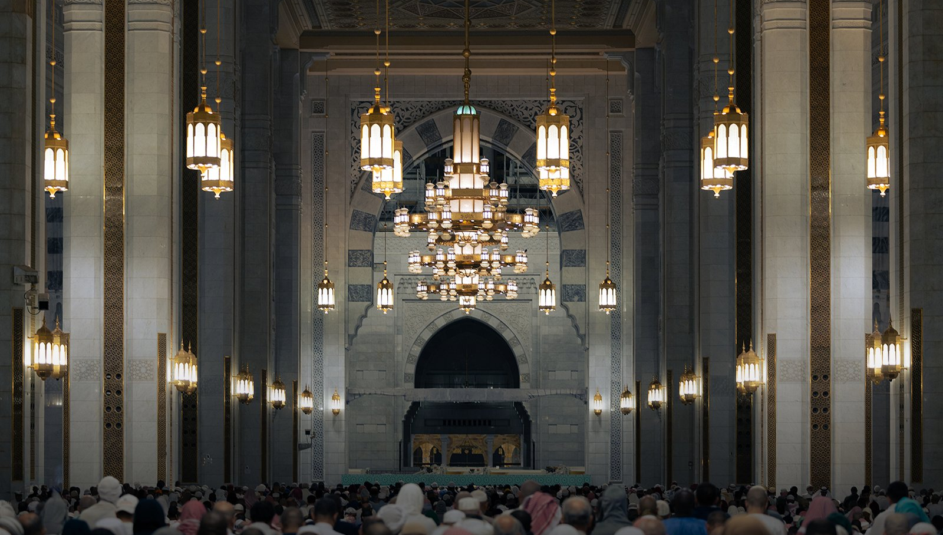
VIRTUES & GOALS OF HAJJ
SESSION 1

Slide 14
THE AMAZING REWARDS
Grants Entry to Paradise
One of the Greatest Acts of Worship
Forgives All Sins
The Messenger of Allah g said, “The ḥajj mabrūr has no reward except Paradise.” (Bukhari).
The Messenger of Allah g was asked, “What is the best deed?” He replied, “Imān in Allah and His Messenger.” It was said, “Then what?” He g said, “Jihād in the path of Allah.” It was said, “Then what?” He said, “Ḥajj mabrūr (a righteous accepted ḥajj)” (Bukhārī).
The Messenger of Allah g said, “Whoever performs ḥajj for the sake of Allah and refrains from sexual relations and sin will return as free of sin as the day his mother gave birth to him” (Bukhārī).
VIRTUES & GOALS OF HAJJ
Notes:
1. Grants Entry Into Paradise
الْحَجُّ الْمَبْرُورُ لَيْسَ لَهُ جَزَاءٌ إِلَّا الْجَنَّةَ،
Ḥajj Mabrūr: righteous and accepted ḥajj:
Free of sin and wrongdoing
Leaves you transformed
2. Greatest Acts of Worship
أنَّ رَسولَ اللَّهِ صَلَّى اللهُ عليه وسلَّمَ سُئِلَ: أيُّ العَمَلِ أفْضَلُ؟ فَقالَ: إيمَانٌ باللَّهِ ورَسولِهِ. قيلَ: ثُمَّ مَاذَا؟ قالَ: الجِهَادُ في سَبيلِ اللَّهِ قيلَ: ثُمَّ مَاذَا؟ قالَ: حَجٌّ مَبْرُورٌ.
Ḥajj is a comprehensive act of devotion that combines all forms of worship, engaging both the heart and body, the outward and the inward. Abū al-Shaʿthā’ Jābir b. Zayd said, “Ṣalāh tires the body but not the wealth. Zakāh affects the wealth but not the body. Ḥajj exhausts both body and wealth, and that is why it is the best of deeds.
3. Forgives All Sins
مَن حَجَّ لِلَّهِ فَلَمْ يَرْفُثْ، ولَمْ يَفْسُقْ، رَجَعَ كَيَومِ ولَدَتْهُ أُمُّهُ.
This is a Divine message sent to you from Allah: If you have fallen short in the past, ḥajj can be your new beginning. Allah, The Most Merciful and Powerful, can cleanse you and help you turn a new chapter in your life.
There are many other virtues too. Refer to My Hajj Companion (Pgs. 12-17 for a detailed list)

Slide 15
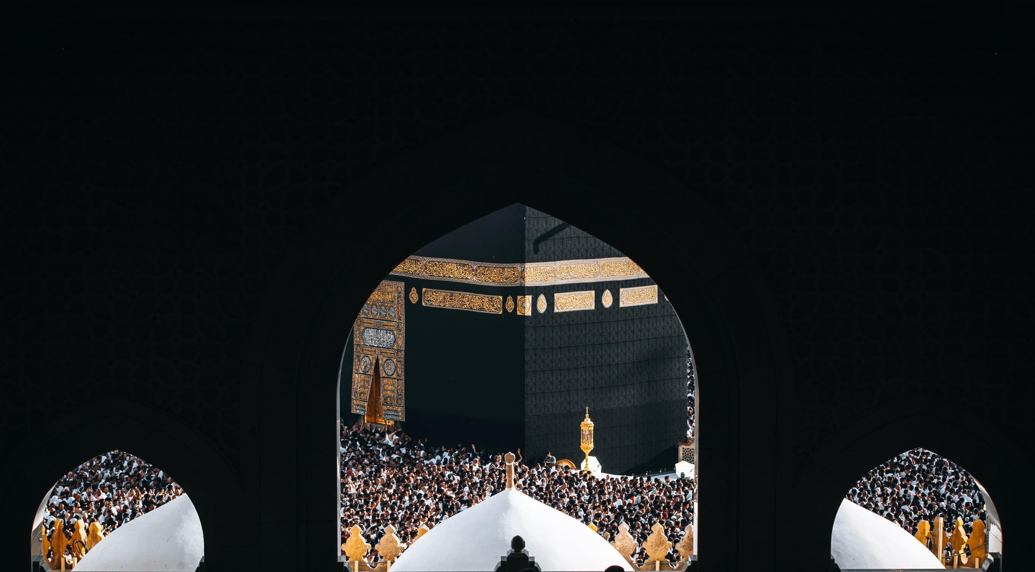
ACTIVITY
Z
VIRTUES & GOALS OF HAJJ
Write on a post-it note:
What do you think the goals of ḥajj are? i.e. what do you want to get out of ḥajj?

Slide 16
10 GOALS OF HAJJ
1. Renew Tawhid and Ikhlas
2. Deepen ʿUbudiyyah and Love of Allah
3. Practise Mindful Dhikr & Salawat
4. Raise Your Duʿa
5. Develop Taqwa
6. Embody Good Character and Work on Your Heart
7. Live a Hereafter-Centric Life
8. Attain Allah’s Forgiveness, Freedom from Hell-fire and Entry into Paradise
9. Repent to Allah and Start Anew
10. Serve the Ummah and Sacrifice
VIRTUES & GOALS OF HAJJ
Notes:
[Facilitator to expand on the following]
Deepen Ubūdiyyah: Ḥajj is a powerful training ground for developing ʿubūdiyyah (true servitude to Allah) where you embody humility, submission, and unwavering obedience. Every act of worship is infused with deep love and longing for Him.
Mindful Dhikr: At every stage — ʿArafah, al-Mashʿar al-Ḥarām, qurbānī, and the Days of Tashrīq — Allah ﷻ specifically commands remembrance of Him. Ḥajj, at its core, is a journey of dhikr (remembrance).
Taqwa: What is taqwa? One of the foremost goals of ḥajj is to attain taqwā. In the āyāt of ḥajj, Allah constantly emphasises the importance of taqwā before, during and following the journey.
Serve the Ummah and Sacrifice: A vow to live and die upon Islam, to devote your life to Him wholeheartedly and serve the ummah of His beloved ﷺ, and to never return to the traps of Shayṭān and his allies.
[For further explanation on the goals of ḥajj, refer to pages 19-26 of My Hajj Companion.]

Slide 17
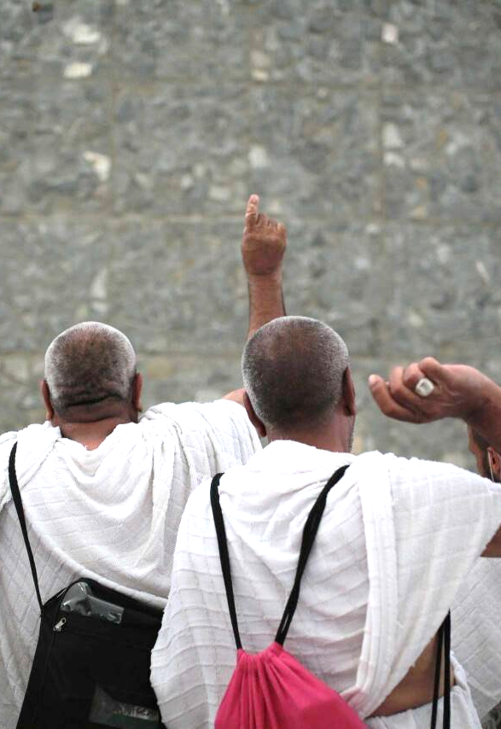
MAXIMISE YOUR INTENTIONS
When the Prophet g set out to perform ḥajj, he said,
“O Allah, a ḥajj in which there is no showing off nor reputation sought”
(Ibn Mājah).
VIRTUES & GOALS OF HAJJ
Multiple Intentions = Multiplied Rewards!
What are your intentions for ḥajj? Write them down.
Notes:
The following are some intentions ḥujjāj can have:
To seek the pleasure of Allah Alone
To attain closeness to Allah
To make a sincere repentance
To attain the forgiveness of Allah
To seek the mercy of Allah
To be protected from the Hell-fire and gain entrance into Jannah
To remember the hereafter
To express the Oneness of Allah and achieve ikhlāṣ
To fulfill the command of Allah and complete the fifth pillar of Islam
To attain taqwā
To respond to the call of Ibrāhīm (s)
To fulfill the sunnah of Ibrāhīm (as), the other great Prophets of Allah and our beloved Prophet ﷺ
To attain the reward of 100,000 prayers by praying in al-Masjid al-Ḥarām and 1,000 prayers in al-Masjid al-Nabawī.
To respect and honour the holy places so that the memories of the events which are connected with these places may be preserved and this may continue to produce good effects in our hearts.
Encourage the audience to do the following when they go home. Face the qiblah. Praise Allah and send ṣalawāt upon the Messenger of Allah ﷺ. Spend at least 5 minutes asking Allah to grant you a ḥajj mabrūr. Then convert the above intentions into duʿās and ask Allah with humility and desperation. (E.g. O Allah, make my ḥajj a means of attaining Your forgiveness.)

Slide 18
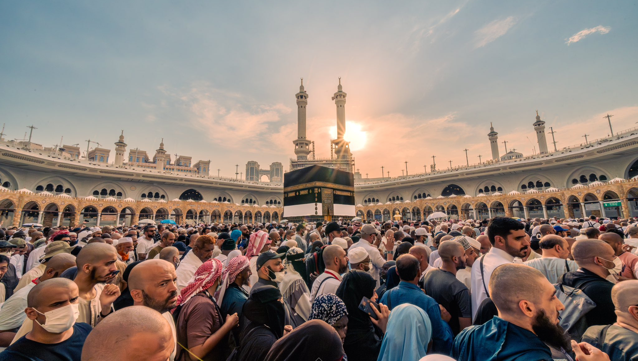
PREPARING FOR HAJJ
Spiritual & Physical Preparation
SESSION 1
Notes:
[If the facilitator has time during the session:
Split the class into 4. Have 4 x A3 sheets. Ask them to brainstorm how they can prepare for hajj. On one side, they will look at the spiritual preparation and on the other side, the physical preparation.]
The following slides will mention a few tips on preparing spiritually and physically for ḥajj. For further information, refer to pages 30-44 of the My Hajj Companion Book.

Slide 19

SEEK HELP FROM ALLAH
PREPARING FOR HAJJ
Istiʿānah and Tawakkul
اَللّٰهُمَّ أَعِنِّيْ عَلَىٰ ذِكْرِكَ ، وشُكْرِكَ ، وَحُسْنِ عِبَادَتِكَ
“O Allah, help me to remember You, be grateful to You and worship You in an excellent manner”
(Abū Dāwūd).
Beg Allah in your duʿās from today
Notes:
Turn to Allah (ʿazza wa jall) with humility and beg Him to grant you the ability to perform this great act of worship with excellence. Remember: you cannot take a single step in ḥajj, or in life, without His help. So keep asking and turning to Him throughout the entire journey. Let your duʿā’ be constant, because success comes only through His permission and mercy.
In every rakʿah, we repeat: إِيَّاكَ نَعْبُدُ وَإِيَّاكَ نَسْتَعِيْن ‘ You Alone we worship, You Alone we ask for help.’ The phrase إِيَّاكَ نَعْبُدُ وَإِيَّاكَ نَسْتَعِيْن teaches us humility, acknowledging our need, dependence, and complete trust (tawakkul) in Allah. He alone grants benefit and removes harm.
From the moment you start thinking of booking your trip until the point you return, arm yourself with tawakkul. No matter what you are going through, place your reliance on Him and know that He is the Best Protector and Guardian (al-Wakīl).
The Prophet ﷺ taught his beloved companion Muʿādh b. Jabal (ra) a beautiful duʿāʾ that captures the essence of istiʿānah (seeking help):
اَللّٰهُمَّ أَعِنِّيْ عَلَىٰ ذِكْرِكَ ، وشُكْرِكَ ، وَحُسْنِ عِبَادَتِكَ.
O Allah, help me to remember You, be grateful to You and worship You in an excellent manner (Abū Dāwūd).
Act: Repeat the above duʿā’ at every moment and beg Allah for His help
Let this be your mindset as you prepare for Ḥajj: rely fully on Allah, seek His help constantly, and walk the path with a heart full of trust and devotion.

Slide 20
SINCERELY REPENT
Stop
Regret
Amend
Resolve
PREPARING FOR HAJJ
4 Steps to Repentance
Notes:
Sins weigh the soul down and prevent it from tasting the sweetness of īmān and being accepted by Allah. Just as an aeroplane cannot take flight while overloaded, your ḥajj cannot rise and ascend if it is burdened by the weight of your sins. Therefore, before setting out for ḥajj, sincerely repent to Allah for your sins and regrets.
In order for tawbah (repentance) to be sincere, follow the steps below:
Stop committing the sin;
Feel a deep sense of regret and remorse over the sin;
Firmly resolve to never return to that sin;
Make amends if you have wronged another person (e.g. ask their forgiveness or supplicate for them).

Slide 21
/
Make repentance your constant companion: The state of tawbah is at the beginning, the middle and the end of the slave’s journey to his Creator. The servant who seeks the pleasure of Allah never abandons tawbah. He remains in the state of tawbah until his death.
- IBN AL QAYYIM

Slide 22
FILL YOUR HEART WITH GRATITUDE
PREPARING FOR HAJJ
‘If you are grateful, I will certainly give you more’ (14:7)
Speech
Heart
Action
Think of the people of the past and the difficulty they had to endure.
Notes:
Out of billions, Allah chose you. He removed all obstacles, whether related to health or finances and made the path smooth. Reflect on how many others, more powerful or wealthy, were not granted this honour. Some don’t even feel the longing for it. But you were chosen. Not because of status or effort, but purely by His mercy.
Remember to stay grateful at every step. Gratitude (shukr) opens the door to even more blessings. Allah ﷻ says, “And (remember) when your Lord proclaimed, ‘If you are grateful, I will certainly give you more’” (14:7). If you wish to be blessed with the ability to do more good deeds and stay firm in worshipping Allah, thank Allah with your tongue, heart and body.

Slide 23
PREPARING FOR HAJJ
Notes:
Ask the audience what they can see.
Many will point to the black dot, however very few will point to the white space around the dot.
Glass half full vs. half empty mindset

Slide 24
PRACTISE YOUR PATIENCE
PREPARING FOR HAJJ
Draw 3 circles:
The things in circles 2 and 3 are likely where you’ll be tested most - expect those trials.
I am always patient with
Remember the reward
Let go of entitlement mindset
Protect your reward
Focus on the positives
Avoid complainers
I am sometimes patient with
I am never patient with
Tips for Patience
Notes:
What is the reward for patience? “Indeed, the patient will be given their reward without measure” (39:10).
Hajj is a journey of patience and taqwā
You will need not only patience with others, but also full control over your own emotions and reactions. Even in this testing environment, you must stay focused on the rites of ḥajj, constantly remembering Allah and begging Him for His forgiveness, love, and mercy.
Ṣabr should be cultivated until it becomes a natural part of your character; something you carry with you through every season of life.
We need patience in every act of obedience to Allah. These acts require effort, consistency, and sacrifice. Their weight rests firmly on the shoulders of patience.

Slide 25
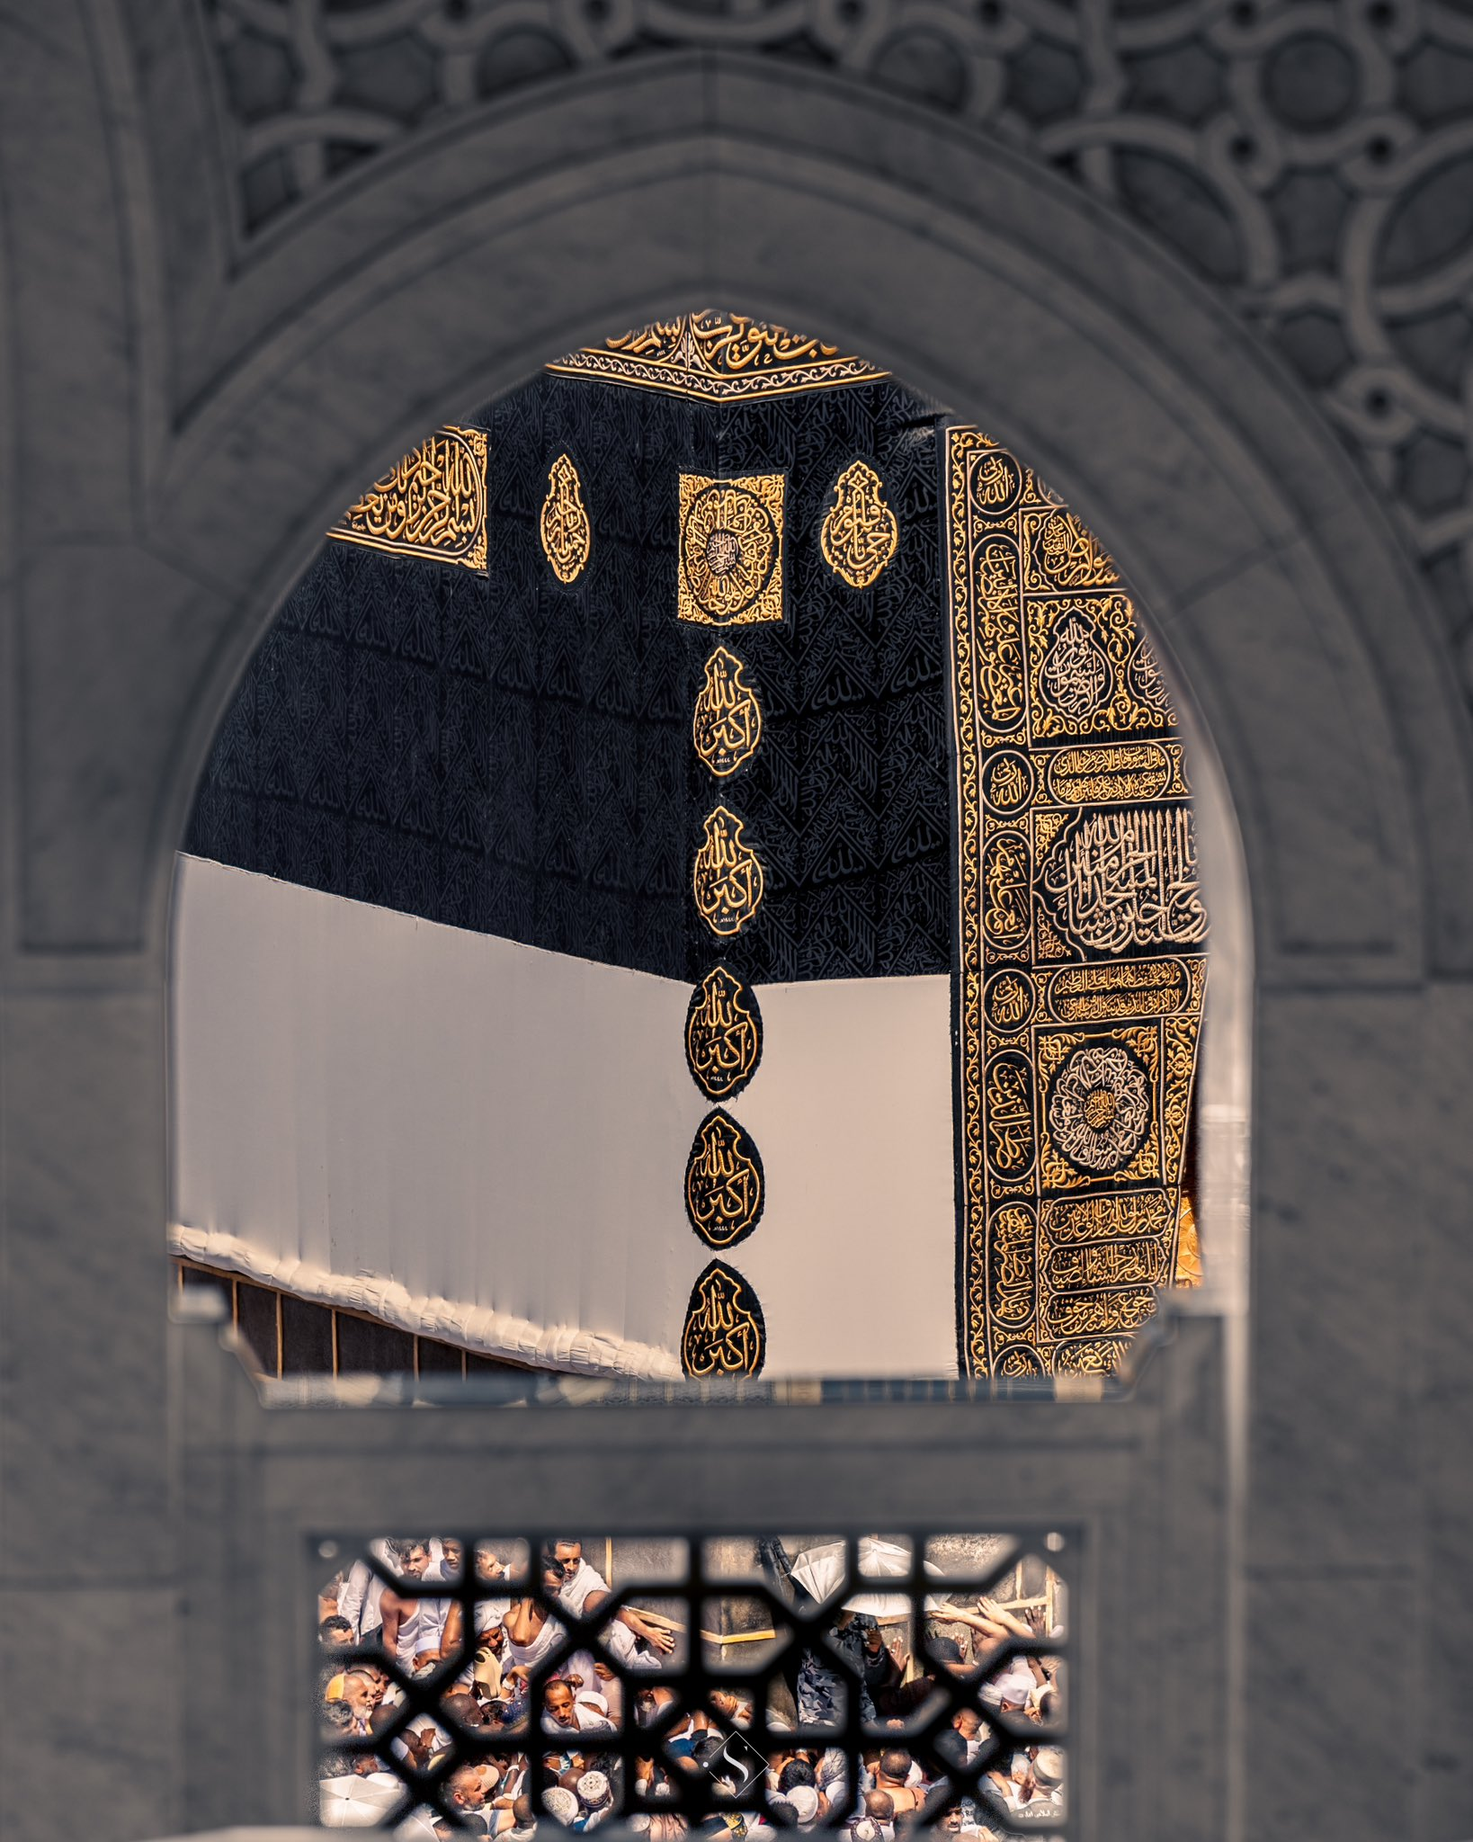
DETACH YOUR HEART FROM THE WORLD
PREPARING FOR HAJJ
What is your heart currently attached to?
What do you love more than Allah?
Notes:
This journey is an opportunity to detach yourself from the world (zuhd) and free your heart from everything but Allah. The Messenger of Allah ﷺ said, “Detach from the world and Allah will love you; detach from what people possess and the people will love you” (Ibn Mājah)

Slide 26
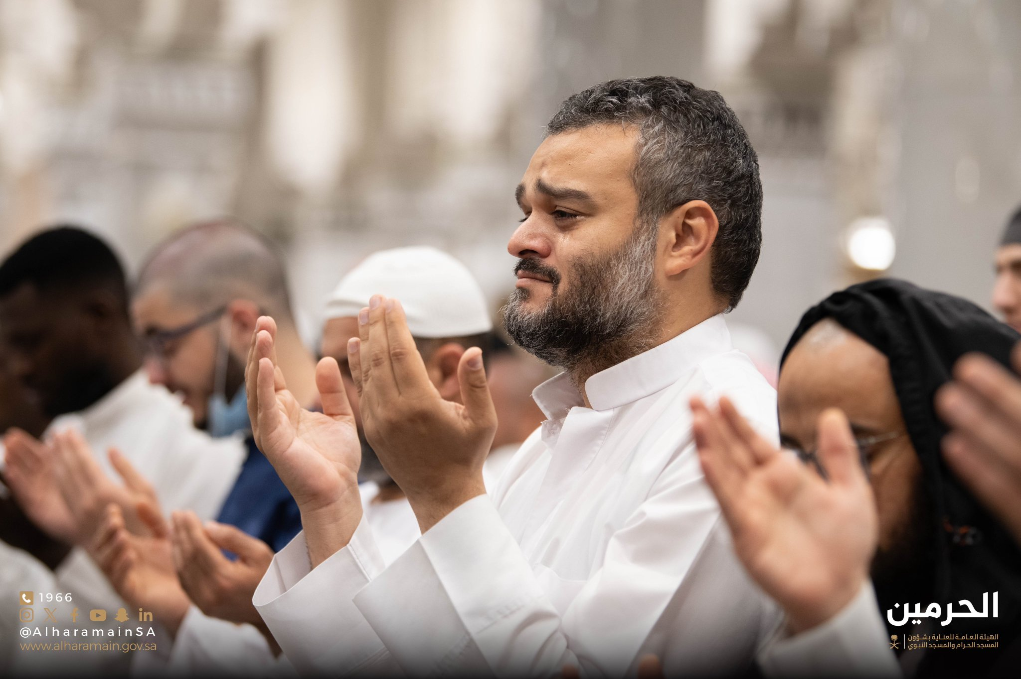
FILL YOUR HEART WITH LONGING & AWE
PREPARING FOR HAJJ
‘Abdullah, the son of the great Imām Aḥmad b. Ḥanbal (rhm) said: “My father performed ḥajj five times — three times riding, and twice on foot. On one of his Hajj journeys, he spent only twenty dirhams. Such was his longing that when he could not afford provisions, he worked as a porter for the caravan to cover the cost — just to not be deprived of the journey.”
Notes:
As you wait to reach the Kaʿbah, let your heart yearn not just for the sacred site, but for the One who made it sacred. True longing (shawq) for ḥajj is not just a desire to visit the House of Allah, but a deep yearning to draw closer to Allah c Himself.
Yearn to draw closer to Allah & to see His Majestic Face in the hereafter
The Prophet ﷺ said, “When the people of Paradise enter it, Allah will say: Would you like anything more? They will say: Have You not brightened our faces? Have You not admitted us into Paradise and saved us from Hellfire? Then, Allah will lift the veil and nothing they are given will be more beloved to them than looking at their Lord Almighty” (Muslim).

Slide 27
SPIRITUAL PREPARATION: SUMMARY
PREPARING FOR HAJJ
Seek Help from Allah & Rely on Him
Sincerely Repent
Fill Your Heart with Gratitude
Practise Your Patience
Detach Your Heart From the World
Fight Your Nafs
Fill Your Heart with Longing & Awe

Slide 28
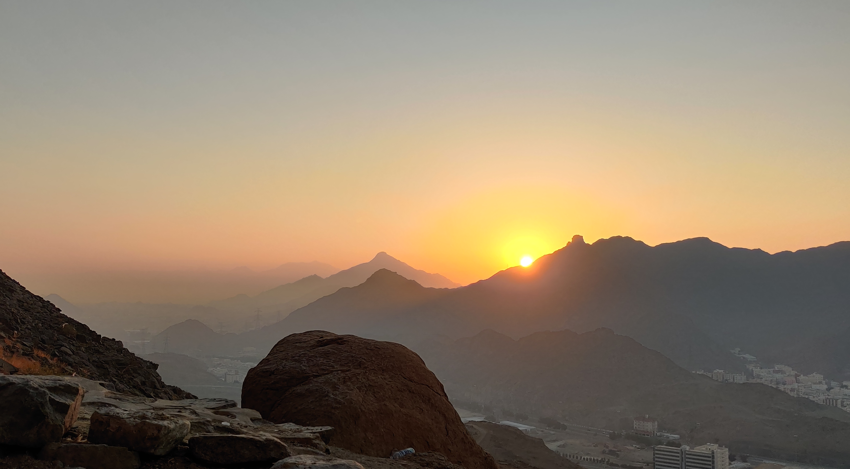
Z
Is your heart really prepared for ḥajj or is there still work you need to do?
Can you worship and remember Allah even when you’re exhausted and overwhelmed?
Are you able to spend six hours in continuous duʿā’?
How do you react when a family member or someone close to you mistreats you?
Notes:
This is a reflective slide. Ask the audience to think about these questions and what actionable steps they can take from today to improve on the above.

Slide 29
Z
Are you able to control your emotions when things are tough?
Are you able to patiently wait for a bus for five hours without complaining?
Are you able to stay in 1-star accommodation without having an emotional breakdown?

Slide 30
PHYSICAL PREPARATION
PREPARING FOR HAJJ
1. Write a Duʿa List and Practise
2. Choose the Right Companion (s)
3. Write Your Will (Wasiyyah)
4. Pay Your Debts
5. Make Amends
6. Reduce Your Social Media Usage
7. Increase Your Steps
8. Drink Lots of Water
9. Learn the Outer and Inner Fiqh of Hajj
10. Pack Light
Notes:
We will return to the duʿā’ list as part of the homework: this is ESSENTIAL!
Surround yourself with someone who pushes you closer to Allah. Limit your time with those who only speak about trivial worldly matters. Just as you would like an upright friend to motivate you, be that good companion and friend for others. Whatever your weakness is, find someone who can cover that. Give personal example.
The Prophet ﷺ said: “It is the duty of a Muslim who has something to bequeath that he should not spend two nights without having his will written” (Bukhārī).
Settling debts takes precedence over performing ḥajj. The Messenger of Allah ﷺ used to ask before praying over a deceased person, “Does he owe any debts?” (Bukhārī). If someone promised to repay it, he would perform the prayer; otherwise, he would not.
Make amends. Ask others for forgiveness and forgive too. Masʿūd al-Hamadhānī (rhm) would often pardon people and forgive their wrongs, saying to them, “The past is not to be mentioned.” One of his companions saw him in a dream after his demise and asked him, “What did Allah do with you?” He replied, “He made me stand in front of Him and said: ‘O Masʿūd, the past is not to be mentioned. Take him to Paradise.’”
Social media platforms are designed to be addictive. They distract us from our goals, hinder us from our social and familial responsibilities and reduce our ability to focus.
Ḥajj is a physically demanding journey, involving long hours of walking, especially on the 10th day of Dhul Ḥijjah, when you may walk up to 30,000 steps. Walk on an incline, in the heat and do dhikr.
One of the most common reasons people fall ill on the Day of ʿArafah is dehydration. The heat can quickly take a toll on your body if you’re not properly hydrated.
Attend courses, read books and watch video series so you’re fully equipped with all the essential guidance.
When packing your bags, don’t over pack or carry more than you need. Ḥajj is a journey of simplicity. It is not about excess or showing off. Don’t fall into the materialist trap and buy everything that has been marketed to you. Give personal anecdote; shops are available.
Some important items to pack:
Vaseline
Backpack and drawstring bag/tote bag
Good footwear
Modest, comfortable and light abayas
Qur’an
Sirah book
Du’aa book
Unscented wipes
Notes
Hydration tablets

Slide 31
/
PLENARY
Write down one duʿāʾ you would like on a post-it note. Place it anonymously in the center.
Then, pick up someone else’s duʿāʾ and commit to including it in your own duʿāʾ list and making duʿā’ for them during ḥajj.

Slide 32
/
HOMEWORK – YOUR DUʿĀ’ LIST
Reflect on your life: regrets, sins and mistakes
List your hopes, dreams and everything you want to ask Allah b for. Don’t forget the ummah in your duʿās, especially those suffering in Palestine under the barbaric Zionist oppression.
Practise, Practise, Practise!
Notes:
Ḥajj is filled with many opportunities to make duʿā. You will make more duʿā in ḥajj than you ever will in your life. The most significant time for duʿā’ will be on the Day of ʿArafah where you should spend approximately six hours in continuous supplication. However, if you’re not used to speaking to Allah regularly or making duʿā, you can’t expect to suddenly stand and pour your heart out for six hours without preparation.
The Messenger of Allah ﷺ said, “The warrior in the path of Allah, the pilgrim, and the person performing ʿumrah are the guests of Allah. He invited them so they responded to Him; they asked Him, so He gave them” (Nasā’ī)
Start a duʿā’ list:
Reflect on your life. Go through all of your regrets, sins and mistakes and write them down so that you can sincerely ask for forgiveness.
List your hopes, dreams and everything you want to ask Allah ﷻ for. Don’t forget the ummah in your duʿās, especially those suffering in Palestine under the barbaric Zionist oppression.
Begin practising now. Start by making duʿā for just five minutes a day, then increase the time by two minutes each day. By the time you leave for ḥajj, you’ll find it much easier and more natural to make duʿā for extended periods of time.
You are going to the KING! ASK, ASK, ASK!
Iman, Health, Hereafter, Family, Finances, Children, Career, Education, Ummah, Community

