Slide 1
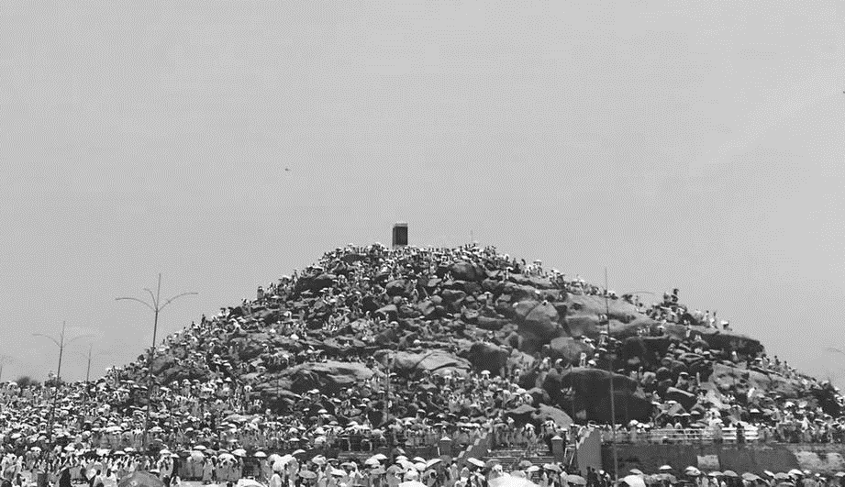
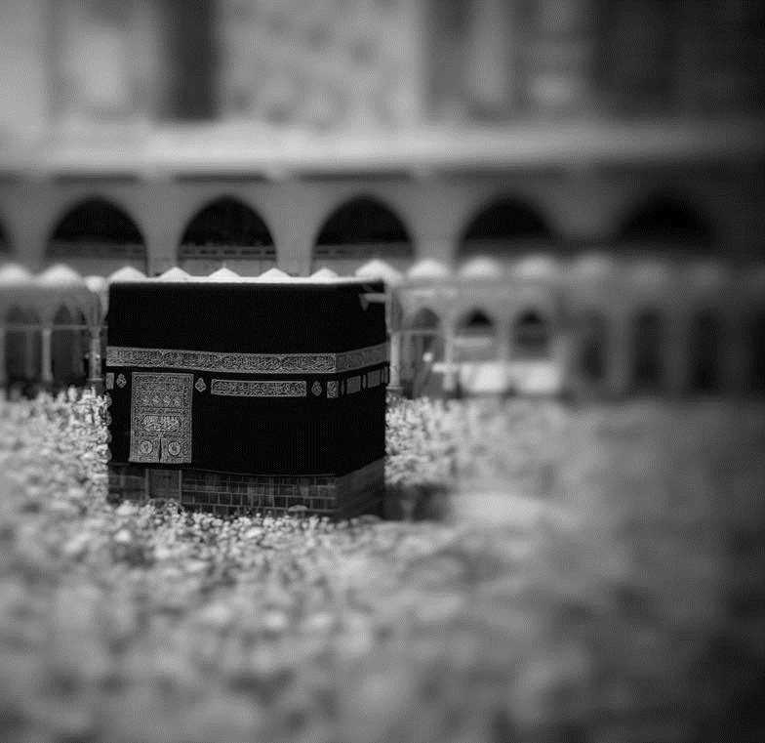
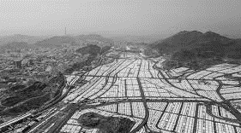
Dhul-Hijjah: Dhikr & Qurbani
PART 2
Notes:
Bismillah, Praise Allah and Salawat.
For further information on this topic, read the articles on: https://lifewithallah.com/articles/dhul-hijjah/
OR
Download the PDF/order the physical book: https://lifewithallah.com/publication/dhul-hijjah-online/
Feel free to adjust this ppt to your learners’ needs.
The ppts sometimes assume prior knowledge and/or knowledge of Arabic.
Read the notes before delivering the lesson.
[A] = Activity. This can be done orally, in writing, on mini whiteboards (MWB), classroom board, through discussion; individually, in pairs, groups etc, and through other methods.
LWA is not responsible for external links.
We would appreciate your feedback on these slides. Fill out this short form: https://forms.gle/yP45KNYEbemxT7hS6

Slide 2
Session Objectives
To explain how to do dhikr with the presence of the heart
To reflect on the significance of Qurbani
To identify how we can attain the reward of hajj and umrah

Slide 3
Starter: Quiz
Why are the 10 days of Dhul Hijjah so special?
What is the main deed of the Days of Dhul Hijjah?
What does Allah b do on the Day of Arafah?
List 5 actions of the Day of Arafah.
When do we recite the Takbir of Tashriq?
Finish off: …لَا إِلٰهَ إِلَّا اللهُ وَحْدَهُMN
Finish off: …اللهُ أَكْبَرُ اللهُ أَكْبَرُ
What date of Dhul Hijjah is Eid?
Is Qurbani wajib or sunnah?
What should you not do once the 10 days start & you are intending to do Qurbani?
How do you attain the reward of Hajj and ‘Umrah without being there?
Notes:
Class quiz: divide into groups and reward winning team
OR
Ask learners to write answers on Mini Whiteboards individually.
OR
Ask a volunteer to come in to the hot-seat. Ask remaining learners to write down 1-11 in their books. Volunteer will answer the questions, whilst the remaining learners will mark the answers in their own books. At the end, ask for a show of hands for the total marks (11/10/9 etc.), and go through the correct answers, if there is a need.

Slide 5
Dhikr
1
With the presence of the heart

Slide 6
Conscious Dhikr
In your group, discuss what each of the following means. What can we think about when we remember Allah with these words?
لَا إِلٰهَ إِلَّا اللّٰهُ
اللهُ أَكْبَرُ
اَلْحَمْدُ لِلّٰهِ
Notes:
https://lifewithallah.com/articles/seasons-of-worship/dhul-hijjah/dhikr-the-hallmark-of-the-days-of-dhul-hijjah/

Slide 7
Tahlil: The Best Dhikr
What is لَا إِلٰهَ إِلَّا اللّٰهُ?
What does لَا إِلٰهَ إِلَّا اللّٰهُ mean?
There is no god, deity or being which deserves to be worshipped and obeyed except Allah.
To be a slave of Allah alone, and not of any another being, ideology, object or desire.
[A] How can we internalise لَا إِلٰهَ إِلَّا اللّٰهُ?
Submit
The foundation of faith
The cornerstone of existence itself
Worship
Love
Fear and hope
Trust
Seek protection
Complete obedience
Seek judgement
Greatest statement ever uttered
Notes:
Meaning
There is no god, deity or being which deserves to be worshipped and obeyed except Allah. It means to be a slave of Allah alone, and not of any another being, ideology, object or desire.
With it, we profess Allah’s Lordship over all creation, and thereby His exclusive right to be worshipped alone.
He Alone has the Most Perfect Names and Attributes. He is the King who has no partner, the One Who has no competitor, the Self-Sufficient Master who has no offspring, and there is nothing like Him. He is Unique; the First who was never preceded by non-existence and the Last who will never come to an end.
Internalising
To internalise لَا إِلٰهَ إِلَّا اللّٰهُ, we submit ourselves to Allah and worship Him alone. We fear none but Him and love none as much as Him. We depend only on Him, seek protection only with Him and invoke Him alone for help and forgiveness. We turn to Him alone for judgement in all matters. Our bowing, prostration and unyielding obedience is solely reserved for Him.

Slide 8
Takbir
اللهُ أَكْبَرُ
Allah is Greater than anything we can imagine, and His greatness encompasses all things: He is Great in His Essence, His Names, His Attributes and His Actions.
Allah is Supreme and above every limitation and deficiency that is inherent in created beings.
Reflect on His creation: humans, animals, mountains, planets, angels, Throne of Allah etc.
Notes:
Allahu Akbar means ‘Allah is Greater than…’ By not specifying what He is Greater than, we are saying that He is Greater than everything. Allah is Greater than anything we can imagine, and His greatness encompasses all things: He is Great in His Essence, His Names, His Attributes and His Actions. Allah is Supreme and Transcendent above every limitation and deficiency that is inherent in created beings.
When we ponder on the greatness of Allah’s creation, such as the heavens, the earth, His Kursī and His Majestic Throne, and then realise our own inability to comprehend them due to their greatness, we should arrive at the most important realisation: how Great must their Creator be!

Slide 9
Tahmid
اَلْحَمْدُ لِلّٰهِ
Gratitude
Praise
[A] What can we think of when we say
‘اَلْحَمْدُ لِلّٰهِ’?
1) The blessings of Allah
2) His Perfect Names
Notes:
Alhamdulillah (All Praise and Thanks are for Allah) is an expression that encompasses both:
(1) Gratitude for what Allah has blessed us with; īmān, life, health etc.
(2) Praise: Allah is worthy of every possible praise on account of His very existence, His mercy, beauty, generosity and all of His other noble Attributes and Names. All of His Attributes are perfect; be they of His majesty (jalāl) or beauty (jamāl). Even if none of His slaves praised Him, He would still be worthy of all praise.

Slide 10
Qurbani
2
Beyond the finger lickin’ chops

Slide 11
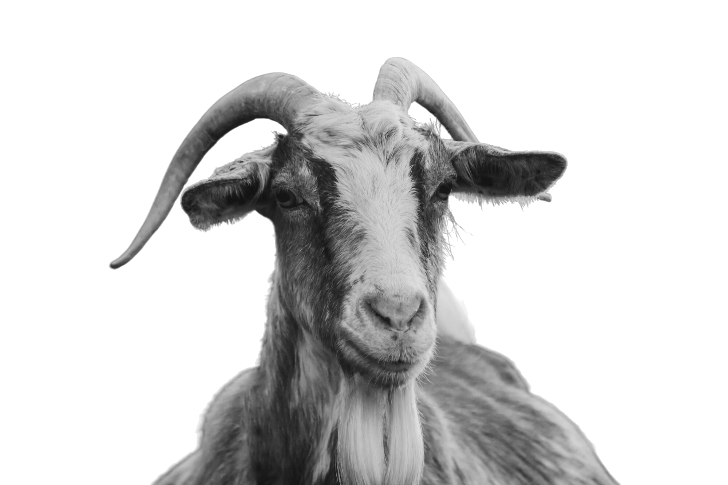
Qurbani/Udhiyah
[A] Why do we perform Qurbani?

Slide 12
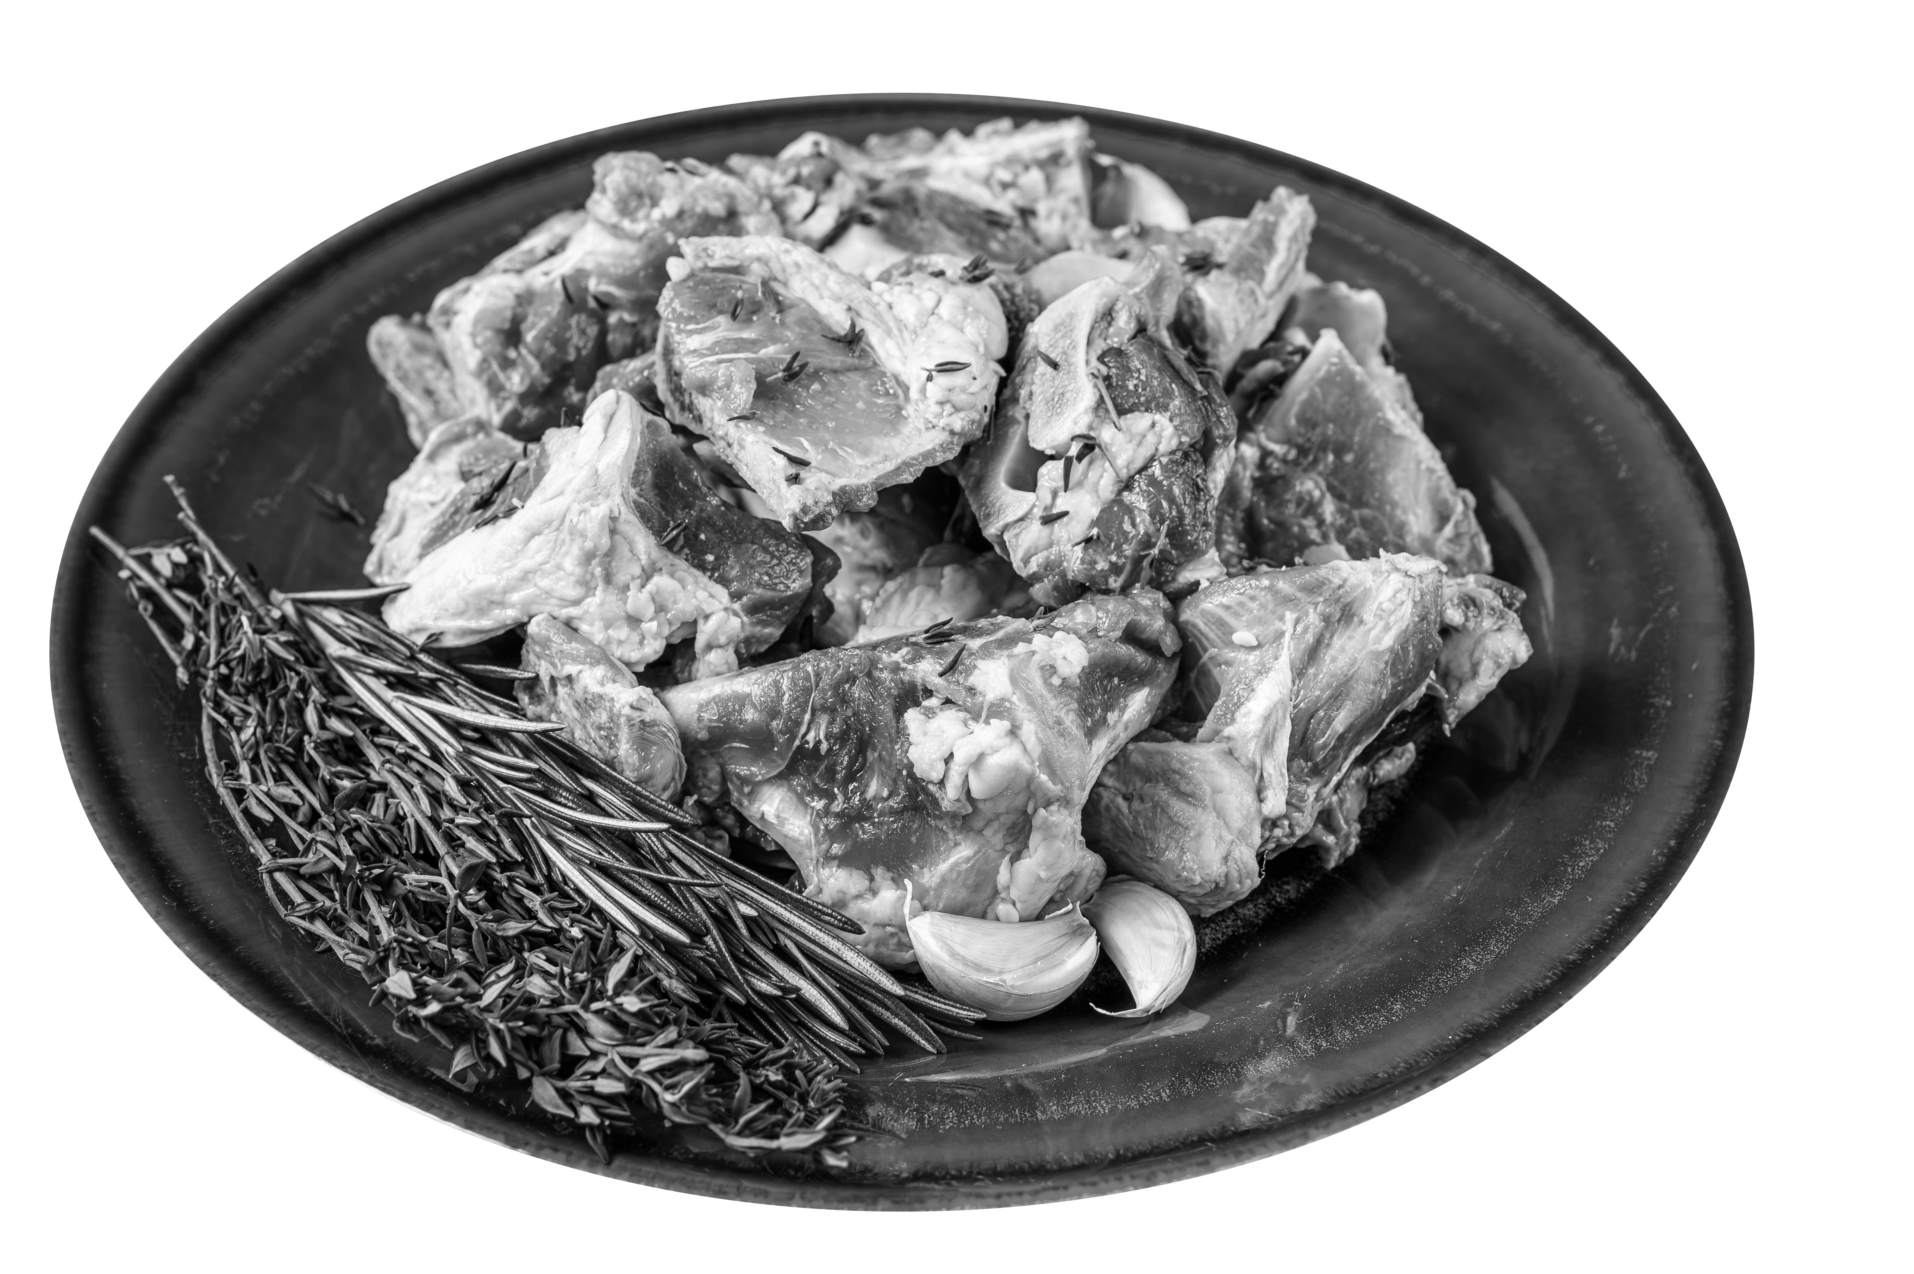
Why Qurbani?
Sunnah of Ibrahim n
Sunnah of Muhammad g
To gain taqwa
To remember and thank Allah b
To venerate a symbol of Allah b
To gain reward
Notes:
https://lifewithallah.com/featured/qurbani-more-than-just-tender-meat/
Allah (subḥānahū wa ta‘ālā) says: “Never does their meat or their blood reach Allah, but what does reach Him is your taqwā (piety).” (22:37)
Allah (subḥānahū wa ta‘ālā) tells us here that our outwardly acts of worship must be accompanied by taqwā and sincerity.
Qurbani is a means to venerate the symbols of Allah. Showing respect to the outwardly symbols which represent and remind us of Allah (subḥānahū wa ta‘ālā) helps us to develop our taqwā. Allah says: “Whoever honours the symbols of Allah – indeed, it is from the piety of hearts.” (22:32)
The Prophet ﷺ said: “There is nothing more beloved to Allah that a slave can do on the day of Naḥr than spill blood (i.e. qurbānī). On the Day of Judgement, it will be brought forth with its horns, hair, and hooves. Indeed, the blood will be accepted by Allah even before it spills on the ground, so whole-heartedly delight in (performing the sacrifice).” (Tirmidhī)

Slide 13
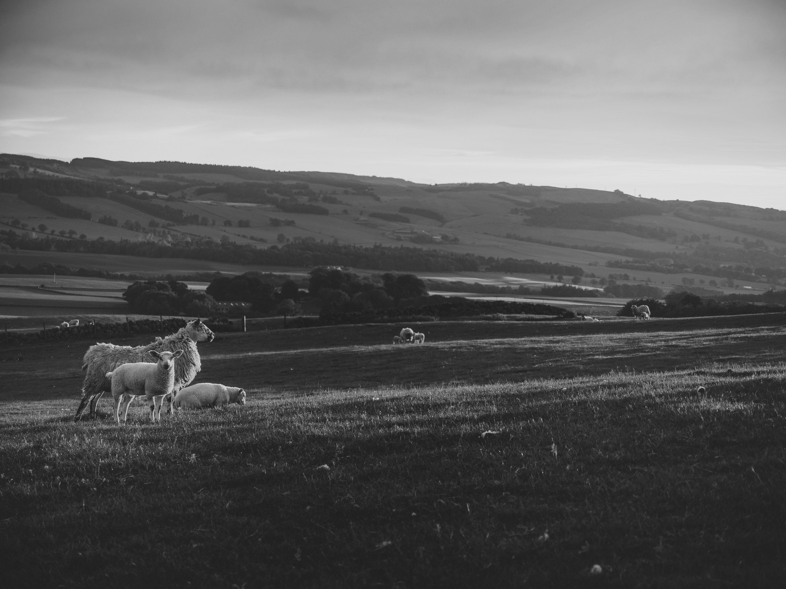
Qurbani
Qurbani
Qurb
Closeness
Udhiyah
Dahha
Sacrifice
Notes:
Ask:
What does the word ‘Qurbani’ stem from? What do you think this tells you about the aim of why we do it?
To attain closeness to Allah.
Sacrifice:
To sacrifice not just an animal; but to sacrifice everything that takes us away from Him.

Slide 14
[QF] Reflection
[A] Write 37:102-107
What lessons can we derive from these ayat? What can we learn from this incident?
Notes:
Qur’anic Focus (QF)
This is an attempt to connect learners’ to the Qur’an and form a strong personal bond with it.
At the beginning of the year, instruct learners to bring in their personal mushaf to every class.
Each lesson (wherever possible), physically make them open the Mushaf at least once.
Ask learners to write down the chosen ayah in their books. Ask one student to recite. Ask another student to attempt a translation. Discuss and explain the meaning of the ayah.

Slide 15
True Servants of Allah
Humility
Trust
Obedience
Submission
فَلَمَّا بَلَغَ مَعَهُ ٱلسَّعْىَ قَالَ يَٰبُنَىَّ إِنِّىٓ أَرَىٰ فِى ٱلْمَنَامِ أَنِّىٓ أَذْبَحُكَ فَٱنظُرْ مَاذَا تَرَىٰ قَالَ يَٰٓأَبَتِ ٱفْعَلْ مَا تُؤْمَرُ سَتَجِدُنِىٓ إِن شَآءَ ٱللَّهُ مِنَ ٱلصَّٰبِرِينَ ‎﴿١٠٢﴾‏
Then when the boy reached the age to work with him, Abraham said, “O my dear son! I have seen in a dream that I ˹must˺ sacrifice you. So tell me what you think.” He replied, “O my dear father! Do as you are commanded. Allah willing, you will find me steadfast.” (37:102)
Notes:
https://lifewithallah.com/articles/seasons-of-worship/dhul-hijjah/eid-al-adha-a-symbol-of-true-faith-and-submission/
To Ibrāhīm (‘alayhis-salām), the question was one of obedience. Since his Lord wanted something, so be it, without hesitation. His son should also know and accept it willingly, with submission so that he too would earn the reward of obeying Allah and experience the pleasure of submission to Him. He himself had known that pleasure and now wants his son to feel it as the pure goodness that surpasses all else that life can offer.
What does the son say as his father proposes to slaughter him in fulfilment of what he saw in a dream? The son also rises to the sublime standard his father had earlier attained: “He said: My father! Do as you are bidden, and, Allah willing, you will find me to be patient in adversity.” (37:102)
This is an example of perfect humility before Allah, trust in Him, combined with complete obedience and submission to His will…
The scene moves further to show us the order being carried out: “When the two of them had surrendered themselves to the will of Allah, and Ibrāhīm laid him on his forehead.” (37: 103) Once more, obedience, faith and acceptance of Allah’s decree rise to a far nobler standard than anything known to humanity. The father lies his son down on his face, and the son submits and shows no resistance. All this takes place in reality.
Such is self-surrender, which is the essence of Islam: complete trust, obedience, certainty, acceptance, submission and action. Both father and son experience nothing other than pure faith…

Slide 16
True Iman and Islam
Self-Reflection
Are there aspects of Islam I struggle to come to terms with? Do I think my intellect is superior or do I submit to Allah?
When faced with a difficulty, do I say ‘Why me, O Allah?’ or do I think the best of Allah?
Do I love Allah & rush to obey the commands of Allah as Ibrahim h did?
What sacrifices am I going to make? (time, money, sleep, social pressure etc.)
Our obedience to Allah is unconditional.
There is wisdom in all of Allah’s commands. We may see them or we may not see them.
Our obedience to Him, however, is NOT dependent on us knowing the wisdoms of commandments.

Slide 17
Mighty Actions
3
To gain the reward of hajj and umrah
Notes:
As the fortunate few of our Ummah make their way to the House of Allah for ḥajj, donning the iḥrām and raising their voices in takbīr and the talbiyah, we are sad at being unable to join them. Allah knows that we long to visit His House, but we cannot always do so. Thus, from His mercy, He gave us these days as a beautiful replacement.
There are some actions which the Prophet (saw) told us, which if we do, we can gain the reward similar to a hajj. Do you know of any actions?

Slide 18
“Whoever offers Fajr in congregation and remains seated, engaging in the remembrance of Allah until the sun has risen, and then offers two rakʿahs, he will have a reward equal to that of performing hajj and ʿumrah.” He g said: “Complete, complete, complete (i.e. complete reward)”
(The Messenger of Allah g , Tirmidhī).
Notes:
Salah al-Duha is approx. 15 mins after sunrise.
The scholars have also stated that this reward is equally applicable to a woman (praying at home) who sits in the place where she performs Fajr and remembers Allah or recites the Qur’ān until sunrise.
Don’t miss out on this reward in these special days.

Slide 19
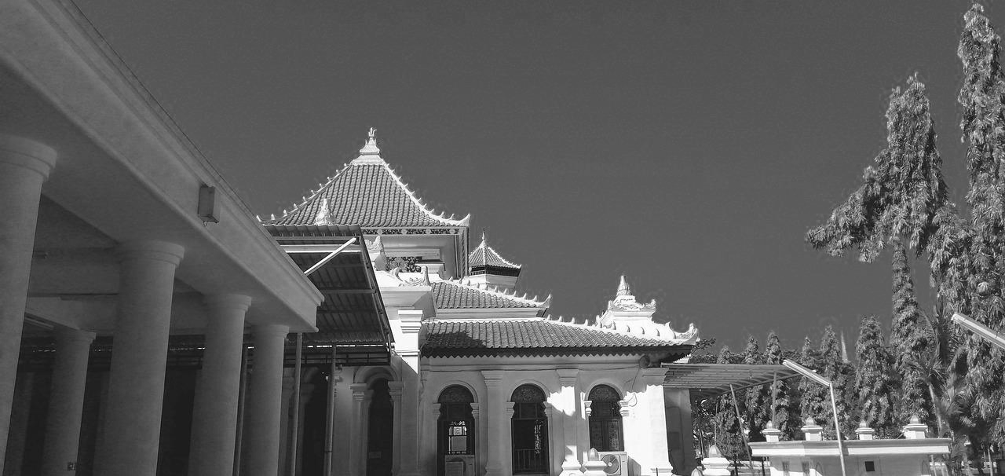
The Messenger of Allah g said: “Whoever goes to the Masjid, only intending to learn some good or teach it, he will have the reward of a complete ḥajj.”
(Tabarānī)

Slide 20
Plenary
Write three key questions which you think your peers should be able to answer, based on today’s lesson. When ready, go around and ask at least 3 people your questions.

Slide 21
(Alternative) Plenary
What can we think of when we say ‘لَا إِلٰهَ إِلَّا اللّٰهُ’?
What can we think of when we say ‘اَللّٰهُ أَكْبَرُ’?
What can we think of when we say ‘اَلْحَمْدُ لِلّٰهِ’?
Why do we perform Qurbani?
What lessons can we learn from the sacrifice of Ibrahim and Isma‘il q?
How can we attain the reward of hajj without being there?

Slide 22
Questions?
سُبْحَانَكَ اللّٰهُمَّ وَبِحَمْدِكَ ، أَشْهَدُ أَنْ لَّا إِلٰهَ إِلَّا أَنْتَ ، أَسْتَغْفِرُكَ وأَتُوْبُ إِلَيْكَ
You are free from imperfection, O Allah, and all praise is to You. I bear witness that there is no god worthy of worship but You. I seek Your forgiveness and turn to You in repentance.

