Slide 1
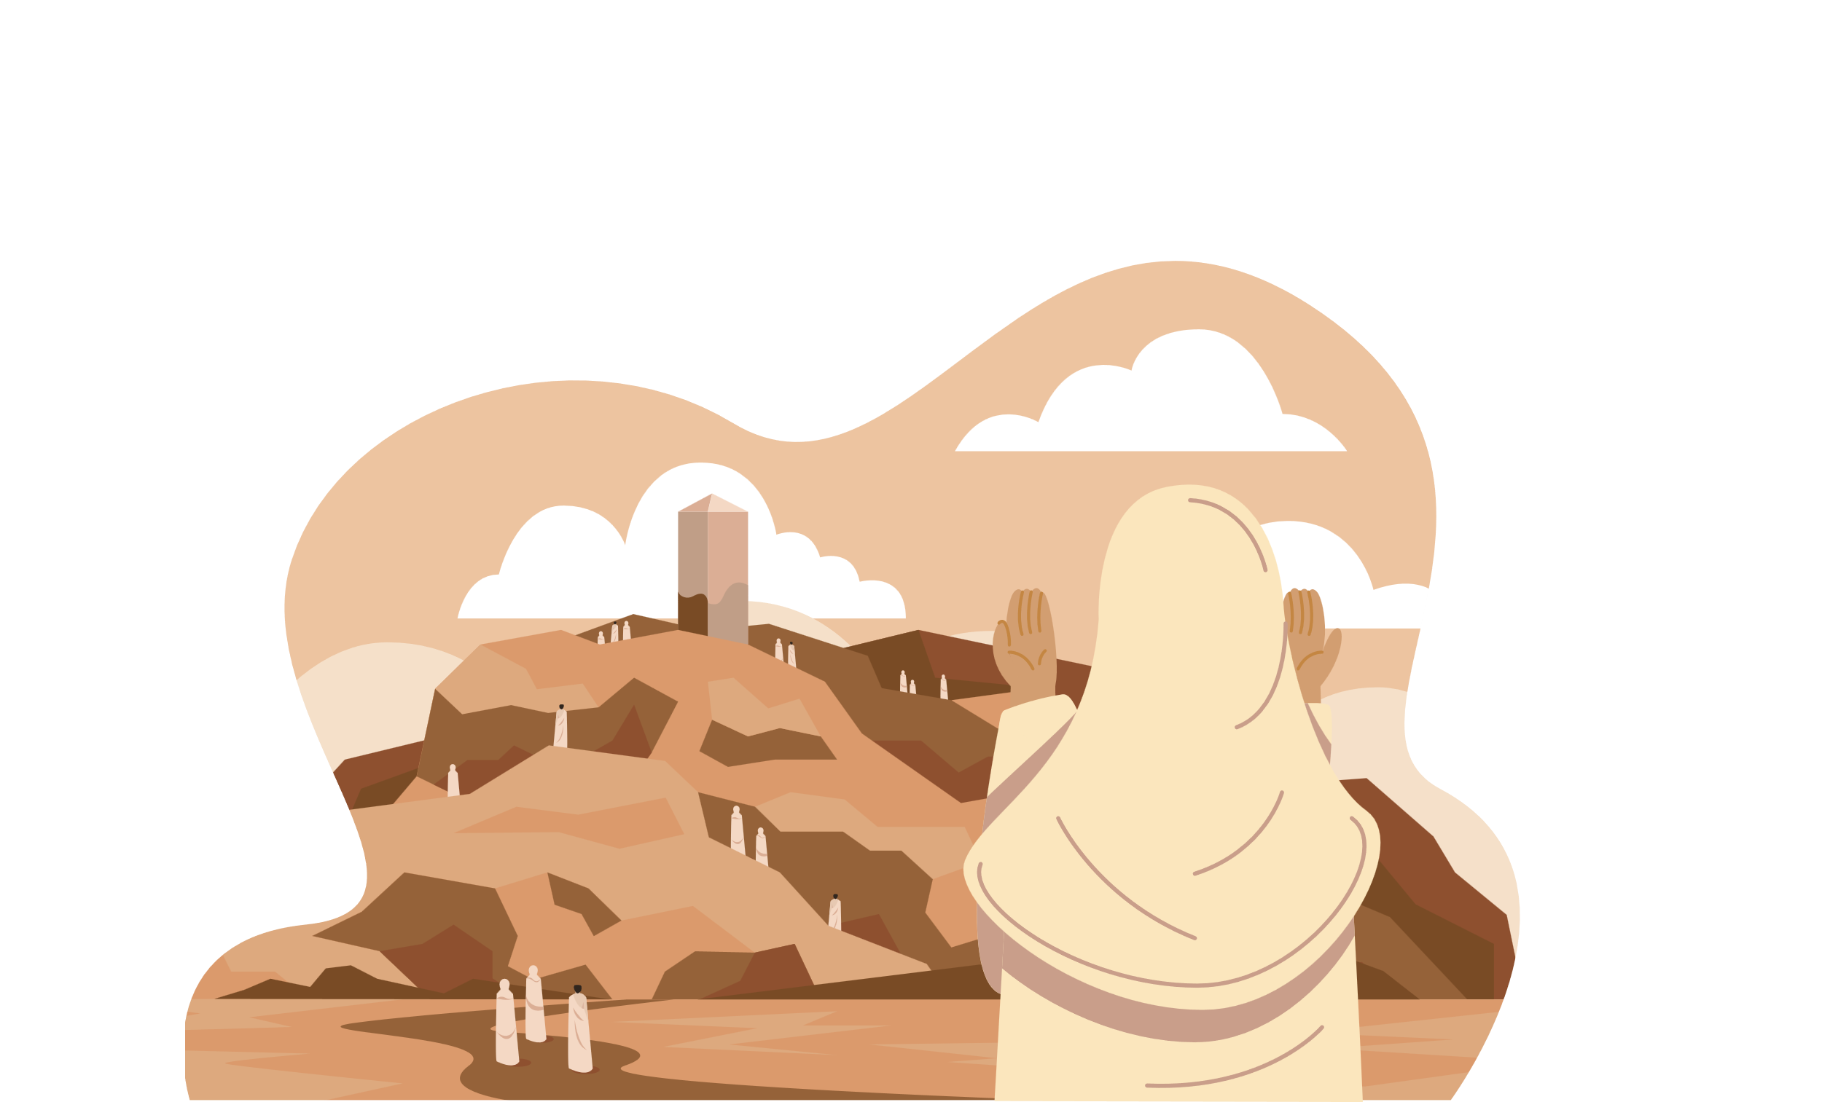
AGES 12+
PART 2
DHIKR &
QURBANI
Notes:
[A] = Activity. This could be oral/written/typed up/in pairs/group/mini-whiteboard/flip-chart paper/discussion etc.
Please refer to ‘The Best Days of Your Life’ by Life With Allah for a detailed read on the topic:
https://alifewithallah.com/publications/

Slide 2
Learning Objectives
To infer key life lessons from the story of Ibrahim (‘alayhis salam)
To identify the significance of qurbani
To explain the meaning of tahlil, takbir and tahmid

Slide 3
Starter
What are the takbirat of tashriq?
When should we recite them?
What 3 specific things should we do on the Day of Arafah?
What did the Prophet ﷺ say about these 10 days?

Slide 4
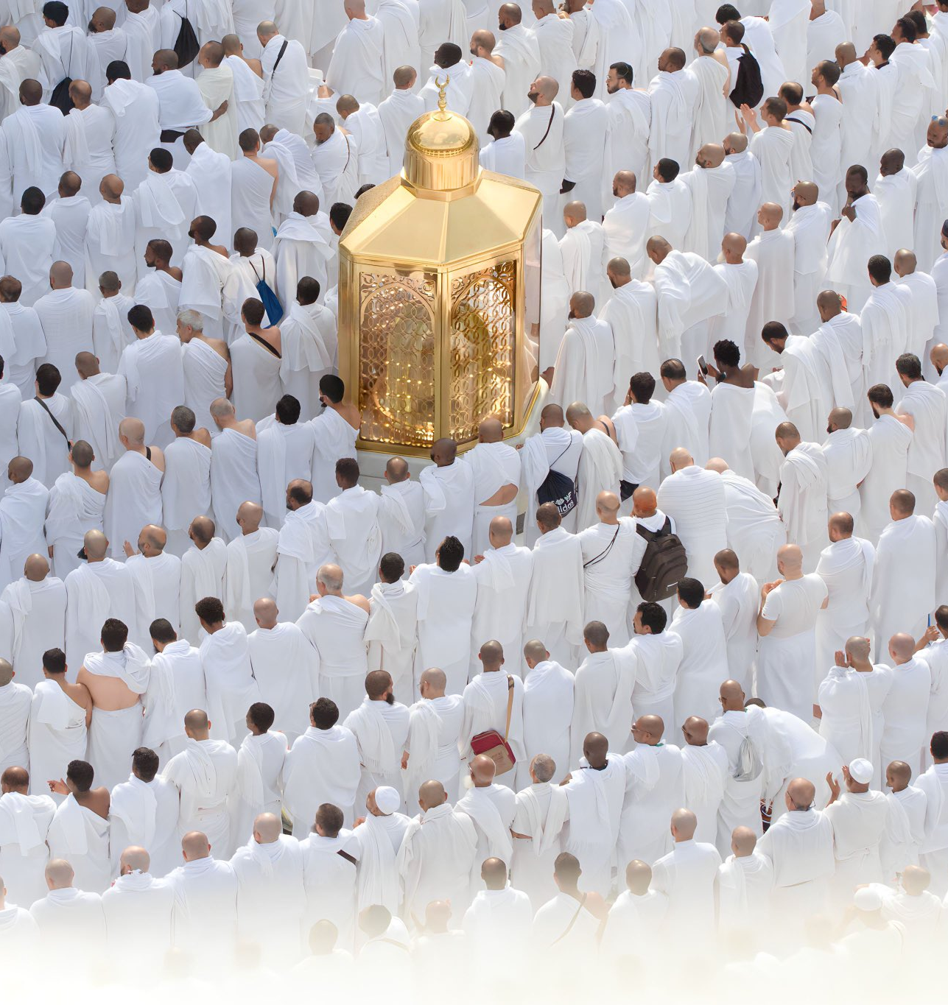
Story Time
A long, long time ago, there lived a boy in Iraq…
Notes:
Narrate the story of Ibrahim alyhis-salam…explain the incident of sacrifice in detail (mention how he was childless for many years, and Ismail as was a gift after so many years…and a model child (pious, respectful and obedient)
https://quran.com/37:102/tafsirs/en-tafsir-maarif-ul-quran

Slide 5
Key Lessons
[A] What can we learn from this story?
Ibrahim (‘alayhis Salam) fully obeyed and submitted to Allah.
He didn’t say: Why? Why ME, O Allah?
Even if it doesn’t make sense to us, we do it because Allah has told us to do so!
Shaytan will come but we have to fight back

Slide 6
Our Sacrifice
Do we have to sacrifice our children?
[A] What do we have to sacrifice to earn the pleasure of Allah?
Time
Sleep
What others think about us
Our desires
Chilling out time
e.g. salah on time
e.g. watching haram
e.g. seeking knowledge
e.g. Fajr
e.g. how we dress

Slide 7
Qurbani/Udhiyah
[A] Why do we sacrifice an animal?
1. In obedience to Allah & His Messenger ﷺ
2. To become close to Allah
3. [A] Write 22:34
وَلِكُلِّ أُمَّةٍ جَعَلْنَا مَنسَكًا لِّيَذْكُرُواْ اسْمَ اللَّهِ عَلَى مَا رَزَقَهُمْ مِّن بَهِيمَةِ الاَنْعَـامِ فَإِلَـهُكُمْ إِلَـهٌ وَاحِدٌ فَلَهُ أَسْلِمُواْ وَبَشِّرِ الْمُخْبِتِينَ
To remember and thank Allah
4. To follow the sunnah of Ibrahim (‘alayhis Salam). It reminds us to prefer and love Allah over our own desires.
Notes:
Allah c says: “For every Ummah (religious community) We prescribed the act of sacrifice, so that they may invoke the name of Allah over the livestock He provided for them: So, your God is One God, so submit to Him Alone…” (22:34)

Slide 8
Eid Mubarak ☺
Eid al-Adha = Sacrificing and cutting out all that which displeases Allah ‘azza wa jall.

Slide 9
Days of Dhikr
“
“There are no days greater in the sight of Allah or in which good deeds are more beloved to Him than these 10 days. So recite a great deal of tahlīl (لَا إلَه إِلَّا اللهُ), takbīr (اللهُ أَكْبَرُ) and tahmīd (الْحَمْدُ للهِ).”
- The Messenger of Allah ﷺ

Slide 10
Takbir
اللهُ أَكْبَرُ
Allah is Greater than…
What can we think of when saying ‘Allahu Akbar’?
Notes:
Simplify and explain:
اَللهُ أَكْبَر means ‘Allah is Greater than…’ By not specifying what He is Greater than, one is saying that He is Greater than everything. Allah is Greater than anything we can imagine and His Greatness encompasses all things: He is Great in His Essence, His Names, His Attributes and His Actions. Allah is Supreme and Transcendent above every limitation and deficiency that is inherent in created beings.
Ask learners to close their eyes and imagine the following:
Imagine the Sahara Desert. The entire desert is the Kursī of Allah, and the size of the heavens and the earth in proportion is equivalent to a ring thrown in the desert. Now close your eyes, and let your mind ascend. Wander around this desert, which is now the Throne of Allah, and remember that the Kursī in proportion is the size of a ring. Can you even imagine the size of the Throne of Allah? It is truly mind-boggling. If we cannot comprehend the above, how can we then comprehend the greatness of Allah?
To understand His greatness, it helps to reflect on His greatest creation: His Throne (the ‘Arsh of Allah). The Messenger of Allah g said, “The seven heavens in comparison to the Kursī is nothing but like a ring thrown in a desert, and the excellence of the Throne of Allah over the Kursī is like the excellence of that desert over that ring” (Bayhaqī).

Slide 11
Tahlil
لَا إلَه إِلَّا اللهُ
The only One who deserves to be worshipped
What can we think of when we are saying ‘La ilaha illa Allah’?
Notes:
There is no god, deity or being which deserves to be worshipped and obeyed except Allah. It means to be a slave of only Allah, and not of any another slave, ideology, material object or one’s own desires.
We should make Him the Only One.
He Alone has the Most Perfect Names and Attributes. He is the King Who has no partner, the One Who has no competitor, the Self-Sufficient Master Who has no offspring, and there is nothing like Him. He is Unique.

Slide 12
Tahmid
اَلْحَمْدُ للهِ
Praise & Gratitude
What can we think of when we are saying ‘Alhamdulillah’?
Notes:
Simplify and explain:
اَلْحَمْدُ لِلَّه is an expression that encompasses both:
(1) gratitude (for what Allah has blessed us with)
(2) and praise (Allah is worthy of every possible praise on account of His very existence, as well as for His Mercy, Generosity and all of His other Noble Attributes and Names). Even if none of His creation praised Him, He would still be worthy of all praise.
We praise Him due to our love and deep respect for Him.
Whilst uttering اَلْحَمْدُ لِلَّه we should reflect on
the blessings of Allah
and His Perfect Names.

Slide 13
Plenary
Why do we do qurbani/udhiyah on the Day of Eid?
What can we learn from the sacrifice of Ibrahim (‘alayhis Salam)?
What can we think of when saying ‘Allahu Akbar’?
What can we think of when we are saying ‘La ilaha illa Allah’?
What can we think of when we are saying ‘Alhamdulillah’?
What are YOU going to put a knife to/cut out?

