Slide 1

Al-Halim
الحليم
Journey to Allah through His Names
Notes:
Start session with Bismillah, Praises of Allah and Salawat; and welcome the audience!
Materials needed (optional): Timer, pens for audience to use, post-it notes/personal journals/flip chart
These slides are produced by Life With Allah (www.lifewithallah.com)
Please give us feedback on these slides by filling in this short feedback form: https://forms.gle/yP45KNYEbemxT7hS6
For the linked article to this PPT:
https://lifewithallah.com/articles/knowing-allah/al-halim-the-most-forbearing-2/

Slide 2

Why are you here?
Activity
“I am attending this session because … so that I can …”
Notes:
Review & set our intention – Let’s start by setting out a clear intention for this session today. (Ask audience to do that and ideally write it down; example below)
I am attending this session because I want to connect with Allah through understanding His Name Al-Halim so that I can increase my iman in Allah, love Him, and worship Him.

Slide 3

Activity
Activity
How many times would you overlook the following?
Spouse did not take the bins out in time for the bin collection
Child spoke rudely to you
Friend ignored your message requesting help
Notes:
This is a starter activity and will work as an icebreaker too. The aim is to get people to reflect on how forbearing they are … what their limit it.
Depending on how and where this session is being delivered, you can tailor the format of this “activity” as follows:
1. Group Activity
Put 1 min timer on for personal reflection and for each person to jot down how many times for each scenario.
Now ask each person to get up and go and sit next to someone they don’t know (or don’t know as well)
Give them 1 min to share with each other their take
Pick 3 random groups and get each to share their feedback on each scenario
2. Personal activity
Ask audience to jot down response in your journals or sticky notes
Ask people to raise their hands for each one by number. For example: For the 1st scenario, how many of you would overlook it 1 time only? 2 times? 3 times? 4 times? 5 times?
3. Question/s to audience (use this if your audience doesn’t have pen/paper to hand or can’t do group activity)
Read each question and then ask people to raise their for each one by number. For example: For the 1st scenario, how many of you would overlook it 1 time only? 2 times? 3 times? 4 times? 5 times?

Slide 4
Imagine if Allah punished us every time we upset or disobeyed Him…

Slide 5

Allah is Al-Halim (The Most Forbearing)
Notes:
Allah doesn’t do that because he is The Most Halim (The Most Forbearing).
To truly understand this, let’s understand what Al-Halim means.

Slide 6
By the end of this session, you will …
Define ‘Al-Halim’ and contrast Allah’s forbearance to our forbearance
01
Identify what true forbearance is and how to develop this trait
02
Learn how to connect with Allah through this Name
03
Reflect on what you have learnt and identify one practical action point
04
Notes:
Brief overview of learning objectives.

Slide 7
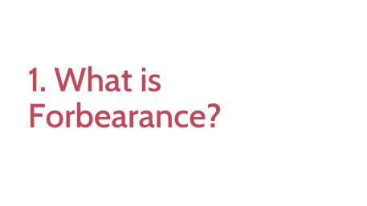

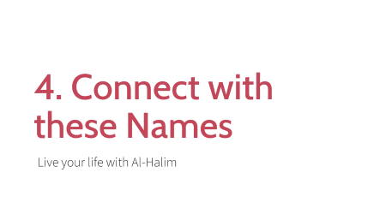
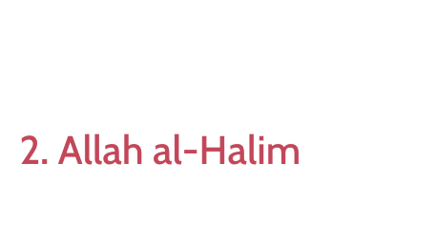
Overview

Slide 8
1. What is Forbearance?

Slide 9

What is forbearance?
When someone hurts us, staying calm and in control of our emotions & not retaliating or taking revenge, despite having the right and means to

Slide 10
Why are some humans forbearing?
Avoid confrontation
Feel weak
Oppressed and don’t have means to retaliate
Think there’s no other option
Notes:
Why are some humans forbearing? (Ask audience)
Humans are forbearing for different reasons. For the many, its often due to compulsion. Being weak, subjugated or lacking the power of redress, means forbearance is not a choice for them in this world.

Slide 11
Allah is Al-Halim (The Most Forbearing)
Notes:
Our Lord, on the other hand, is completely free of need…He doesn’t need anyone, but EVERYONE needs Him and relies on Him…and He is the Most Powerful…Yet He told us about Himself that He is al Halim: The Most Forbearing.
Forbearance isn't merely about restraining your anger or staying patient under duress. It's about staying calm with transgressors despite being able to dominate, have the upper hand and take revenge. Forbearance is, therefore, an attribute of the strong, not the weak, and it’s why Allah attributes the quality to Himself.

Slide 12
2. Allah al-Halim

Slide 13

Close your eyes
Notes:
I want everyone to close their eyes.
Take a moment to visualize the world. Observe the array of people living on its surface from the east to the west, and reflect on the innumerable sins that are being committed every minute. Consider all the injustice, murders, fraud, and theft that continues to occur around the world. Compound this image in your mind with all the kufr (disbelief in Allah) that occurs across the earth. Now imagine a world where we instantly faced the consequences of our actions. Who amongst us would survive a terrible fate? Who amongst us would not be ruined?

Slide 14
وَلَوْ يُؤَاخِذُ ٱللَّهُ ٱلنَّاسَ بِظُلْمِهِم مَّا تَرَكَ عَلَيْهَا مِن دَآبَّةٍ وَلَٰكِن يُؤَخِّرُهُمْ إِلَىٰٓ أَجَلٍ مُّسَمًّى “If Allah were to punish people (immediately) for their wrongdoing, He would not have left a single living being on earth. But He gives them respite for an appointed term.” (16:61)
Notes:
From that image, we get a glimpse of how forbearing Allah is towards us, out of His mercy. Allah (ʿazza wa jall) says:
وَلَوْ يُؤَاخِذُ ٱللَّهُ ٱلنَّاسَ بِظُلْمِهِم مَّا تَرَكَ عَلَيْهَا مِن دَآبَّةٍ وَلَٰكِن يُؤَخِّرُهُمْ إِلَىٰٓ أَجَلٍ مُّسَمًّى
“If Allah were to punish people (immediately) for their wrongdoing, He would not have left a single living being on earth. But He gives them respite for an appointed term” (16:61).
He is so forbearing and patient that He does not immediately punish us, but instead gives us time.

Slide 15
Al-Halim (The Most Forbearing)
1. Delays punishment
2. Sends us subtle reminders so we turn back to Him
3. Delays recording of our sins
Notes:
Allah giving us respite is one of His greatest blessings upon us. There are three ways He does this:
1. Delays punishment so what we have time to run back Him with sincere repentance and good deeds
2. Sends us subtle reminder so we turn back to Him
3. Delays recording of our sins

Slide 16
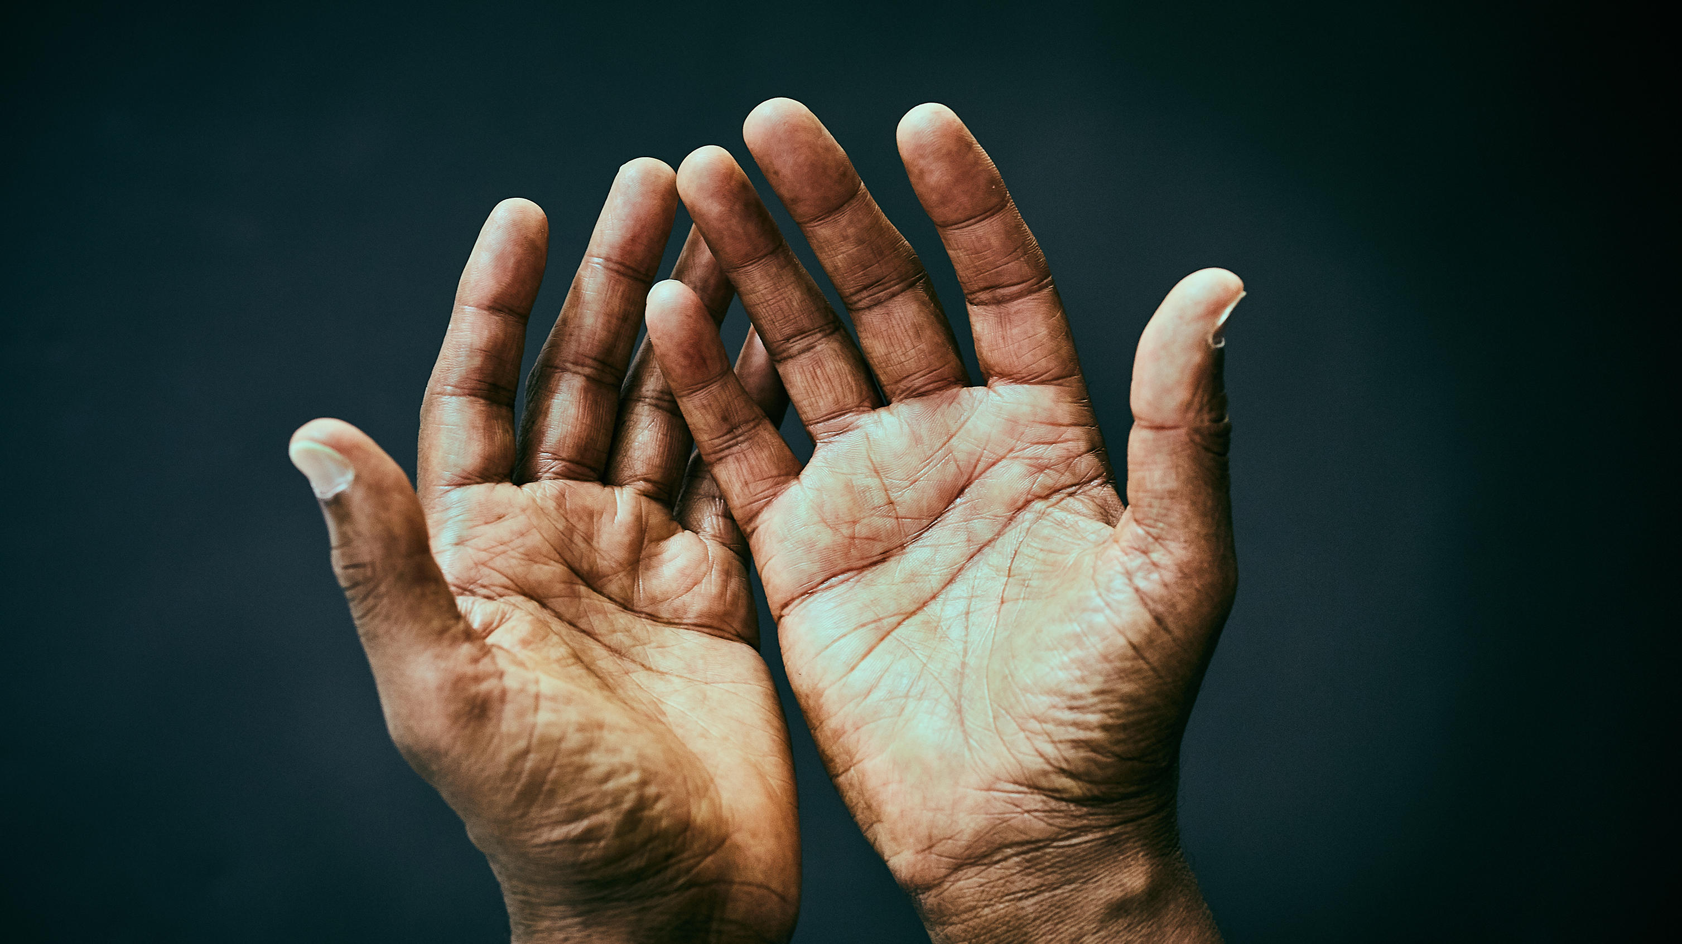
The Prophet ﷺ said: “The scribe (angel) on the left delays registering the sin of a Muslim for six periods of time. If he repents (within these six periods of time), and seeks Allah’s forgiveness, they drop it off. If he doesn’t, they write it down as a single sin.” (Ṭabarānī)
Notes:
Allah’s forbearance (ḥilm) extends to not just delaying punishment, but also to delaying the recording of our sins.
The Prophet ﷺ said: “The scribe (angel) on the left delays registering the sin of a Muslim for six periods of time. If he repents (within these six periods of time), and seeks Allah’s forgiveness, they drop it off. If he doesn’t, they write it down as a single sin.” (Ṭabarānī)

Slide 17

Questions
1. Does that mean it’s OK for me to keep sinning?
2. But I have felt Allah’s punishment?
Notes:
1. Does that mean its OK for me to keep sinning? No, this does not mean that we can become complacent and think that because Allah is Forbearing and Merciful, we can continue sinning.
2. But I have felt Allah’s punishment, so how is He the Most Forebearing? Some of us may have experienced what we feel is a clear punishment from Allah for a sin we committed. This does not contradict the fact that Allah is al-Ḥalīm. This is because Allah’s forbearance is always purposeful and merciful. What may seem as ‘punishments’ in this world are actually blessings in disguise, as He, the Most Wise, wants to alert us that we are on the wrong path and we need to return back to Him.

Slide 18
3. Forbearance of the Prophets & Righteous

Slide 19

Notes:
Ask audience (optional): Can someone thing of a time in the Prophet’s life where he showed true forbearance?
Forbearance (ḥilm) is a character trait embodied by the Prophets (ʿalayhimu-salām) and the righteous. When our beloved Prophet ﷺ was assaulted by the people of Makkah, out of his beautiful character, love and wisdom, he chose to endure it with forbearance, patience and forgiveness. He never considered revenge, despite having the option to do so, and instead asked Allah to forgive and have mercy on those who harmed him.
We see a beautiful display of his forbearance when he ﷺ travelled to the city of Ṭā’if to call people to Allah. Along with rejecting and mocking him, some people instructed their children to pelt him with stones. The Prophet ﷺ was so badly injured that he fell unconscious. When he re-gained consciousness, Allah sent to him the angel of the mountains who said, “O Muḥammad…If you wish, I will make al-Akhshabayn (two huge mountains located at the outskirts of Makkah) fall on them.” The Prophet ﷺ replied, “Rather, I hope that Allah will bring forth from their descendants who will worship Him Alone, and they will not associate any partners with Him” (Bukhārī).
“On that day, when he could have easily given in to rage, and revenge could have easily been his, he decided not to bring the two mountains down upon a people —some of whom had harmed him and probably most of whom had not— to redress the abuse he had been dealt that day. Make no mistake, when the time came to fight, Muhammad and his companions proved formidable as soldiers with a disciplined ferocity that struck fear in the two superpowers of his day: Rome and Persia. Yet, for this affront at Ta’if that was centered primarily at him, he would not punish them.
It was the way of our beloved Prophet to not hold accountable an entire people for the injustices of their leaders and those who followed them in oppression. It was the way of our beloved Prophet to not bring those two towers down upon them. Think about them” (Source: https://www.virtualmosque.com/islam-studies/prophet-muhammad/the-two-towers-of-taif/)

Slide 20
Allah loves those who are forbearing
Allah praises Ibrāhīm (ʿalayhis-salām) in the Qur’ān twice, by describing him as ‘forbearing (ḥalīm)’.
The Messenger of Allahﷺ said to Al-Ashajj ʿAbd al-Qays, “Indeed you have two qualities which Allah loves: forbearance and patience” (Muslim).
Notes:
Forbearance is dearly loved by Allah. Allah praises Ibrāhīm (ʿalayhis-salām) in the Qur’ān twice, by describing him as ‘forbearing (ḥalīm)’. And when Ibrāhīm (ʿalayhis-salām) made duʿā’ that Allah grants him children, Allah responded to his duʿā’: “So We gave him good news of a forbearing son” (37:101). Similarly, the Messenger of Allah (saw) said to Al-Ashajj ʿAbd al-Qays, “Indeed you have two qualities which Allah loves: forbearance and patience” (Muslim).

Slide 21

What stood out for you on this video clip we just watched?
Activity
Notes:
A modern-day example of forbearance. Please make audience watch this video clip (and discussion to follow)
Great mother forgives her son: https://www.youtube.com/watch?v=rVgJ4crut1o
Depending on how and where this session is being delivered, you can tailor the format of this “activity” as follows (#1 is ideal):
1. Group Activity
Put 2 min timer on for personal reflection and jotting down
Then give 2 min to discuss with the person next to them (give a reminder after 1 min to swap)
Get each person to share one unique/different thing from their partner’s list.
2. Personal activity
Jot down your thoughts
Give the audience 2 min to do this, then you can ask a few people to share with all.
3. Question/s to audience (use this if your audience doesn’t have pen/paper to hand or can’t do group activity)
What is the key thing you took away from this?

Slide 22
4. Connect with these Names
Live your life with Al-Halim

Slide 23
How can we worship Allah with His Name al-Halim?
Activity
Activity
Notes:
(Optional activity dependent on time)
Depending on how and where this session is being delivered, you can tailor the format of this “activity” as follows (#1 is ideal):
1. Group Activity
Put 2 min timer on for personal reflection and jotting down the answer to this question
Give 2 min to discuss with the person next to them (give a reminder after 1 min for partners to swap).
Get each person to share one unique/different thing from their partner’s list.
2. Personal activity
Jot down how you think we can worship Allah through these names
Give the audience 2 min to do this, then you can ask one or two people to share with all.
3. Question/s to audience (use this if your audience doesn’t have pen/paper to hand or can’t do group activity)
How can we worship Allah through His name al-Haleem?

Slide 24
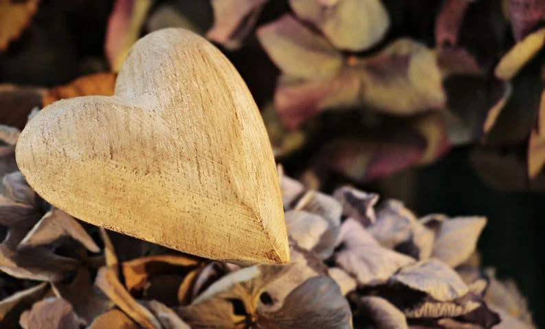
1. Love and thank Allah al-Halim
No one is more capable than Him in punishing us, yet no one is more forbearing and forgiving with us than Him
Notes:
Love Allah al-Ḥalīm
Reflecting on the forbearance of Allah should make our hearts melt out of love for Him. No one knows the extent of our sins as much as He does. No one is more capable than Him in punishing us, and yet no one is more forbearing and forgiving with us than Him. Allāhu Akbar!
2. Thank and praise al-Ḥalīm for His forbearance
Allah al-Ḥalīm manifests His forbearance upon us when we sin and are heedless. Even without our gratitude and acknowledgement, we are already subject to the mercy and forbearance of Allah. Imagine the blessings that await us if we expressed gratitude and praised Him for His ḥilm!

Slide 25

2. Always turn to Him in repentance
3. Ask Allah with His Name al-Halim
لَا إِلٰهَ إِلَّا اللّٰهُ الْعَظِيْمُ الْحَلِيْمُ ، لَا إِلٰهَ إِلَّا اللّٰهُ رَبُّ الْعَرْشِ الْعَظِيْمِ ، لَا إِلٰهَ إِلَّا اللّٰهُ رَبُّ السَّمٰـوٰتِ وَرَبُّ الْأَرْضِ وَرَبُّ الْعَرْشِ الْكَرِيْمِ
There is no god worthy of worship but Allah, the Magnificent, The Forbearing. There is no god worthy of worship but Allah, Lord of the Magnificent Throne. There is no god worthy of worship but Allah, Lord of the heavens, Lord of the earth, Lord of the Noble Throne. (Bukhārī)
Notes:
2. Always turn to Him in repentance
Through reflecting on our daily lives, we realise that Allah is aware of our many sins and shortcomings, yet we still receive His forbearance and His kindness.
Recognizing the forbearance of Allah should alert us to the fact that we need to change, and not take His forbearance for granted. It is the attribute of Allah’s forbearance that provides us the chance to even be able to change. Thus, we should constantly turn to Him and repent before it is too late.
Question for audience: Anyone know of a dua that contains the name Al-Halim?
- Ask al-Ḥalīm to forgive you
We should ask Allah through His Name ‘al-Ḥalīm’ to forgive us, conceal our faults and protect us from punishment. Similarly, we can supplicate with the duʿā’ our beloved Prophet ﷺ would recite when he encountered a difficulty:
لَا إِلٰهَ إِلَّا اللّٰهُ الْعَظِيْمُ الْحَلِيْمُ ، لَا إِلٰهَ إِلَّا اللّٰهُ رَبُّ الْعَرْشِ الْعَظِيْمِ ، لَا إِلٰهَ إِلَّا اللّٰهُ رَبُّ السَّمٰـوٰتِ وَرَبُّ الْأَرْضِ وَرَبُّ الْعَرْشِ الْكَرِيْمِ
There is no god worthy of worship but Allah, the Magnificent, The Forbearing. There is no god worthy of worship but Allah, Lord of the Magnificent Throne. There is no god worthy of worship but Allah, Lord of the heavens, Lord of the earth, Lord of the Noble Throne. (Bukhārī)

Slide 26
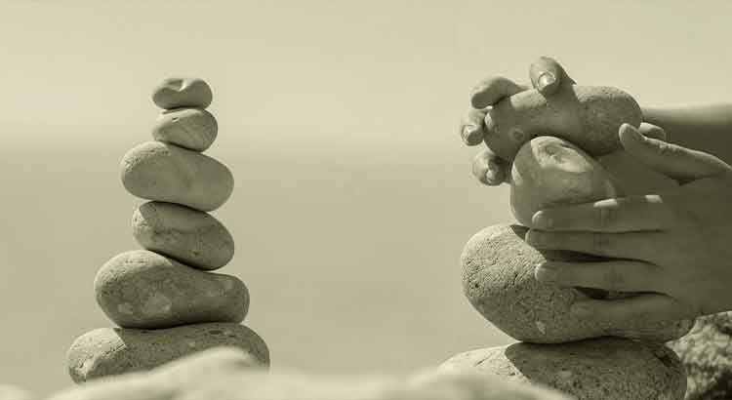
4. Be forbearing and patient with others
Notes:
3. Be forbearing and patient with others
If we want to be recipients of Allah’s forbearance, we should embody this same trait in our dealings with His creation. A forbearing person is calm, collected, and undisturbed with others’ mistakes. He makes excuses for others’ shortcoming, forgives easily, smiles at those who frown, joins family ties, and withholds insults and the urge to retaliate, despite having the ability and right to retaliate. He is gentle and has a big heart.

Slide 27
Activity
Activity
Forbearance is learnt through practice.
What practical tips can we adopt to become forbearing?
Notes:
Question is how do we become forbearing? How do we embody this trait? Knowledge, we learn through seeking knowledge, but become forbearing yes, we need to know how but we need to become forbearing?
(Optional activity dependent on time)
Depending on how and where this session is being delivered, you can tailor the format of this “activity” as follows (#1 is ideal):
1. Group Activity
Put 2 min timer on for personal reflection and jotting down the answer to this question
Give 2 min to discuss with the person next to them (give a reminder after 1 min for partners to swap).
Get each person to share one unique/different thing from their partner’s list.
2. Personal activity
Jot down tips that come to mind
Give the audience 2 min to do this, then you can ask one or two people to share with all.
3. Question/s to audience (use this if your audience doesn’t have pen/paper to hand or can’t do group activity)
What practical tips can we adopt to become forbearing?

Slide 28
Tips to be forbearing
Stay silent
Move
Say ta‘awwudh
Go and do Wudu
Move to another room
Make du‘a for the other person
Try and look at things from the other person’s perspective
Remember who you are being forbearing for
Work on your ego and pride – learn how to purify your heart
Notes:
Often when our anger is evoked we struggle to be forbearing.
These are tips from the sunnah about HOW to be forbearing.
Remember: Hurt people hurt others. Someone asked a wise person: My mother often criticises me and can’t see the good I do for her. I’ve told her that it is not fair but she continues. This really upsets me. The wise person said: You being upset is totally understandable. But I want you to think about what kind of a life did your mum live, what difficulties must she have been through, to treat her own child like that?! (empathy and the promise of the reward from Allah is how you’ll be able to deal with it in a way that it stops affecting you negatively)

Slide 29
Does this mean we should be forbearing to everyone & in every situation?
Activity
Forbearance must be used with wisdom and for the greater good
Notes:
Question/s to audience
Think for a minute. Raise your hands: Who thinks the answer to this is yes/no/I don’t know?
Answer is: NO
(Ask Audience) Can anyone think of a situation where we must not be forbearing? (ask audience)
We must exercise forbearance with wisdom and for the greater good.
It should not be used as an excuse to allow abuses to continue, or avoid having difficult conversations, or abandoning moral boundaries, or neglecting the pursuit of justice.
For example:
- When you not putting boundaries or standing up for what is right is going to harm you or others, then that kind of forbearance is harmful.
- When the rights of others are being forgone or others are being treated badly, we should stand up for them.
Defending oneself, and the Ummah, from abuse and tyranny is in fact an obligation; and even retaliating when it is likely to have a beneficial outcome is recommended.

Slide 30
4. Reflections & close

Slide 31
What is the most beneficial thing you’ve learnt in this session?
Activity
Notes:
Aim: Attendees reflect on what they have learnt today (and where possible share with group using sticky notes)
Depending on how and where this session is being delivered, you can tailor the format of this “activity” as follows (#1 is ideal):
1. Group Exercise
Give people 1 min personal reflection time to jot their point on to a sticky note.
Share & discuss their reflection in pairs for 2 minutes (1 min each, give a reminder after 1 min to swap).
Ask everyone to get up and put their sticky notes onto a wall.
Ask everyone to group up similar sticky ones (i.e. theme them up), and then instructor can go over it. Good way to get group to reflect/revise on what we’ve learnt.
2. Personal reflection in Journals
Spend 2 min reflecting and jotting down the most beneficial thing you have learnt today.
Ask audience: who wants to share their point?
3. Open Question to Audience (use this if your audience doesn’t have pen/paper to hand or can’t do group activity)
Spend 1 min thinking about what is the most beneficial thing you have learnt in this session (put timer on) … Who wants to share their point?

Slide 32
What one thing are you going to do this week based on what we’ve covered today?
Activity
Notes:
Aim: Attendees need to take away one practical action, either something new they are going to do, or do something differently.
Method: Give attendees one minute for personal reflection, and then give them one minute to jot it down in their personal journals or as a reminder on their phone/calendar. Then ask attendees: Who wants to share their action?
[Give this reminder to audience before/after this activity: A true appreciation of Allah’s names should lead us to living more ethical lives [too]. It should inspire us to show kindness to others, and behave towards them with genuine good will and respect. It should help us be sincere in our devotion to Allah and to express this sincerity in our daily lives]

Slide 33
By the end of this session, you will …
Define ‘Al-Halim’ and contrast Allah’s forbearance to our forbearance
01
Identify what true forbearance is and how to develop this trait
02
Learn how to connect with Allah through this Name
03
Reflect on what you have learnt and identify one practical action point
04
Notes:
Brief overview of learning objectives. (So we covered …)

Slide 34

Any questions?
سُبْحَانَكَ اللّٰهُمَّ وَبِحَمْدِكَ ، أَشْهَدُ أَنْ لَّا إِلٰهَ إِلَّا أَنْتَ ، أَسْتَغْفِرُكَ وأَتُوْبُ إِلَيْكَ
You are free from imperfection, O Allah, and all praise is to You. I bear witness that there is no god worthy of worship but You. I seek Your forgiveness and turn to You in repentance.
Notes:
Any questions? (encourage audience to ask questions and allocate adequate time for questions)
We ask Allah, al-Ḥalīm to extend His forbearance to us so that it increases us in faith, gratitude, and obedience. We ask al-Ḥalīm to grant us the quality of forbearance, seeking His pleasure alone and becoming people of mercy.
We end with a) thanks to Allah for blessing us with the opportunity to remember Him and learn about Him, and b) the dua at the conclusion of a gathering (ask everyone to read together).
Further notes on this du’a:
Abu Dawood (4859) related that Abu Barzah al-Aslami (may Allah be pleased with him) said: The Messenger of Allah (peace and blessings of Allah be upon him) used to say, when he wanted to leave a gathering: “Glory and praise to you, Allah, there is no god but you, I seek your forgiveness and I repent. “A man said: O messenger of Allah, you say something you did not say before. He said, “This is an atonement for everything that happened at the gathering”

