Slide 1

Al-Kabir & Al-Azim
Journey to Allah through His Names
Notes:
Start session with Bismillah, Praises of Allah and Salawat; and welcome the audience!
Materials needed (optional): Timer, pens for audience to use, post-it notes/personal journals
These slides are produced by Life With Allah (www.lifewithallah.com)
Please give us feedback on these slides by filling in this short feedback form: https://forms.gle/yP45KNYEbemxT7hS6
For article:
https://lifewithallah.com/articles/seasons-of-worship/dhul-hijjah/al-kabir-the-most-great-and-al-azim-the-magnificent/

Slide 2


3 people you consider ‘great’ (and are currently alive).
Activity
Activity
Notes:
This is a starter activity and will work as an icebreaker too.
Depending on how and where this session is being delivered, you can tailor the format of this “activity” as follows (#1 is ideal):
1. Group Activity
Put 1 min timer on for personal reflection and for each person to jot down their list.
Now ask each person to get up and go and sit next to someone they don’t know.
Tell them they have 1 min each to share with the person next to them one person from their own list, and why they think the person is great. Give them a reminder after 1 min to swap.
Get each person to share with the entire group the name of their partner, the ‘great person’ their partner chose and why.
2. Personal activity
Jot down in your journals or sticky notes 3 people you consider great and why.
Give the audience 2 min to do this, then you can ask one or two people to share with everyone.
3. Question/s to audience (use this if your audience doesn’t have pen/paper to hand or can’t do group activity)
I want you to take the next minute to think about 3 people you consider great.
Who wants to share with us who they thought of and why?

Slide 3
Dhul Hijjah: A perfect opportunity to re-connect with the Names of Allah which denote His majesty and greatness.
Notes:
[OPTIONAL SLIDE:
Only use this slide if this is being presented in Dhul Hijjah or just before it
For this slide to show in this PPT when presenting, right click on the slide selection on the left hand side, and select “Hide Slide” to unhide the slide ]

Slide 4
By the end of this session, you will …
Appreciate what Al-Kabīr & Al-Aẓīm mean
1
Understand how one can reflect on Allah’s greatness
2
Learn how to connect with Allah through these names
3
Reflect on what you have learnt and identify one practical action point
4
Notes:
Brief overview of learning objectives.

Slide 5
Why are you here?
Activity
“I am attending this session because … so that I can …”
Notes:
Review & set our intention – Let’s start by setting out a clear intention for this session today.
I am attending this session because I want to connect with Allah through understanding His Names Al-Kabir & Al-Azim so that I can increase my iman in Allah, love Him, and worship Him.

Slide 6
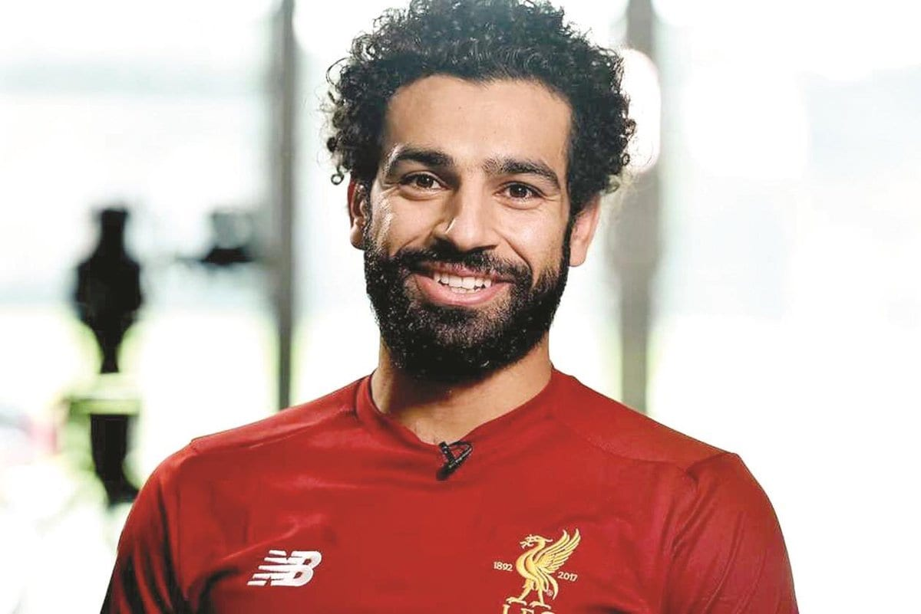
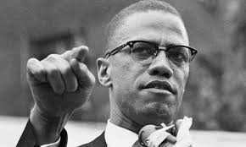
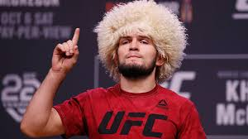
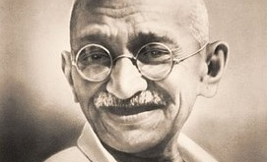
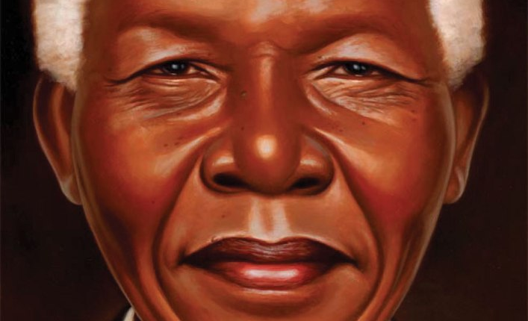
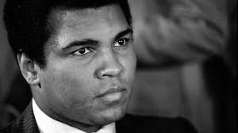
Notes:
These individuals are considered by different people to be ‘great’ due to what they accomplished in their lives. They are held in great esteem by their admirers.
These people may be great in their specific fields or have done something great; but they made mistakes, they had many limitations and were not perfect…or committed the worst crime (shirk).
However, Allah (swt) is the only one without any flaws and limitations. Absolutely Perfect. He is THE Ultimately Great. Perfect…..He is Al-Kabir and Al-Azim.

Slide 7
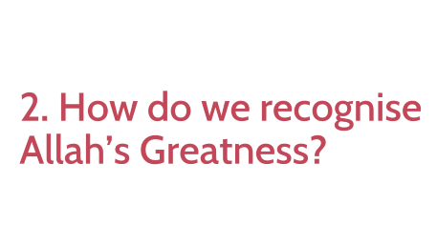
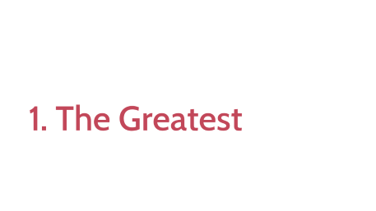

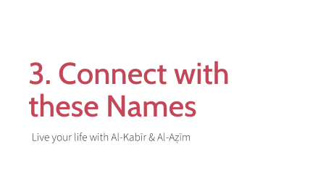
Overview

Slide 8
1. The Greatest

Slide 9
Allah is Al-Kabir & Al-Azim
Al-Kabīr - The Most Great
Al-Aẓīm - The Magnificent
These Names denote the greatness, majesty and grandeur of Allah
Allah is Great and Perfect in every possible way. He is Greater than anything we can imagine.
Notes:
Amongst these Names are: al-Kabīr, The Most Great, and Al-Aẓīm, The Magnificent. Both of these Names denote the greatness, majesty and grandeur of Allah (swt).
Allah is Greater than anything we can imagine, and His greatness encompasses all things: He is Great in His Essence, His Names, His Attributes and His Actions.
Allah is Supreme and Perfect: free from every limitation and deficiency that is inherent in created beings.
Allah is Great in His power, wisdom, knowledge and authority.
There was nothing before Him, and there is nothing after Him. Everyone will perish except Him. None can overpower or defeat Him.

Slide 10
2. How do we recognise Allah’s Greatness?

Slide 11

What reminds you of the greatness of Allah?
Activity
Notes:
Depending on how and where this session is being delivered, you can tailor the format of this “activity” as follows (#1 is ideal):
1. Group Activity
Put 2 min timer on for personal reflection and jotting down
Then give 2 min to discuss with the person next to them (give a reminder after 1 min to swap)
Get each person to share one unique/different thing from their partner’s list.
2. Personal activity
Jot down quickly all the things that remind you of Allah’s greatness.
Give the audience 2 min to do this, then you can ask one or two people to share with all.
3. Question/s to audience (use this if your audience doesn’t have pen/paper to hand or can’t do group activity)
What reminds you of the greatness of Allah?
Or you could ask:
What’s the last thing you saw that reminded you of the greatness of Allah?
In the past month, what did you see that reminded you of the greatness of Allah?

Slide 12
Our limited minds are unable to fully comprehend the greatness of Allah.
But we can attempt to appreciate His Greatness by …
Notes:
Our limited minds are unable to fully comprehend the greatness of Allah. However, we can attempt to appreciate His Greatness by pondering over

Slide 13
… reflecting upon:
When we think of ‘reflecting on His creation’, what does this include?
1. His creation
2. His words (Qur’an)
Universe
Majestic Throne
Angels
Humans
Animals
Notes:
… by pondering over: (1) His creation, (2) and His words (the Qur’ān).

Slide 14
Amazing facts about the human body
Laid end to end, an adult’s blood vessels could circle Earth’s equator four times!
Information zooms along nerves at about 400kmph!
Human nose can recognise a trillion different scents!
Every second, your body produces 25 million new cells.
Tongue is covered in about 8,000 taste-buds, helping you taste your food!
Humans have unique fingerprints and tongue prints
Notes:
Reflecting on how these amazing facts about the human body helps us appreciate how great Allah, their Creator, is.

Slide 15
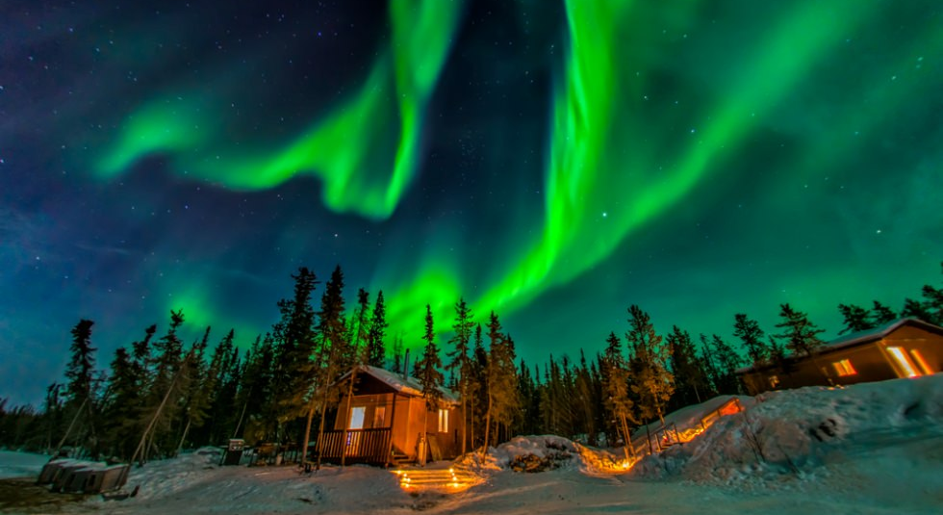
Notes:
We reflect on how great the northern lights are! How majestic this is! Imagine how Great the creator of this is!

Slide 16
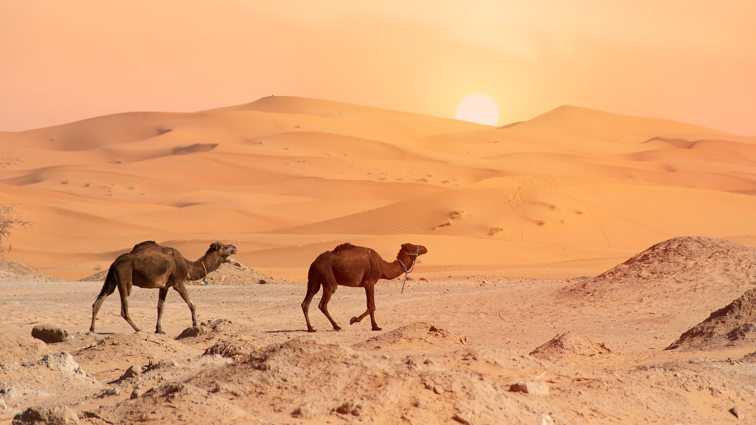
Notes:
Allah says in the Quran (88:17):
أَفَلَا يَنظُرُونَ إِلَى ٱلْإِبِلِ كَيْفَ خُلِقَتْ ١٧
Do they not ever reflect on camels—how they were ˹masterfully˺ created
Allah has so masterfully created camels so that they can live and travel in hot sandy deserts. Ponder upon this! For example:
Camels’ humps are not used to store water. Even though they come from hot climates, their humps store fat and also help the rest of their bodies to stay cooler. When needed, the fat will be converted to food or water.
During winter, these desert animals can survive for 6-7 months without water. Nonetheless, whenever they access to water they can drink as much as 32 gallons in one drinking session! Considering it’s not being stored in their humps, that’s pretty amazing.
Camel’s nostrils are amazing. They retain water vapor which can be returned to the body when necessary, but they can also be closed if there is too much sand or wind blowing.
A camel might appear to have thick fur, but its coat reflects the sun. This makes it ideal in the hot desert, and the camels don’t get too hot.
Furthermore (if time and interest to cover):
Their long eyelashes help to keep sand out of their eyes
Their ears are small and covered in hair to prevent sand and dust from getting in.
Wide feet and thick leathery pads help them to walk on the hot sand and keep them from sinking.
Thick lips allow them to eat prickly plants easily without hurting themselves.

Slide 17
Allah’s Majestic Throne (‘Arsh)
The Majestic Throne (‘Arsh) is the greatest creation of Allah
The Kursi (footstool)
Watch this video: https://www.youtube.com/watch?v=i10uciVqAME
Notes:
Briefly define what the ‘Arsh and Kursi are and then show the video linked for further detail.
The link to this clip is here: https://www.youtube.com/watch?v=i10uciVqAME
The clip is called: Al-ʿArsh and Kurshi of Allah (by: Shaykh Ahmad Ali)
It is 7:36 min but definitely worth playing!
Additional notes for the instructor as background reading:
When we ponder on the greatness of Allah’s creation, such as the heavens, the earth, His Kursī and His Majestic Throne, and then realise our own inability to comprehend them due to their greatness, we should arrive at the most important realisation: how Great must their Creator be!
To understand His greatness, it helps to reflect on His greatest creation: His Throne (the ʿArsh of Allah). The Messenger of Allah g said, “The seven heavens in comparison to the Kursī is nothing but like a ring thrown in a desert, and the excellence of the Throne of Allāh over the Kursī is like the excellence of that desert over that ring” (Bayhaqī).
Imagine the Sahara Desert. The entire desert is the Kursī of Allah b, while the size of the heavens and the earth in proportion is equivalent to a ring thrown in this desert.
Now close your eyes, and let your mind ascend. Wander around this desert, which is now the Throne of Allah b, and remember that the Kursī in proportion is the size of a ring. Can you even imagine the size of the Throne of Allah? It is mind-boggling.
If we cannot comprehend this, how can we then comprehend the greatness of Allah?

Slide 18
Angels
How big is Jibrīl (as)?
His awe of Allah despite his greatness.
One angel is so great that his feet are in the lowest earth & his neck is under the Throne of Allah. Realising the greatness of Allah, he constantly repeats, “How Perfect are You! How Magnificent are You, Our Lord!” (Ṭabarānī).
Reflecting on how great the angels are will help us appreciate how great Allah, their Creator, is.
Notes:
Jibrīl
How big is Jibrīl (as)? (ASK AUDIENCE)
The best of angels, Jibrīl was tasked with the most prestigious responsibility of transmitting the word of Allah b. He has 600 wings. If he was to unroll a pair of them, it would fill the space between the sky and the earth.
Despite his physical and spiritual greatness, the Prophet g saw him on the night of Miʿrāj (ascension) looking like “a worn-out piece of cloth due to the fear of Allah” (Ṭabarānī).
Jibrīl’s knowledge of Allah’s majesty and greatness reduced him to this state.
The Great Angel
Our beloved Prophet informed us about an angel who is so great that his feet are in the lowest earth and his neck is under the Throne of Allah.
Realising the greatness of Allah, he constantly repeats, “How Perfect are You! How Magnificent are You, Our Lord!” (Ṭabarānī).
Reflecting on how great the angels are will help us appreciate how great Allah, their Creator, is.
OPTIONAL:
Mighty Angels
Angels are amongst the creation of Allah that recognise His greatness, and revere Him as He deserves to be revered.
Despite being given immense strength and being huge in size, angels constantly praise Allah and worship Him, and they never disobey Him.
Yet, on the Day of Judgement, they will look at Allah and say, “How Perfect are You! We did not worship You as You deserved to be worshipped.”

Slide 19
3. Connect with these Names
Live your life with Al-Kabīr & Al-Aẓīm

Slide 20
How can we worship Allah with His Names al-Kabir and al-Azim?
Activity
Activity
Notes:
Depending on how and where this session is being delivered, you can tailor the format of this “activity” as follows (#1 is ideal):
1. Group Activity
Put 2 min timer on for personal reflection and jotting down the answer to this question
Give 2 min to discuss with the person next to them (give a reminder after 1 min for partners to swap).
Get each person to share one unique/different thing from their partner’s list.
2. Personal activity
Jot down how you think we can worship Allah through these names
Give the audience 2 min to do this, then you can ask one or two people to share with all.
3. Question/s to audience (use this if your audience doesn’t have pen/paper to hand or can’t do group activity)
How can we worship Allah through His names al-Kabir and al-Azim?

Slide 21
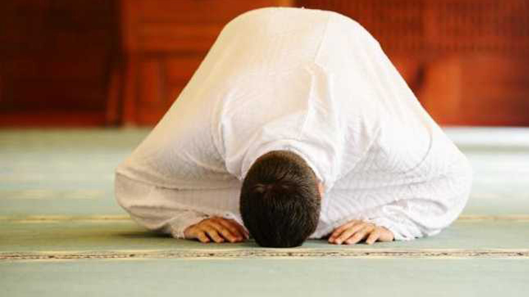
1. Humble yourself to His greatness, by affirming His Oneness, obeying Him, and fearing Him.
ذَٰلِكَ بِأَنَّ ٱللَّهَ هُوَ ٱلْحَقُّ وَأَنَّ مَا يَدْعُونَ مِن دُونِهِۦ هُوَ ٱلْبَٰطِلُ وَأَنَّ ٱللَّهَ هُوَ ٱلْعَلِىُّ ٱلْكَبِيرُ ‎﴿٦٢﴾‏
That is because Allah alone is the Truth and what they invoke besides Him is falsehood, and Allah alone is truly the Most High, All-Great.
Notes:
1. Humble yourself to His greatness, by affirming His Oneness, obeying Him, and fearing Him.
Let us fill our hearts with utmost respect and reverence for Allah.
Let us feel awe in our hearts for Him, and feel shy of disobeying Him.
Let us humble our hearts to the truth and submit to the commands of Allah and His Messenger g, even if they appear ‘irrational’ to us.

Slide 22
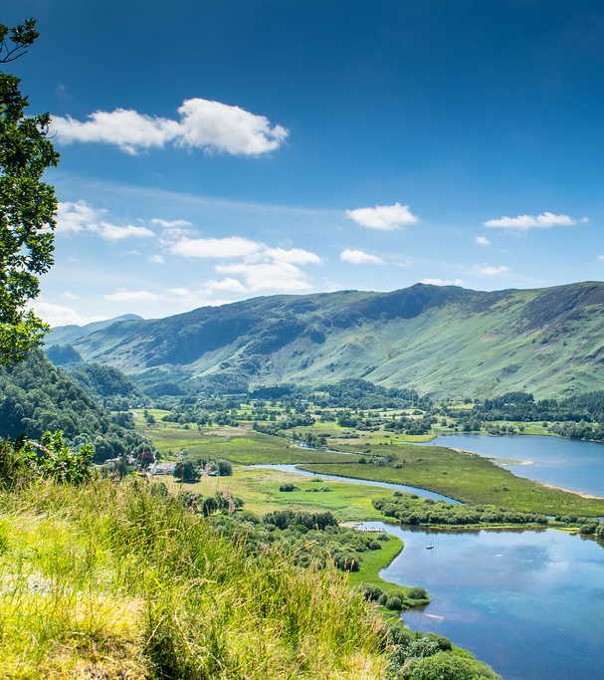
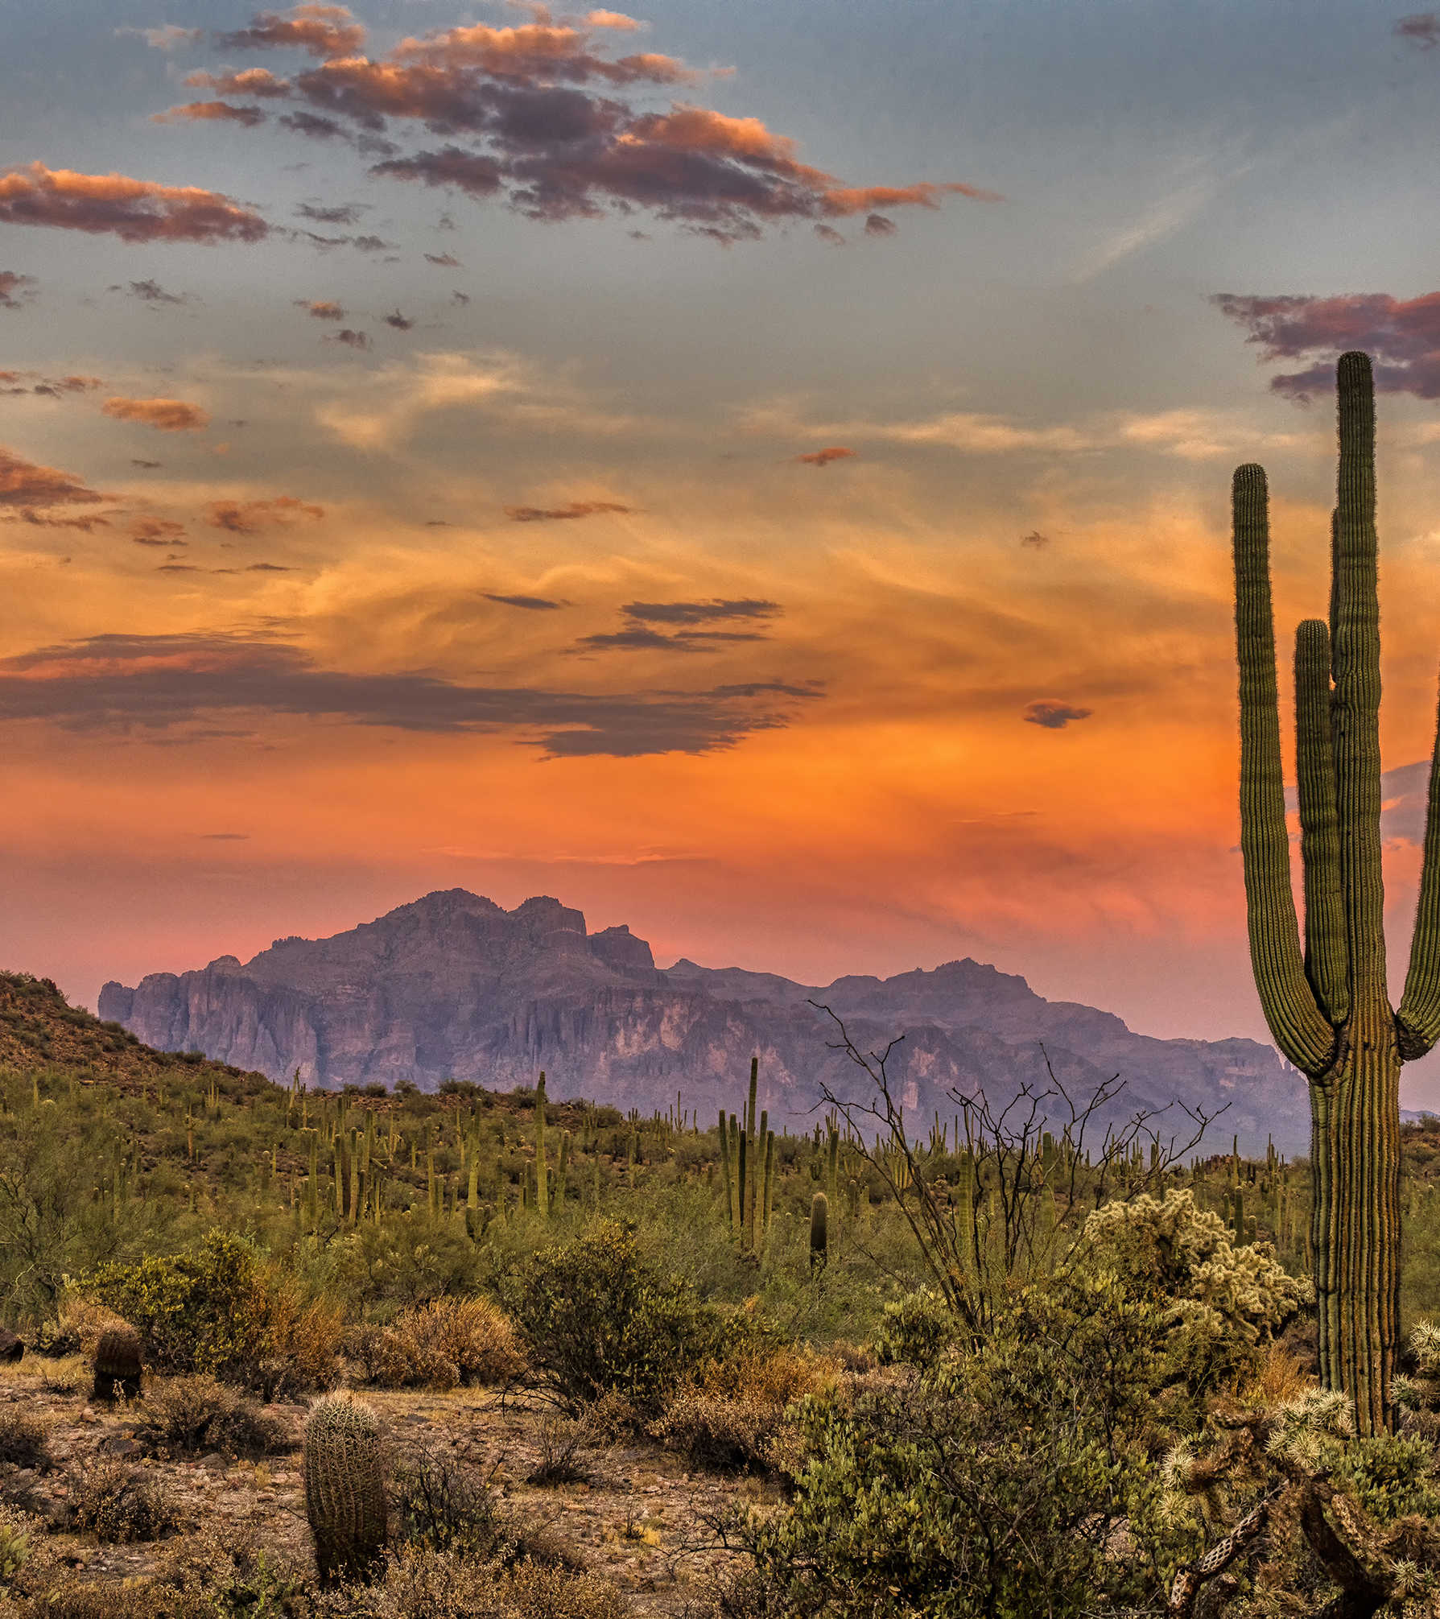
2. Glorify Him by constantly reflecting on His creation
Notes:
2. Glorify Him by constantly reflecting on His creation.
Every day we repeat ‘Allāhu Akbar’ (Allah is greater…!) and ‘Subḥāna Rabbiya-l-ʿAẓīm’ (How perfect is my Lord, The Magnificent!) over a hundred times in ṣalāh. Due to the repetition, we may say it mindlessly. Let us constantly think of how great He is, and magnify Him with our tongues and our hearts simultaneously.
Go outside in nature and praise Allah with your tongue and heart. It will help you marvel at His greatness. [Tip: Perform your morning and evening adhkār outside, especially on days when the skies are clear and you can appreciate the beauty of Allah’s creation.]

Slide 23
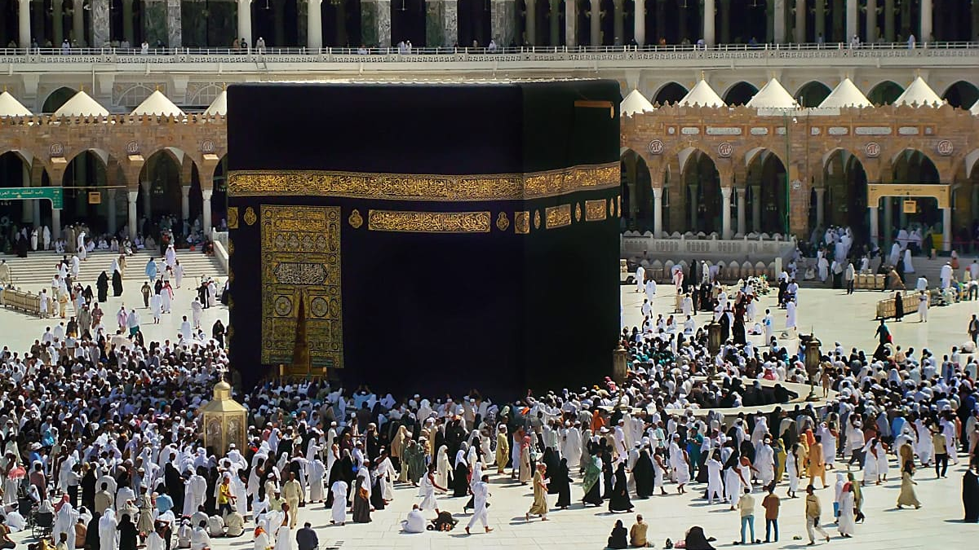
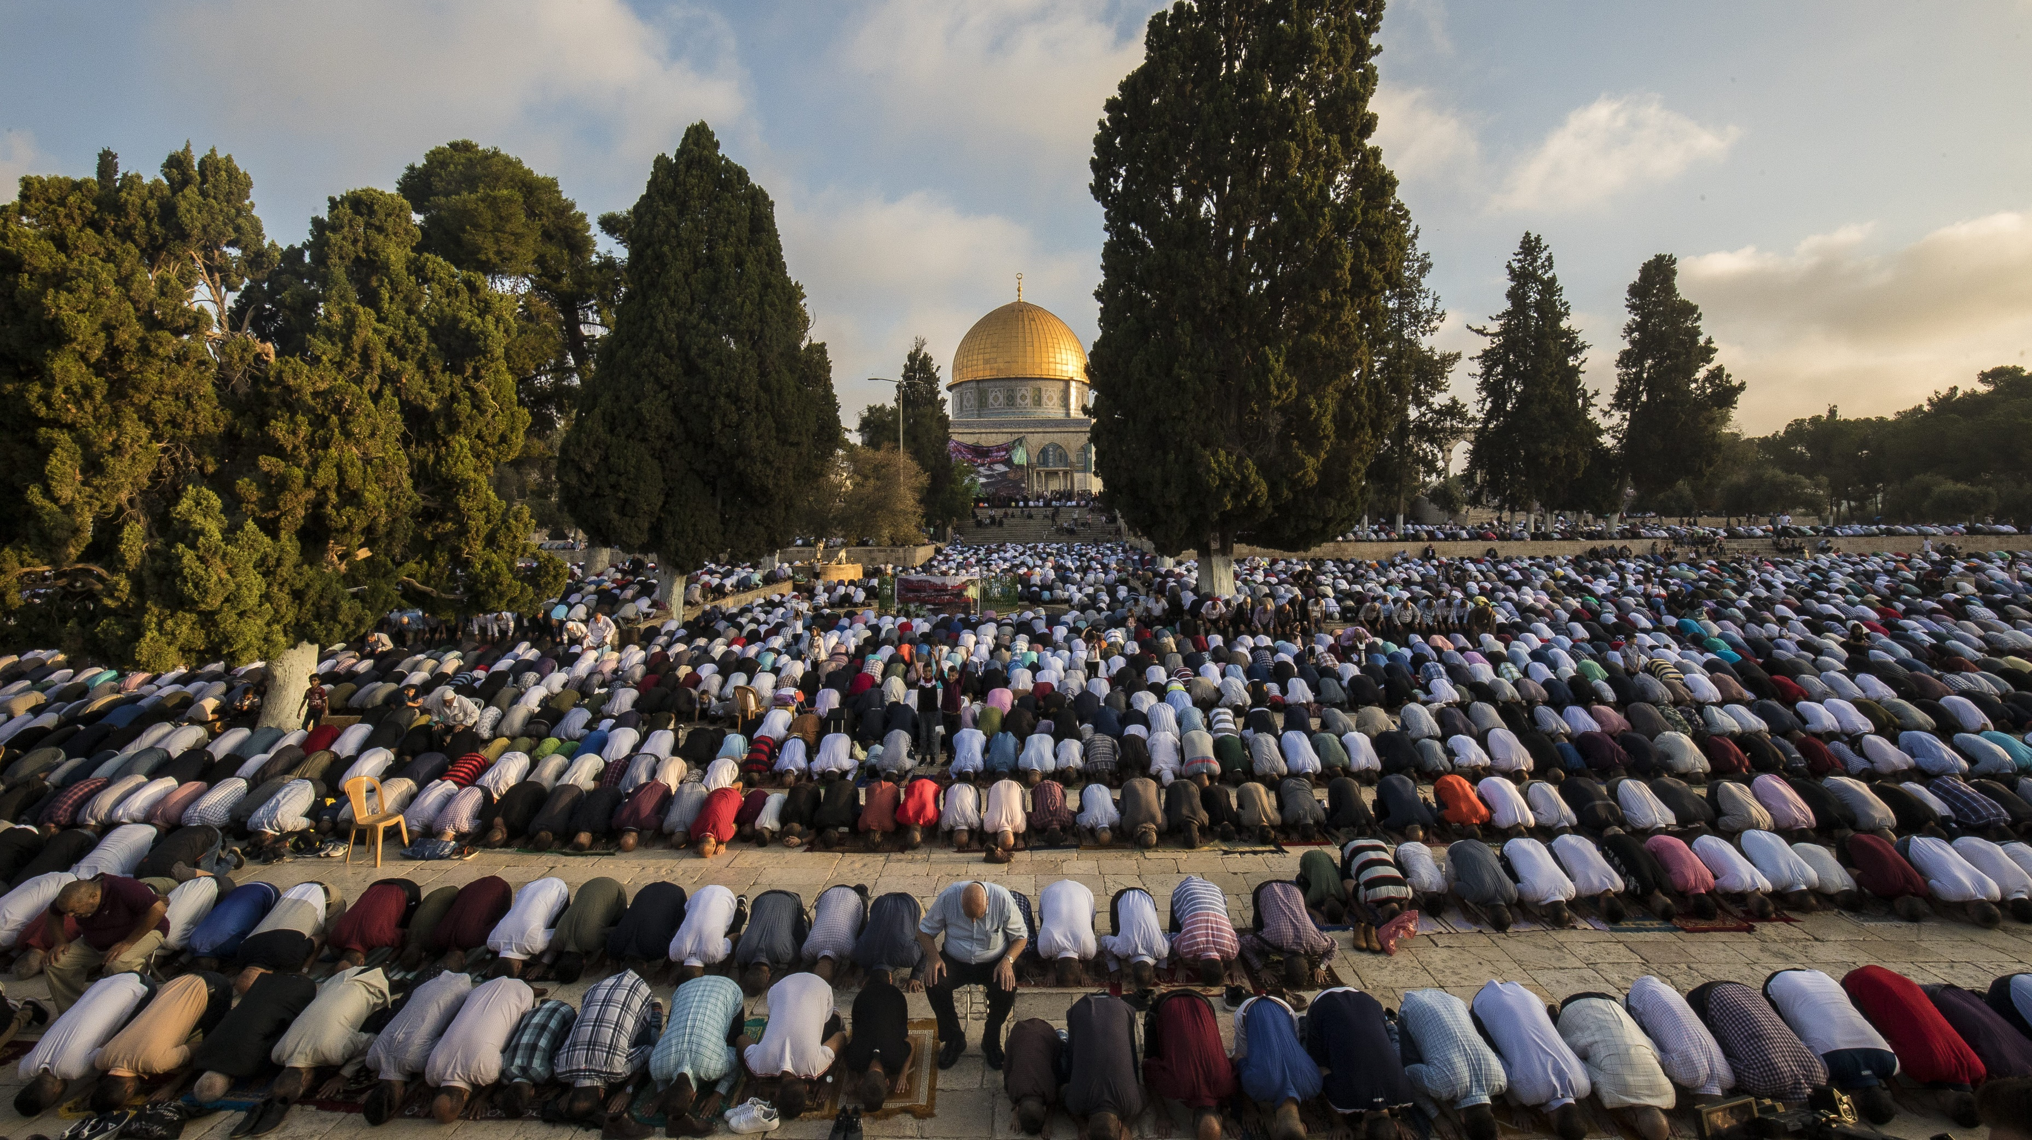
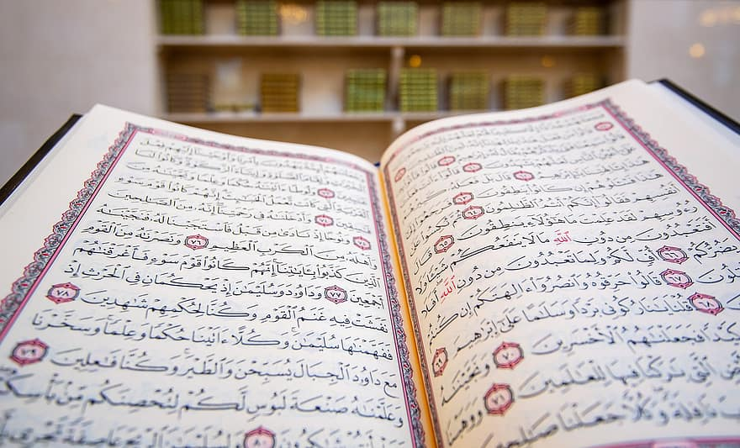
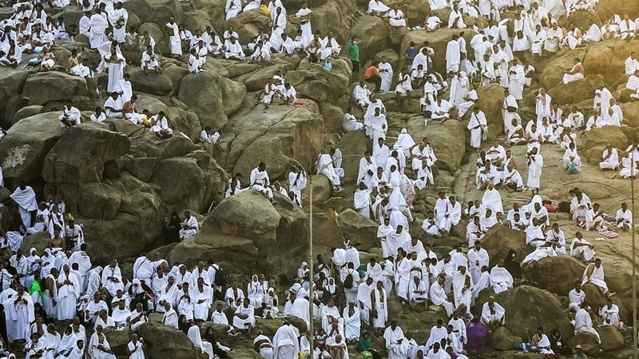
3. Consider great what Allah has considered ‘great’
Notes:
3. Consider great what Allah has considered ‘great’.
Let us magnify and revere Allah by honouring what He has honoured: occasions (e.g. Dhul Hijjah, Ramaḍān), places (e.g. al-Masjid al-Harām), actions (e.g. ṣalāh, qurbānī) & speech (e.g. recitation of the Qur’ān).
Instead of allowing society and our social media feeds to dictate to us how we should live and what we should aspire to be, let us live by the standards that Allah has set for us.
This will save us from misery, anxiety and depression, as the only standards that can guarantee us success and peace are the ones Allah, our Creator, has set for us.
The ones set by humans are more often than not unrealistic, egotistic, flawed, harmful, and constantly changing.

Slide 24
4. Humble yourself in your dealings with people - don’t be arrogant!
4. Humble yourself in your dealings with people - don’t be arrogant!
When you make a mistake or hurt someone, do you immediately acknowledge, apologise and make amends?
Do you think you have something special (e.g. job, child, car) AND you think it is from you?
Are you overbearing or pushy?
What is arrogance?
When we think like this, we begin competing with Allah’s grandeur, not realising that the blessings we possess are from Allah alone.
Notes:
4. Humble yourself in your dealings with people.
There are some qualities of Allah that we should try to emulate in our dealings with others (e.g. love, kindness, forgiveness). But there are others which are exclusive to Him such as majesty, pride and grandeur. The Messenger of Allah g said: “Allah – Exalted and Mighty is He- said, ‘Grandeur (kibriyā) is My cloak and Magnificence (ʿaẓamah) is My lower garment. Whoever competes with Me in regards to either of them, I shall cast him into the Hell-fire’” (Abū Dāwūd).
Internalising that Allah is the Greatest, not us, should make us humble. When we make a mistake or hurt someone, we should acknowledge it, apologise and make amends.
What is arrogance? (Ask Audience)
Arrogance is thinking we are better than others because of something we possess. When we think like this, we begin competing with Allah’s grandeur, not realising that the blessings we possess are from Allah alone.
We should humble ourselves with humans, and not be dominating or aggressive in our character or behaviour, nor arrogant.

Slide 25
5. Ask Allah through His Names and be comforted
لَا إِلٰهَ إِلَّا اللهُ الْعَظِيْمُ الْحَلِيْمُ ، لَا إِلٰهَ إِلَّا اللهُ رَبُّ الْعَرْشِ الْعَظِيْمِ ، لَا إِلٰهَ إِلَّا اللهُ رَبُّ السَّمٰوَاتِ وَرَبُّ الْأَرْضِ وَرَبُّ الْعَرْشِ الْكَرِيْمِ
Relying on Al-Aẓīm (The Magnificent) means any ‘big’ problem or enemy we encounter can be overcome, and feel ‘small’.
Notes:
5. Ask Allah through His Names and be comforted.
Our beloved Prophet would recite the following duʿā’ when he encountered a difficulty:
لَا إِلٰهَ إِلَّا اللهُ الْعَظِيْمُ الْحَلِيْمُ ، لَا إِلٰهَ إِلَّا اللهُ رَبُّ الْعَرْشِ الْعَظِيْمِ ، لَا إِلٰهَ إِلَّا اللهُ رَبُّ السَّمٰوَاتِ وَرَبُّ الْأَرْضِ وَرَبُّ الْعَرْشِ الْكَرِيْمِ
Translation: There is no god worthy of worship but Allah, the Magnificent, The Forbearing. There is no god worthy of worship but Allah, Lord of the Magnificent Throne. There is no god worthy of worship but Allah, Lord of the heavens, Lord of the earth, Lord of the Noble Throne. (Bukhārī)
Let us calm and soothe our hearts, by reminding ourselves of how great Allah is, and by asking Him through His Oneness in this beautiful duʿā’. Relying on Al-Aẓīm (The Magnificent) means any ‘big’ problem or enemy we encounter can be overcome, and feel ‘small’.
We ask Allah, The Magnificent, The Great, to allow us to appreciate and glorify Him as He deserves to be appreciated and glorified. We ask Allah, The Supreme to cause our awe of Him to enable us to live by His commands.

Slide 26
4. Reflections & close

Slide 27
What is the most beneficial thing you’ve learnt in this session?
Activity
Notes:
Aim: Attendees reflect on what they have learnt today (and where possible share with group using sticky notes)
Depending on how and where this session is being delivered, you can tailor the format of this “activity” as follows (#1 is ideal):
1. Group Exercise
Give people 1 min personal reflection time to jot their point on to a sticky note.
Share & discuss their reflection in pairs for 2 minutes (1 min each, give a reminder after 1 min to swap).
Ask everyone to get up and put their sticky notes onto a wall.
Ask everyone to group up similar sticky ones (i.e. theme them up), and then instructor can go over it. Good way to get group to reflect/revise on what we’ve learnt.
2. Personal reflection in Journals
Spend 2 min reflecting and jotting down the most beneficial thing you have learnt today.
Ask audience: who wants to share their point?
3. Open Question to Audience (use this if your audience doesn’t have pen/paper to hand or can’t do group activity)
Spend 1 min thinking about what is the most beneficial thing you have learnt in this session (put timer on) … Who wants to share their point?

Slide 28
What one thing are you going to do this week based on what we’ve covered today?
Activity
Notes:
Aim: Attendees need to take away one practical action, either something new they are going to do, or do something differently.
Method: Give attendees one minute for personal reflection, and then give them one minute to jot it down in their personal journals or as a reminder on their phone/calendar. Then ask attendees: Who wants to share their action?
[Give this reminder to audience before/after this activity: A true appreciation of Allah’s names should lead us to living more ethical lives [too]. It should inspire us to show kindness to others, and behave towards them with genuine good will and respect. It should help us be sincere in our devotion to Allah and to express this sincerity in our daily lives]

Slide 29
By the end of this session, you will …
Appreciate what Al-Kabīr & Al-Aẓīm mean
1
Understand how one can reflect on Allah’s greatness
2
Learn how to connect with Allah through these names
3
Reflect on what you have learnt and identify a practical take away
4
Notes:
Quick review over what has been covered in this session.

Slide 30
Any questions?
سُبْحَانَكَ اللّٰهُمَّ وَبِحَمْدِكَ ، أَشْهَدُ أَنْ لَّا إِلٰهَ إِلَّا أَنْتَ ، أَسْتَغْفِرُكَ وأَتُوْبُ إِلَيْكَ
You are free from imperfection, O Allah, and all praise is to You. I bear witness that there is no god worthy of worship but You. I seek Your forgiveness and turn to You in repentance.
Notes:
Any questions? (encourage audience to ask questions and allocate adequate time for questions)
We end with a) thanks to Allah for blessing us with the opportunity to remember Him and learn about Him, and b) the dua at the conclusion of a gathering (ask everyone to read together).
Further notes on this du’a:
Abu Dawood (4859) related that Abu Barzah al-Aslami (may Allah be pleased with him) said: The Messenger of Allah (peace and blessings of Allah be upon him) used to say, when He wanted to leave a gathering: “Glory and praise to you, Allah, there is no god but you, I seek your forgiveness and I repent. “A man said: O messenger of Allah, you say something you did not say before. He said, “This is an atonement for everything that happened at the gathering”

